Slide 1
Northern Bobwhite Nest Site Characteristics and Artificial Brush Structure Use in Weeping Lovegrass CRP
C. Wade Abbott, Department of Range, Wildlife, and Fisheries, Texas Tech University
C. Brad Dabbert, Department of Range, Wildlife, and Fisheries Management, Texas Tech University
Duane R. Lucia, Texas Parks and Wildlife Department
Robert B. Mitchell, Department of Range, Wildlife, and Fisheries Management, Texas Tech University
Alicia K. Andes, Department of Natural Resource Management, Texas Tech University

Slide 2
INTRODUCTION
Decreasing populations of grassland birds
Northern bobwhite quail
Habitat loss and fragmentation

Slide 3
INTRODUCTION
1985- Food Security Act initiated the Conservation Reserve Program (CRP)
Protect highly erodible lands
Reduce crop surpluses
Improve water quality
PROVIDE WILDLIFE HABITAT (secondary purpose)
≥ 1 million acres enrolled into CRP in Texas Southern High Plains at one time
Native and exotic grasses seeded

Slide 4
INTRODUCTION
Northern bobwhite quail (NOBQ) nest success in weeping lovegrass (Eragrostis curvula) ?
Woody cover and forb production limiting factors?
↑ woody cover = ↑ BOQU use?

Slide 5
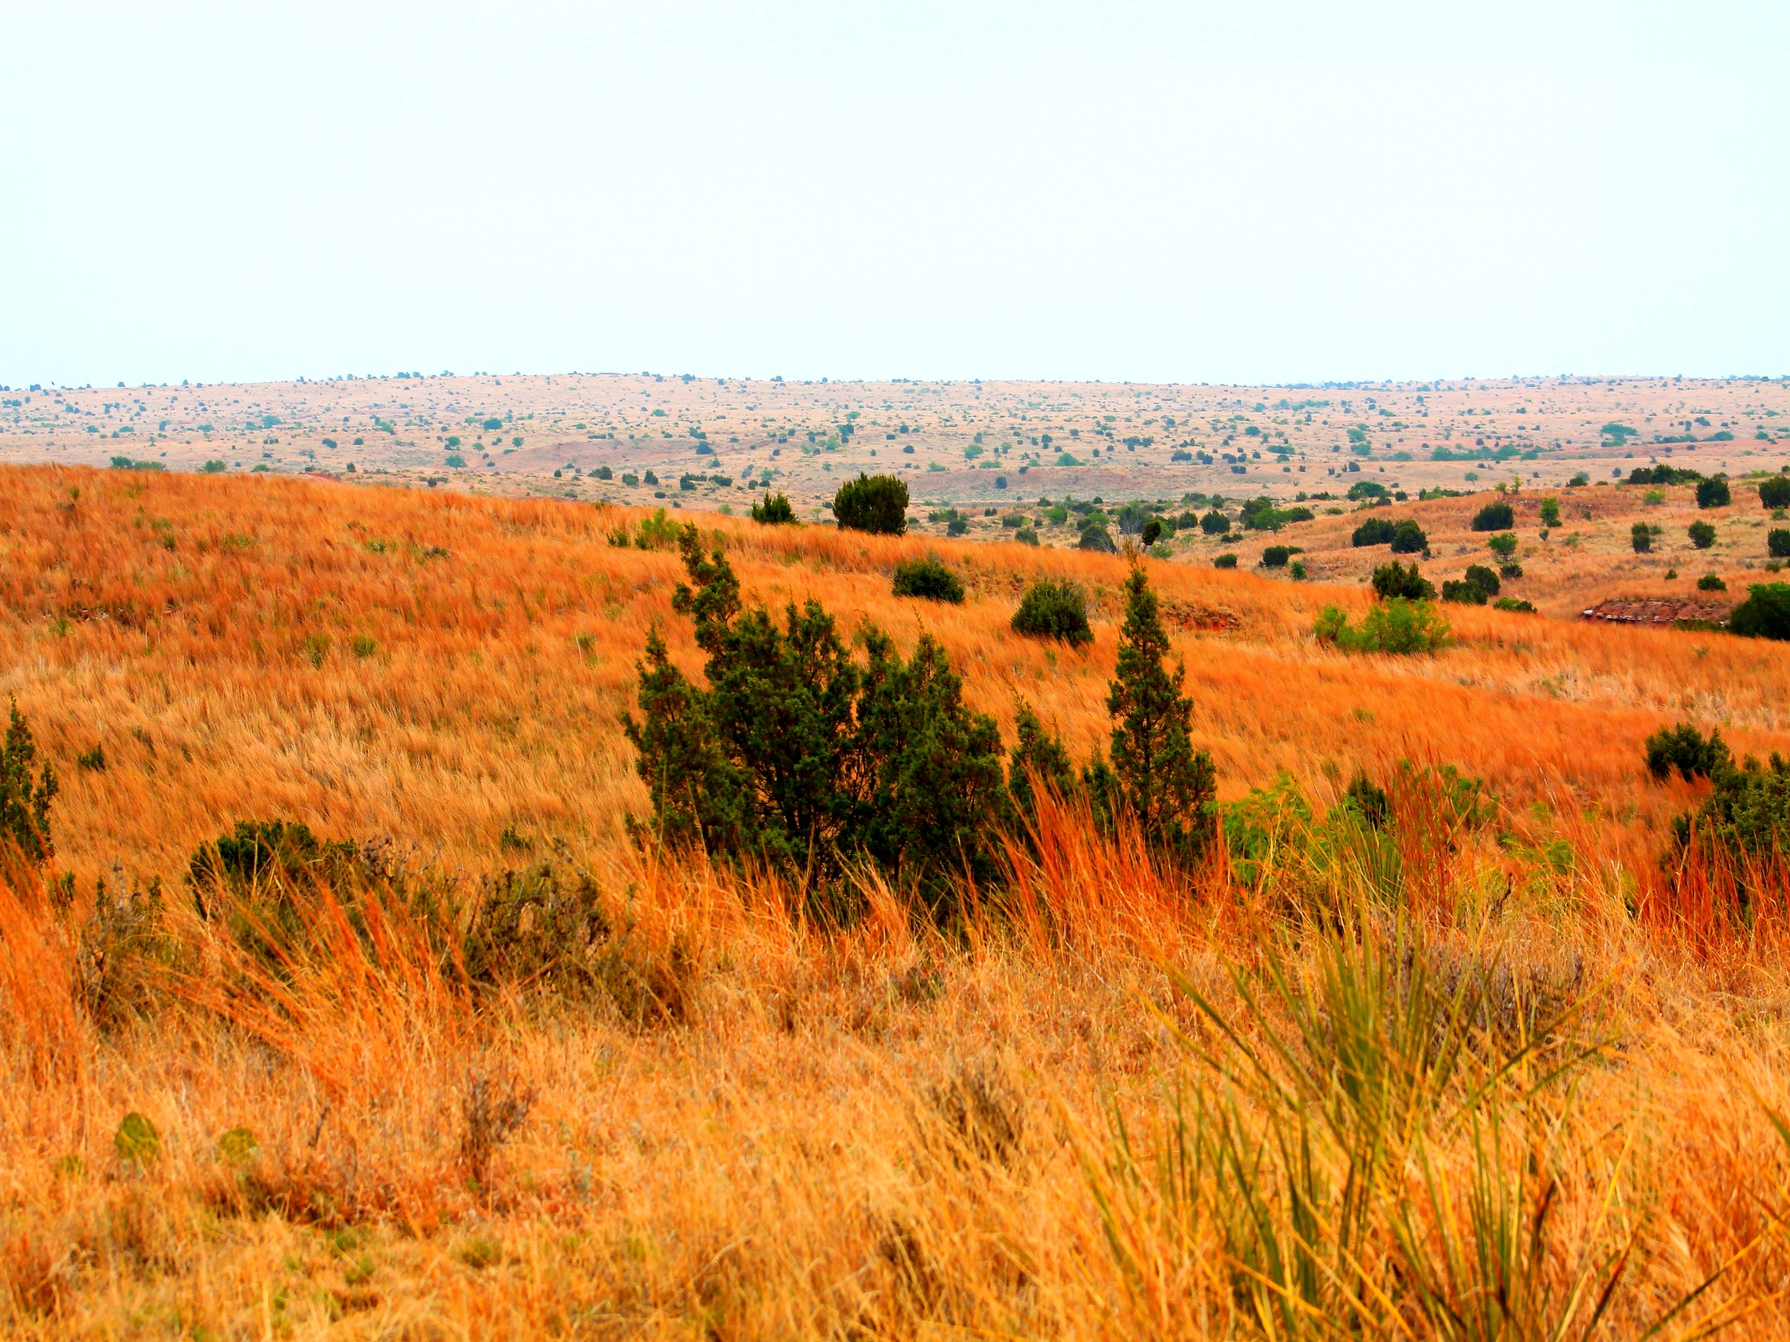
INTRODUCTION
Methods to increase woody cover
Containerized or root stock shrubs
May take years to reach usable size
Plant large shrubs
Expensive and not always feasible
Artificial Brush Structures

Slide 6
INTRODUCTION
Artificial Brush Structures (ABS)
Teepee-type ABS used most by BOQU (Webb and Guthery 1982)
Nest Success ↑ 2X by addition of predator exclusion welded wire on teepee-type ABS (Treadway 2002)

Slide 7
OBJECTIVES
Estimate nesting success in WL CRP
Identify habitat features associated with successful nests
Identify habitat features selected by BOQU for nest sites
Observe the use of ABS by BOQU

Slide 8
STUDY AREA
400 ha CRP
Lynn County, TX
Weeping lovegrass,
silver bluestem (Bothriochloa laguroides), three awns (Aristida spp.)

Slide 9
STUDY AREA
Subhumid climate
Hot summers and moderate winter temperatures
Loam and sandy loam soils with ≤ 1% slopes
951 m elevation
51 cm average annual precipitation
85% precipitation between April 1st to October 31st

Slide 10
METHODS
Weld 4 t-posts
Remove upper 30cm to form a flat-topped teepee structure
Weld rebar to top form a square
Cover with 5cm x 10cm welded wire
Rebar, wire, vinyl siding, hog rings for door
Screening cover

Slide 11
ABS SETUP
24 transported to study site
1 Structure/2.7 ha
Cedar boughs (Juniperus pinchotti)
screening cover
1 feeder + 1 waterer / ABS
≥ 30% protein feed and water
Chicken wire at base
Detain BOQU temporarily

Slide 12
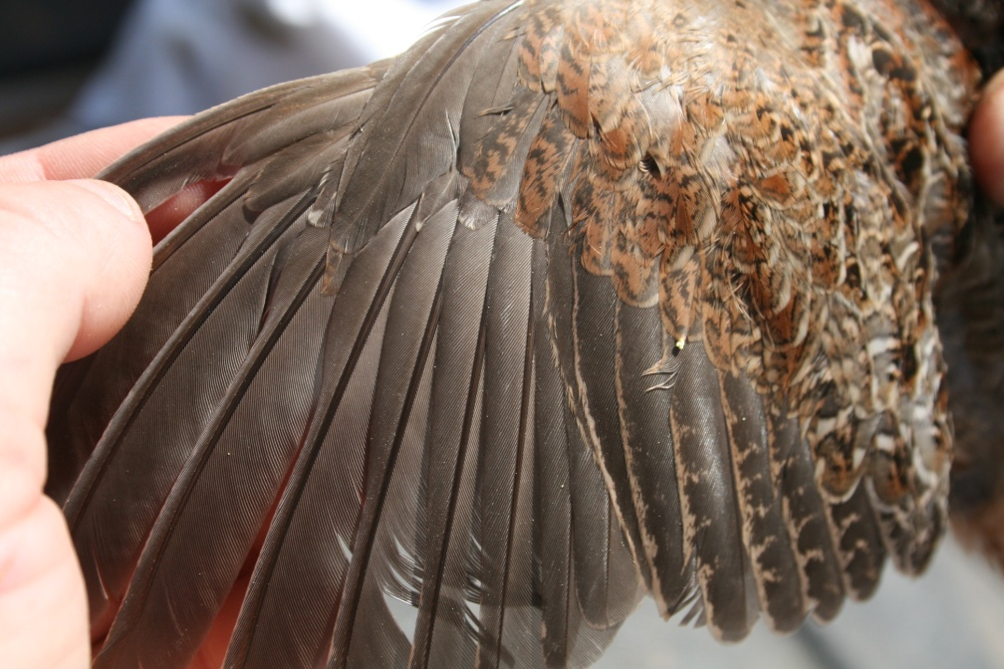
CAPTURE
2/20/2002-4/04/2002
3/01-24/2003
Walk-in funnel traps
Trapped quail
Ventilated cotton bags
Banded
Sexed
Aged
Weighed to nearest 0.01 g

Slide 13
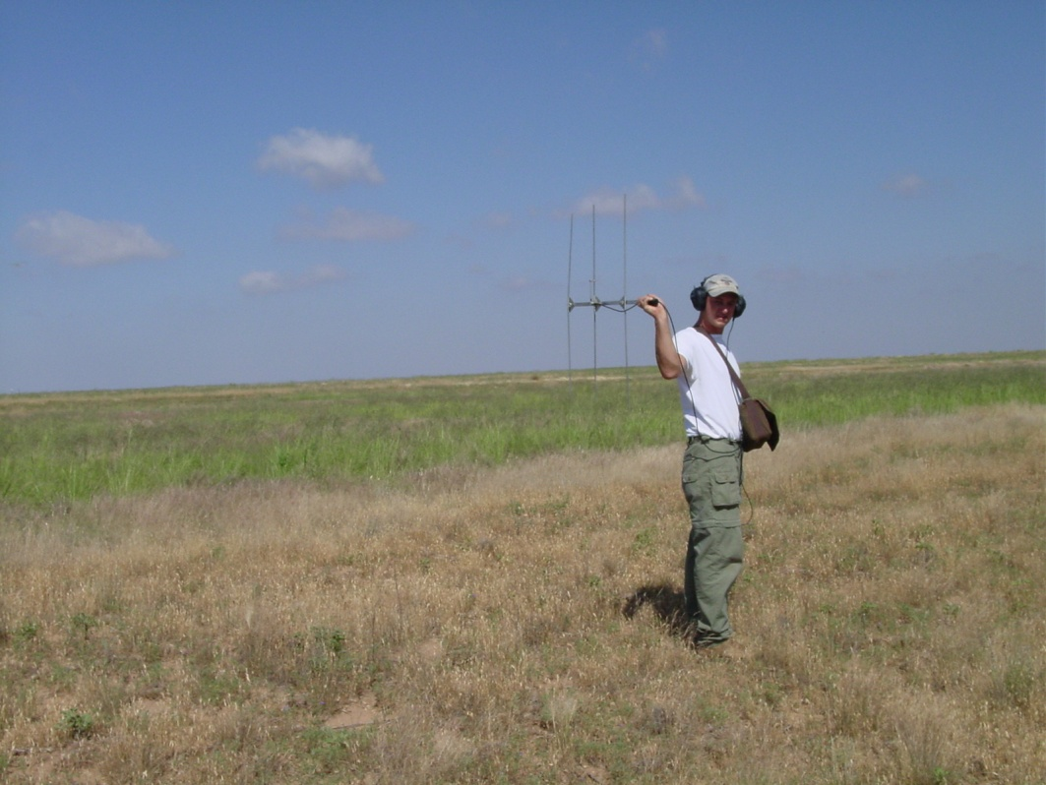
RELEASE
Ventilated cage
Transportation
6.5 necklace style radio transmitter
Monitored 1/ 3 days until 8/15
Bird use of ABS noted
Birds trapped together
Released together as covey

Slide 15
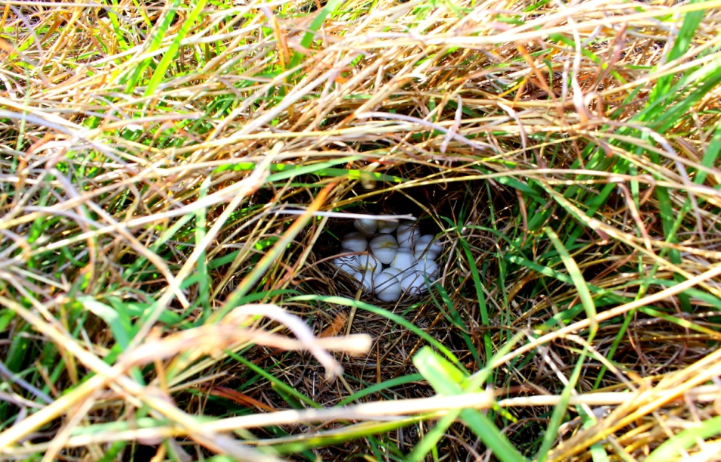
NEST MONITORING
Incubation activity
Determined by telemetry
Nest
Found when hen absent
Eggs counted
Location flagged
Successful nest
Any hatched eggs

Slide 16
NEST SITE CHARACTERISTICS
Evaluated after nest termination
Visual obstruction with Robel pole
% ground cover
Weeping lovegrass
Native grass
Forbs
Bare ground
Measurements
At nest site
10 m in cardinal directions
Characteristics measured at random points

Slide 17
DATA ANALYSIS
Stepwise logistic regression
Identify habitat characteristics of successful vs predated nests and selected by BOQU for nest sites
Predictor variables - % weeping love grass, native grass, forbs, bare ground and visual obstruction
Predictor variables + distance from ABS → Successful nest characteristics
Nest site location and success solved separately
Identify habitat characteristics of potential and successful nests sites

Slide 18
DATA ANALYSIS
Interpreted logistic regression coefficients by stating odd ratios
2-factor ANOVA
Year and location
Year and success
Determine differences in predictor variables
Binomial proportions tests
Compare nest success between years

Slide 19
RESULTS
2002
2003
15 hens radiomarked
5 hens nested in weeping lovegrass area
7 nests
2 hens nested in a wheat (Triticum aestivum) field with no weeping lovegrass
2 hens renested
Occurred after loss of a nest
No hens nested > 2
71% nest success
32 hens radiomarked
15 BOQU nested in weeping lovegrass area
20 nests
7 BOQU nested in areas with no weeping lovegrass
8 nests
4 BOQU renested
4 ♂ incubated a nest
No BOQU nested > 2
70% nest success

Slide 20
RESULTS
% bare ground + nest location relationship
B=-0.156, SE=0.040, Wald=15.61, P<0.001, Exp(B)=0.856
Potential nest sites ↓ 14% with each 1% ↑ in bare ground
No other variable predicted nest location
% weeping lovegrass > @ nest vs random site
Not selected as predictor variable for location
No variables predicted successful nests (P=0.19)

Slide 21
RESULTS
Variable vegetation characteristics between yrs
No difference
Except for nest site distance from ABS
2002: Nest sites closer to ABS (n=7, v=32.9, SE=5.5)
2003: Nest sites further from ABS (n=20, v=343.9, SE=72.8)
2-factor ANOVA revealed no differences in predictor variables (P > 0.05)
BOQU observed frequently using ABS
60% of nests located ≤ 55m
Use peaked during hot summer temperatures
♂ observed using structure as calling perches
Brooding adults used structures > other individuals

Slide 22
DISCUSSION
High nest success = 70-71%
38% (Mueller 1999)
46% (Hernandez 1999)
38% (Carter et al. 2002)
42% (Treadway 2002)
Reasons for high nest success unclear
Nest predators observed @ site throughout study
Weeping lovegrass CRP composition @ site
thick but did not form monoculture
Not avoided by BOQU
Weeping lovegrass present in ¼ m² quadrats @ nest
Suitable nest cover for BOQU

Slide 23
DISCUSSION
Reasons unclear why no variables differentiated successful from predated nests
Reasons unclear why nests closer to ABS in 2002 than 2003
Possibly caused by increased forb abundance
↑ forbs = ↑ food = ↓ reliance on ABS food source =↑ nest distance from ABS
Confirmed consumption of high protein feed
Radiomarked bird predated but crop left intact

Slide 24
MANAGEMENT IMPLICATIONS
1000s acres of weeping lovegrass CRP in Texas Southern High Plains
Landowners attempting to convert weeping lovegrass CRP to native grasses
Land ownership changes
CRP rules
Belief that BOQU will not nest in weeping lovegrass
Conversion process expensive
Establishment of native grasses relies on substantial > average precipitation

Slide 25
MANAGEMENT IMPLICATIONS
Results suggest complete conversion of weeping lovegrass to native grass CRP unnecessary
Steps to ↑ BOQU usable space in weeping lovegrass CRP
Burn strips in December-January
Disk 10% of burnt strips to ↑ forb abundance and diversity
Plant woody species
Install ABS
Too expensive to install ABS @ densities used in study

Slide 26
ACKNOWLEDGEMENTS
Landowners
C. Johnson
C.B. Edmiaston
G. Dalby
Dr. L. Bromberg Charitable Trust Fund for their generosity
Technicians and personnel that helped

Slide 27
LITERATURE CITED
Abbott, C. W. 2003. Transplanting northern bobwhite (Colinus virginianus) in the Southern High Plains of Texas. Thesis, Texas Tech University, Lubbock, Texas, USA.
Carter, P. S., D. Rollins, and C. B. Scott. 2002. Initial effects of prescribed burning on survival and nesting success of northern bobwhites in West-Central Texas. National Quail Symposium 5:129-134.
Hernandez, F. 1999. The value of prickly pear cactus as nesting cover for northern bobwhite. Dissertation. Texas A&M University, College Station, Texas, USA .
Hosmer, D. W., and S. Lemeshow. 2000. Applied logistic regression, Second edition. John Wiley and Sons, Inc., New York, New York, USA.
Mowery, I. C., and G. S. McKee. 1959. Soil survey of Lynn County, Texas. U. S. Department of Agriculture, Soil Conservation Service, Washington D. C., USA.
Robel, R. J., J. N. Briggs, A. D. Dayton, and L. C. Hulbert. 1970. Relationship between visual obstruction measurements and weight of grassland vegetation. Journal of Range Management 23:295-297.
Rosene, W. 1969. The bobwhite quail: its life and management. Rutgers University Press, New Brunswick, New Jersey, USA.
Smith, H. D., F. A. Stormer, and R. D. Godfrey, Jr. 1981. A collapsible quail trap. United States Forest Service, Research Note RM-400, Washington D.C., USA.
Treadway, J. H. 2002. Protecting northern bobwhite nests from mammalian predators In areas inhabited by the red imported fire ant. Thesis, Texas Tech University, Lubbock, Texas, USA.
Webb, W. M. and F. S. Guthery. 1982. Response of bobwhite to habitat management in northwest Texas. Wildlife Society Bulletin 10:142-146.

