Slide 1
IN
MEMORIUM

Slide 2
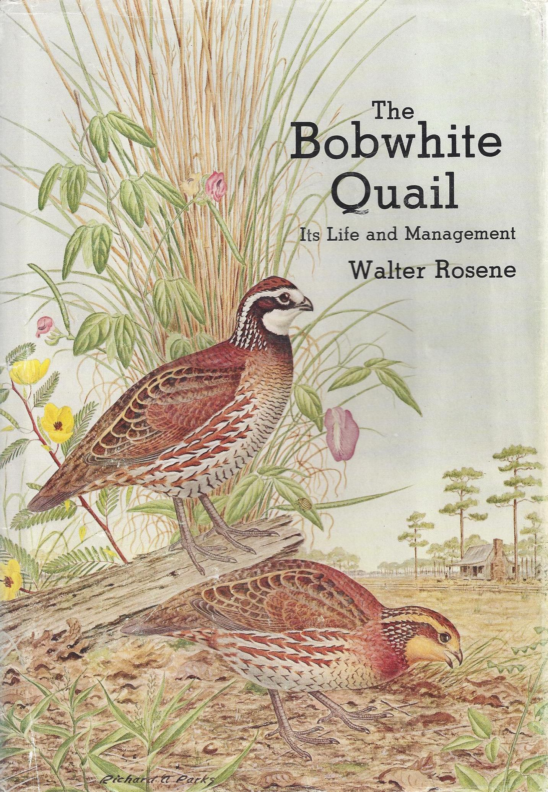
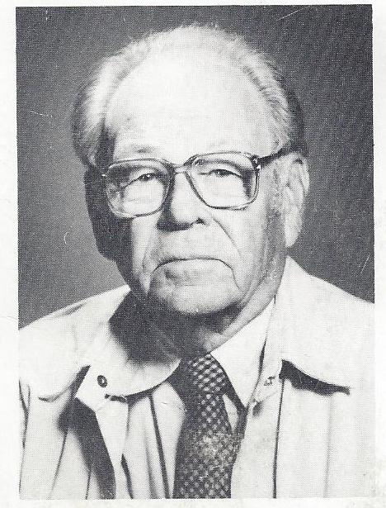
Walter Rosene
15 May1912 – 30 December 2005

Slide 3
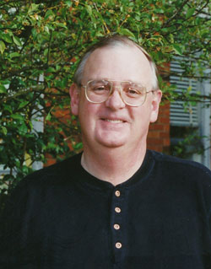
John A. Crawford
24 July 1946 – 11 July 2010

Slide 4
RECOGNITION
OF
EXCELLENCE

Slide 5
For Outstanding Scientific Contributions
that Support the Foundations
of Quail Conservation
Quail VII
Seventh National Quail Symposium
9 – 12 January 2012
Tucson, Arizona

Slide 6
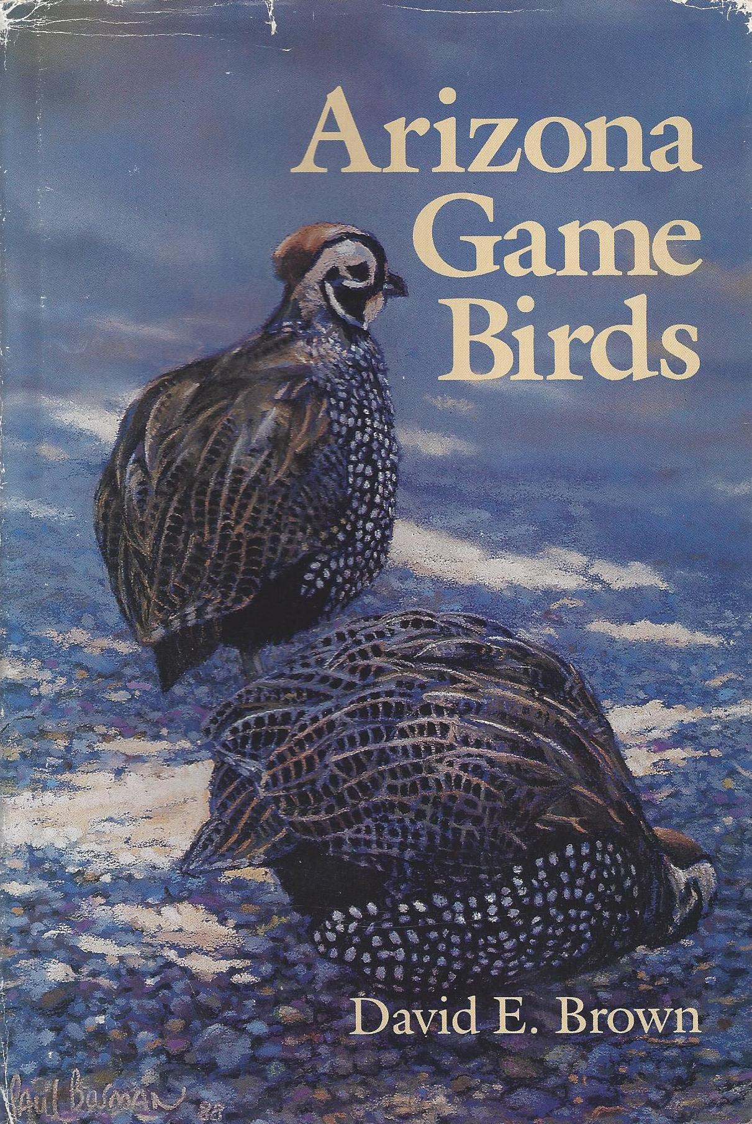

Slide 7
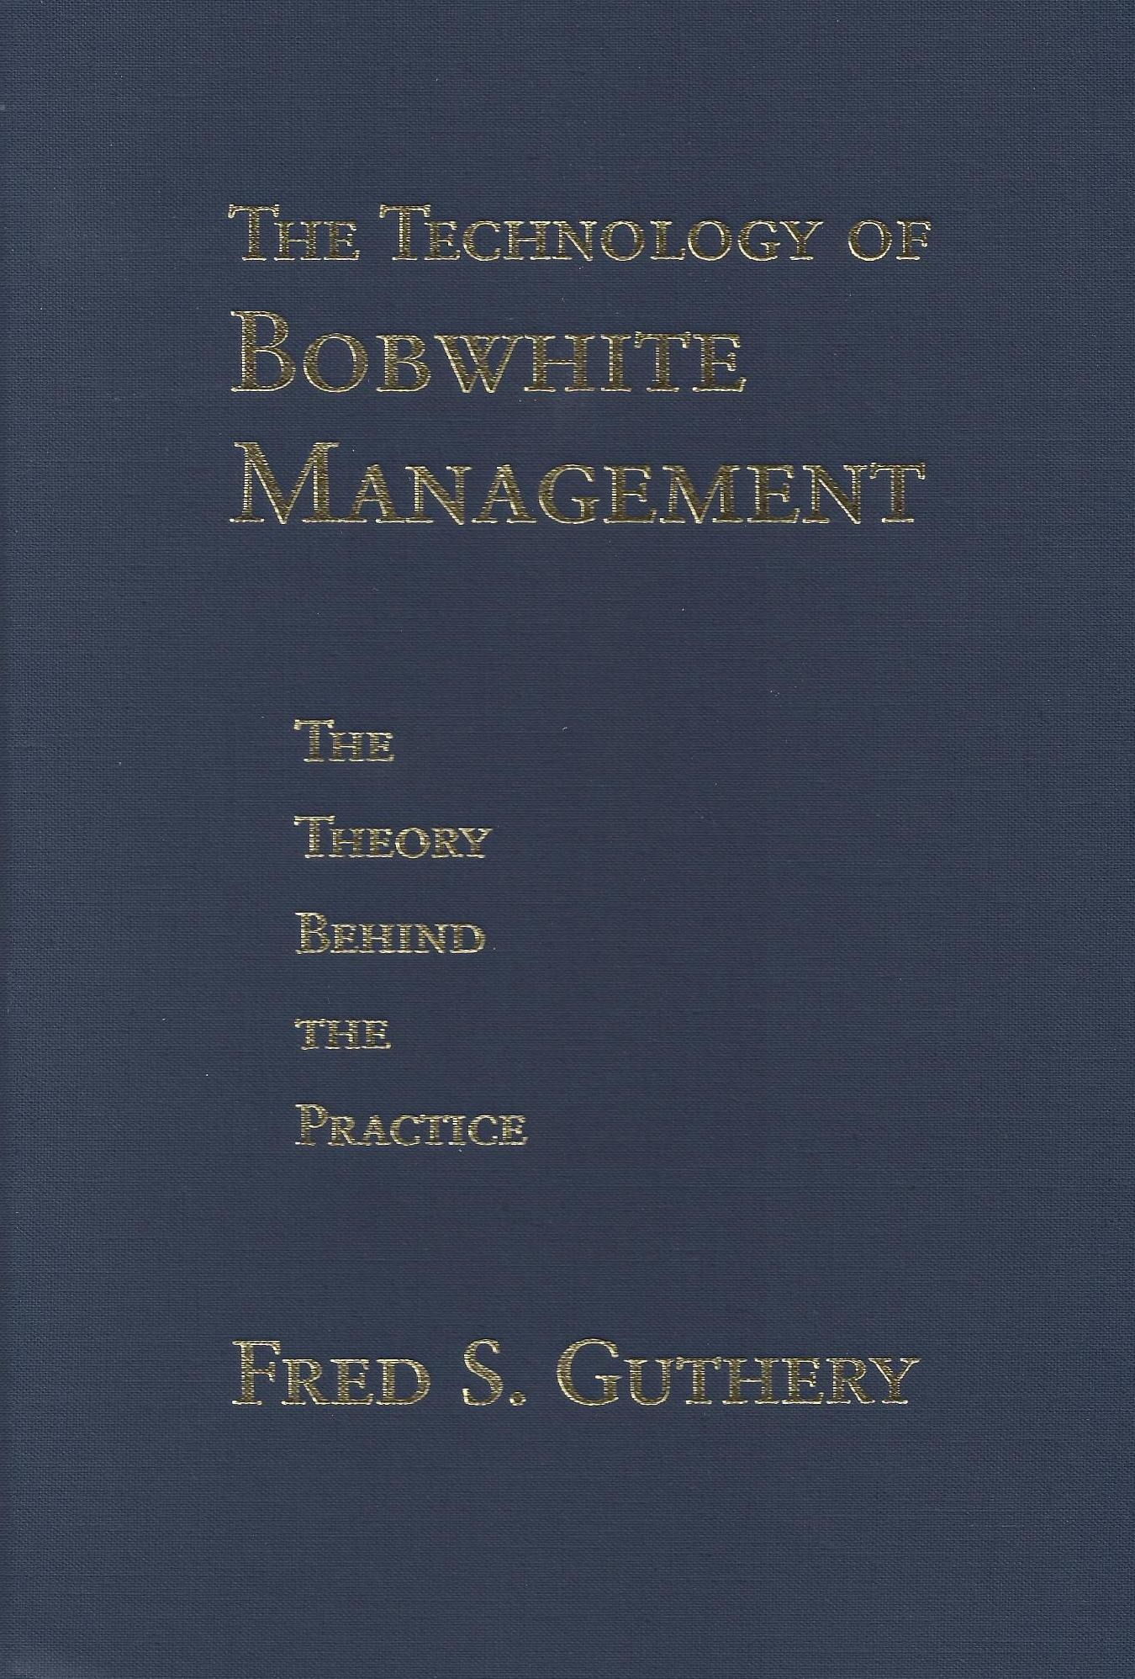
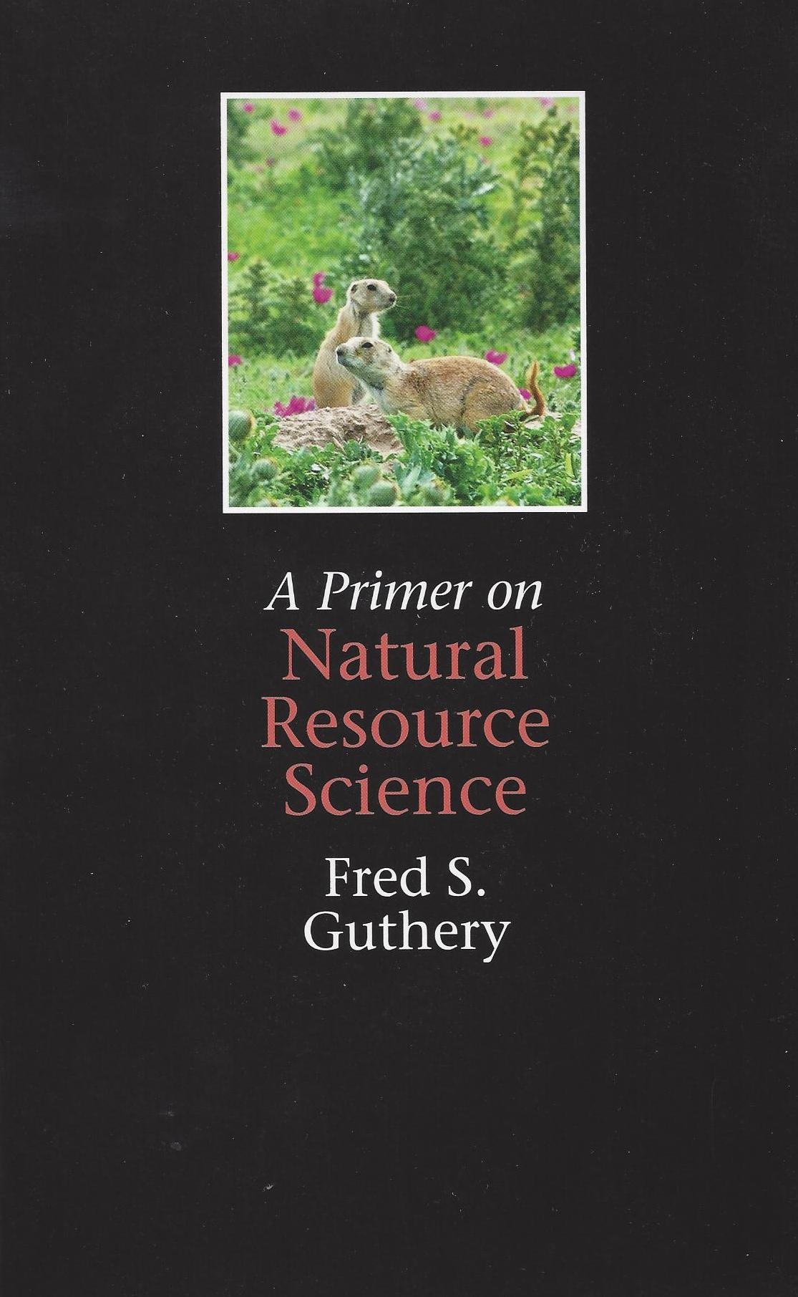

Slide 8
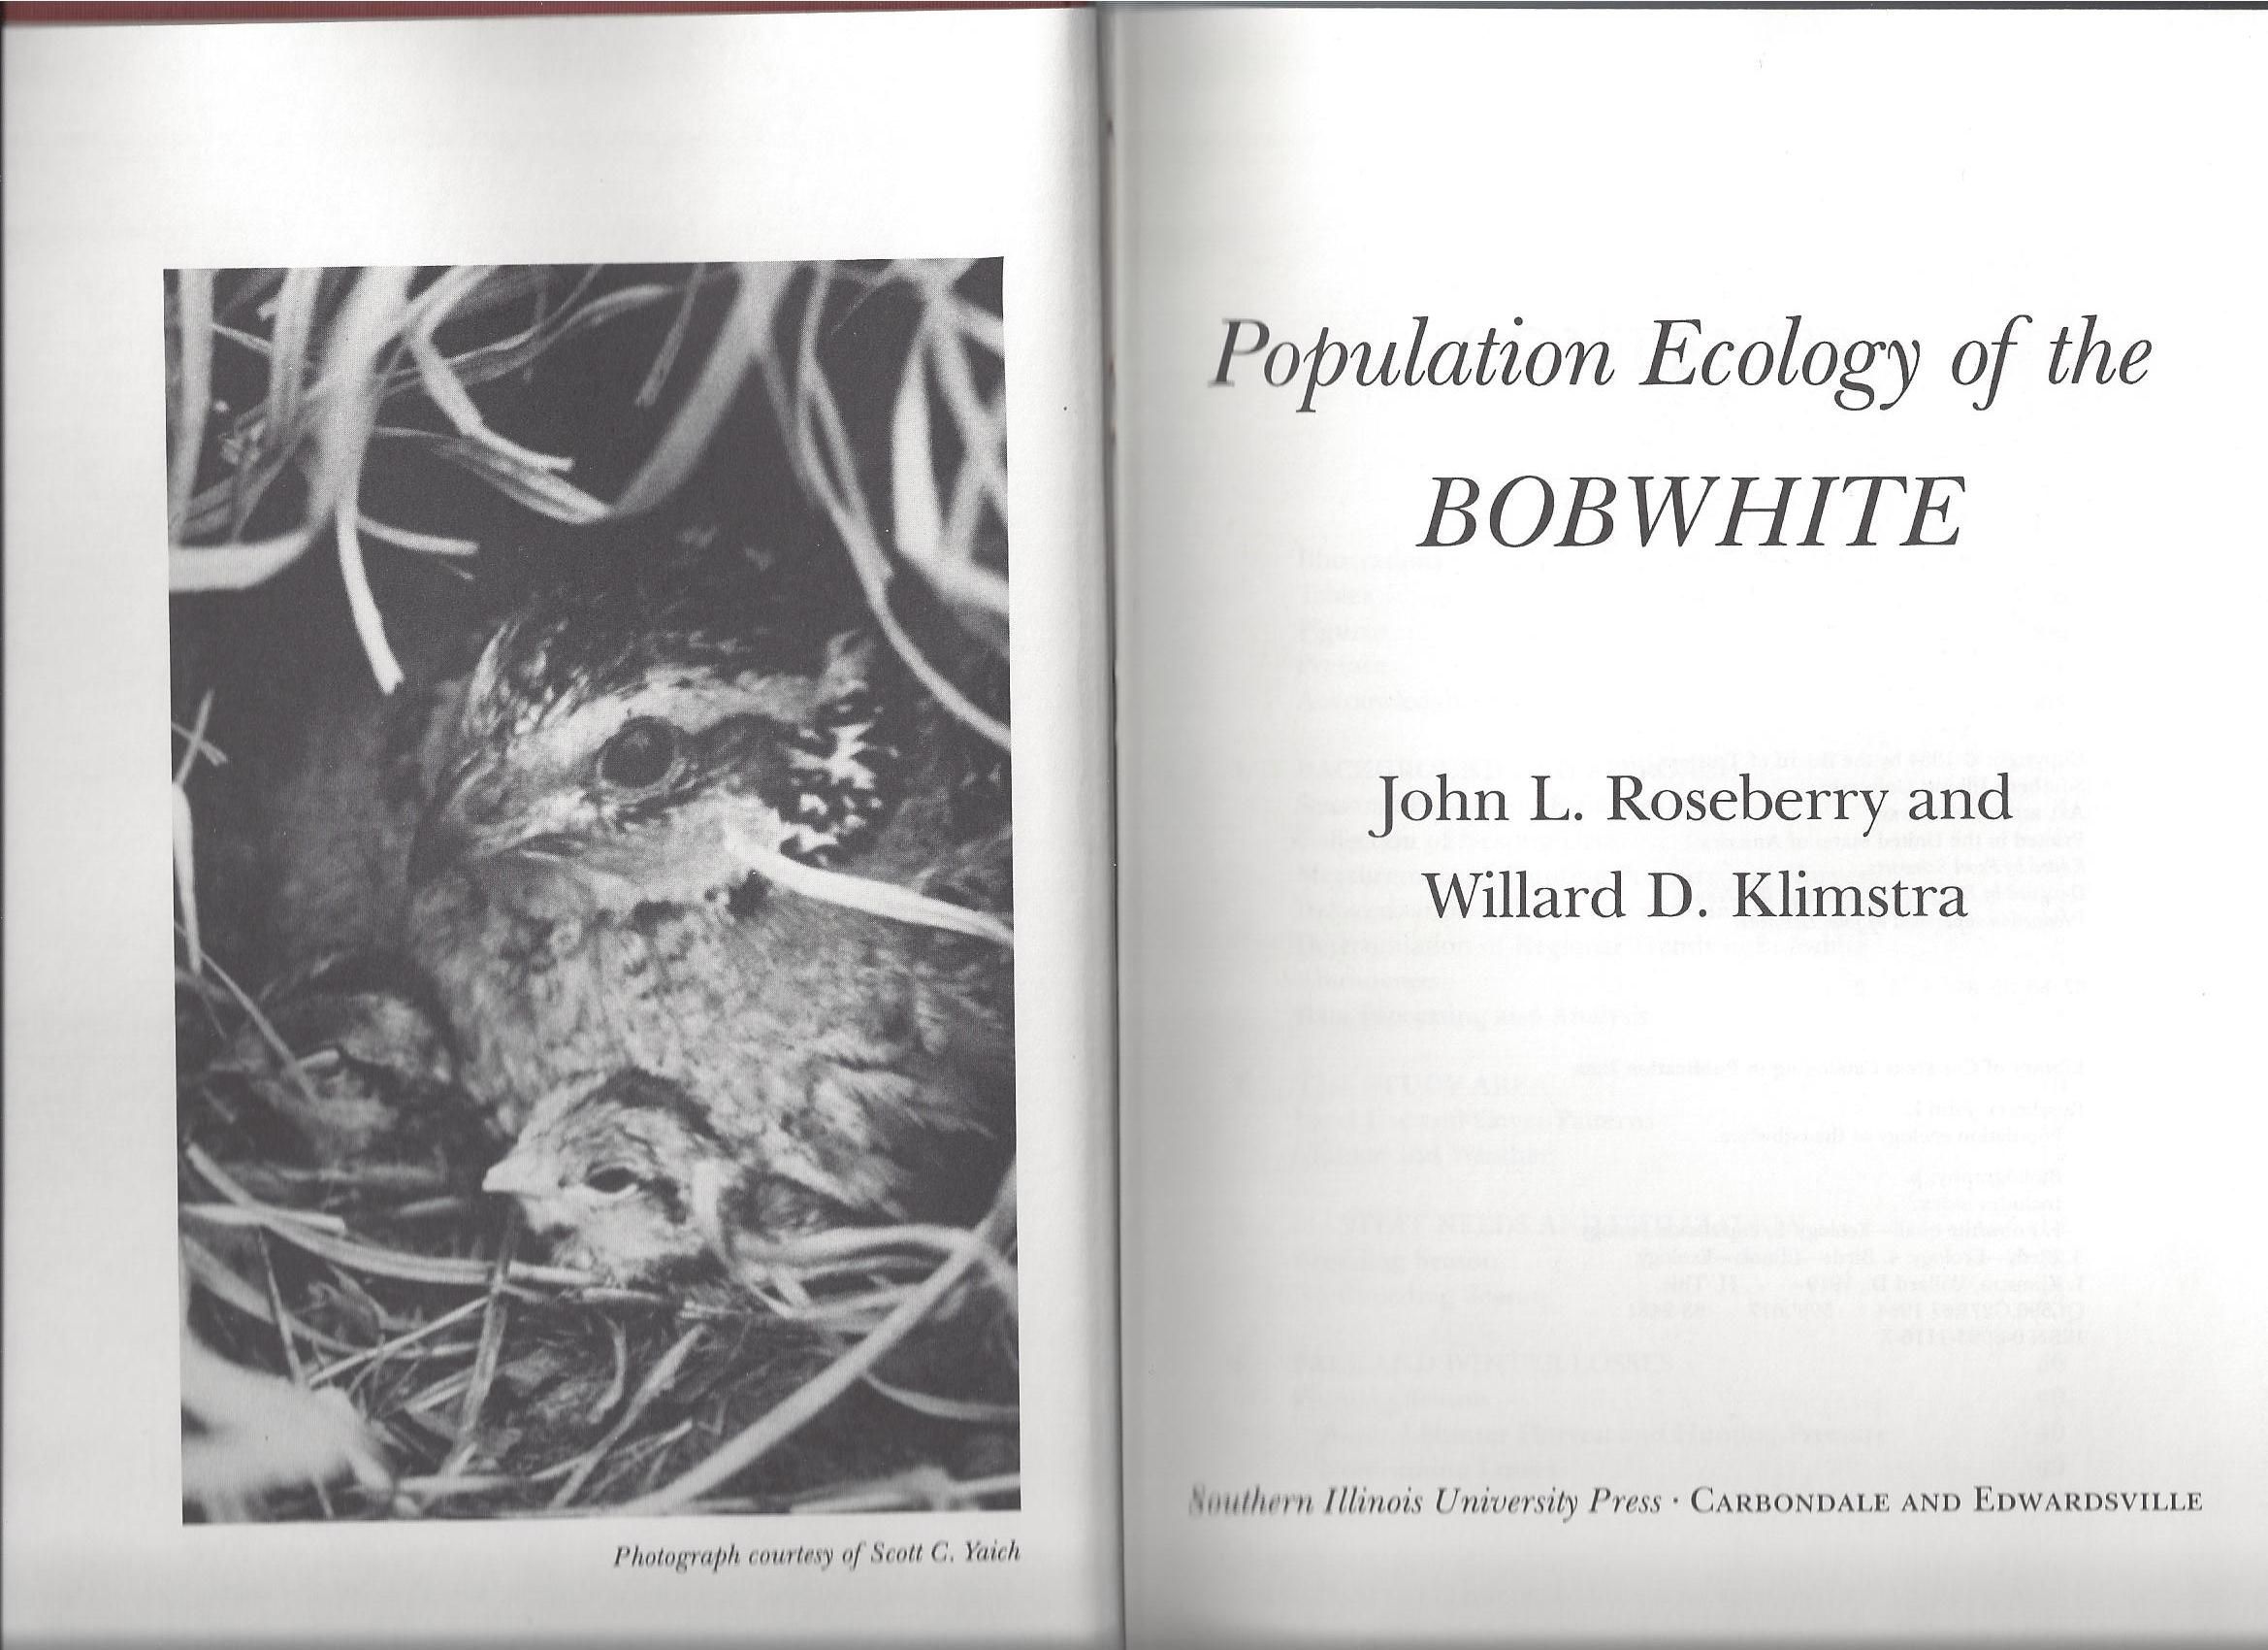
Roseberry Book Cover

