Slide 1


Bobwhite response to two large-scale wildfires in the Texas Panhandle
Kenneth A. Cearley
Dale Rollins
Chris Snow
Brandon Wilson

Slide 2
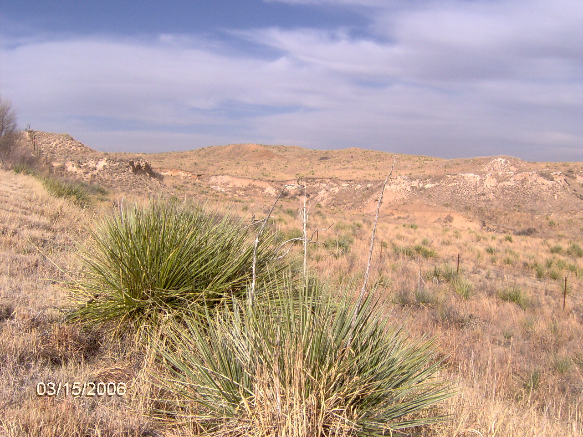
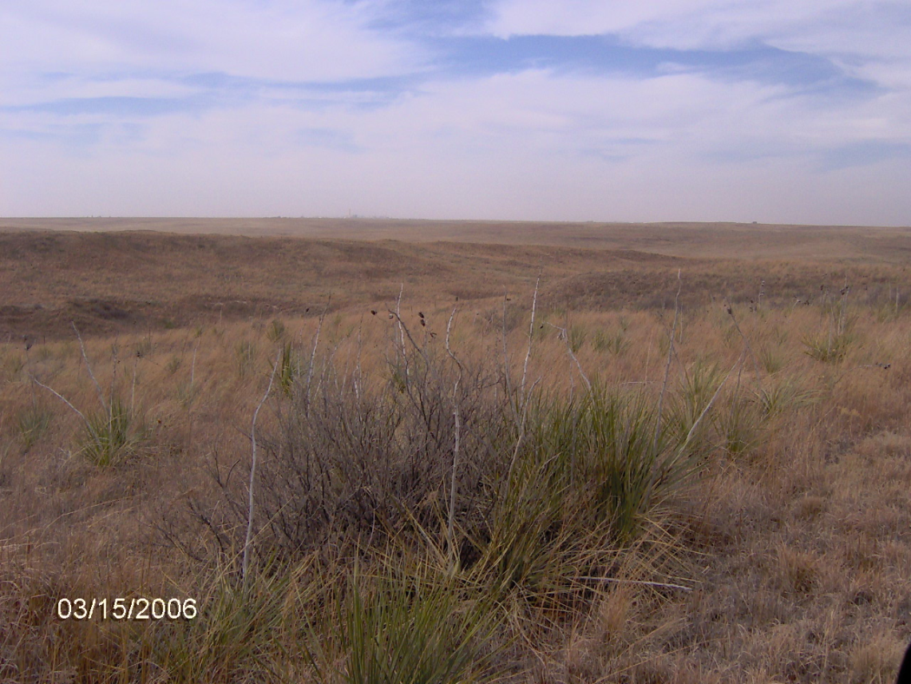
March 2006

Slide 3
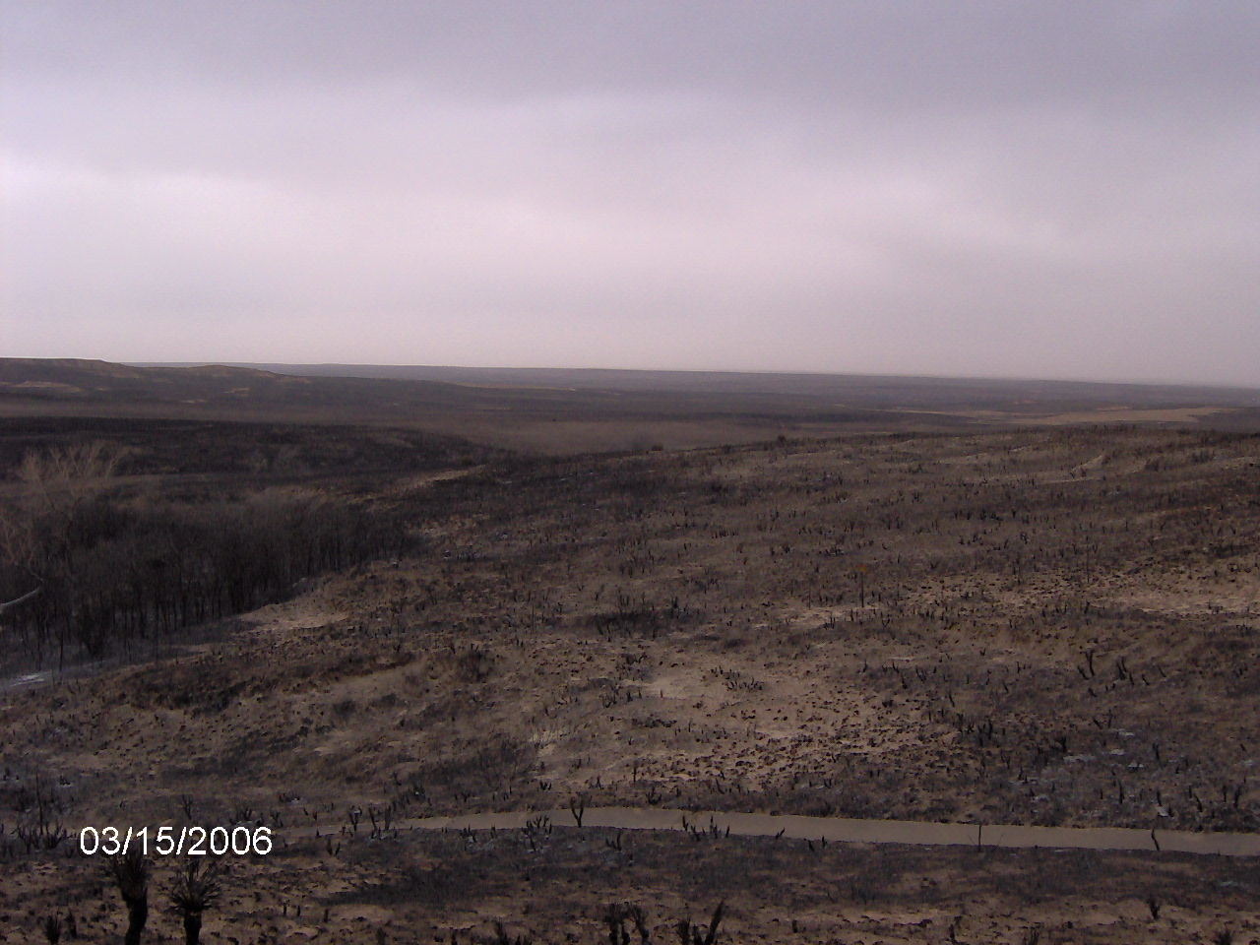
12-18 Mar 2006
  <10% relative humidity
  74 km/h sustained winds (gusts of 93 km/h)
Fire initiated by downed power lines
  Ex: advanced 72 km in 9 h
  Flame lengths > 3 m
Notes:
Rangeland wildfires burned more than 725,000 acres in two large blocks in the Texas Panhandle, March 12-15, 2006. Following several months of abnormally low rainfall and extremely low relative humidity, unseasonably warm temperatures and sustained 30+ mph winds with gusts of 58 mph pushed the fires eastward across the region. Twelve lives were lost, as were more than 89 structures, thousands of head of livestock, and various wildlife that could not move fast enough to escape. At one point the fire advanced 45 miles in 9 hours.

Slide 4
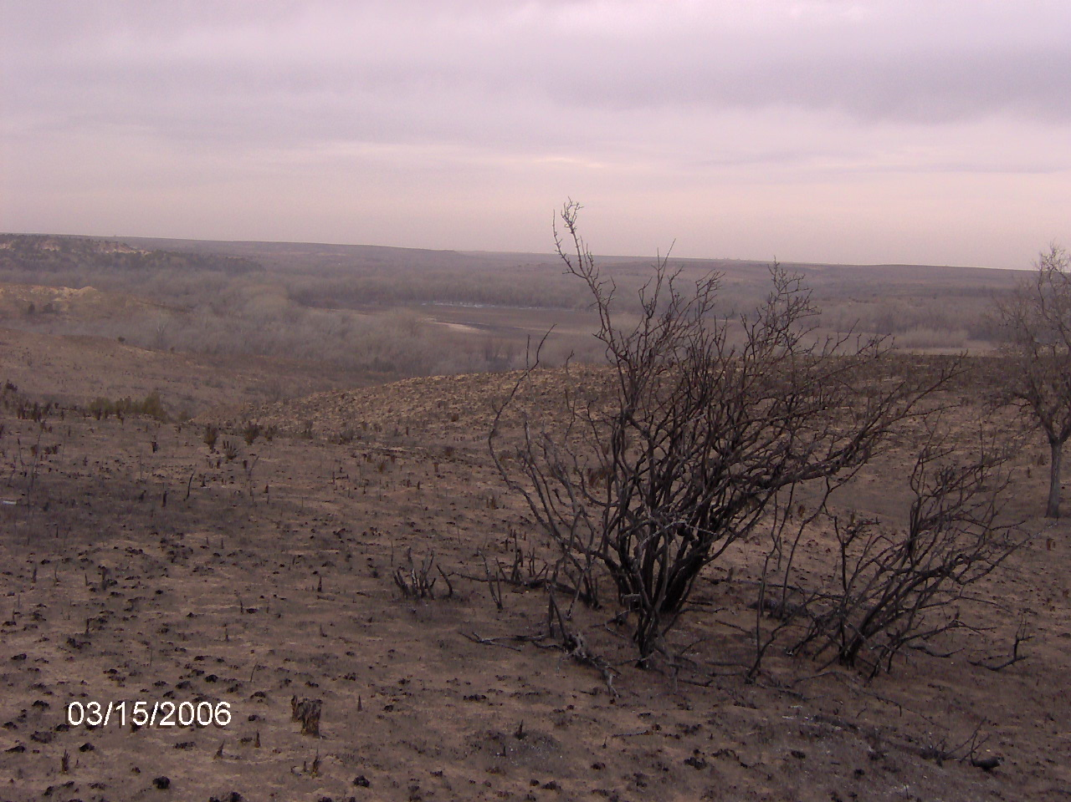
Notes:
Rangeland wildfires burned more than 725,000 acres in two large blocks in the Texas Panhandle, March 12-15, 2006. Following several months of abnormally low rainfall and extremely low relative humidity, unseasonably warm temperatures and sustained 30+ mph winds with gusts of 58 mph pushed the fires eastward across the region. Twelve lives were lost, as were more than 89 structures, thousands of head of livestock, and various wildlife that could not move fast enough to escape. At one point the fire advanced 45 miles in 9 hours.

Slide 5
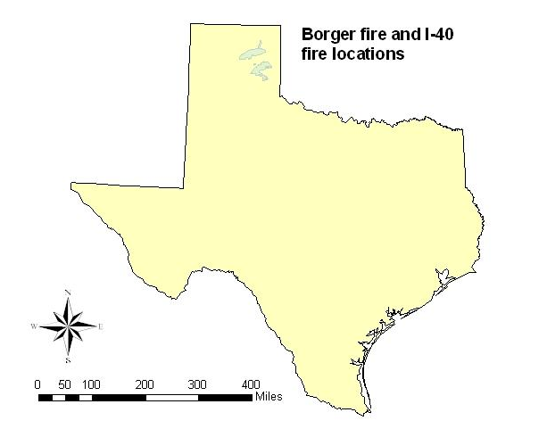
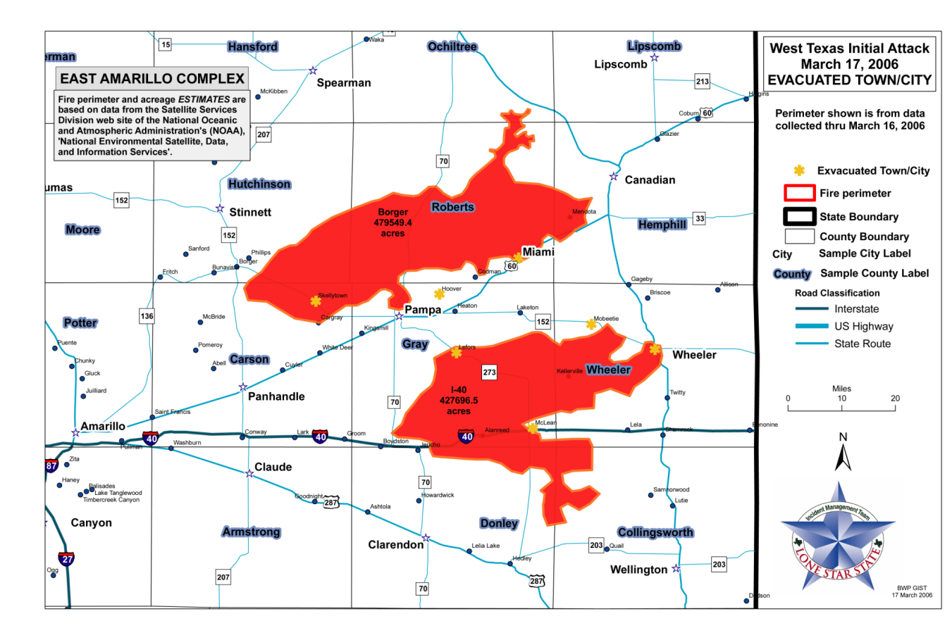
12-18 Mar 2006
  275,805 ha burned
    Borger (North)
      143,775 ha
    I-40 (South)
      132,030 ha
Notes:
Rangeland wildfires burned more than 725,000 acres in two large blocks in the Texas Panhandle, March 12-15, 2006. Following several months of abnormally low rainfall and extremely low relative humidity, unseasonably warm temperatures and sustained 30+ mph winds with gusts of 58 mph pushed the fires eastward across the region. Twelve lives were lost, as were more than 89 structures, thousands of head of livestock, and various wildlife that could not move fast enough to escape. At one point the fire advanced 45 miles in 9 hours.

Slide 6
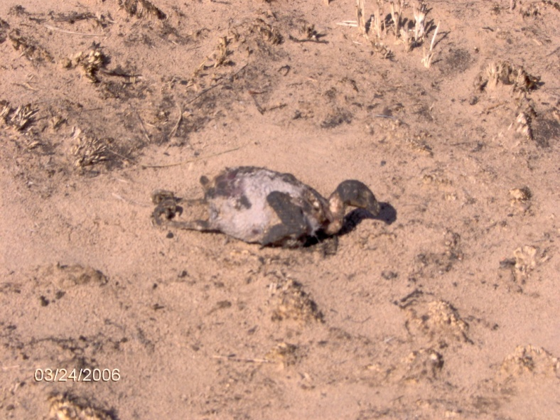
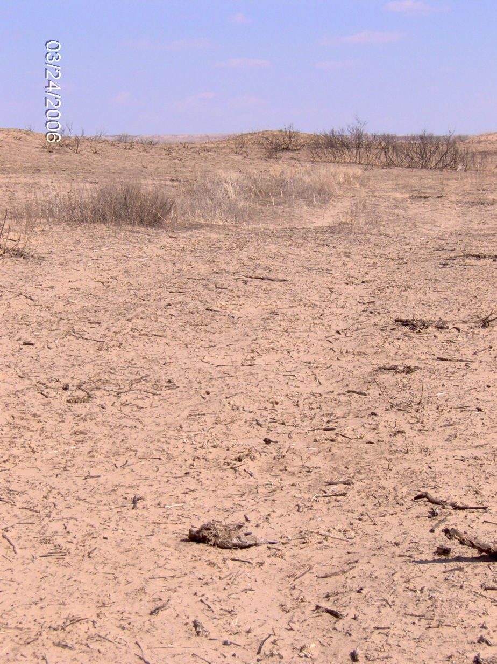
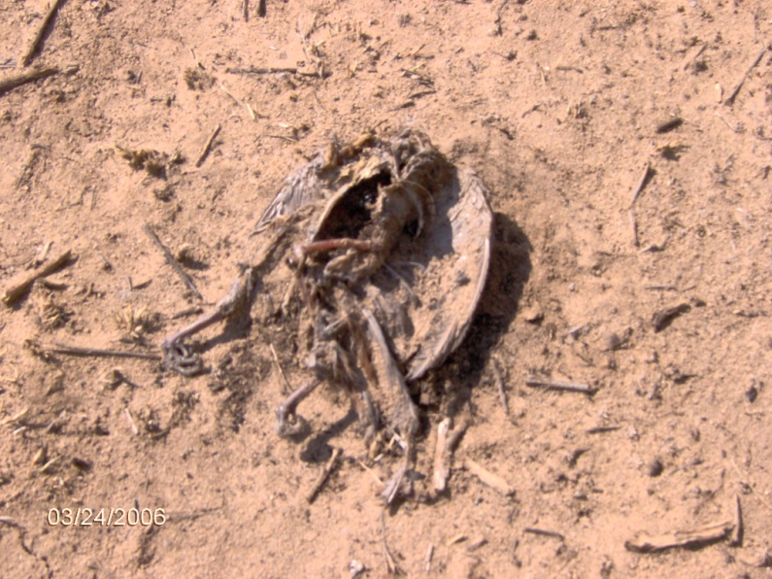
Wildfire quail mortalities
Mar 06 Gray County

Slide 7
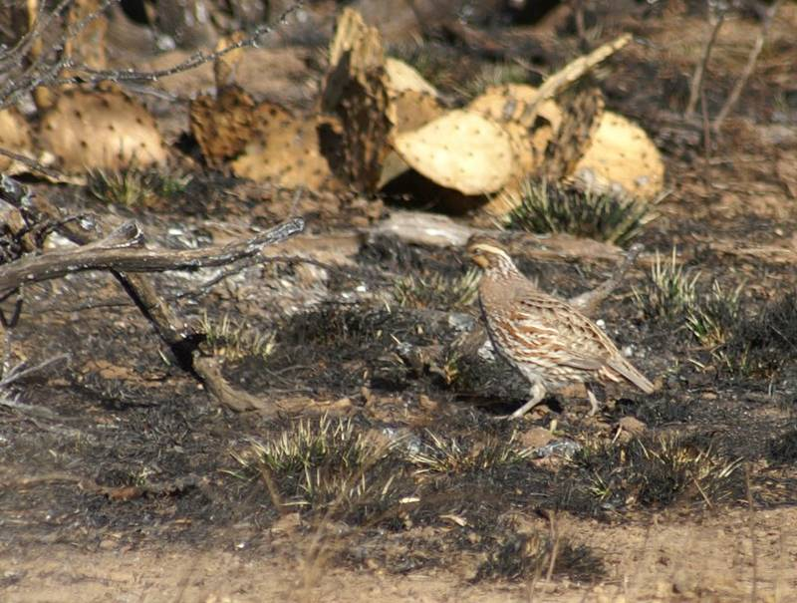
Impact on quail populations?
Notes:
To assess the impact on bobwhite (Colinus virginianus) populations, spring call counts were undertaken for a 3 year period beginning in the summer of 2006.

Slide 8
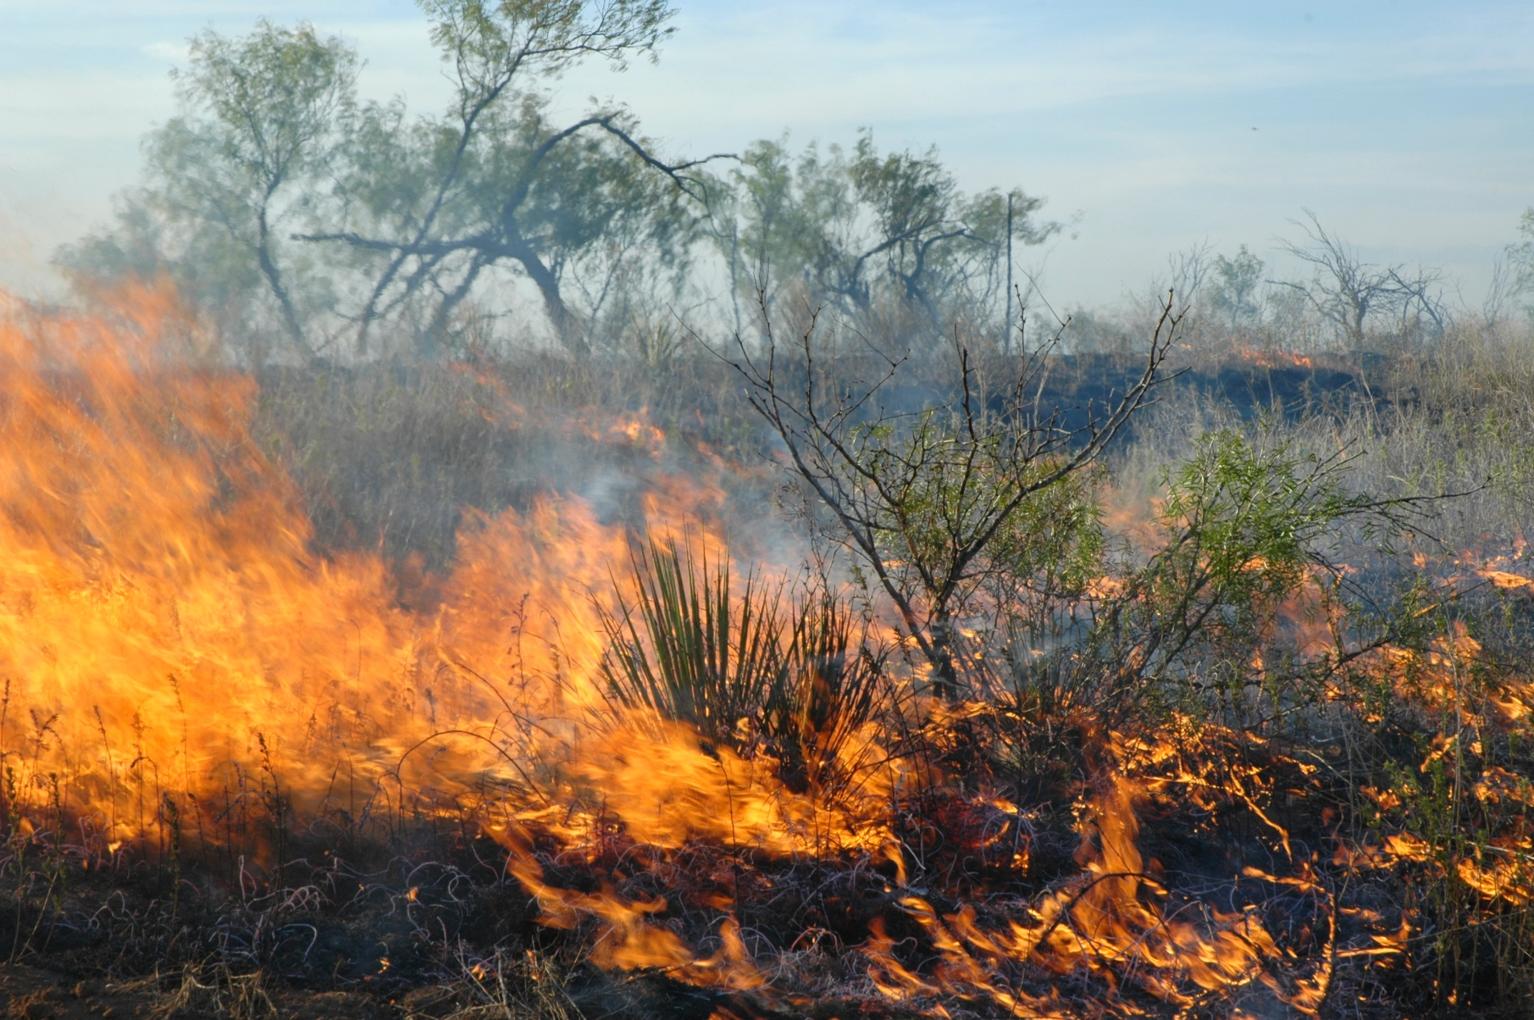
Benefits of burning relative to quail habitat
Increased forb production short-term
Decreased brush density
Rejuvenation of fire tolerant woody plants (food source)
Increased mobility

Slide 9
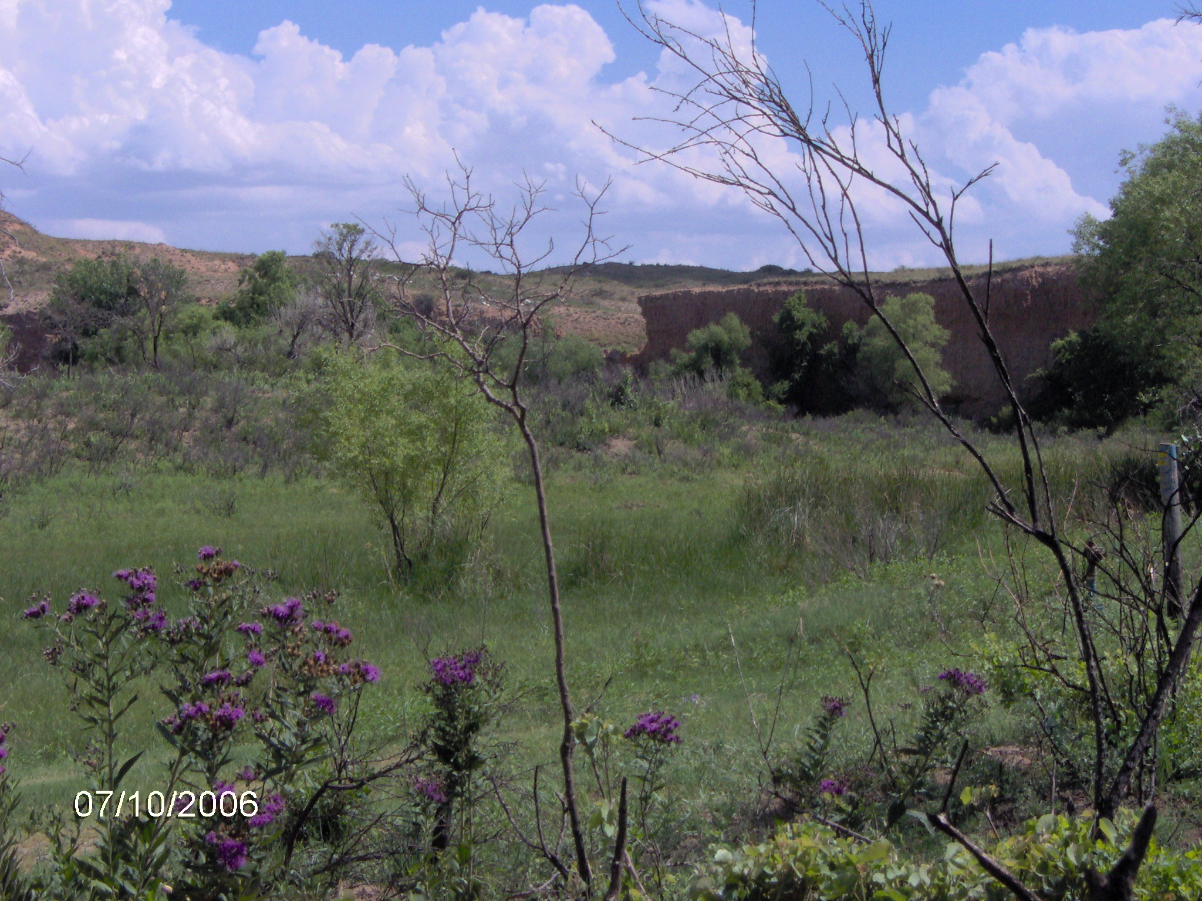
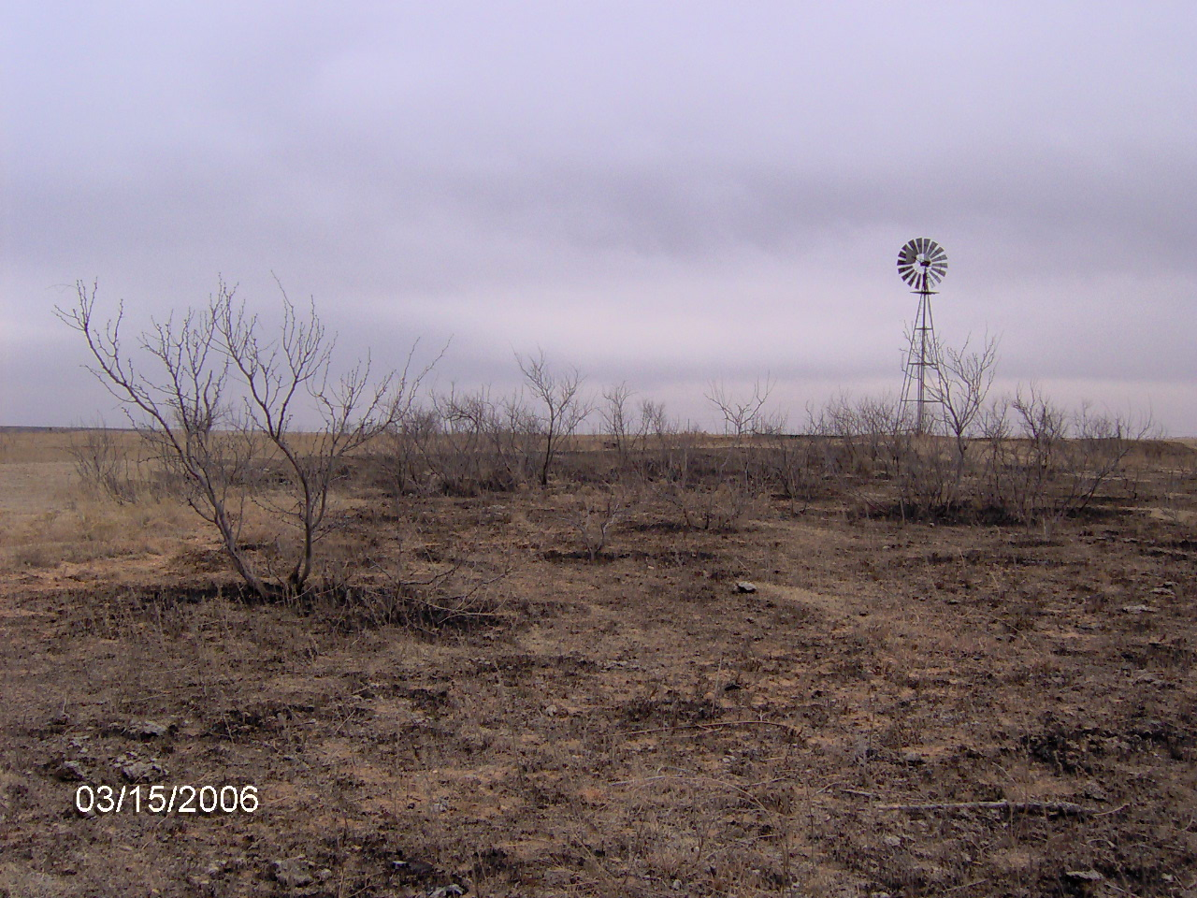
Expectations post-burn
Lowered survival rate short-term
  Decreased availability of cover
  Increased effectiveness of predators
Flush of re-growth if adequate soil moisture and follow-up precipitation
  Successful nesting
  Recruitment
In subsequent few years higher populations on burned areas than on un-burned areas due to habitat improvement

Slide 10
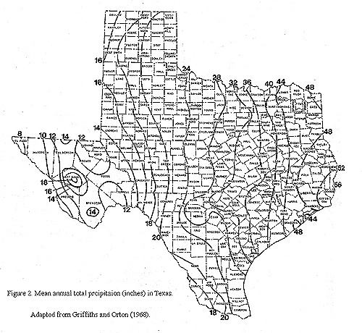
Precipitation

Slide 11
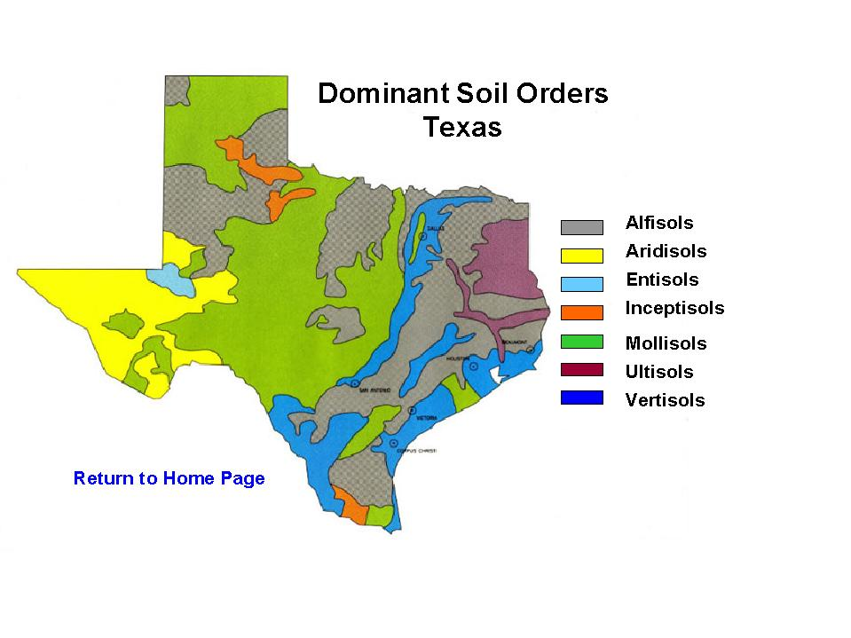
Soils
soildata.tamu.edu

Slide 12
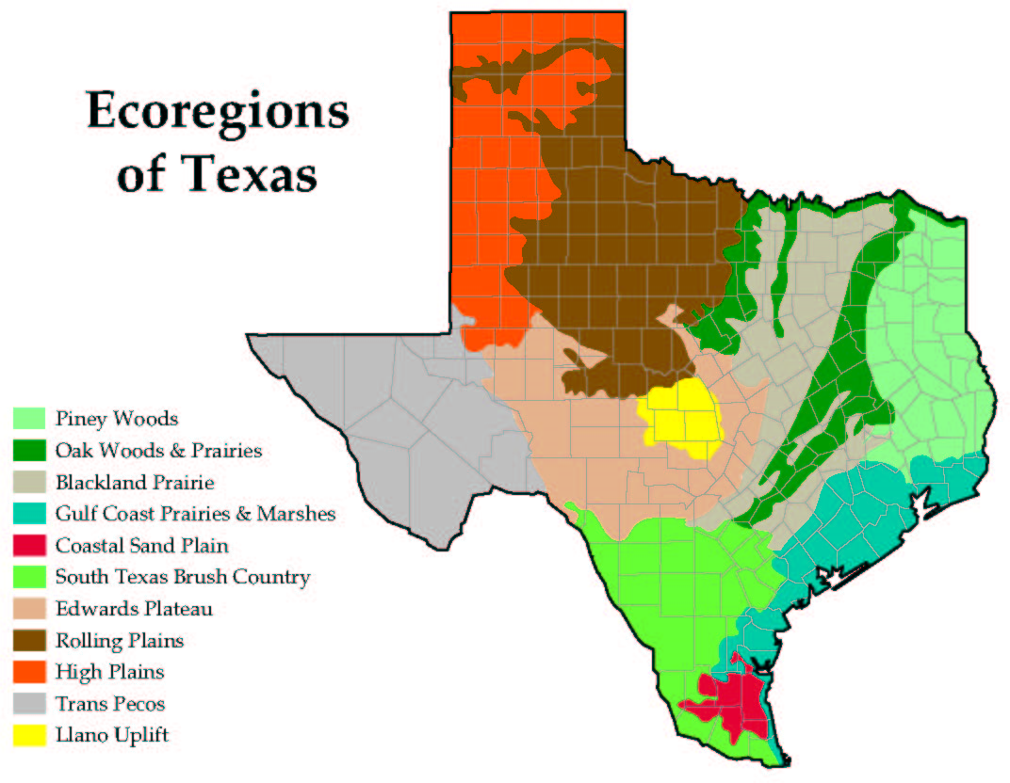
Vegetation
Midgrass
Shortgrass
TPWD

Slide 13
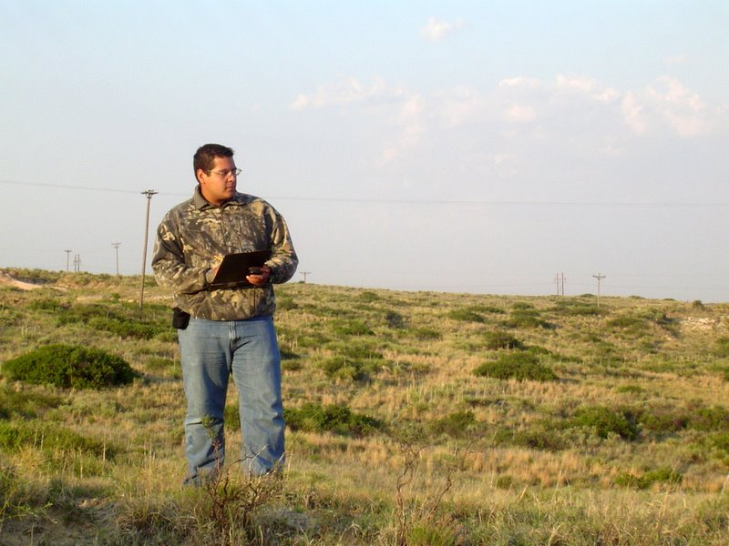
Methods
Count individual calling males
16 km transects
  11 listening points
    1.6 km intervals
  Oriented north-south
  Three per burned block
  ≥ three points within burned area
  ≥ three points in the unburned area
30 min. before sunrise + 2 hrs.
Listen 5 min.
3 counts, different days
Peak breeding season- late May to early July

Slide 14
Methods
Gross characterization of soils within 81 ha Area of Interest (AOI)
  Web Soil Survey
    (http://websoilsurvey.nrcs.usda.gov)

Slide 15
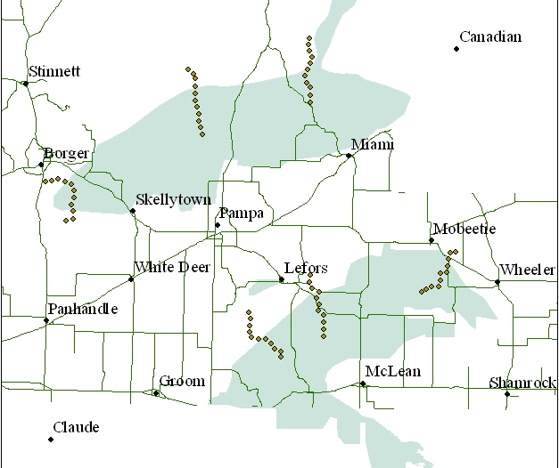
Monitoring Sites
Counties
Gray
Carson
Roberts
Notes:
Study Area
Six study sites were established in Gray, Carson, Huthinson, Wheeler, Hemphill, Ochiltree, and Roberts counties. The study area was in the High Plains (shortgrass prairie) and Rolling Plains (midgrass-shrub) ecoregions. Long-term average rainfall ranged from 20” to 23”, west to east. Soils ranged from fine sand to clay loam.

Slide 16
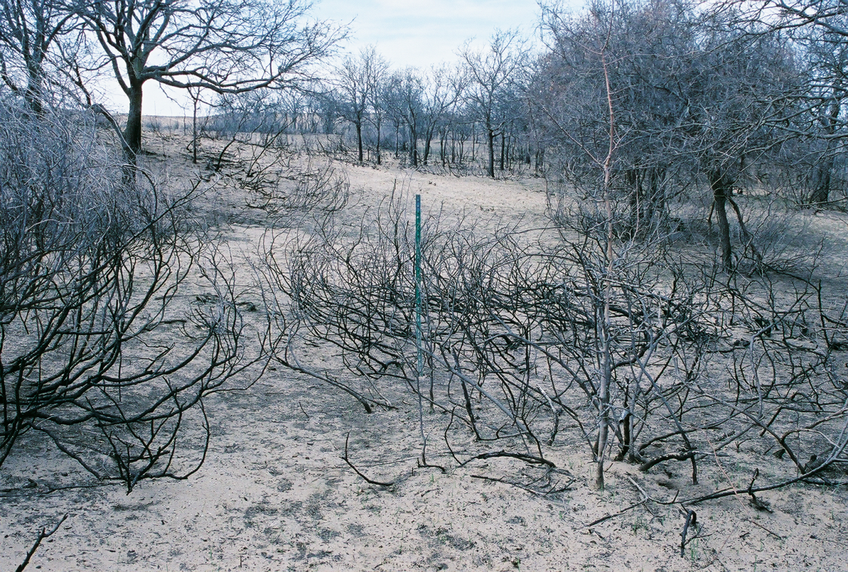
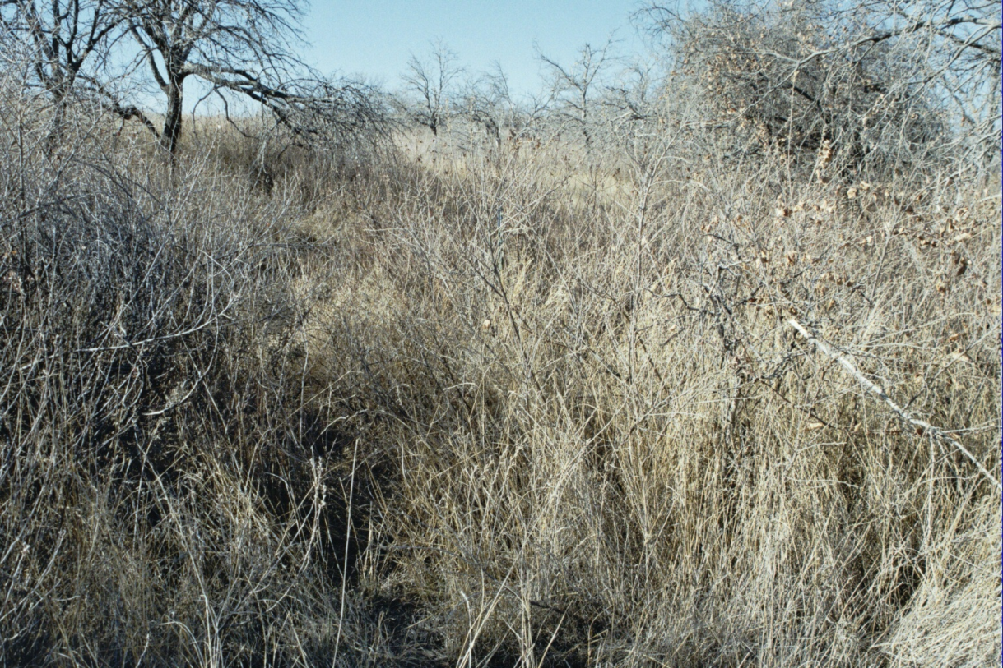
Recovery
Gray County Mar 06
Gray County Nov 07

Slide 17
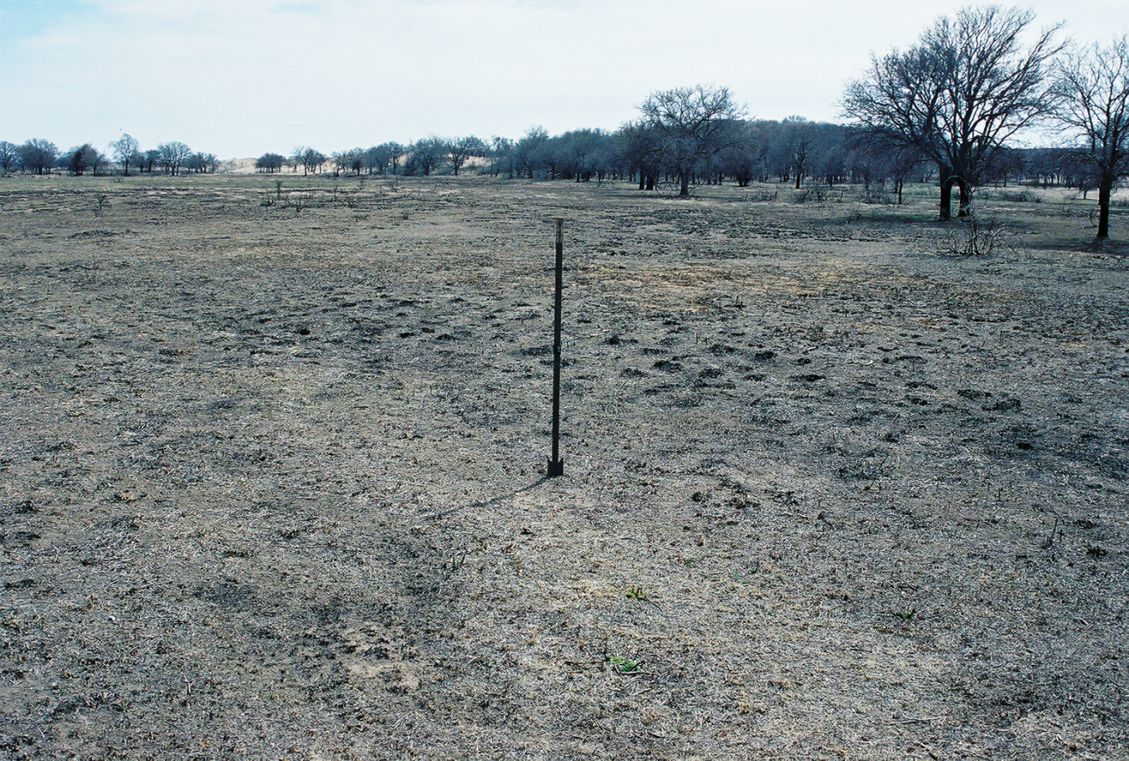
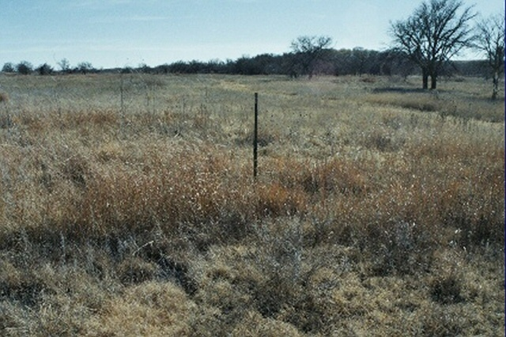
Recovery
Gray County Mar 06
Gray County Nov 07

Slide 18
\
Annual precipitation totals (cm) and long-term mean for Amarillo, Texas. Data from National Oceanic and Atmospheric Administration

Slide 19
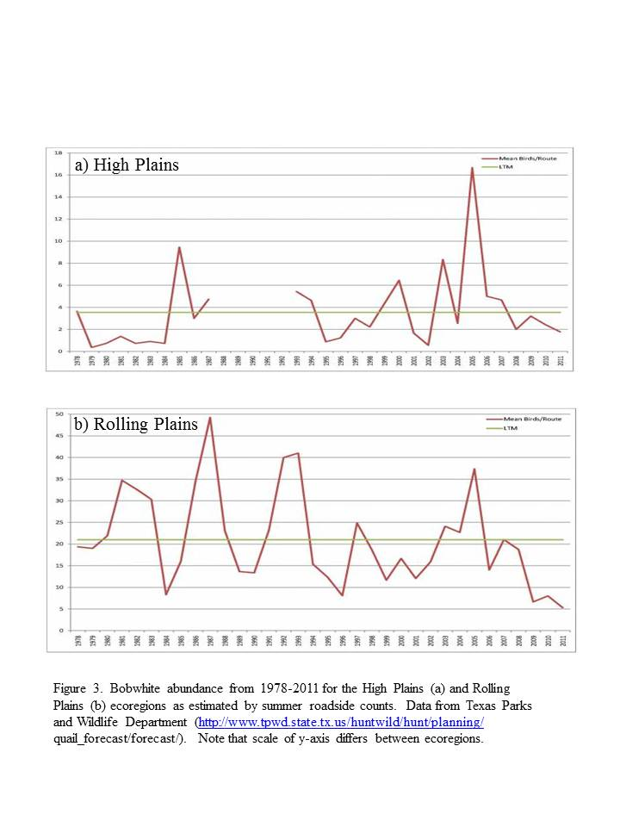
Bobwhite abundance from 1978-2011 for the High Plains (a) and Rolling Plains (b) ecoregions as estimated by summer roadside counts. Data from Texas Parks and Wildlife Department

Slide 20
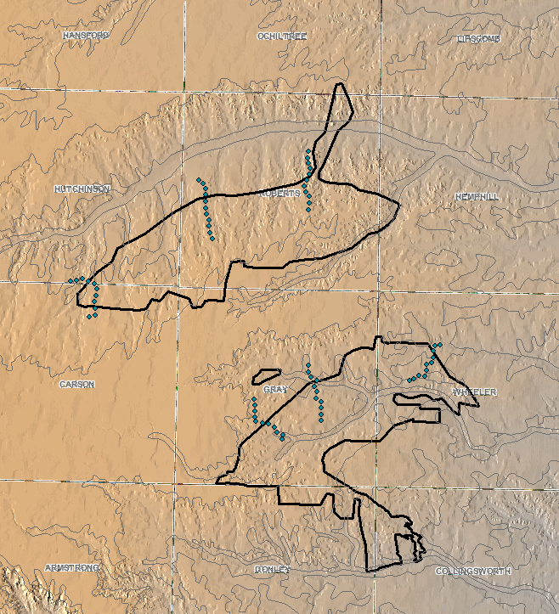
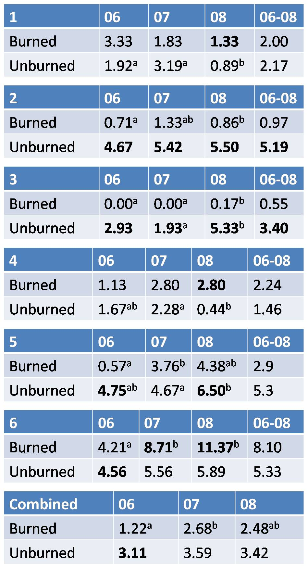
Bobwhite average densities by transect.
3
2
1
6
5
4
Significant difference (p ≤ 0.05) indicated by differing superscript (years) or bold (treatment, within year(s)).

Slide 21
Results
3
2
1
6
5
4
Combined
  Burned < Unburned 2006
  Burned 06 < Burned 07
  North Block
    B < UB 2006
    B < UB 06/07, 06/08
  South Block
    B < UB 2006, 2007, 2008
Notes:
Abundance appeared to be affected more by: soil particle size; vegetative composition and its response to fire; inherent pre-burn habitability for quail; topography; and rainfall than whether burned or unburned. Sandier sites responded more quickly and likely supported higher densities pre-burn than sites with tighter soils.
Calling male density difference (p ≤ 0.05)
Transect data combined
By year: 2006- Burned < Unburned
Between years: 2006/2007- Burned < Unburned
North Block
By year: 2006- Burned < Unburned
Between years: 2006/2007 and 2006/2008- Burned < Unburned
South Block- Burned < Unburned 2006, 2007, 2008
4 of 6 lines in 2006- Burned < Unburned
2 of 6 lines, all three years combined, Burned < Unburned
Only 3 lines showed higher densities on burned areas
2 in 2008 only
1 (sandy site) in 2007 and 2008
2 lines showed higher densities on unburned areas all three years

Slide 22
Results
3
2
1
6
5
4
2 of 6 lines, all 3 years combined, B < UB
4 of 6 lines 2006 B < UB
Only 3 lines showed higher densities on burned areas
  2 in 2008 only
  1 (sandy site) in 2007 and 2008
2 lines showed higher densities on unburned areas all three years
Notes:
Abundance appeared to be affected more by: soil particle size; vegetative composition and its response to fire; inherent pre-burn habitability for quail; topography; and rainfall than whether burned or unburned. Sandier sites responded more quickly and likely supported higher densities pre-burn than sites with tighter soils.
Calling male density difference (p ≤ 0.05)
Transect data combined
By year: 2006- Burned < Unburned
Between years: 2006/2007- Burned < Unburned
North Block
By year: 2006- Burned < Unburned
Between years: 2006/2007 and 2006/2008- Burned < Unburned
South Block- Burned < Unburned 2006, 2007, 2008
4 of 6 lines in 2006- Burned < Unburned
2 of 6 lines, all three years combined, Burned < Unburned
Only 3 lines showed higher densities on burned areas
2 in 2008 only
1 (sandy site) in 2007 and 2008
2 lines showed higher densities on unburned areas all three years

Slide 23
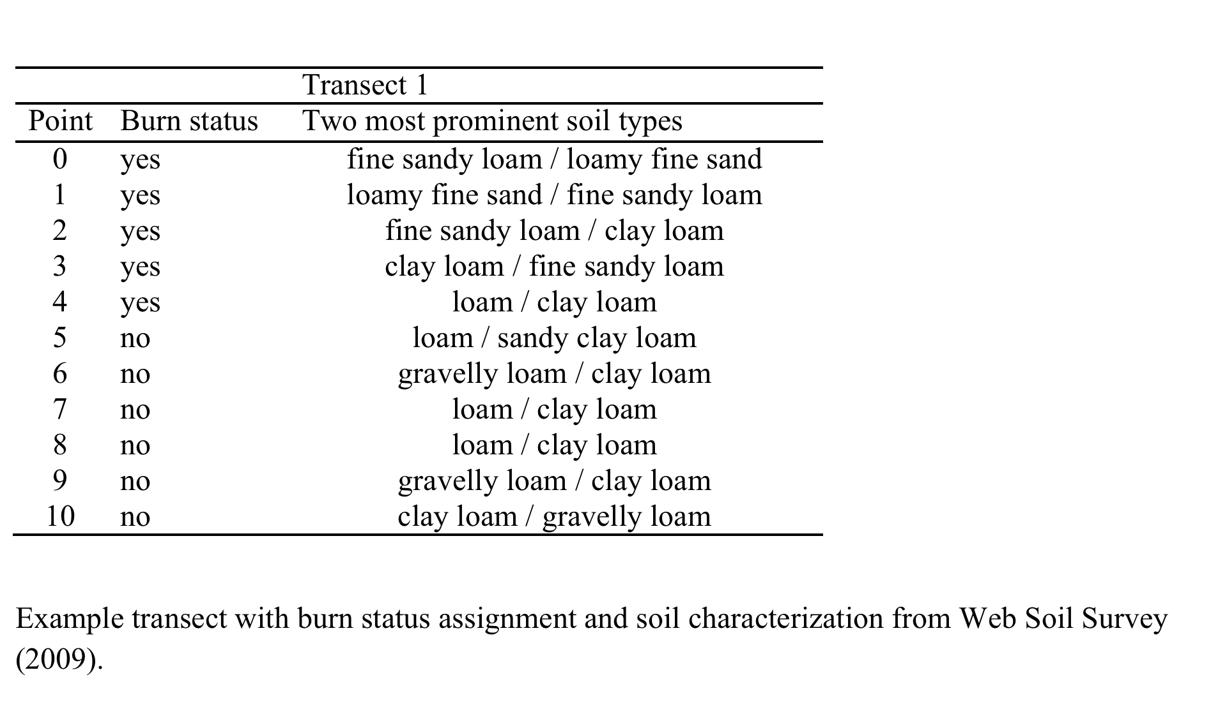

Slide 24
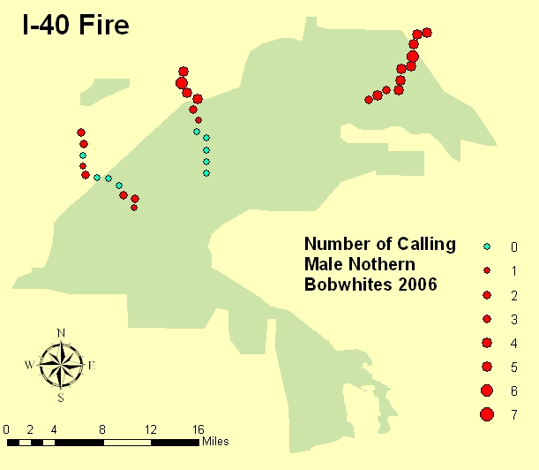
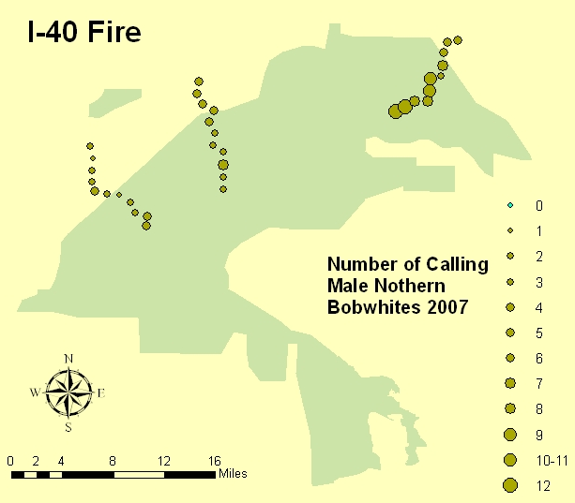
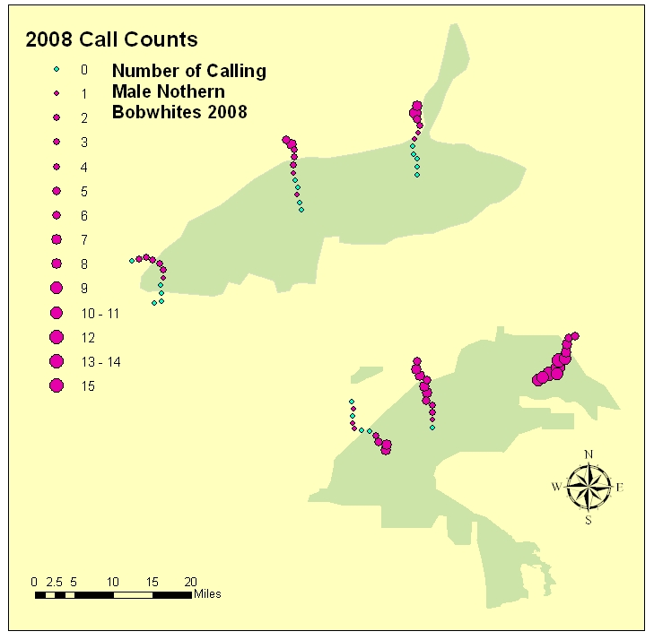
Results
Soil Particle Size
Fine Sand / Loamy Fine Sand
+
Soil Particle Size
Fine Sandy Loam (S)
Clay Loam (N)

Slide 25
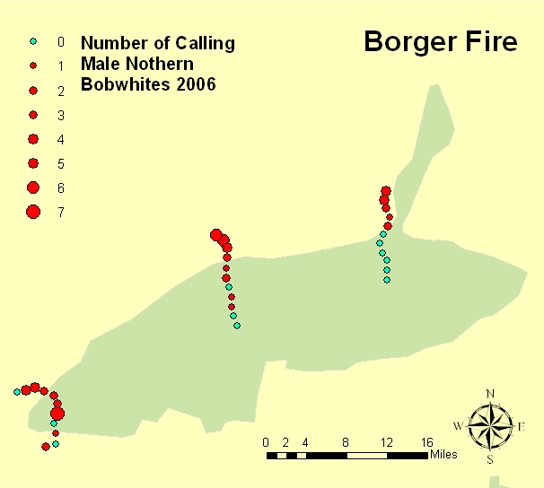
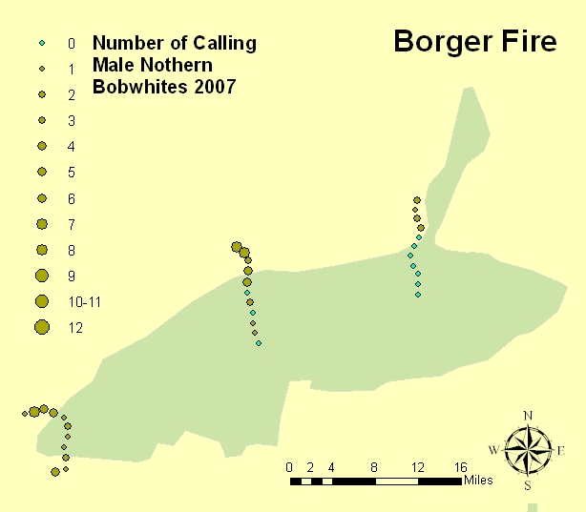
Results
+
+
Soil Particle Size
Clay Loam (S)
Fine Sandy Loam (N)

Slide 26
Soils
Clay Loam
Loam
Fine Sandy Loam
Gravelly Loam
Loamy Fine Sand
Fine Sandy Loam
Fine Sand

Slide 27
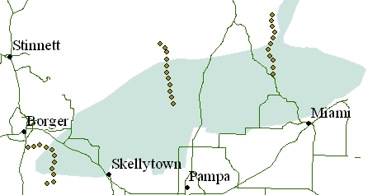
Results
burned
unburned

Slide 28
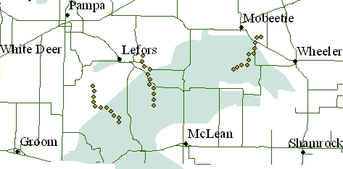
Results
burned
unburned

Slide 29
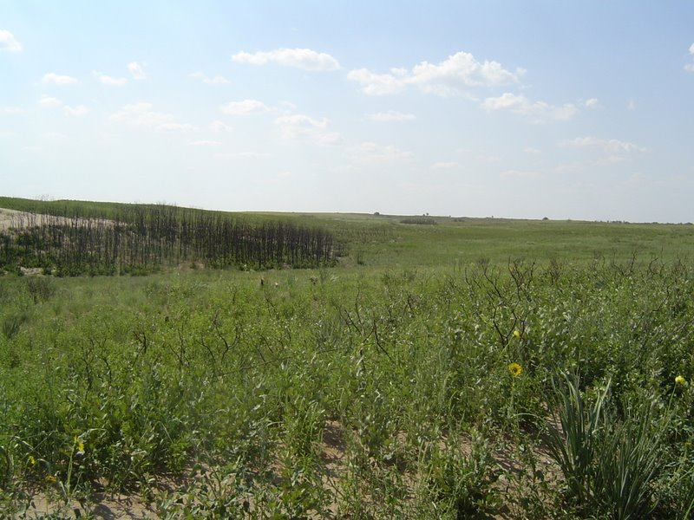
Shinoak resprouting post-fire

Slide 30
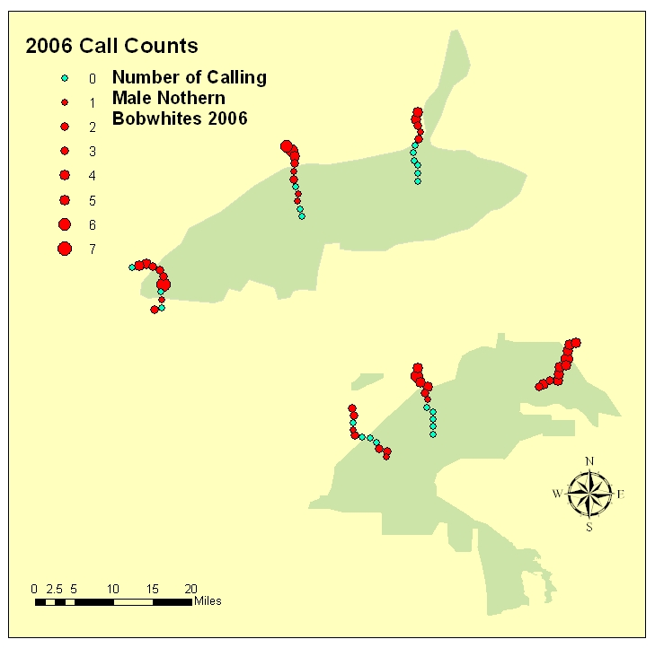
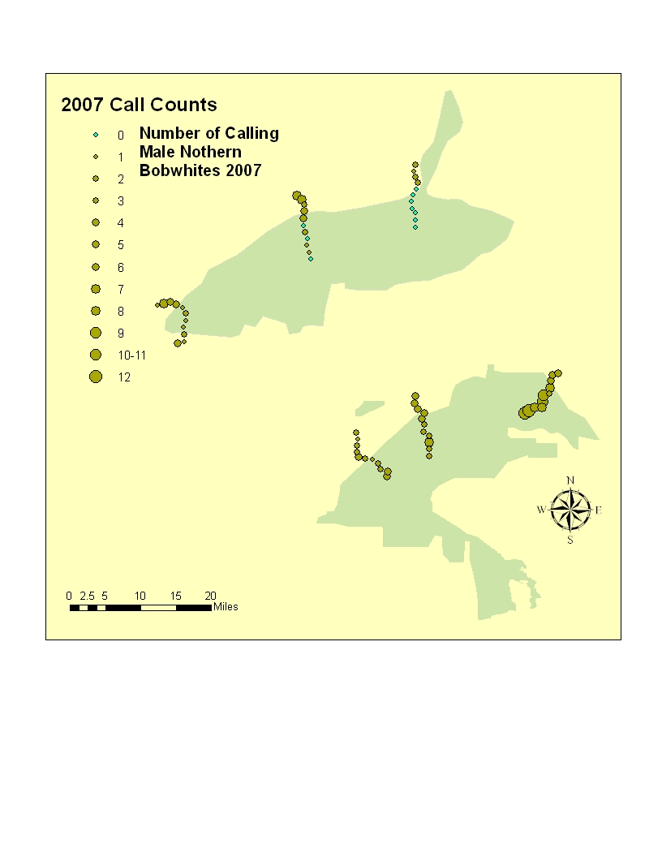

Slide 31

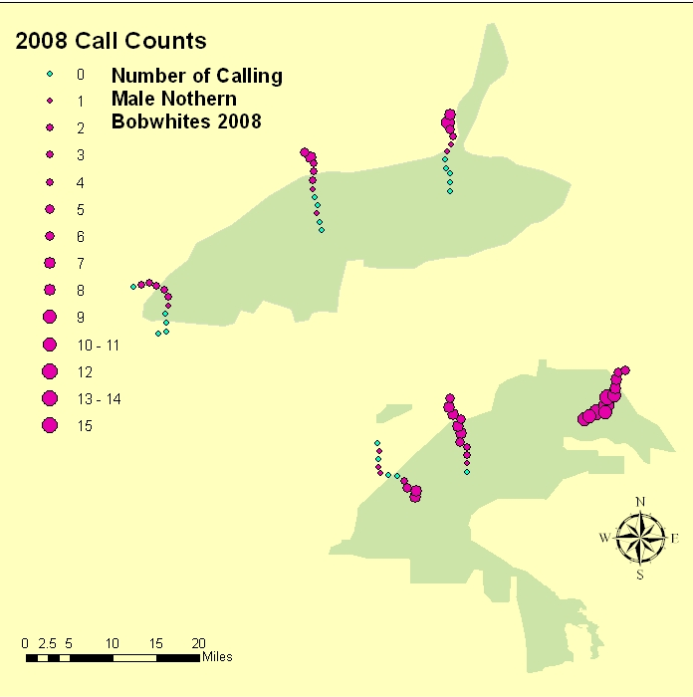

Slide 32
Results
unburned
burned
unburned

Slide 33
Results
burned
unburned

Slide 34
Results
burned
unburned

Slide 35
Results
burned
unburned

Slide 36
Summary
Abundance unknown pre-burn
Shortgrass Prairie inherently lower potential than midgrass/Rolling Plains
  Shortgrass sites probably less habitable
    Yucca, buffalograss, blue grama
    Woody structure lacking
  Woody component on midgrass sites more resilient
    E.g. shinnery
Call counts varied according to soil type, i.e. sandier soils responded more quickly
  Likely higher pre-burn numbers than harder sites
Notes:
Discussion
Pre-burn local bobwhite population densities were not known
Shortgrass prairie (High Plains) portion of transects without a significant woody component probably had lower bobwhite populations pre-burn, and recovered more slowly than midgrass/shrub (Rolling Plains) transects possessing a strong woody component.
Rough topography appeared to mitigate the immediate impact of the burn at some sites, thereby speeding recovery by providing refugia (unburned patches) within the burn.
Shortgrass prairie—much of the area burned—is inherently less habitable than midgrass/shrub community
Dominated by Yucca (Yucca sp.) , buffalograss (Buchloe dactyloides), blue grama (Bouteloua gracilis)
Relative shortage of adequate escape and nesting cover
Woody component, primarily on midgrass sites, was largely resilient to fire, i.e. reprouted rapidly and profusely
E.g. shin oak (Quercus havardii) on sandier soils responded more quickly
Likely higher pre-burn quail numbers than clay loam sites
Substantial rainfall occurred on the eastern-most transects within several weeks of the wildfire, and likely contributed to the rapid recovery of vegetation, and subsequently, bobwhite densities
The fire boundary often followed natural breaks in terrain and in essence burned lower quality quail habitat, at least partially explaining some of the post-burn higher densities outside of the burn. The result was less benefit from the burn than expected.

Slide 37
Summary cont’d
Rough, broken topography (with more shrubs) likely mitigated impact of the fire on some sites by providing unburned refugia
Substantial early rainfall on eastern, more sandy side contributed to early recovery

Slide 38
Management Implications
Wildfire ≠ Prescribed Fire
Slow recovery of quail populations possibly the result of
  Amount and timing of rainfall post-burn
  Soil type and accompanying plant response
  Size of the burned areas may have overwhelmed ability to recolonize in 3 years, especially where devoid of woody cover
Grazing deferment through at least one full growing season would encourage earlier recovery
Notes:
Management Implications
Rangeland wildfire cannot be accurately equated to prescribed burning
Prescribed burning is implemented under conditions that are favorable to management objectives such as
Invasive species control
Forage production enhancement
Browse and/or forb quality improvement
Time of day, soil moisture, season, air temperature, and wind speed are among the parameters considered in planning a successful prescribed burn
Apparent overall slow recovery of quail populations in the wildfire-affected areas can likely be attributed at least partly to
Amount and timing of rainfall post-burn
Soil type and accompanying plant communities that are not particularly habitable for quail
Extended grazing deferment through at least one full growing season (assuming adequate rainfall) would encourage earlier recovery

Slide 39
Next
Continue monitoring?
  Has full impact on quail populations been realized?
Precipitation effect
  Palmer Modified Drought Index
  Local precipitation
    Monthly
    Annual vs. 30-year mean
Compare with TPWD roadside counts
  Shortgrass sites
  Midgrass sites

Slide 40




Acknowledgments
Panhandle Chapter Quail Unlimited
Texas AgriLife Extension Service
  Ricardo Hernandez
  Corbin Neill
  Quail Decline Initiative
WTAMU
  Ray Matlack
NRCS local offices

Slide 41
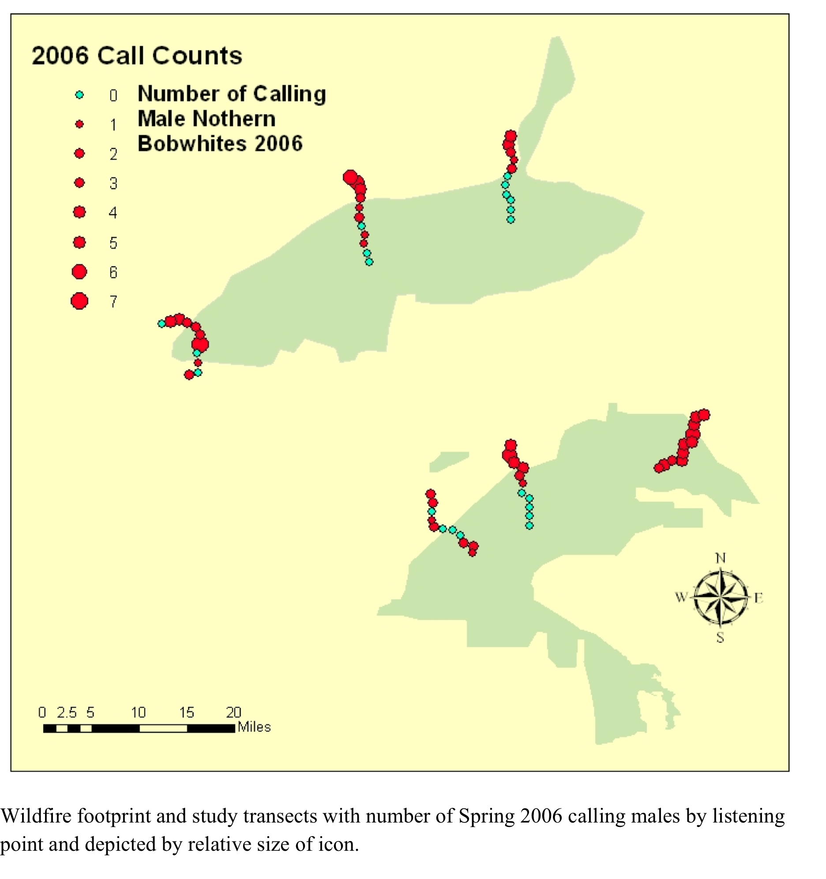

Slide 42
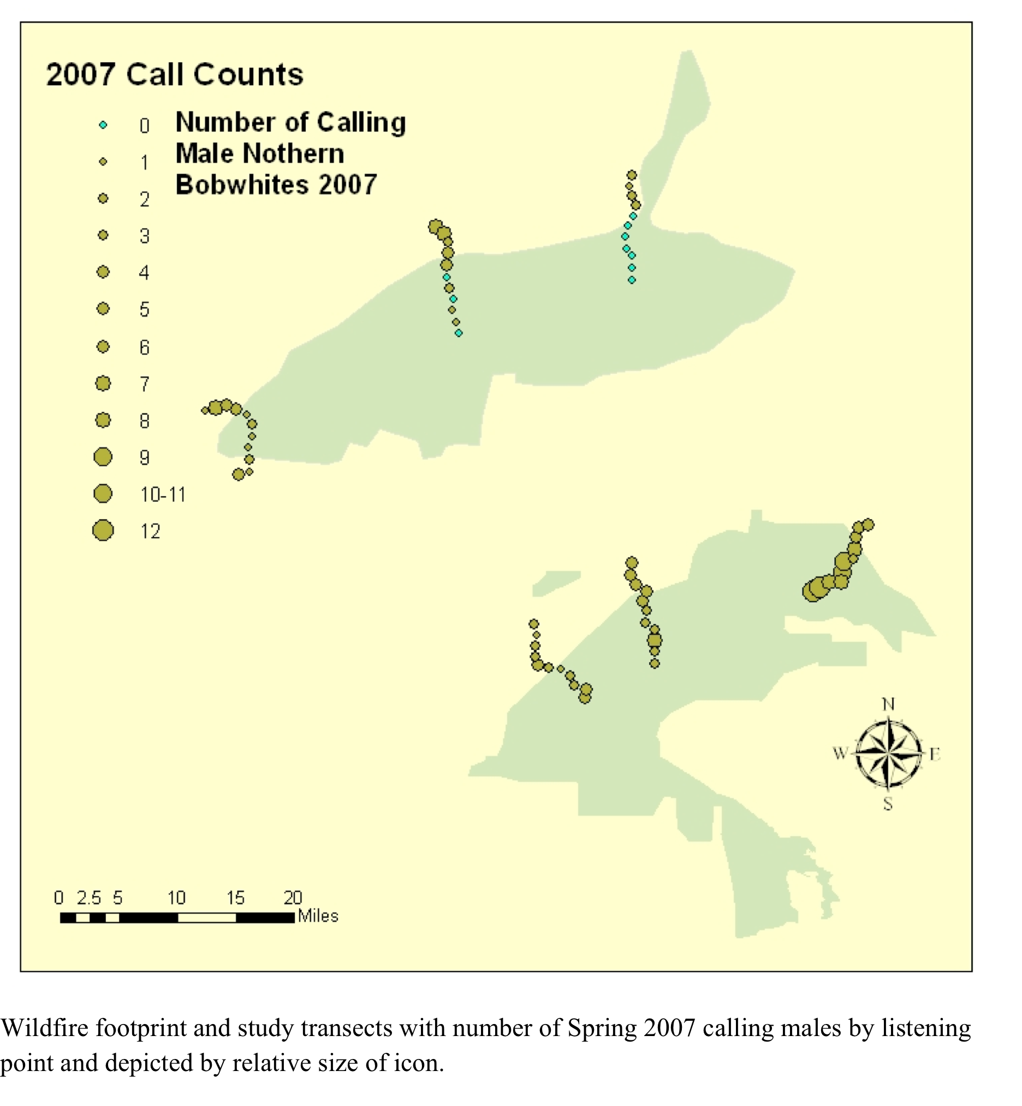

Slide 43
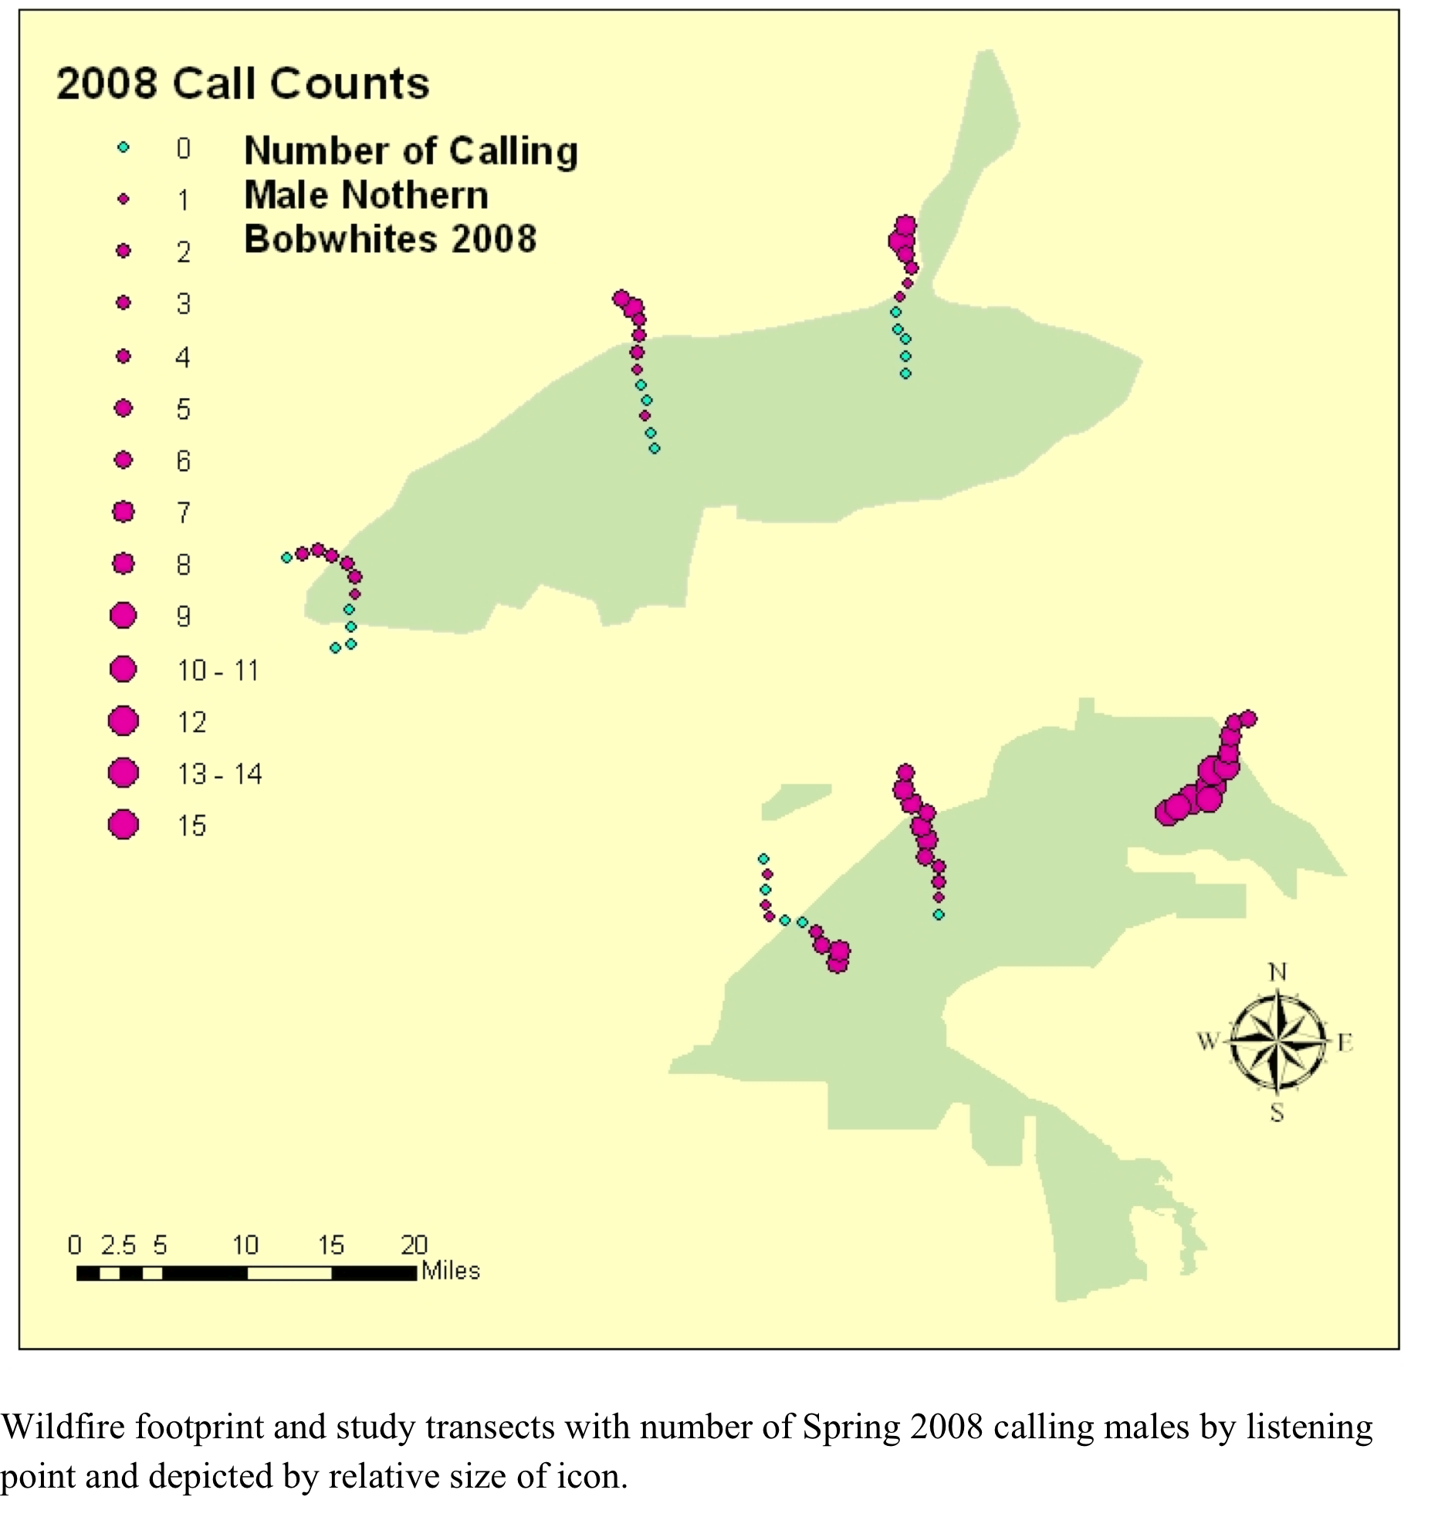

Slide 44
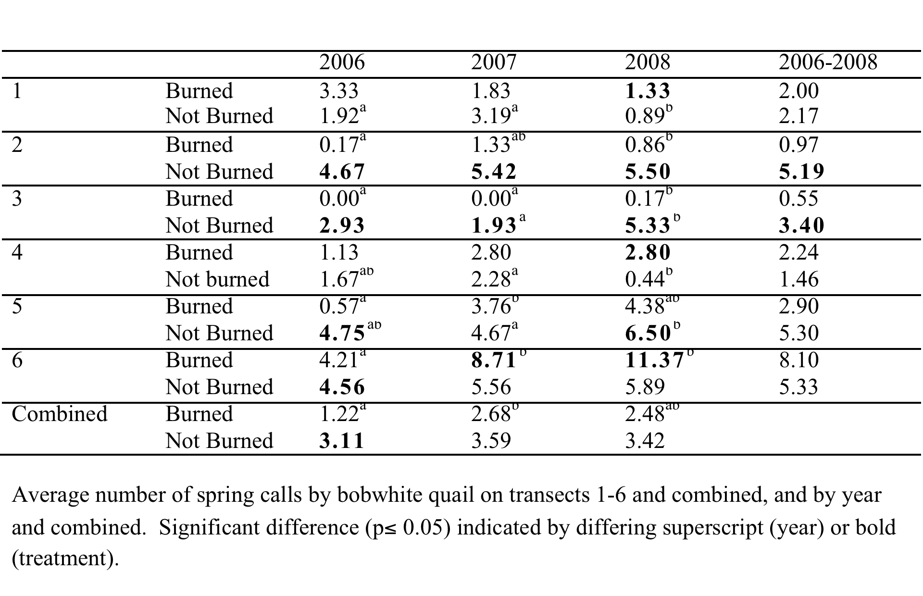

Slide 45
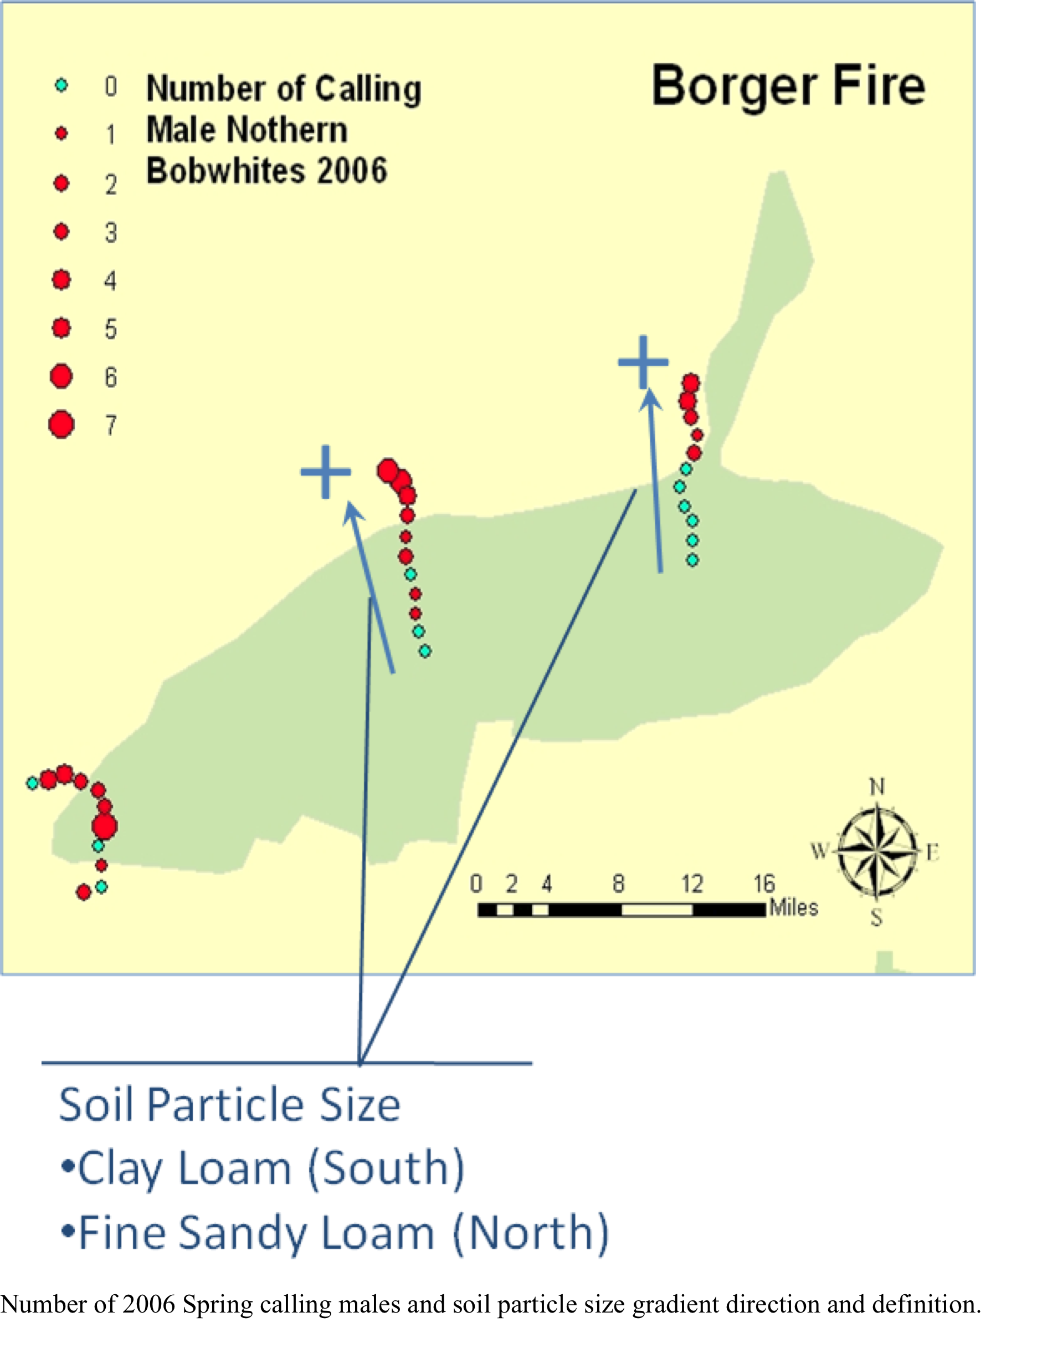

Slide 46
