Slide 1


OCCUPANCY MODELING FOR BOBWHITES IN
OKLAHOMA
Andrew D. Crosby
and
R. Dwayne Elmore

Slide 2
PAO and Index of Abundance
Index
  No defined relationship between abundance and call count index
Proportion of Area Occupied
  Done using presence/absence surveys
  May act as a surrogate for abundance

Slide 3
Standard Presence/Absence
Normally analyzed with logistic regression
Does not account for detection probability
Low detection probabilities can lead to extremely low-biased PAO estimates
Notes:
The probability of a site being occupied based on habitat variables was estimated using logistic regression. Occupancy estimates can be derived from BBS data and state surveys, but there is an issue. Traditionally, PAO was estimated using raw data (60/100=.6). Doesn’t take detection probability into account. Low p can lead to low-biased PAO estimates. No way to estimate how many false-negatives occurred. Until about 10 years ago.

Slide 4
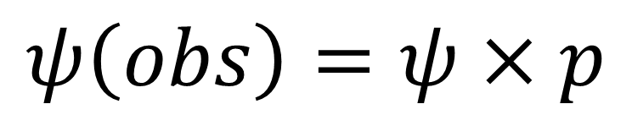
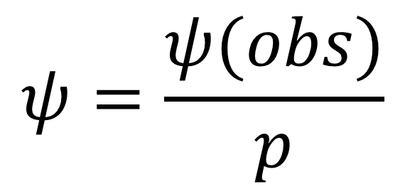
Occupancy Modeling:
Accounting for Detection Probability
$$ψ\left(obs\right)=ψ×p$$
$$ψ=\frac{ψ(obs)}{p}$$
Notes:
The problem defined in a simple equation. P is almost always <1. If p=0.6, than psi(obs) will underestimate psi by 40%. We can estimate psi by dividing psi(obs) by p. The question is, how do we estimate p? McKenzie et al. 2001 used closed capture-recapture methods and multiple surveys to estimate p, what is now commonly referred to as Occupancy Modeling.

Slide 5
Questions
How does PAO estimate change based on:
  Number of surveys per year?
  Abundance of bobwhites in region?
  Accounting for detection probability?
How does time during the breeding season effect detection probability?
Notes:
It is possible to derive occupancy estimates from historical data sets such as BBS or state surveys.
BBS and most state surveys only conducted 1/year.
Does this give an accurate estimate of PAO?
Here we did not compare occupancy to indices.

Slide 6
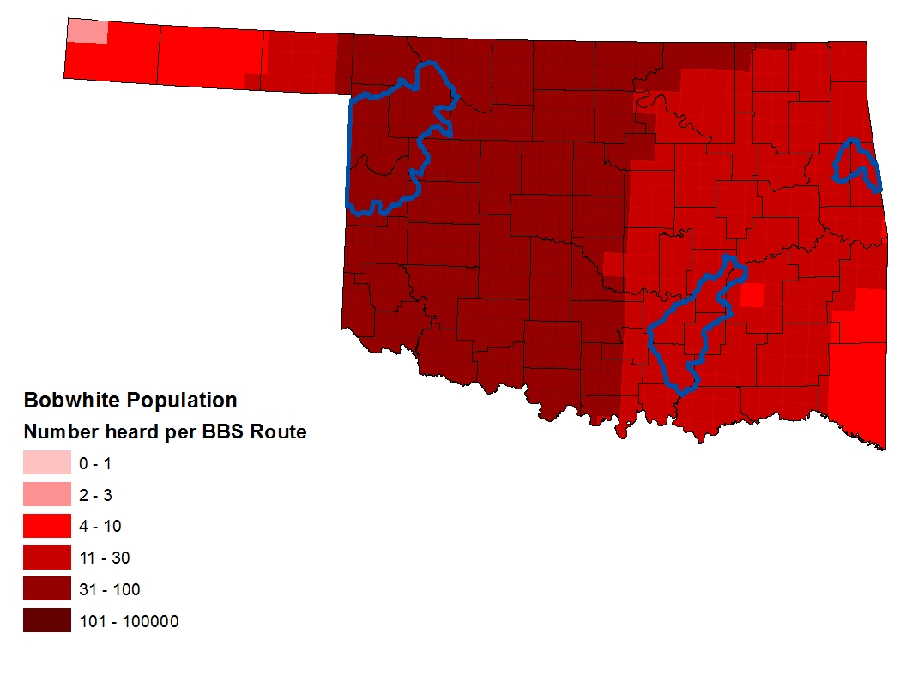
Population
From BBS Routes 1966-2003
Notes:
Analysis part of a larger study of habitat restoration. Done on private properties in regions selected for restoration. For this analysis, we did not look at habitat variables or restoration activities. We had 2 study areas (common, uncommon) and were only interested in how occupancy estimates differed between the areas at given survey intensities.

Slide 7
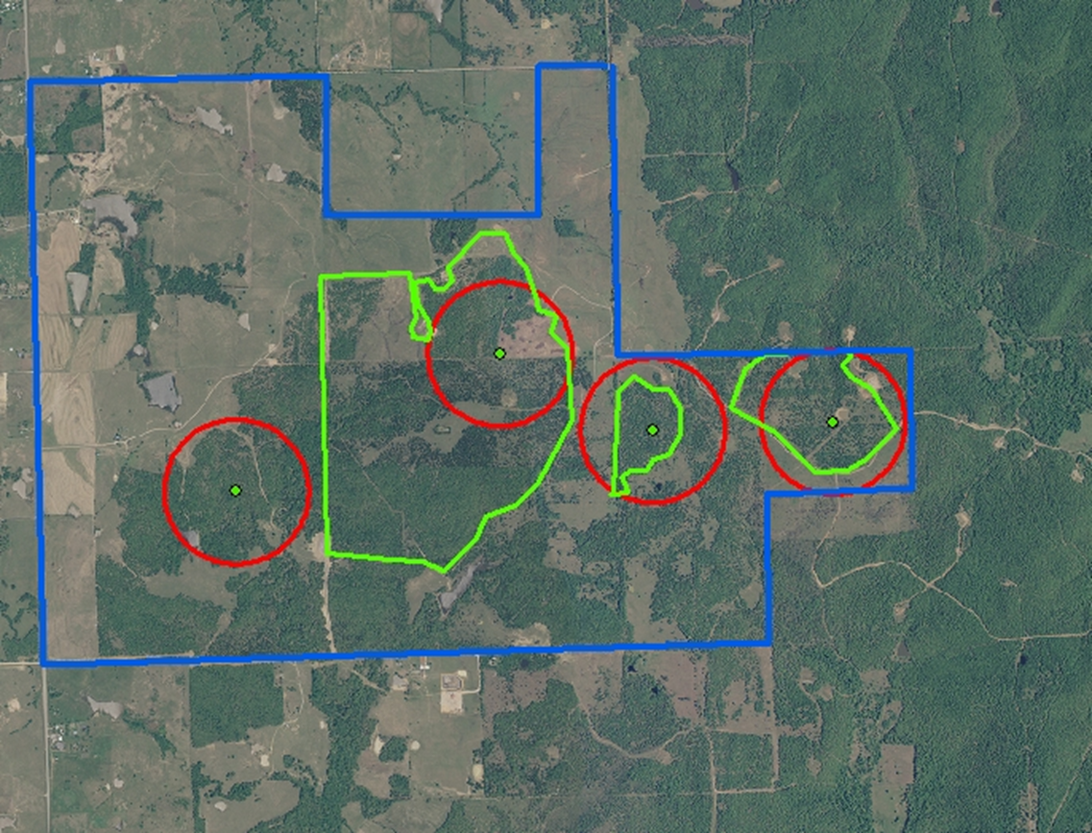
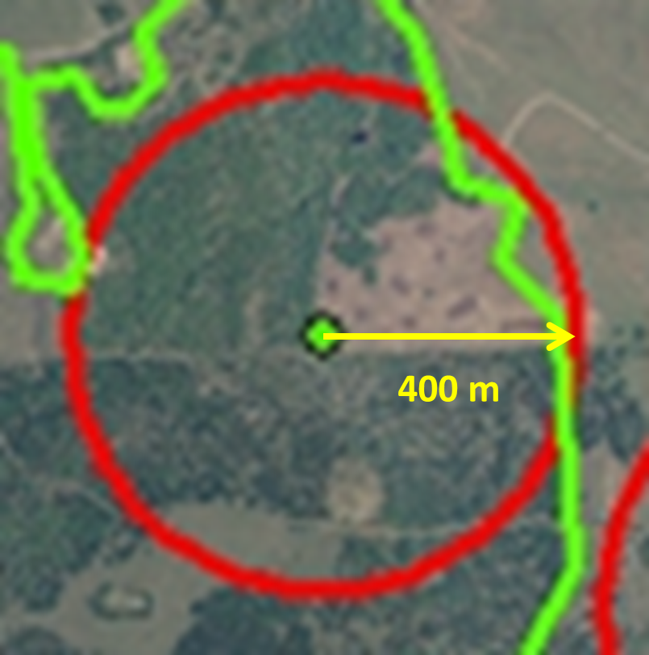
Sample Unit Placement
3 Surveys per Year (2009-2011)
Mid-May – Late July

Slide 8
Analysis
Analyzed Presence/Absence using 1, 2, and 3 surveys/year
Calculated detection probability and occupancy using 2 and 3 surveys/year
Regression of detection probability on Julian day
Notes:
McNemar’s chi-square test for paired samples
Compared p(.) using a chi-square test on proportions
AIC on Julian day model
Treated year as a random variable and combined all years

Slide 9
Results
Uncommon
Common
Sites = 31
Site × year = 91
Detections = 21
Sites = 27
Site × year = 80
Detections = 75
Notes:
Common is eastern area and uncommon is western

Slide 10
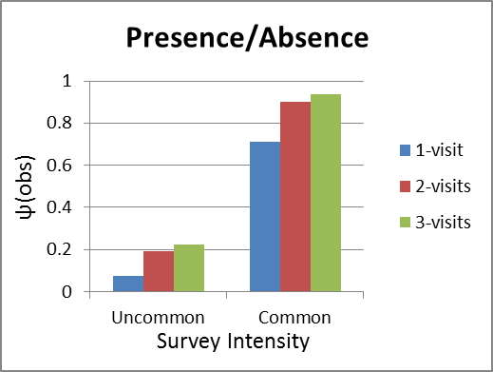
Presence/Absence
(not accounting for detection probability)
↑32%
↑201%

Slide 11
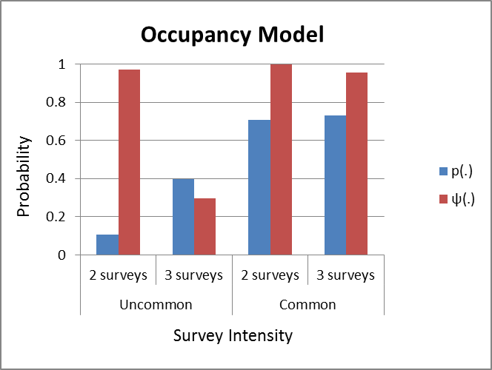
Occupancy Model
(accounting for detection probability)
↑1.9%
↑31%
Notes:
Detection probability significantly different between areas.
As p increases psi decreases, leading to a (theoretically) more accurate estimate
Note p < 0.15 in the uncommon area for 2 surveys, leading to the unreasonably high occupancy estimate

Slide 12
Compared Occupancy Estimates
Notes:
Between 1 and 3, psi(obs) increased 201% (Uncommon) and 32% (Common) – very significant
2 and 3 was 16% and 4% (uncommon, common) – not significant
Note again the unreasonably high psi(2-visits) for uncommon

Slide 13
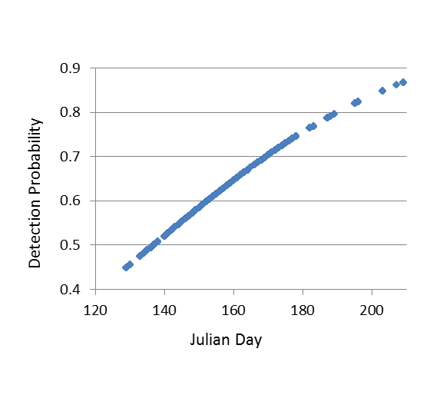
Effect of time during breeding season
Notes:
180 is ~ June 30

Slide 14
Discussion
Single surveys can give very inaccurate estimates of the state of the population
Accounting for detection probability can be critical
≥ 3 surveys/year needed if bobwhites are uncommon
Notes:
Single surveys can seriously underestimate PAO, especially when bobwhites are uncommon
If p < 0.15, we get wildly inaccurate estimates of occupancy

Slide 15
Management Implications
Maximizing p should be done through survey design
p varies based on N
p may be a good predictor of relative abundance
Notes:
We’ve seen that estimates of both psi and p increase dramatically in areas where bobwhites are more abundant.
Should be cautious in interpreting this in terms of abundance. P may be a good predictor of relative abundance.
Accounting for p is critical in areas where bobwhites are uncommon

Slide 16
Acknowledgements
Dr. Dwayne Elmore
Dr. David M. Leslie
Dr. Rodney Will
Oklahoma Department of Wildlife Conservation
The Nature Conservancy
Oklahoma Ornithological Society
Payne County Audubon Society

