Slide 1
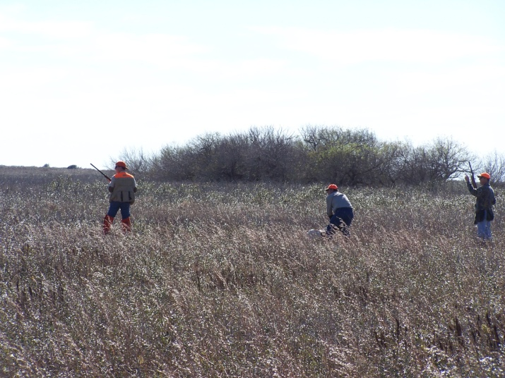
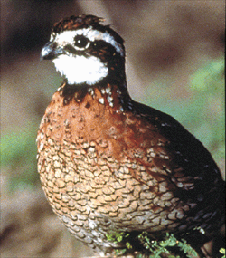
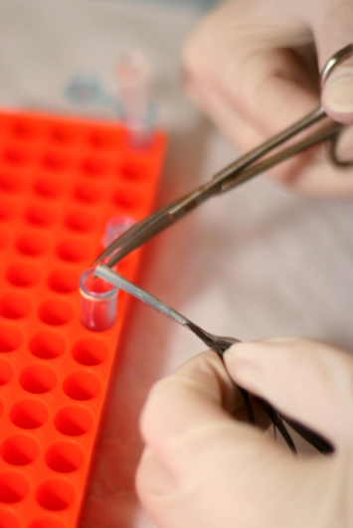
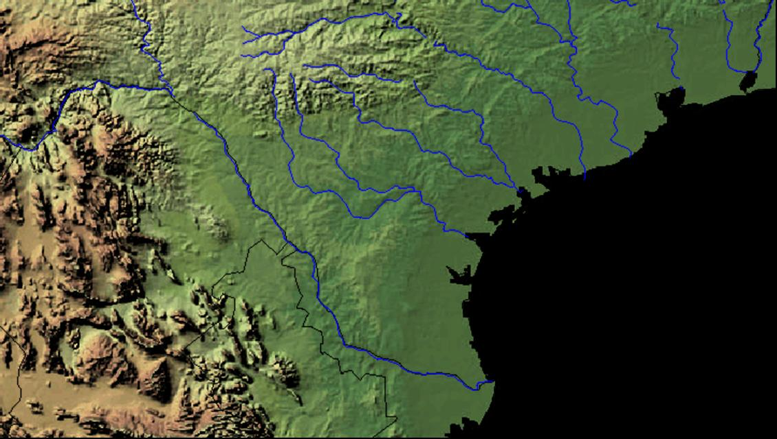
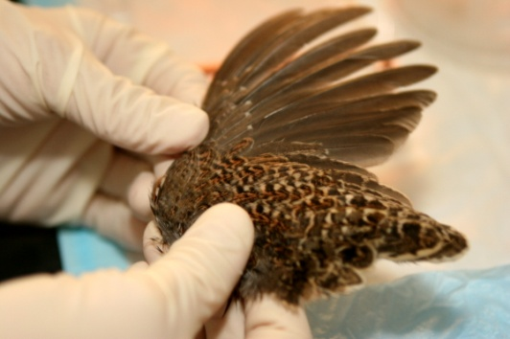
Genetic Structure and Diversity in South Texas Bobwhites: Implications for Conservation
Randy W. DeYoung, Erin M. Wehland, Damon L. Williford, Angeline Zamorano, Joseph P. Sands, Leonard A. Brennan, Fidel Hernández, Stephen J. DeMaso, and Robert M. Perez

Slide 2
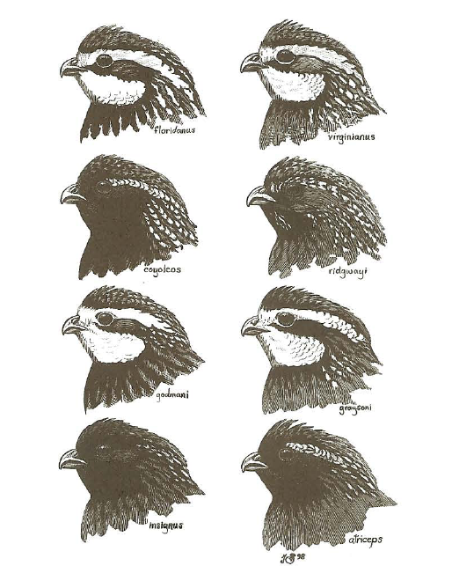
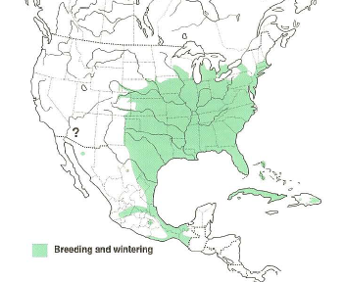
Meet the Northern Bobwhite…
Twenty-two subspecies
Ground-dwelling upland bird
About 200 g
Short-lived (1 yr)
High reproductive rate
Relatively sedentary

Slide 3
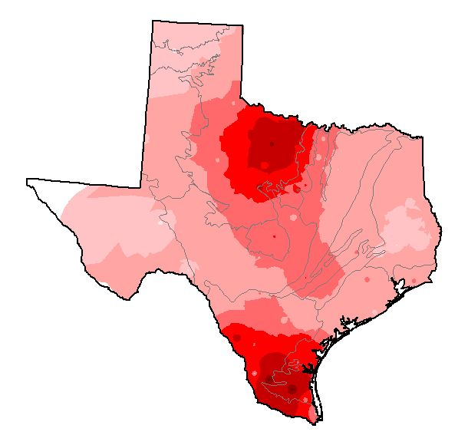
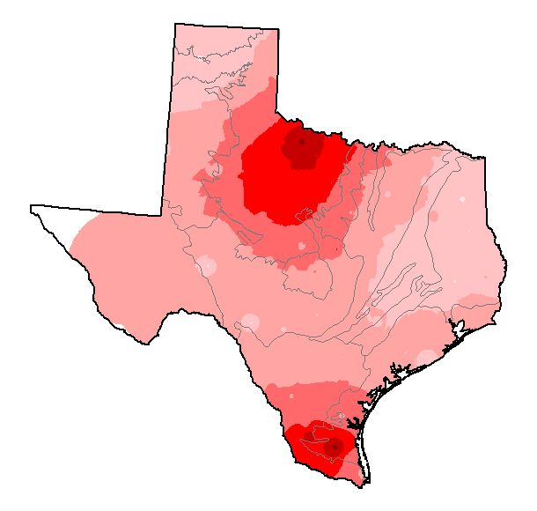
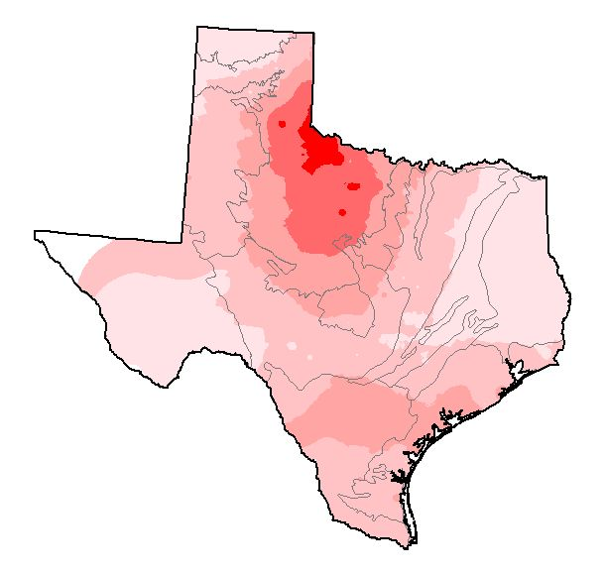
Bobwhite population trends
Range-wide decline
Changes in land-use
Huntable populations in Texas, Georgia-Florida
1978
1987
1997
Changes in quail density (Peterson et al. 2006)

Slide 4
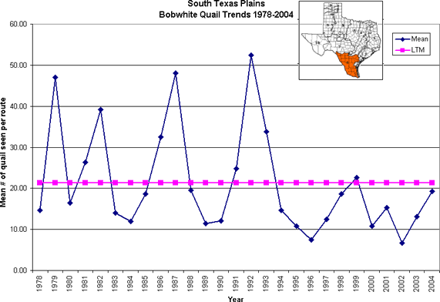
Bobwhite population trends
“Boom and bust” population dynamics
Winter densities varied 6-fold during 10-yr period (Lehmann 1984)
1.4 to 8.2 ha × quail⁻¹

Slide 5
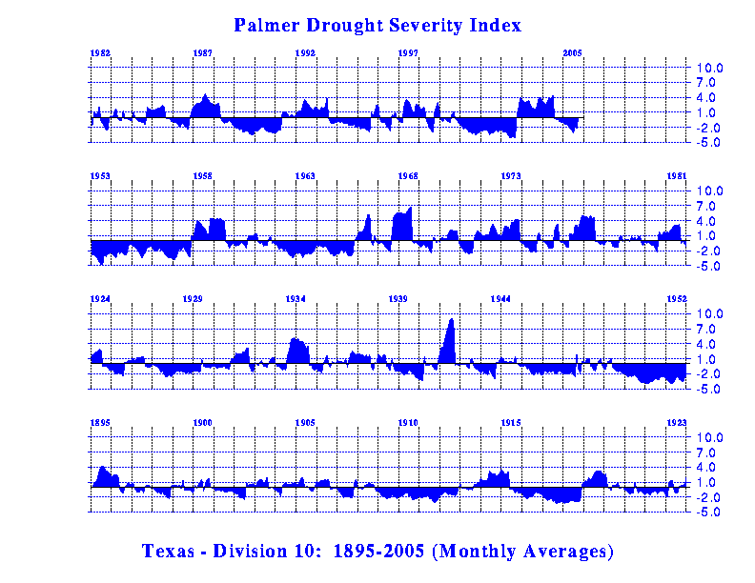
Precipitation drives populations

Slide 6
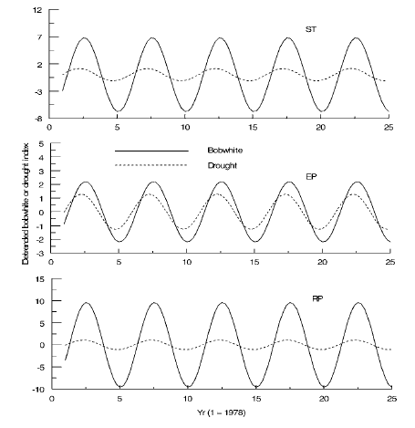
Bobwhite population trends
Cyclic behavior
Region-wide
South Texas
Edwards Plateau
Rolling Plains
Five-year periods
Lusk et al. 2007

Slide 7
Bobwhite population dynamics
Sustaining populations found only in extensive areas of contiguous habitat
When habitat patches are altered or fragmented to some (presently unknown) threshold level, populations collapse

Slide 8
South Texas quail populations…
Effects of land-use, dynamics at regional scale
Management at local scale
How do local—regional dynamics function?
Local
Local
Regional
Local
Local
Local
Local

Slide 9
Population dynamics and structure
Low dispersal, high turnover
Genetic structure high
Genetic diversity low or variable
Dispersal among populations
(+)
(-)
(+)
Turnover
Differentiation of populations
(+)
Long term
(-)
Total (metapopulation) genetic variation
Modified from Harrison & Hastings (1996)

Slide 10
Population dynamics and structure
Estimate diversity and population structure
Large-scale investigation
Infer effects of population dynamics, connectivity
Harrison & Hastings 1996

Slide 11
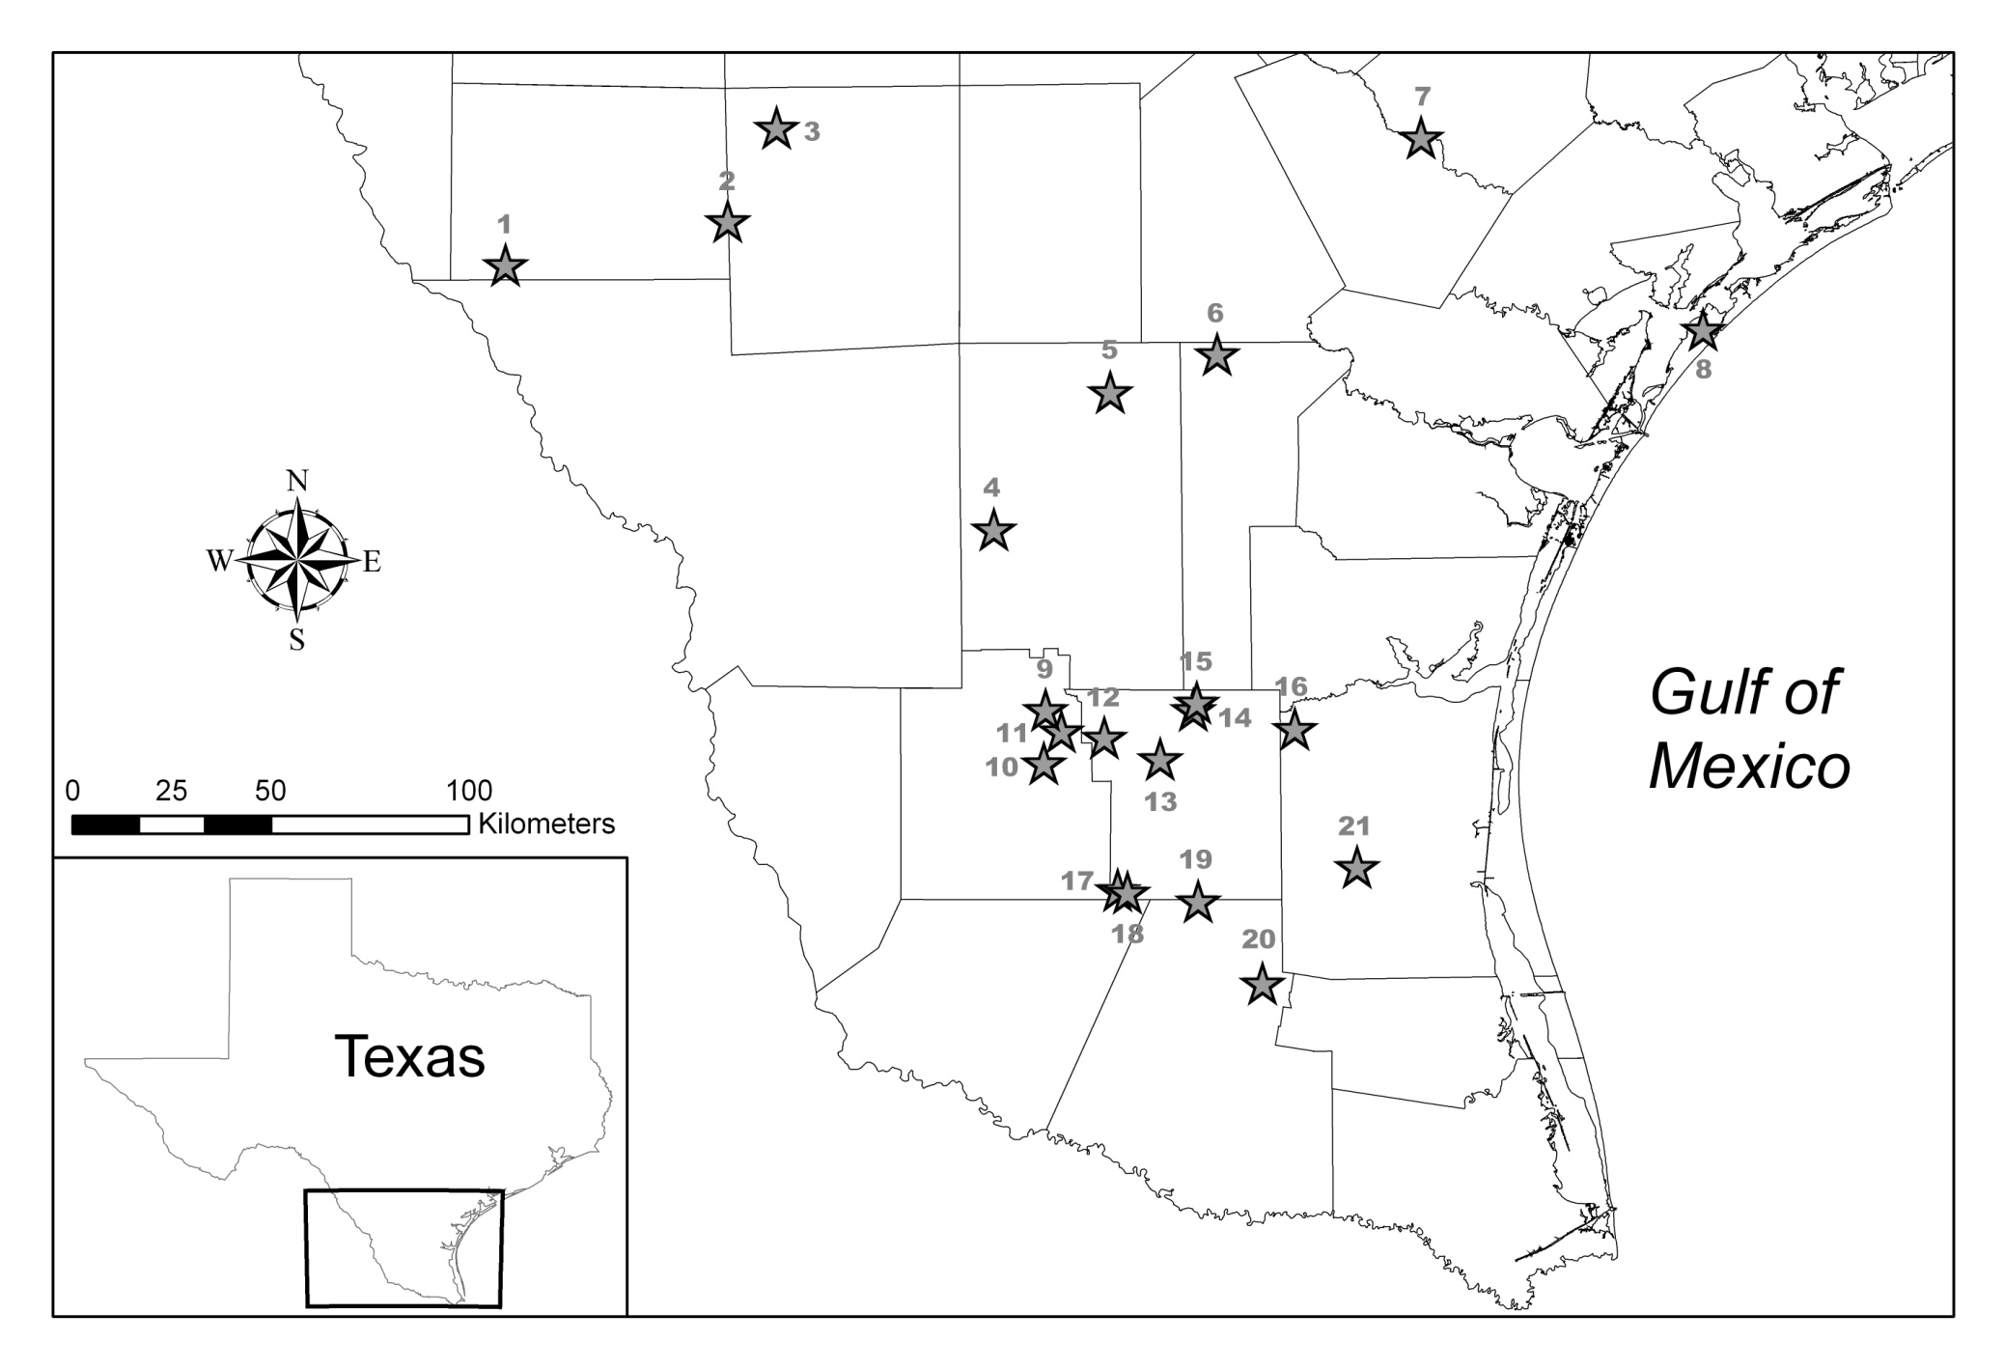
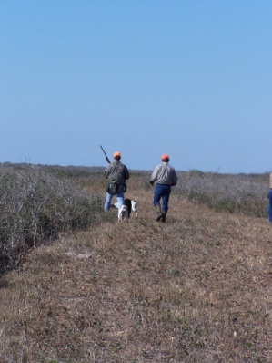
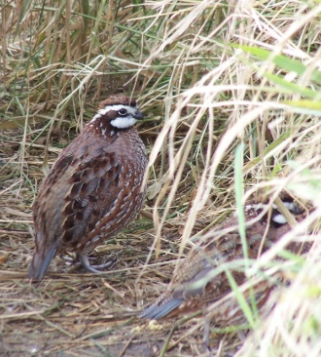
Populations used in genetic analyses

Slide 12
DNA extraction and amplification
Extracted DNA using a commercial kit
Sequenced 380bp portion of mtDNA control region
Amplified 7 microsatellite DNA loci using PCR

Slide 13
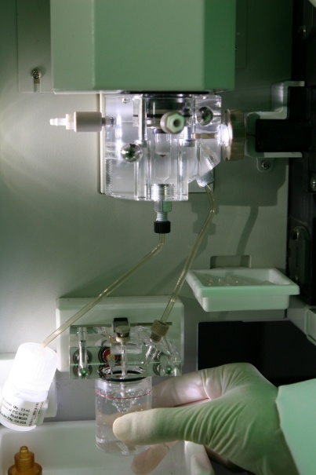
Data analysis
mtDNA data (380 bp)
Haplotype diversity
AMOVA
Minimum spanning network
Microsatellite data (7 loci)
Gene and allelic diversity
Pairwise F_{ST} , exact test of differentiation
AMOVA
Spatial autocorrelation

Slide 14
Haplotype diversity
Error bars are +/- 1 SE
Haplotype diversity
21 sites
N = 8 to 12 per site
Site

Slide 15
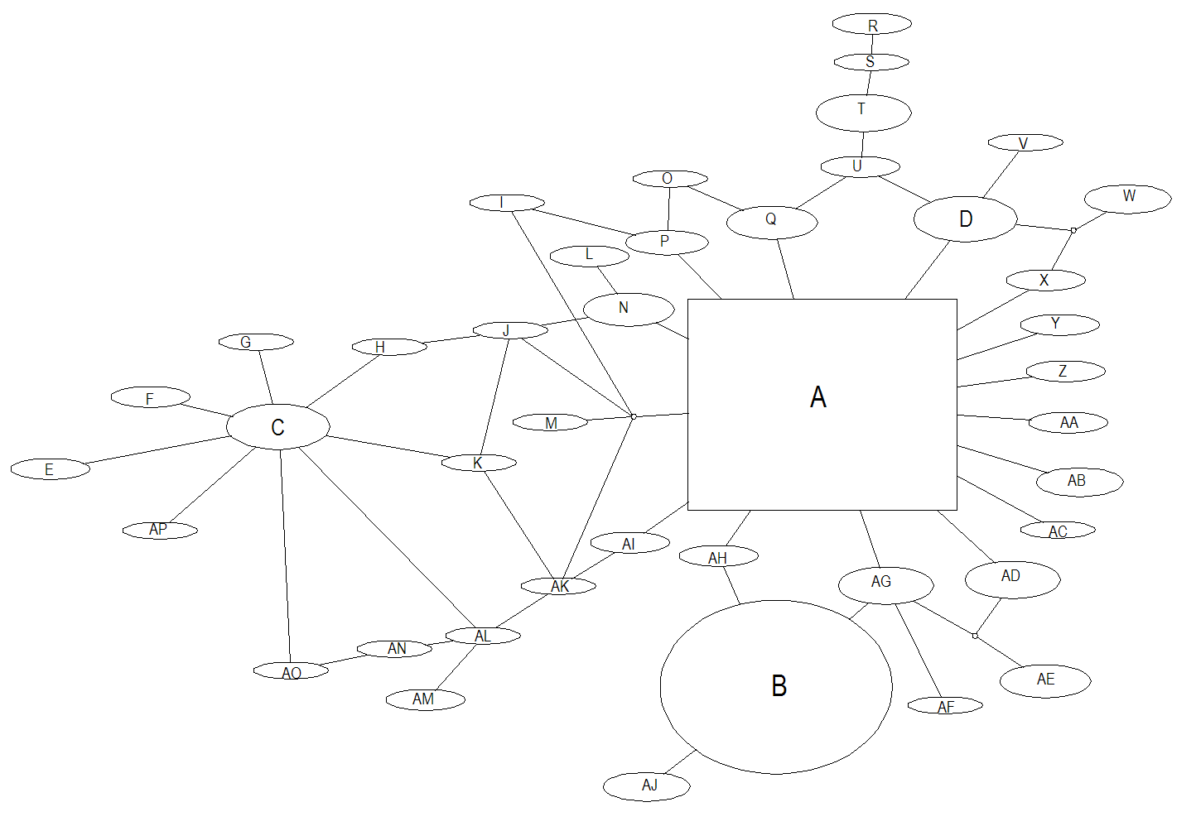
Minimum spanning network:
Relationships among haplotypes

Slide 16
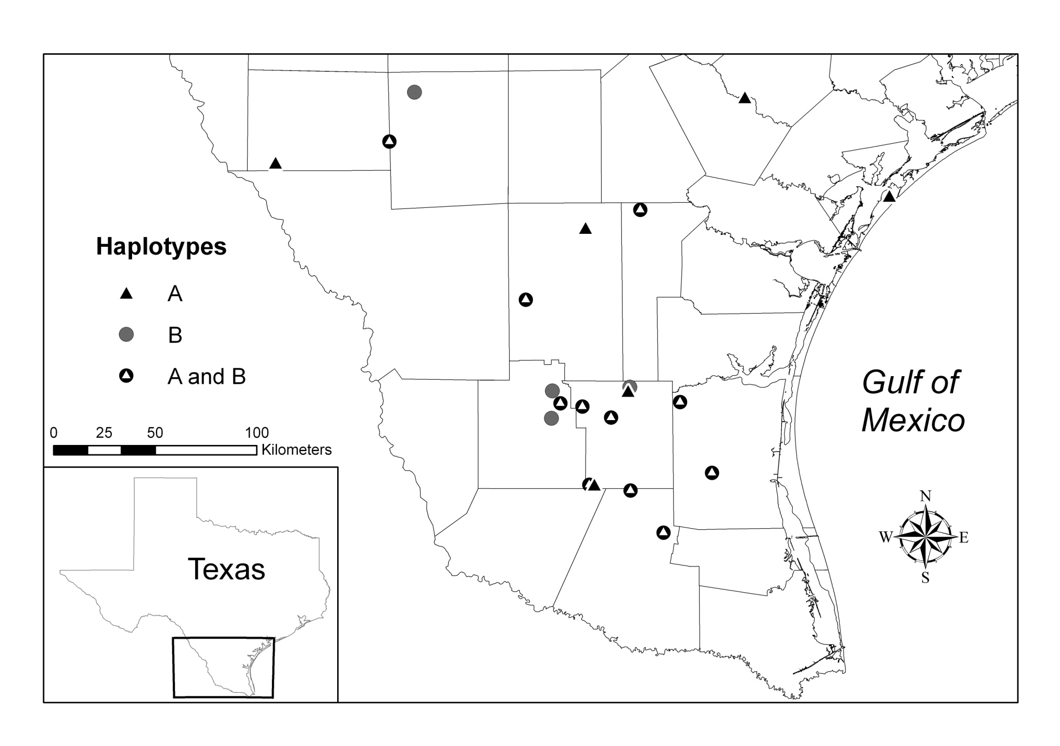
The 2 most common haplotypes were widely distributed…

Slide 17
AMOVA for mtDNA data
21 sites
N = 190
F_{ST}= 0.037

Slide 18
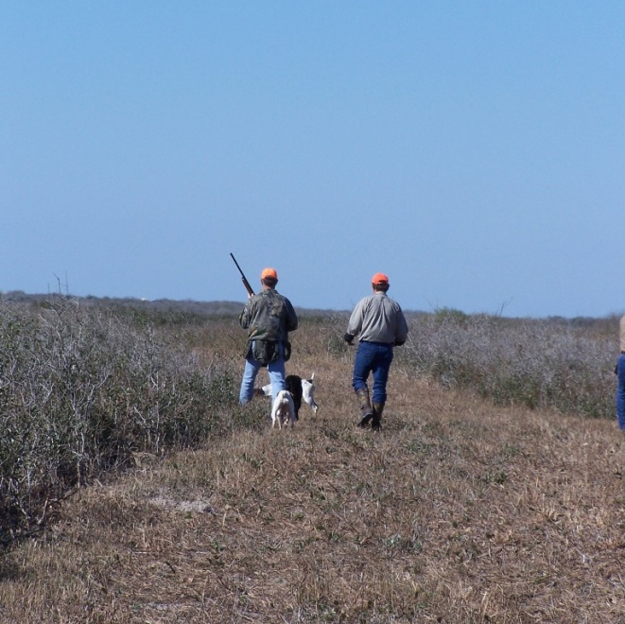
Microsatellite diversity and population structure
Sampled 24 sites, 567 individuals
Observed heterozygosity = 0.58
Range: 0.39 to 0.86
13 alleles/ locus
Range: 7 to 19 alleles
Low structure
Fst < 0.01
Exact tests non-significant
Pairwise Fst non-significant

Slide 19
AMOVA for microsatellite data
24 sites
N = 567
F_{ST} < 0.01

Slide 20
Intercept at ~50 km
Implies sites within 50 km are non-independent
Assume diameter of a local population is 50 km….
Corresponds to an area of 1,964 km² or 502,655 ac

Slide 21
Population dynamics, diversity and structure
Low differentiation, high diversity
Importance of dispersal? Role of population turnover?
Life history, dispersal, and genetic variation….
Modified from Harrison & Hastings (1996)
Dispersal among populations
(+)
(-)
(-) or (+)
Turnover
Differentiation of populations
(+)
Long term
(-)
Total (metapopulation) genetic variation

Slide 22
Implications for bobwhites
Theoretical predictions for high-turnover populations: should be good dispersers
Otherwise, bottlenecks, stochastic events
Dispersal more important than previously realized?
Maintain genetic variability, minimize structure
Do bobwhites fit a metapopulation model?
Re-colonization and extinction dynamics
Counterbalance local extinctions during boom-bust

Slide 23
Implications for bobwhites
One of the most studied, managed species
Populations continue to decline
Extant populations occupy intact habitats
Large continuous sections of suitable habitat
Uninterrupted patterns of dispersal
Habitat fragmentation = no re-colonization?
Local populations eventually extirpated through stochastic events

Slide 24
Implications for bobwhites
Most current management is site-specific
If dispersal is critical to bobwhite populations, small-scale management may be insufficient
To halt or reverse the Northern Bobwhite decline, a shift to large-scale management of habitat resources that provide usable space may be required (Williams et al. 2004).

Slide 25
Acknowledgements
Texas Parks and Wildlife Department
Richard M. Kleberg, Jr. Center for Quail Research
South Texas Quail Associates Program
C. Berdon Lawrence, Lawrence Family Foundation
C. C. Winn Endowed Chair for Quail Research
Alfred C. Glassell, Jr. Endowed Professorship for Quail Research

