Slide 1
The Sexual Proclivities of Bobwhites
Brant C. Faircloth
University of California
Tall Timbers Research Station

Slide 2
1
1
1
1
Fall
Winter
Monogamy
Notes:
What we’re really going to be talking about are mating systems, and the mating system really refers to the behavior of individuals within a given population. Either they are MONOGAMOUS…

Slide 3
2
3
1
1
1
4
Fall
Winter
Polygyny
Notes:
Polygynous (one male reproduces with several females)

Slide 4
2
2
1
1
1
1
Fall
Winter
Polyandry
Notes:
Or polyandrous, where one female mates with several males

Slide 5
1
1
2
2
4
4
3
3
5
5
6
6
Fall
Winter
Population-level
Notes:
At the population level, we think of behavior as being static – individuals within populations behave in similar fashion – so a population is monogamous, which was the common way of viewing birds populations before the late 80s, early 90s.

Slide 6
2
1
1
Fall
Winter
Polygynous
4
2
3
Fall
Winter
6
8
3
5
4
7
Fall
Winter
Notes:
But then, in most bird populations, we discovered that many individuals have extra-pair mates or more than one mate. Generally speaking, many scientists assumed that polygyny was the primary mating system – it was male driven, and females competed for access to mate territorial resources.

Slide 7
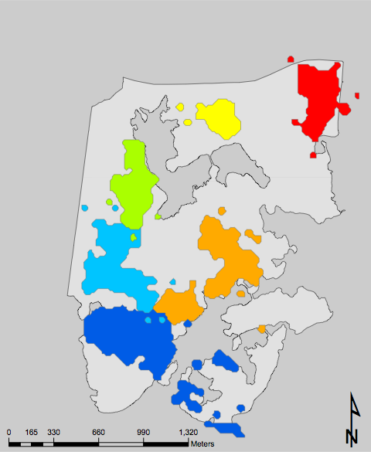
Territoriality
Notes:
In addition to these general classifications of mating behavior, several theories attempt to explain that behavior by integrating environmental or population-level factors. So, the mating system is influences by “territory” quality… or…

Slide 8
2
1
1
3
4
Fall
Winter
Operational Sex Ratio
Notes:
Operational sex ratio…

Slide 9
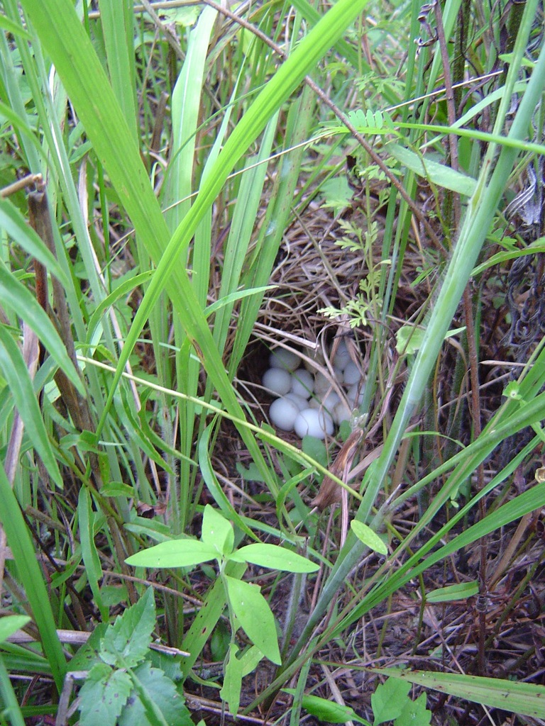
Habitat
Quality
Notes:
Or habitat quality (nest sites, food resources, etc).

Slide 10
Difficult
Notes:
Part of the problem in studying all of these questions as they related to quail is that bobwhites are very difficult to observe in the wild

Slide 11
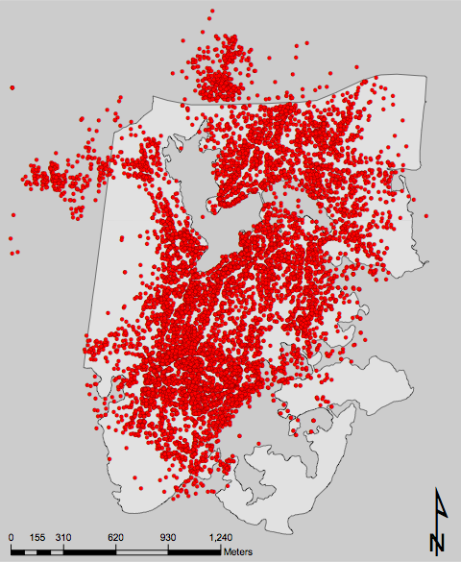
Difficult
Notes:
And even with telemetry data, each position that we take is only a very, very small snapshot of what a given bird does throughout the day.

Slide 12
Capture
+
Telemetry
+
Genetics
Notes:
So, we decided to attack the problem using traditional tools (capture + telemetry) and some newer tools (genetics).

Slide 13
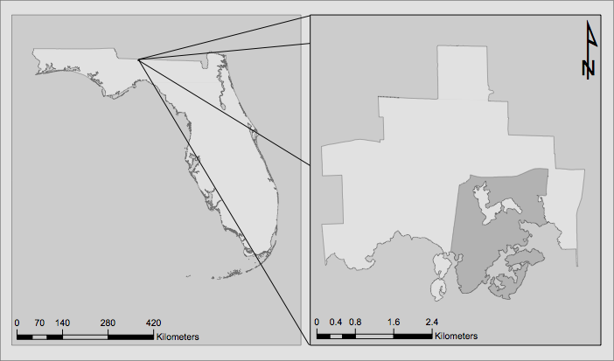
250 ha
RED HILLS ≈ 1-7 BOBWHITE/ACRE
STUDY SITE ≈ 1-3 BOBWHITE/HA

Slide 14
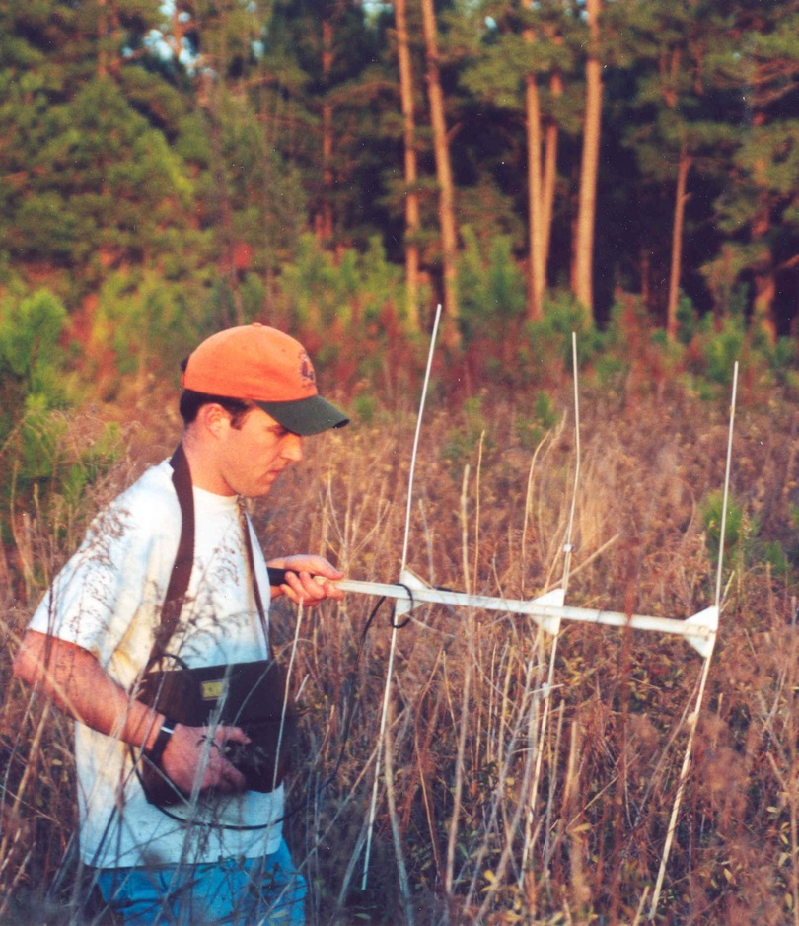
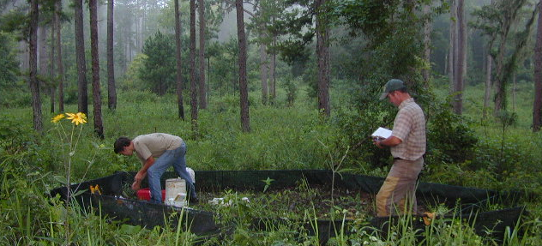

Slide 15
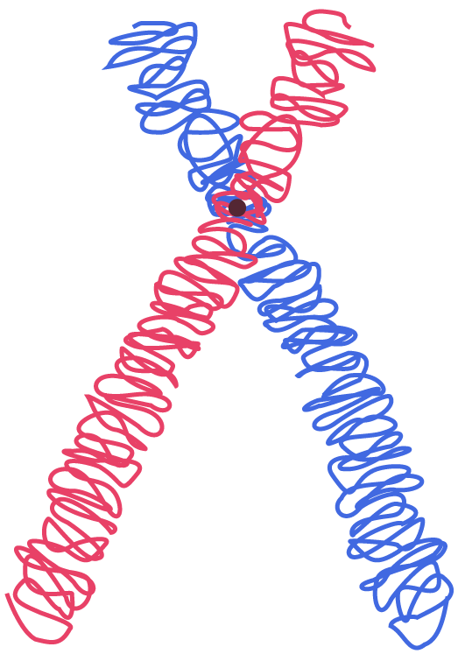
Telemetry
Genetics
14 Microsatellite Loci

Slide 16
Telemetry
Brood
Capture
621
Adults &
Subadults
841 Neonates
2001-2003

Slide 18
178 Males
180 Females
52 Broods
36%
1
1
2
64%
1
1
2
0%
1
1

Slide 19
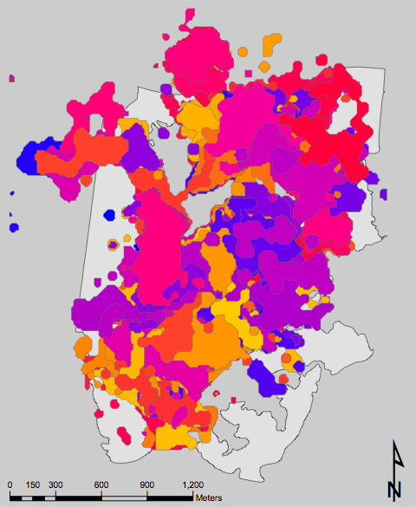
2002
2002

Slide 20
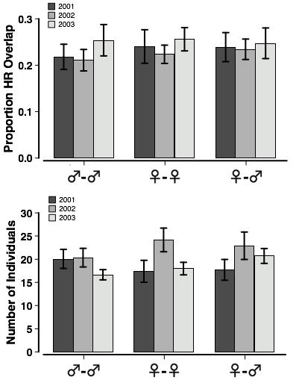

Slide 21
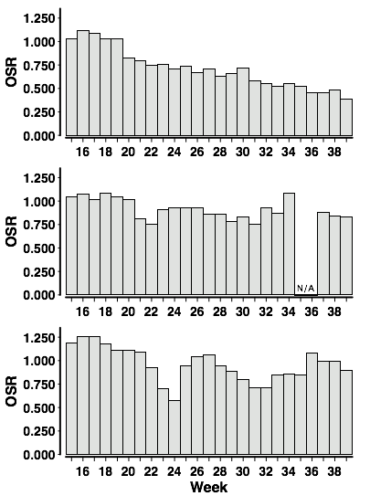

Slide 22
Territoriality
Operational Sex Ratio
Habitat
Quality

Slide 23
3
1
1
1
2
Fall
Winter
5
6
2
4
2
5
2
7
Fall
Winter
3
8
3
8
Fall
Winter
Notes:
Perhaps most interestingly, we found that individual birds reproduced flexibly – so the same female might be monogamous or polyandrous within or between given seasons. Other females might be entirely monogamous.

Slide 24
2
1
1
3
4
Fall
Winter

Slide 25
Adaptive Flexibility
PREDATION
ENCOUNTER
FLEXIBILITY
B
DENSITY
LATENCY
B
B
BEHAVIOR
PERCEPTION
HABITAT
SURVIVAL

Slide 26
CO-AUTHORS
THERON TERHUNE
PATRICIA GOWATY
BILL PALMER
JOHN CARROLL

Slide 27
TECHNICIANS
KATHERINE CROOK
JOHN GRUCHY
ADAM BUTLER
BRIAN SHAMBLIN

Slide 29
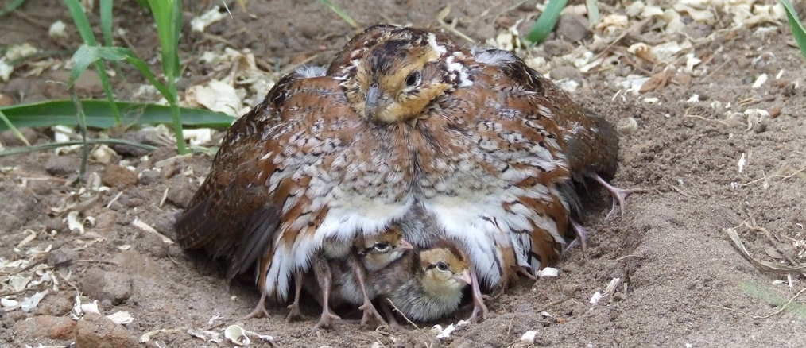
Questions?

Slide 30
Social Mates

Slide 31
Territoriality
2002
2002
Notes:
Because birds were radio-collared, we could immediately analyze home-ranges

Slide 32
Territoriality

Slide 33
Female
Male

