Slide 1
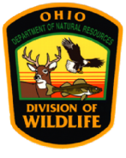
Population Ecology and Habitat Relationships of Northern Bobwhites in Southwestern Ohio
Robert J. Gates,
Adam K. Janke,
Marjorie R. Liberati
Mark J. Wiley
School of Environment and Natural Resources, Ohio State University, Columbus, OH 43201

Slide 2
Ohio Bobwhite Population Trends
Christmas Bird Counts:
Population in decline even before severe winters of 1977 and 1978.
Ohio Division of Wildlife Whistle Counts:
Decline has continued despite Conservation provisions of Farm Bills implemented since 1985

Slide 3
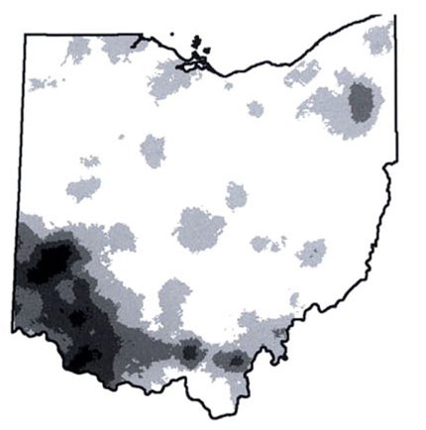
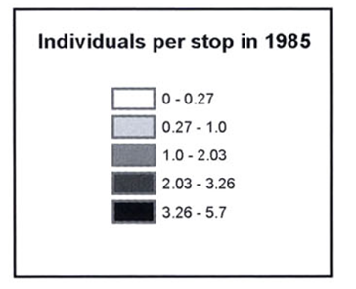
Once distributed statewide, the detectable range of NOBO in Ohio has contracted to about 25 counties (Spinola and Gates 2008)
(Spinola and Gates 2008)
Notes:
Population changes in US and Ohio
Show kriging and then say that the study was initiated to look at bobwhite population dynamics in the core of their current distribution in the state.

Slide 4
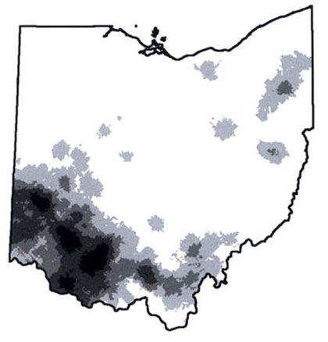
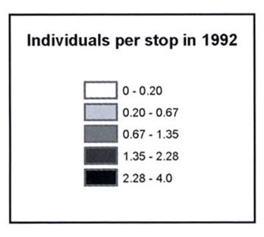
Once distributed statewide, the detectable range of NOBO in Ohio has contracted to about 25 counties (Spinola and Gates 2008)
(Spinola and Gates 2008)

Slide 5
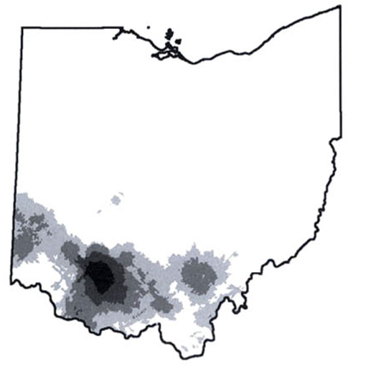
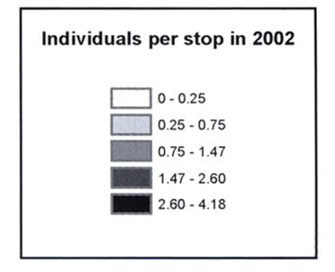
Once distributed statewide, the detectable range of NOBO in Ohio has contracted to about 25 counties (Spinola and Gates 2008)
(Spinola and Gates 2008)

Slide 6
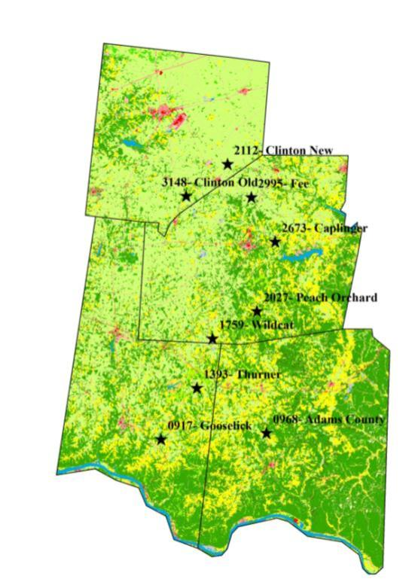
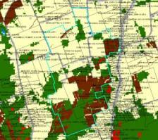
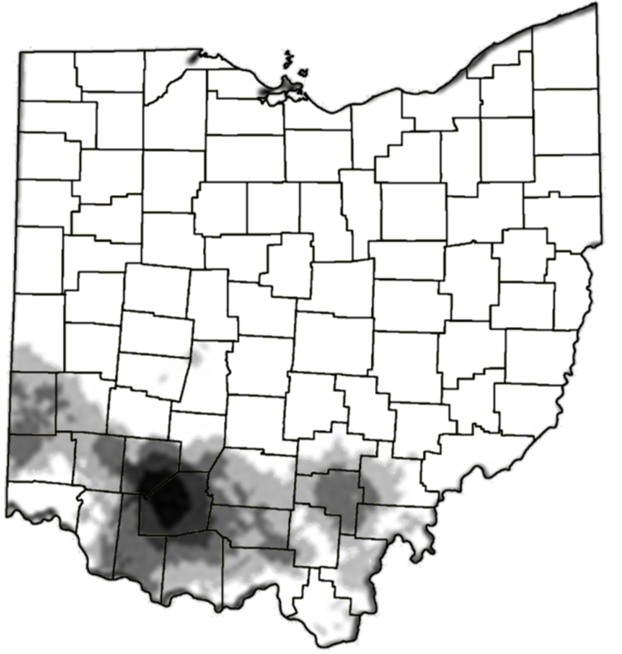
Nine study sites randomly selected* to represent a range of landscape conditions (forest vs. openland) and connectivity where suitable habitat remains on private lands within in the core of NOBO range in Ohio.
*Simple Habitat suitability model
applied to National Land Cover Database and Conservation Reserve Program feature coverages

Slide 7
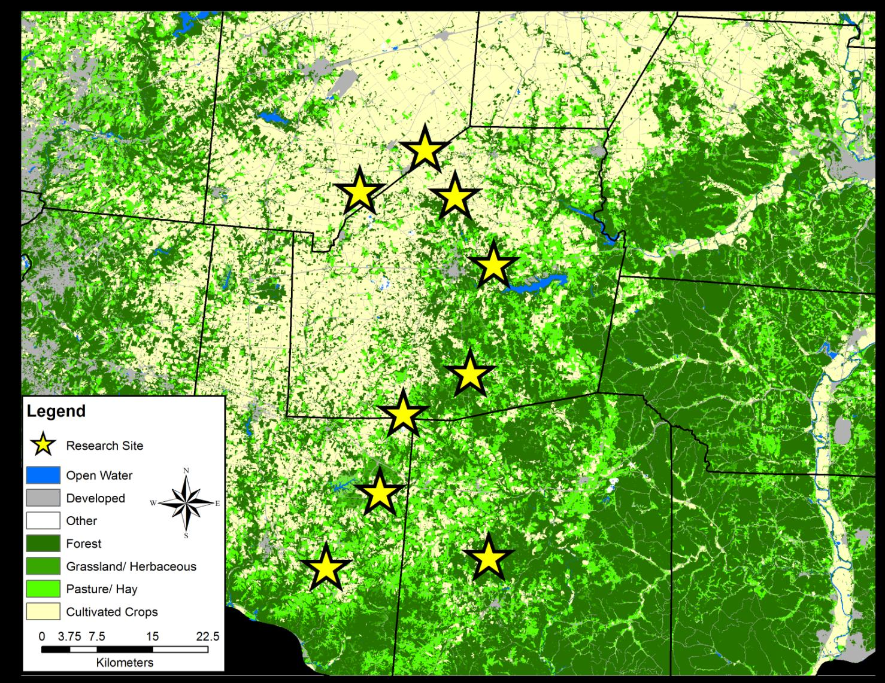

Slide 8
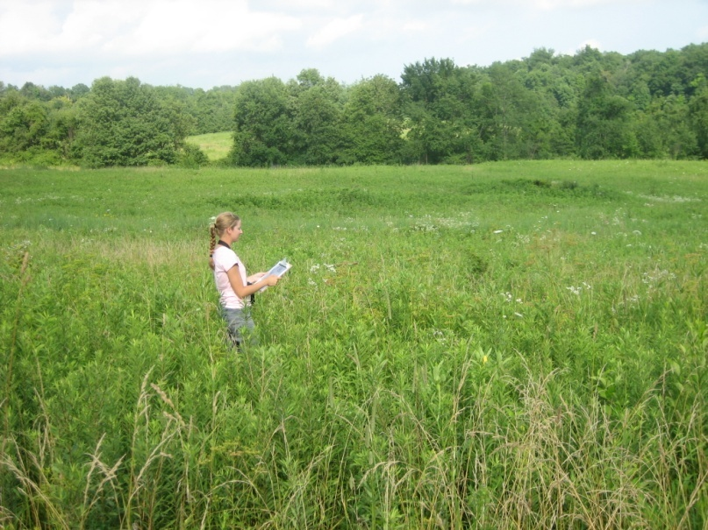
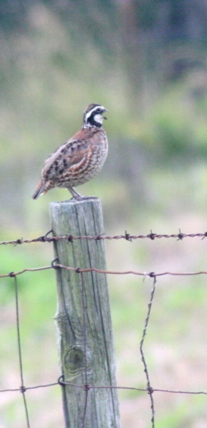
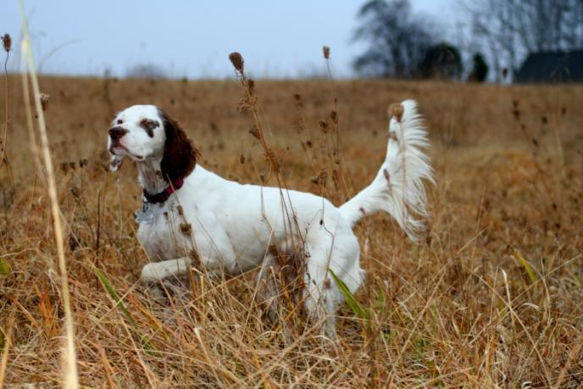
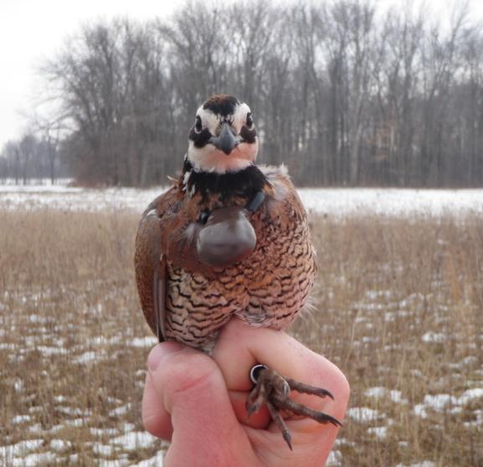
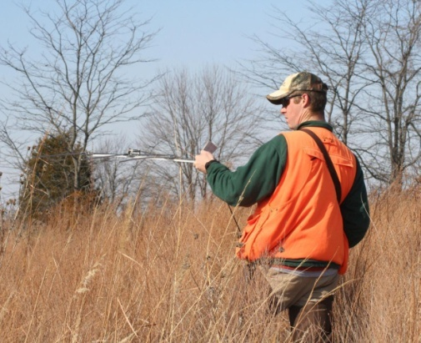
Relative Abundance
Spring whistle counts on 4-8 study sites during April-June 2008 - 2011
Intensive searches with pointing dogs and by snow tracking on 4-8 study sites during October-March 2008-09 through 2010-2011.
Covey call counts on four study sites during October-December 2009-10 and 2010-11.
Radio-marked coveys located daily on 4 sites during October-March 2008-9 through 2010-2011.

Slide 9
Spring whistle counts, fall covey counts, and intensive searches revealed substantial NOBO densities on only 4 of 8 study sites

Slide 11
Habitat composition
3*
2
4
1

Slide 12
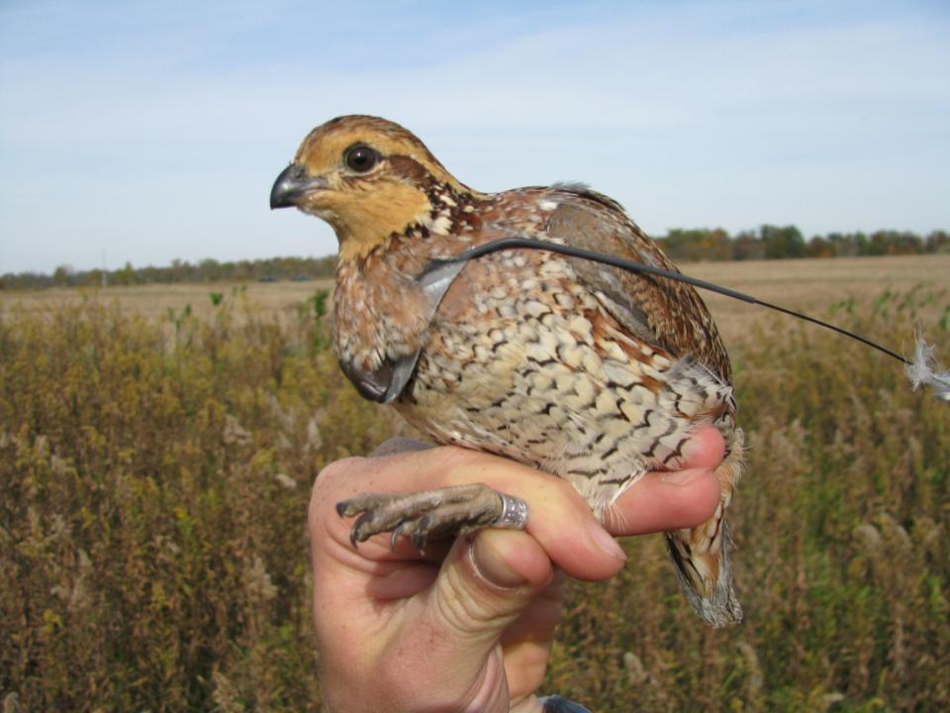
Demographic Parameters: Fall Winter Survival
Kaplan-Meier estimates of adult and juvenile survival (October-March 2009-2011) from radio-marked birds at Wildcat, Thurner, Fee, and Peach Orchard sites.

Slide 13
Demographic Parameters: Summer Survival
Kaplan-Meier estimates of adult survival (Apr-Sep) from radio-marked birds at Wildcat, Thurner, Fee, and Peach Orchard sites

Slide 14
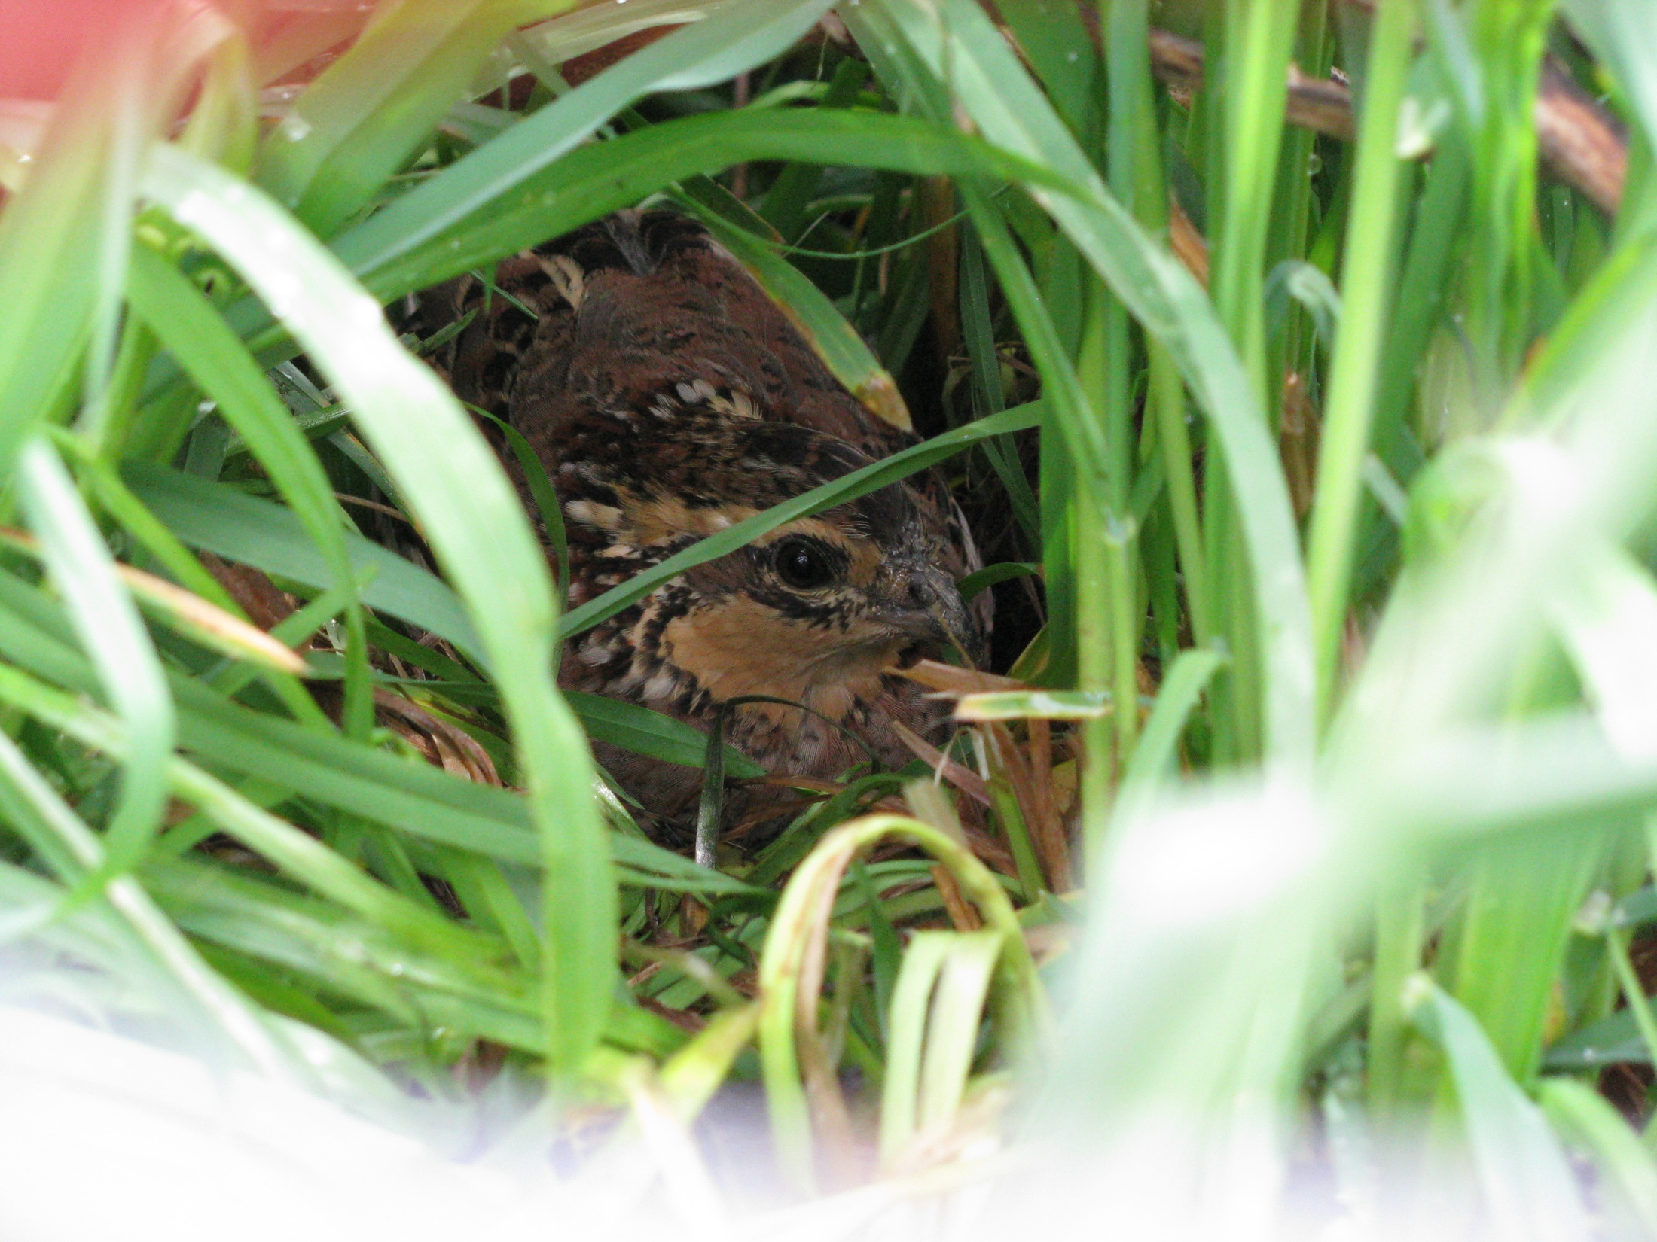
Demographic Parameters: Nest Behavior Liberati M.S. Thesis 2012 (exp.)
Renesting rate = 0.647 (95% CI = 0.420-0.874)
(11 of 17 females renested after failed nests)
Double-brooding rate = 0.250 (95% CI = 0.005-0.495)
(3 of 12 females renested after hatching a clutch)
Male incubation rate = 0.432 (95% CI = 0.361-0.517)*
8 of 53 (15.1%) radio-marked males incubated nests
9 of 37 (24%) nests incubated by males when gender was determined
*Estimated from the relative probabilities of finding radio-marked males vs. females incubating nests (after Collins et al. 2009)

Slide 15
Demographic Parameters: Nest Productivity Liberati M.S. Thesis 2012 (exp.)
Apparent Nest Success = 0.415
(95% CI = 0.282-0.0.548, n = 53)
Incubated Clutch Size = 14.4
(95% CI = 13.6-15.2, n = 37)
Egg Hatchability = 0.922
(95% CI = 0.836-0.988 n = 21)
Chick survival to fledging = 0.843
(95% CI = 0.740-0.943)*
*Source: Suchy and Munchel (2000), adjusted from 38 to 30-day hatch to fledging interval

Slide 16
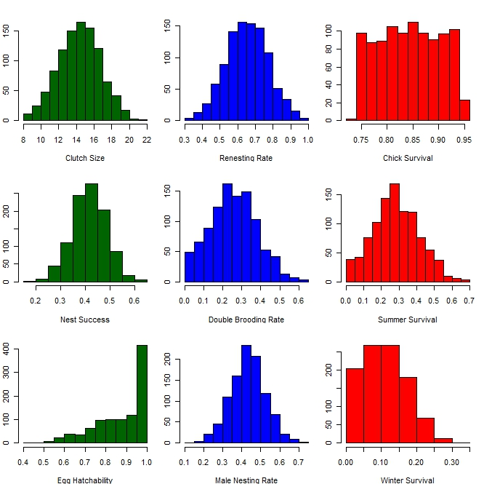
Life-stage Simulation Analysis (after Sandercock et al. 2008)
8 of 9 demographic parameters modeled using empirical data from southwestern Ohio.
Randomly selected from normal distribution (mean, sd)
Modeled population growth rate (λ) after 1,000 iterations.
Sensitivity of λ to demographic parameters (r²).

Slide 17
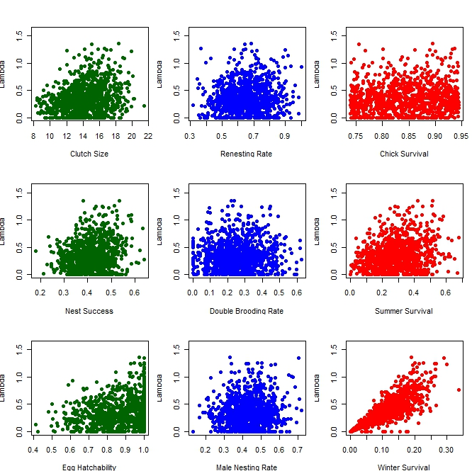
Life Stage
Simulation of
Pop. Growth:
Median λ = 0.324 (0.175 – 0.514 I.Q. range)
Fall-winter survival dominant, (69.1%) followed by summer survival (7.3%), nest productivity (3.8-5.6%), nesting rates, and chick survival (<1%)
r²=0.056
r²=0.007
r²=0.007
r²=0.039
R²<0.001
r²=0.073
r²=0.038
r²=0.004
r²=0.691

Slide 18
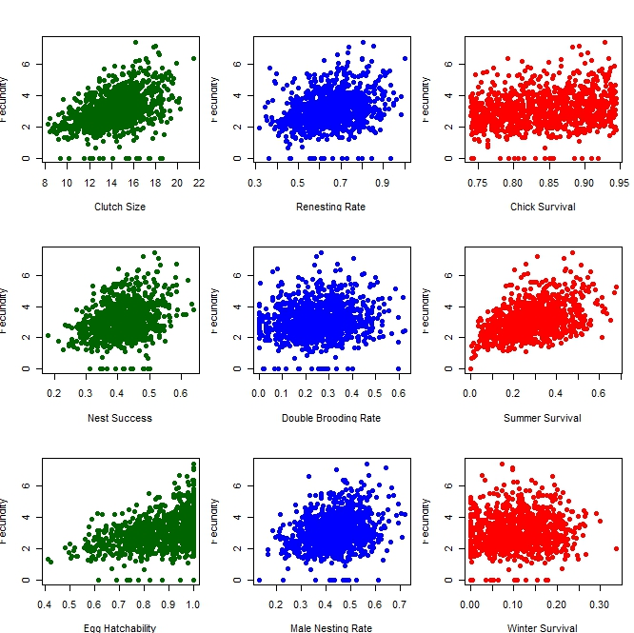
Life Stage
Simulation of
Fecundity:
Total fecundity explained 24.9% of variation in λ
Summer survival dominant, (24.6%),
followed by (7.3%), nest productivity (14.5-20.3%), nesting rates, (1.2-7.7%) and chick survival (3.8%)
r²=0.203
r²=0.077
r²=0.038
r²=0.117
r²=0.012
r²=0.246
r²=0.145
r²=0.055
r²=0.001

Slide 19
Habitat Selection (Janke 2011)
Selection
Avoidance
Notes:
Coveys used habitat non-randomly at all scales
Site differences at 2nd Order and 3rd Order Point
Early successional woody (e.g. fencerows and ditches) most important at all scales
Variable forest, grassland selection
Grassland site differences

Slide 20
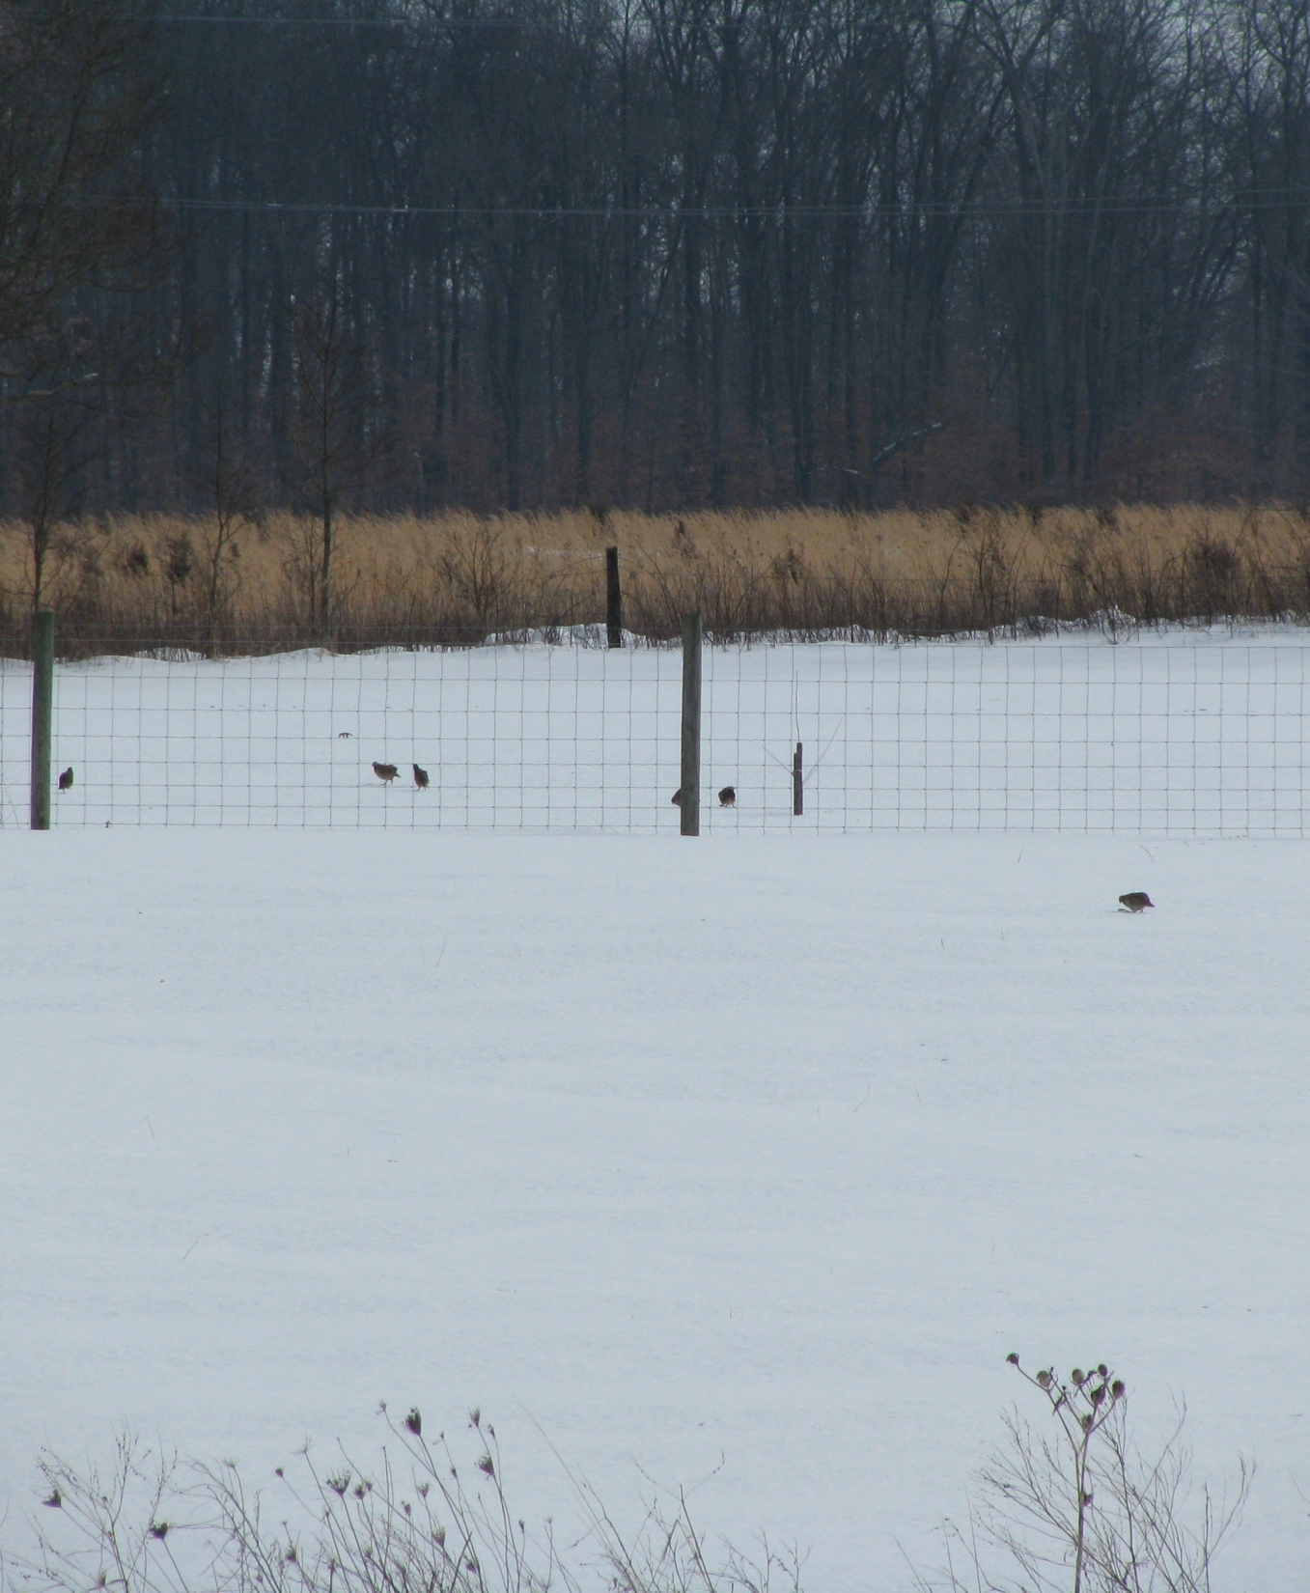
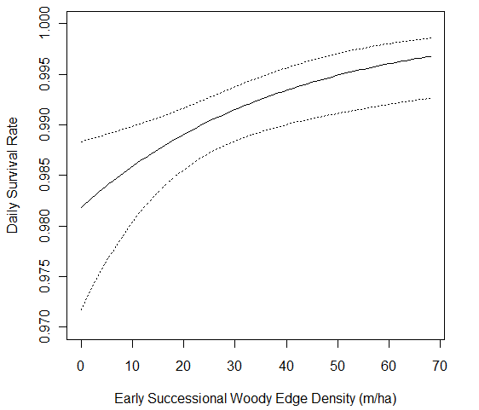
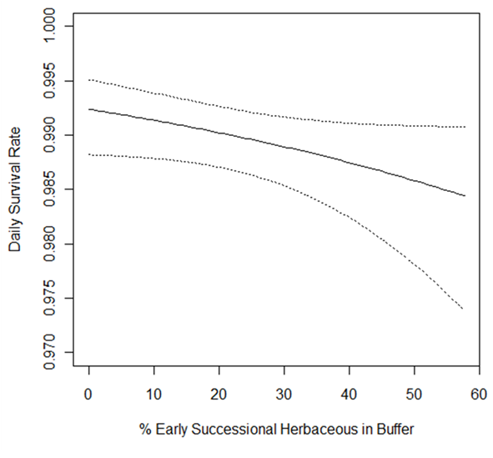
Non-breeding Season Survival:
Sources Janke and Gates In Prep., Q7 Proceedings,
Janke 2011, M.S. Thesis

Slide 21
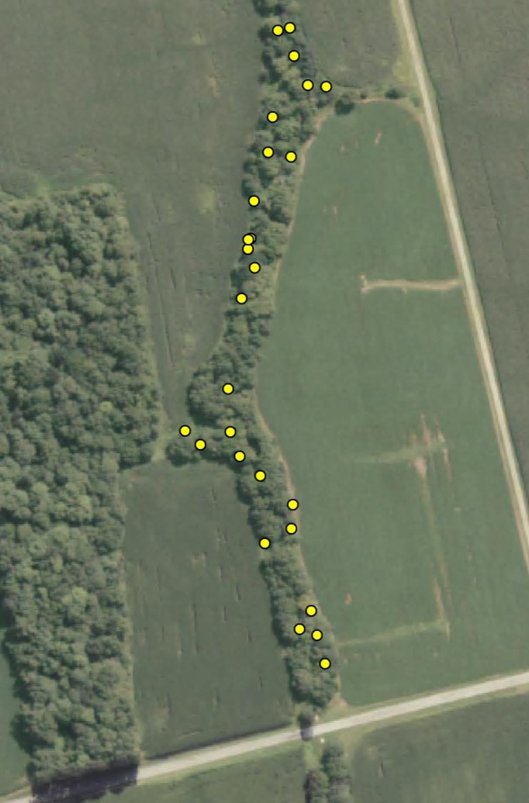
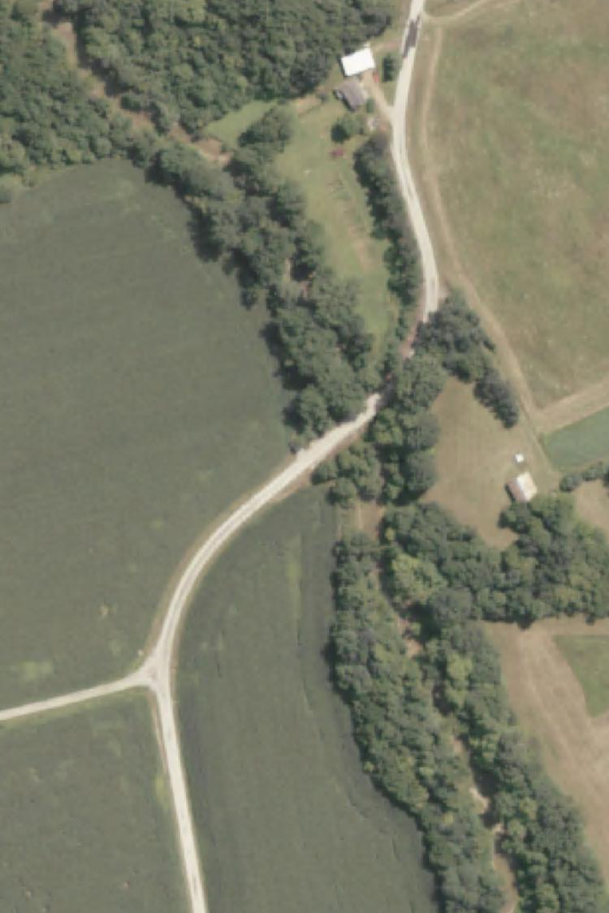
Bobwhites did
not use all
wooded edges
equally….

Slide 22
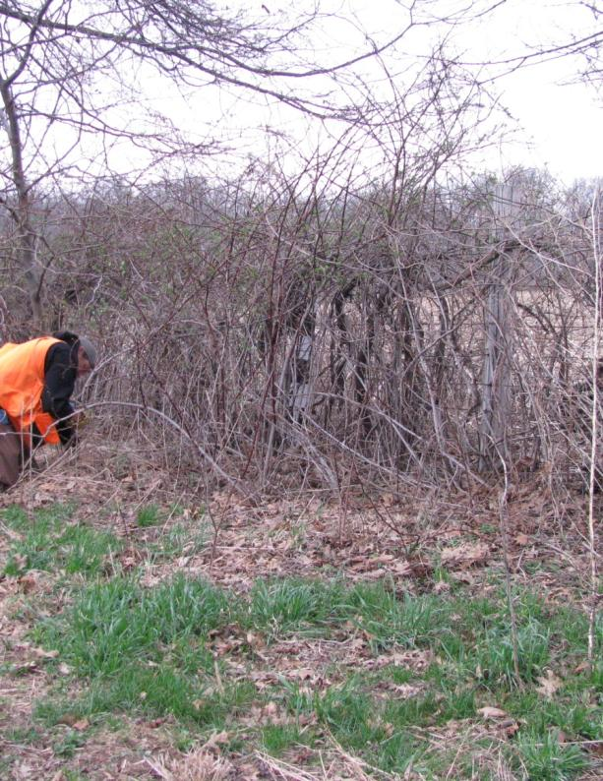
Wooded Edges Wiley M.S. Thesis 2012 (exp.)
Not Used Used

Slide 23
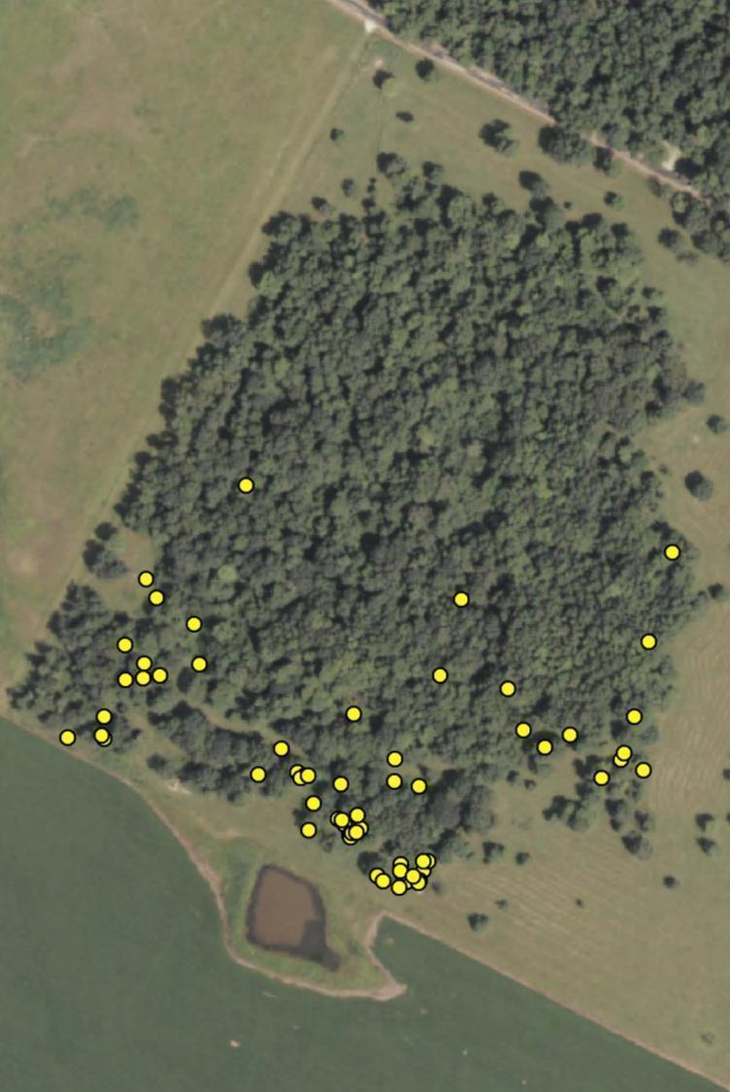
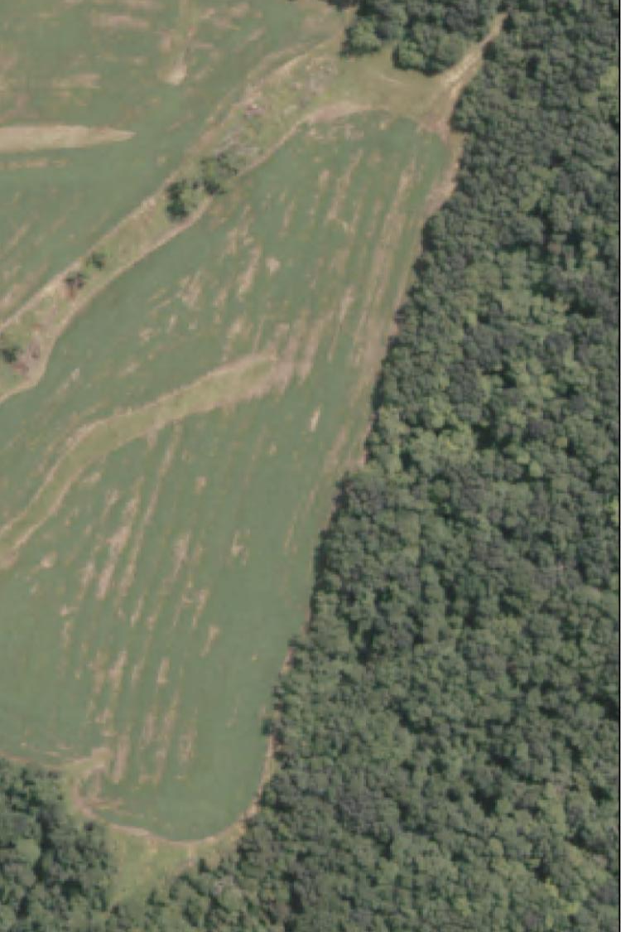
…likewise, only a
few woodlots
were used
by bobwhites,

Slide 24
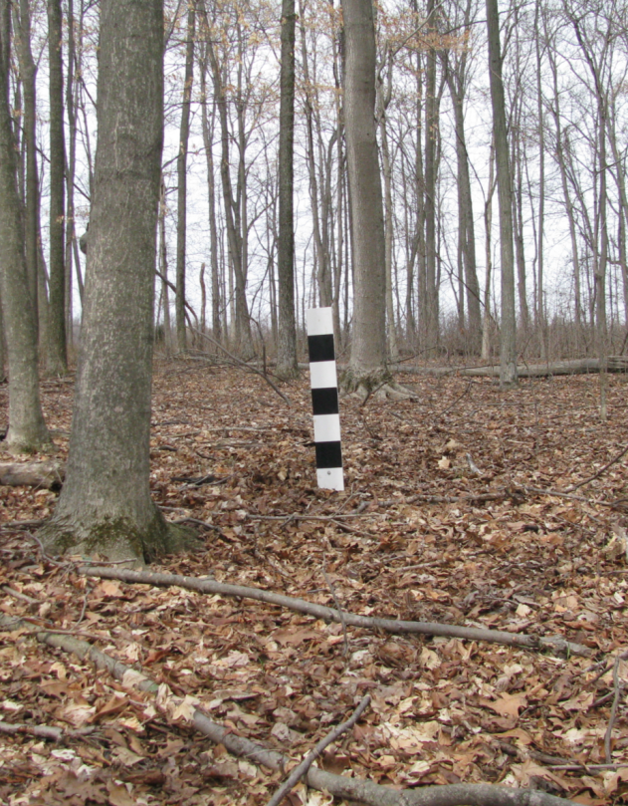
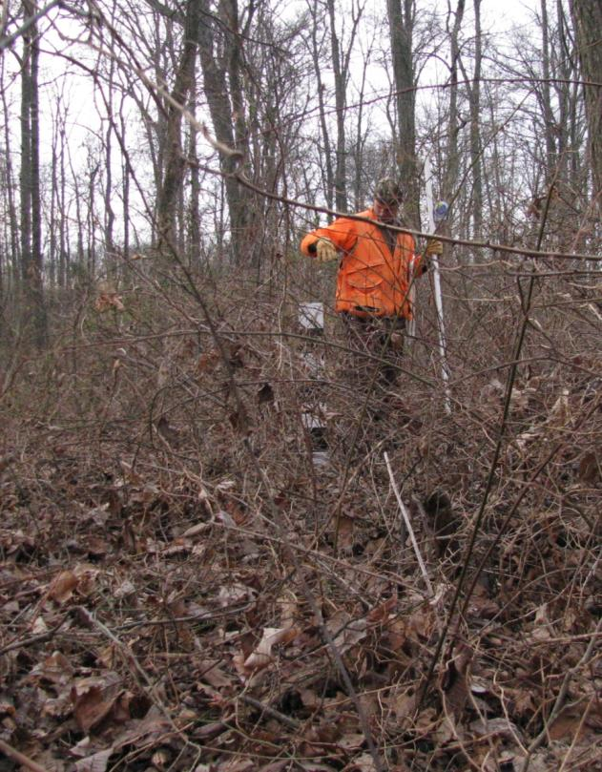
Woodlots Wiley M.S. Thesis 2012 (exp.)
Not Used Used
Notes:
You got this

Slide 25
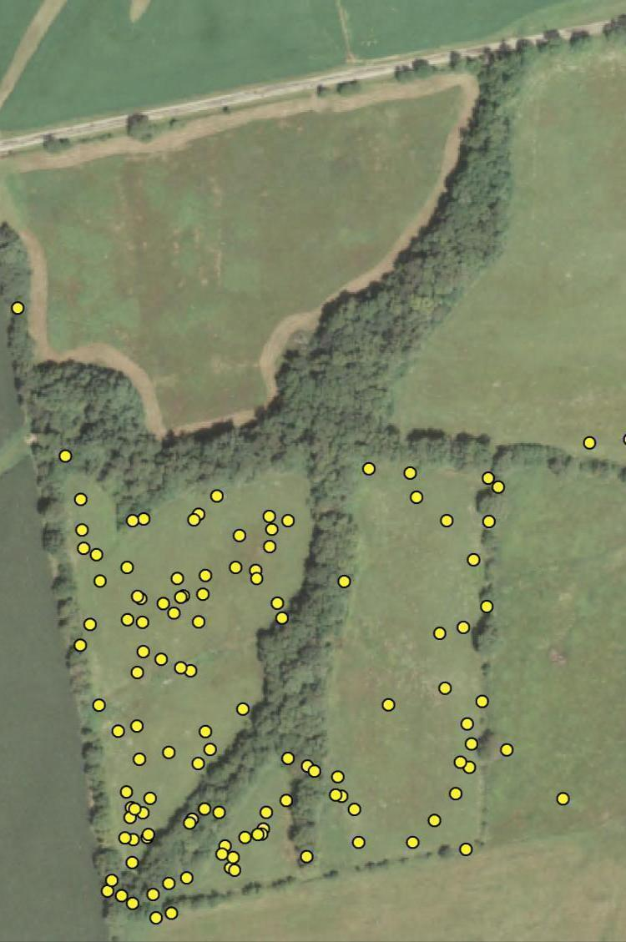
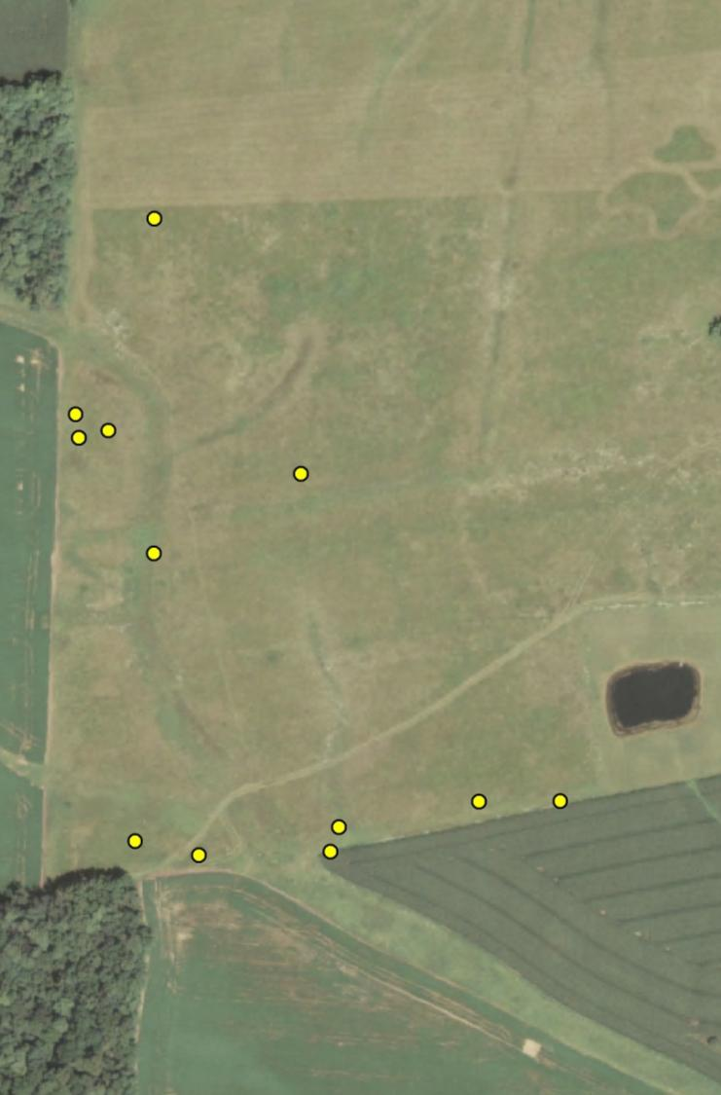
…and use of early
succession herbaceous
fields was concentrated
near edges and also
varied with vegetation
structure & composition

Slide 26
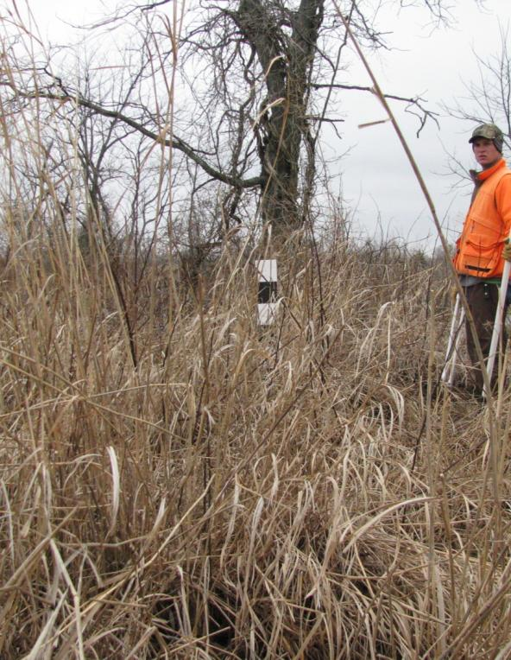
Early Successional Herbaceous Wiley M.S. Thesis 2012 (exp.)
Not Used Used
Notes:
This slide shows the difference in horizontal visual obstruction in grass fields dominated by fescue and warm season grasses with woody cover

Slide 27
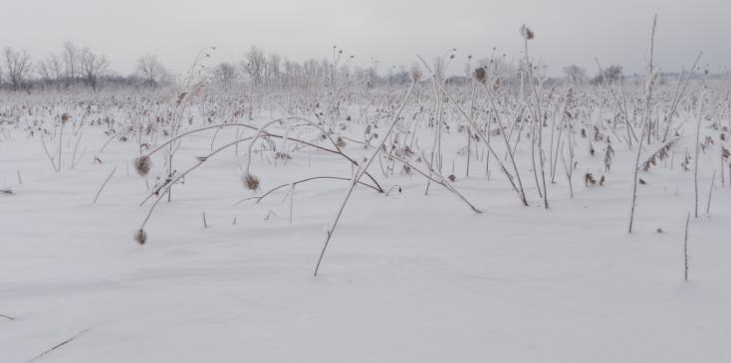
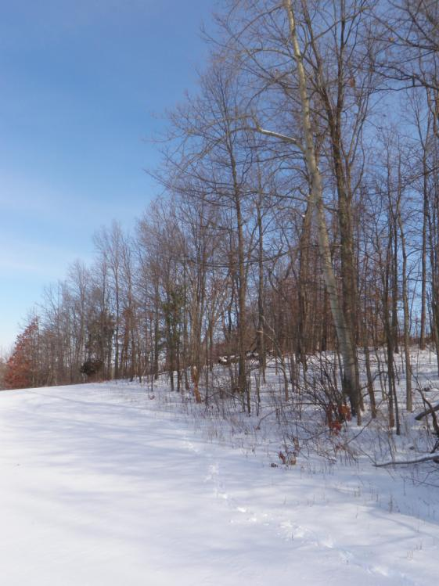
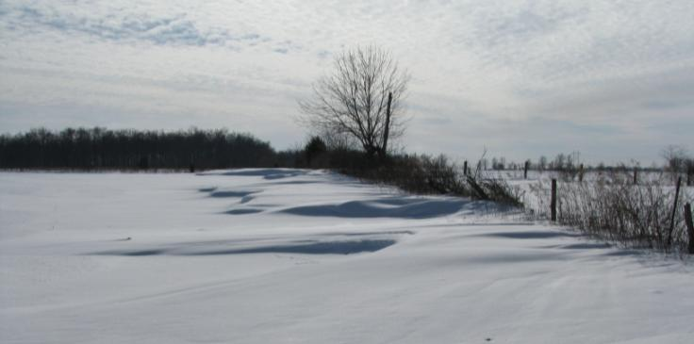
Conclusions
“One of the characters common to the entire range of quail in the north central region is that every farm has good quail cover from May to December, but that most farms have deficient winter cover or often none at all”
-Aldo Leopold (1931:70)

Slide 28
Conclusions
Bobwhites have a “patchy” distribution on the landscape, even within the core range in Ohio
metapopulations?
Mortality rates were low compared to other populations.
mediated by winter weather?
Fecundity vital rates , although “normal” were inadequate to sustain the population or to produce surplus individuals to colonize vacant habitats.
not dispersal limited?
Population growth is limited by non-breeding season survival associated with low quality and quantity of suitable woody cover.
a woodland bird in OH?

Slide 29
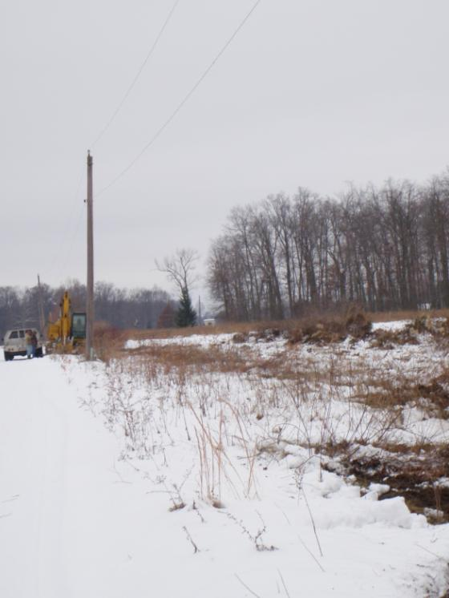
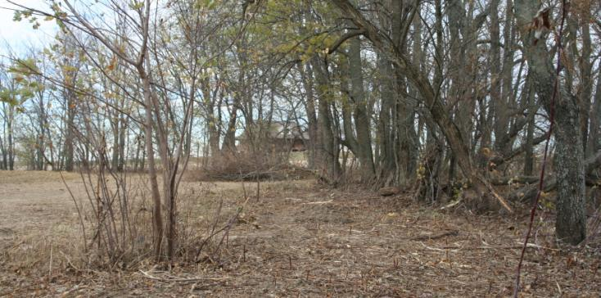
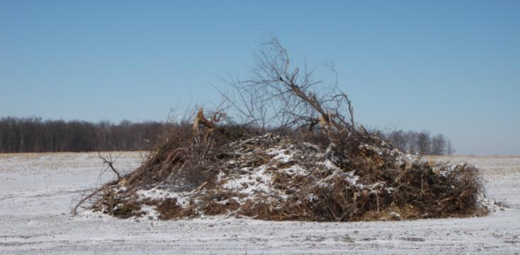
Management
Recommendations
“What about the future of Bob-white in Ohio? That depends upon the amount of food, cover, and protection we provide for these birds. … It is only when the proper amounts of food, cover, and protection are given that Bob-white can reach his maximum numbers on a farm.”
-Milton Trautman, 1935

Slide 30
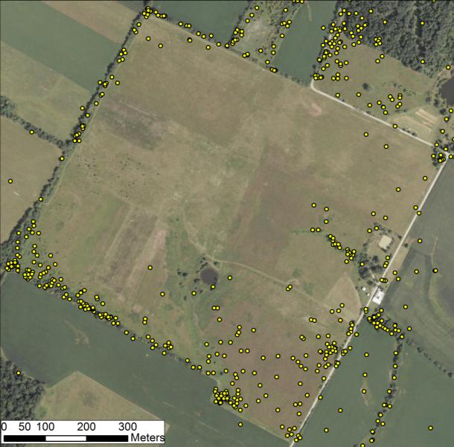
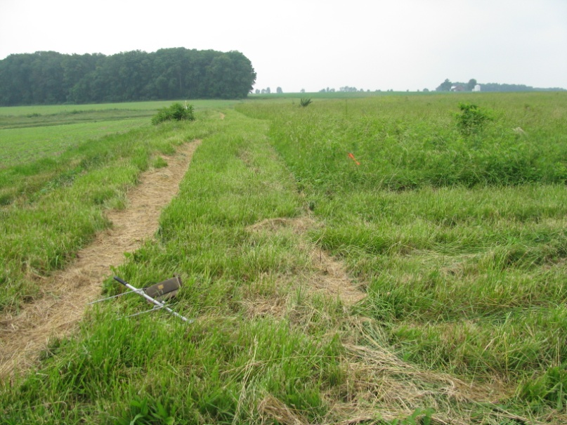
Conservation Strategy
Start small and work outward – overcome Allee effects
Focus on early succession woody habitats to increase survival and…
…increase “Usable Space” to support higher covey densities.
Continue to conserve and enhance early succession herbaceous habitats (nests and broods)
Notes:
Emphasize fitness advantage woody cover near food

Slide 31
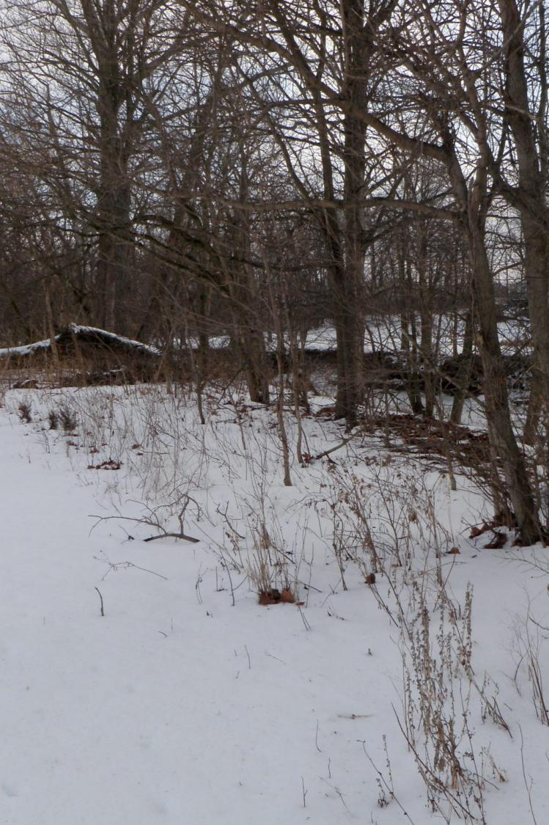
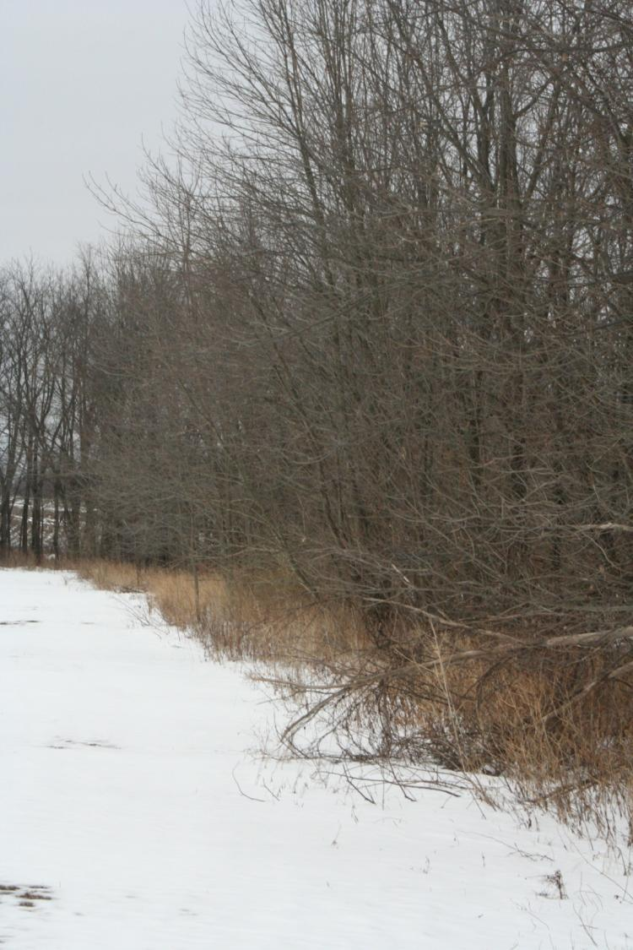
Edge Feathering
Thin overstory trees to promote early succession woody cover in fencerows and riparian areas, and woodlot edges

Slide 32
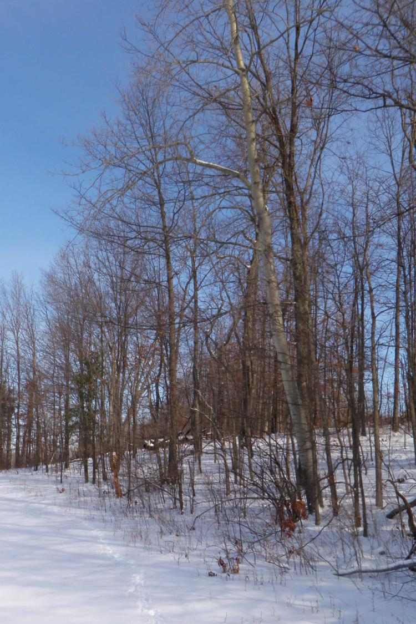
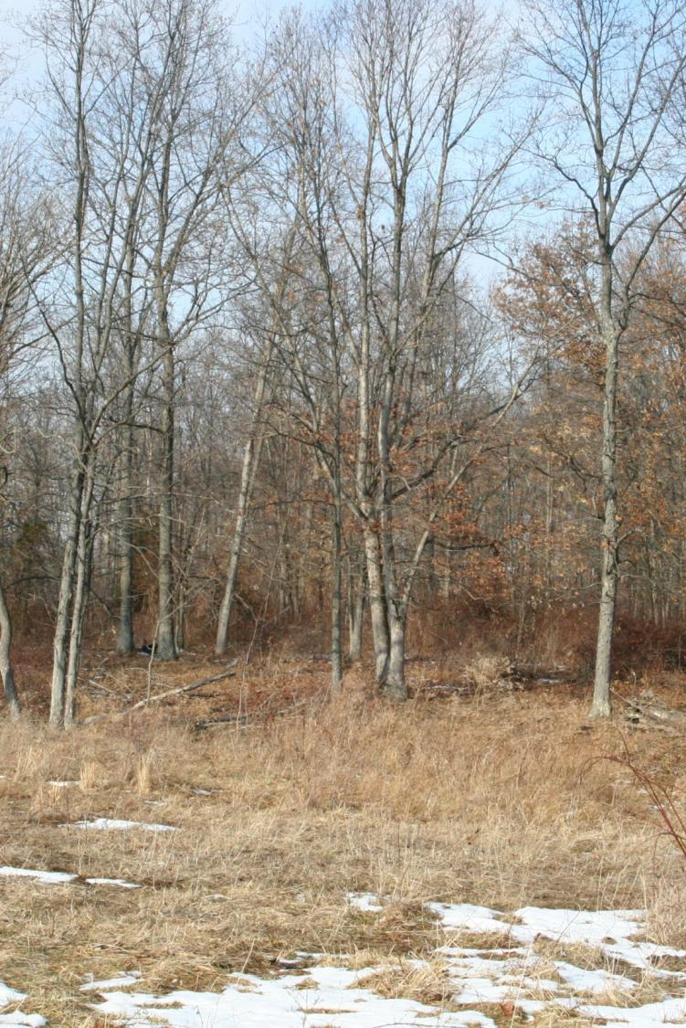
Woodlot Management
Open woodlot canopy to promote early succession woody plants (moderate grazing, timber harvest).

Slide 33
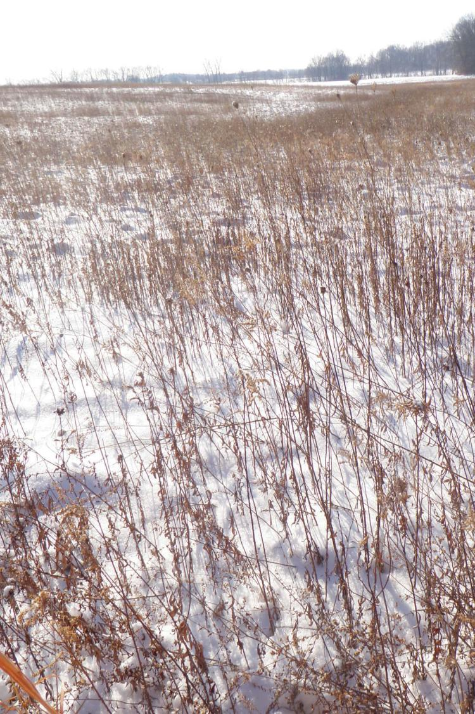
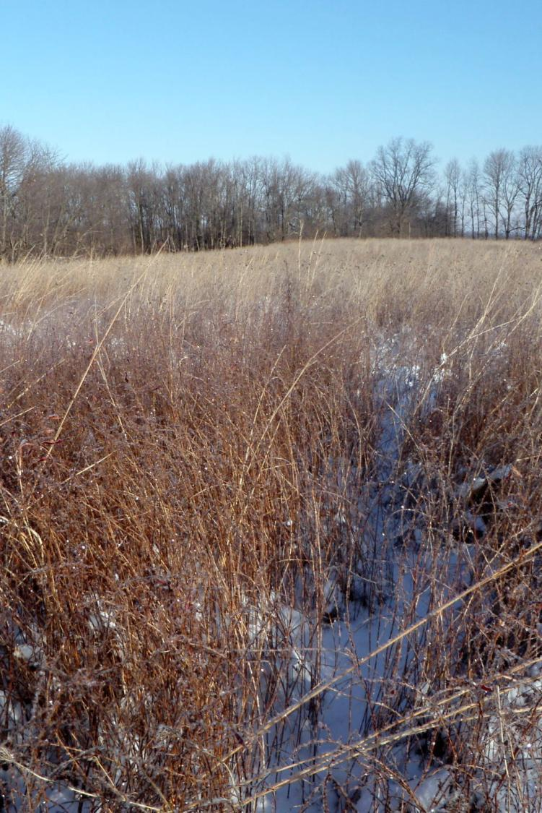
Herbaceous Cover Enhancement
Promote warm season
grasses and forbs, allow
some woody cover, especially
near edges.

Slide 34
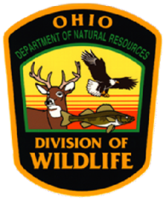
Acknowledgements
Funding
Ohio Department of Natural Resources, Division of Wildlife
Federal Aid in Wildlife Restoration
Cooperating Landowners
Fallsville Wildlife Area
Indian Creek Wildlife Area
Field Assistants:
Jay Jordan
Bryce Adams
Bret Graves
Nan Radabaugh
Mark Peugeot
Laura Jenkins
George Fee
Mark Jones
Don Neel
Marty Staker
John Davis
Chris Grimm
Matt Crowell

Slide 35
Questions?
Robert Gates
gates.77@osu.edu

Slide 36
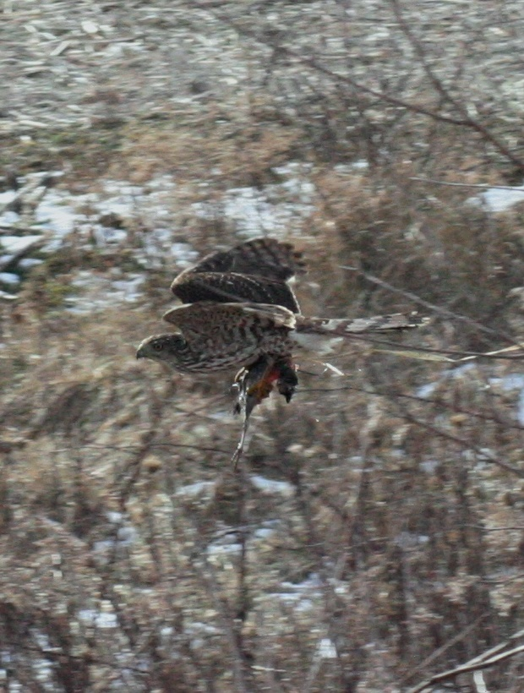

Slide 37
Cover
Food

Slide 38
Winter Mortality:
Sources Janke and Gates In Prep., Q7 Proceedings,
Janke 2011, M.S. Thesis

