Slide 1
Structured Decision-Making in Avian Conservation
  Is it really that easy?
  James (Barry) Grand

Slide 2
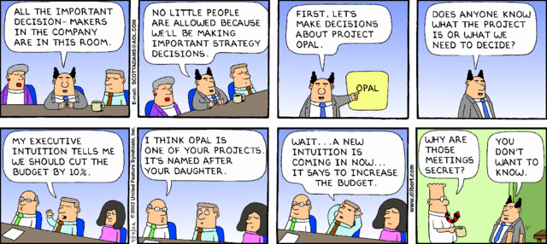
Transparency in decision-making…

Slide 3
Stuctured Decision-making &
Adaptive Management
Terms have become commonplace
Over 300 papers 2000-2009 on Web of Science
(Huang et al. 2011)
Google scholar
  Adaptive Management & Wildlife - >55,000 hits
  Structured Decision-making & Wildlife > 29,000 hits
Documented successes are rare
Barriers to implementation abound
What are they – really?

Slide 4
Presentation outline
Define Structured Decision-making and Adaptive Management
Dismiss some common misconceptions
Discuss the key elements of each
  Roles of stakeholders, decision-makers, biologists, and researchers
Identify factors limiting implementation
Answer the question:
Is it really that easy?

Slide 5
Background
Concepts used in natural resources management since the late 1950's (Beverton and Holt 1957)
Formally introduced in 1978
  Hollings (1978)
  Walters and Hilborn (1978)
More explicit treatment by Walters (1986)
Socio-political treatment by Lee (1993)

Slide 6




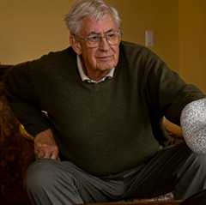


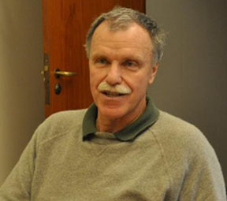

The recent cast of characters

Slide 7
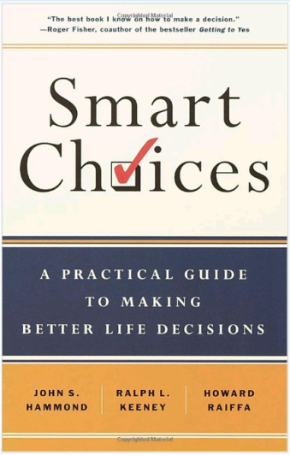
Structured decision-making (SDM)
What is it?
“A formal application of common sense for situations too complex for the informal use of common sense.”
R.L. Keeney

Slide 8
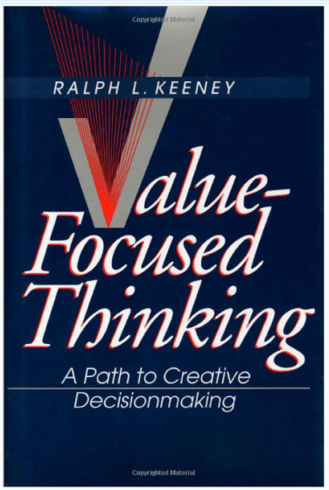
Structured decision-making (SDM)
Term used to describe the application of decision analysis to natural resources management
Generalized approach
  One-off decisions
  Iterative decisions (Adaptive management)
Values-Focused Thinking by R.L. Keeney

Slide 9
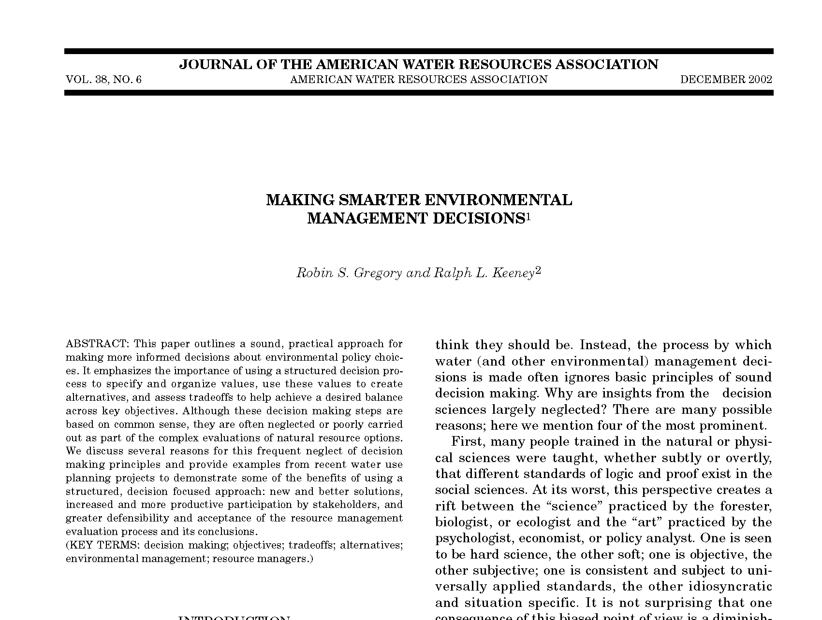
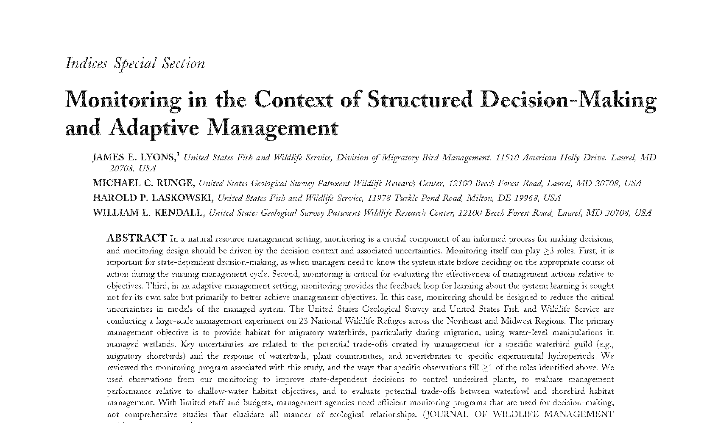
Two good examples
Gregory, R.S., and R.L. Keeney. 2002. Making smarter environmental decisions. Journal American Water Resources Association. 38(6):1601-1612.
Lyons, J.E., M.C. Runge, H.P. Laskowski, W.L. Kendall. 2008. Monitoring in the context of structured decision-making and adaptive management. Journal of Wildlife Management. 72(8):1683–1692.

Slide 10
SDM core elements - PrOACT
Problem – Solve the right problem
Objectives – Describe the desired outcomes
Alternatives – Means for achieving objectives
Consequences – Predicting outcomes of alternatives
Tradeoffs – Incorporate values, uncertainty, and seek optimal solutions
  Core of structured decision-making (Hammond et al. 1999).

Slide 11
Three additional elements - URL
Uncertainty – System response, environment
Risk Tolerance – Gravity of the problem
Linked Decisions – Complex, dynamic systems
  More specialized concepts
  Usually important in ecological decisions

Slide 12
Adaptive management (AM)
…a [decision] process with deliberative and iterative phases, with their sequential implementation over the timeframe of an application.
Williams (2011) J. Environ. Manage.
…flexible decision-making that can be adjusted in the face of uncertainties as outcomes from management actions and other events become better understood.
National Research Council (2004)
Notes:
National Research Council, 2004. Adaptive Management for Water Resources Planning. The National Academies Press, Washington, DC.

Slide 13
Definitions
Simply put:
“Managing to learn and learning by managing”
B.K. Williams
Consequences
  Improved understanding of the resource and
  Improved management based on that understanding.

Slide 14
Learning and Adaptive Management
Feedback between learning and decision-making is a defining feature
Management conducted by design with the goal of learning to manage effectively
Necessitates management (experimentation) useful for learning
  Scope – large enough to span the problem
  Scale – large enough to have an effect
  Replication – enough to provide statistical rigor

Slide 15
Management & experimentation
Typically science emphasizes Type I errors
  Rejecting the null
  Probability of incorrectly accepting information
  High standard for failing to reject (Pr < 0.05)
Emphasis on Type II errors
  Probability of falsely rejecting useful information
  Management decisions often based on much lower standard (Pr > 0.5)

Slide 16
How SDM & AM work
Break problems in into key components
  Makes decision-making transparent
Identify the difficulties in making decisions
Identify key uncertainties
  System (management) response
  Environmental variation
Provide a wide array of tools for decisions-making
  Spreadsheets
  Decision networks
  Decision trees
  Dynamic programming

Slide 17
SDM and Adaptive Management (AM)
Problem
Objectives
Alternatives
Consequences
Tradeoffs
Setup
Setup
Define Problem
Define Problem
Articulate objectives
Identify alternatives
Articulate objectives
Predict consequences
Iterative Decision-making
Decide
Identify alternatives
Adjust
Implement
Predict consequences
Monitor
Decide

Slide 18
General features of AM
SDM
Managed system is dynamic in response to environment and management
Environmental variation is only partially predictable (i.e., stochastic)
Periodic management can vary over time and has direct or indirect effects on the system state (e.g., size or distribution) or ecological processes (e.g., mortality or movement)
Uncertainty about system processes and the influence of management

Slide 19
Misconceptions
Not trial and error – ad hoc process
  "Try something, and if it doesn't work try something else.“
SDM & AM Require:
  Articulation of objectives
  Identification of management alternatives
  Prediction of consequences,
  Recognition of key uncertainties, and
  Monitoring
  Re-assessment

Slide 20
Misconceptions
Large amounts of data are required for setup
Complex models required
SDM & AM
  Often start with conceptual models
  Appropriate data is often unavailable
  Management is conducted experimentally to inform decision-making
  Rely upon simplifying assumptions

Slide 21
Roles in SDM & AM
Key Element | Stake-holders | Decision Makers (Principals) | Managers (Agents) | Researchers (Analysts)
Problem | ✓ | ✓ | ✓
Objectives | ✓ | ✓ | ✓
Alternatives | ✓ | ✓ | ✓ | ✓
Consequences |  |  | ✓ | ✓
Tradeoffs | ✓ | ✓
Uncertainty |  |  | ✓ | ✓
Risk tolerance | ✓ | ✓ | ✓
Linked Decisions | ✓ | ✓ | ✓ | ✓

Slide 22
SDM core elements - PrOACT
Problem – Solve the right problem
Objectives – Describe the desired outcomes
Alternatives – Consider any reasonable approach
Consequences – Predicting outcomes of alternatives
Tradeoffs – Incorporate values, uncertainty, and seek optimal solutions
  Core of structured decision-making (Hammond et al., 1999).

Slide 23
Get the problem right
Extra time to craft a concise yet comprehensive and accurate problem definition pays off… (R. Keeney)
Critical first step in structured decision making
  Make sure you’re solving the right problem!
  Guides process toward appropriate tools and information
  Determines appropriate level of investment
Requires input from many groups
  Stakeholders
  Decision-makers
  Managers

Slide 24
Describe the PROBLEM
Who?
What?
Where?
When?
Why, why, why?
How?
Who are the decision makers?
Who is affected by the decision?
What resources are affected?
Where are the affected resources?
When is the decision needed?
How often will decisions be made?
Why is this important?
How will the problem be solved?
How will we know if we are successful?
What is the goal of the project?
Leads to objectives!

Slide 25
SDM core elements - PrOACT
Problem – Solve the right problem
Objectives – Describe the desired outcomes
Alternatives – Consider any reasonable approach
Consequences – Predicting outcomes of alternatives
Tradeoffs – Incorporate values, uncertainty, and seek optimal solutions
  Core of structured decision-making (Hammond et al., 1999).

Slide 26
Objectives
Used to gauge success
What we are really managing for
ALL subsequent steps build on these
Must be measurable
Must ultimately be affected by actions
Selection of ALTERNATIVES
Evaluation of CONSEQUENCES
TRADEOFFS and optimization

Slide 27
SDM core elements - PrOACT
Problem – Solve the right problem
Objectives – Describe the desired outcomes
Alternatives – Consider any reasonable approach
Consequences – Predicting outcomes of alternatives
Tradeoffs – Incorporate values, uncertainty, and seek optimal solutions
  Core of structured decision-making (Hammond et al., 1999).

Slide 29
Creating alternatives
Ask how you can best achieve the objectives
Challenge constraints
Avoid “psychological traps”
  Anchoring on initial values
  Salient examples
  Sunk costs
Do we need to learn first?
  Adaptive management
  Requires monitoring & evaluation

Slide 30
SDM core elements - PrOACT
Problem – Solve the right problem
Objectives – Describe the desired outcomes
Alternatives – Consider any reasonable approach
Consequences – Predicting outcomes of alternatives
Tradeoffs – Incorporate values, uncertainty, and seek optimal solutions
  Core of structured decision-making (Hammond et al., 1999).

Slide 32
Consequences
Predict outcomes (objectives)
Requires a model
  May be qualitative (initially)
  Usually quantitative
  Estimate uncertainty
Strive for simplicity

Slide 33
SDM core elements - PrOACT
Problem – Solve the right problem
Objectives – Describe the desired outcomes
Alternatives – Consider any reasonable approach
Consequences – Predicting outcomes of alternatives
Tradeoffs – Incorporate values, uncertainty, and seek optimal solutions
  Core of structured decision-making (Hammond et al., 1999).

Slide 34
Grassland Bird Prototype

Slide 35
Spectacled Eider Listing

Slide 36
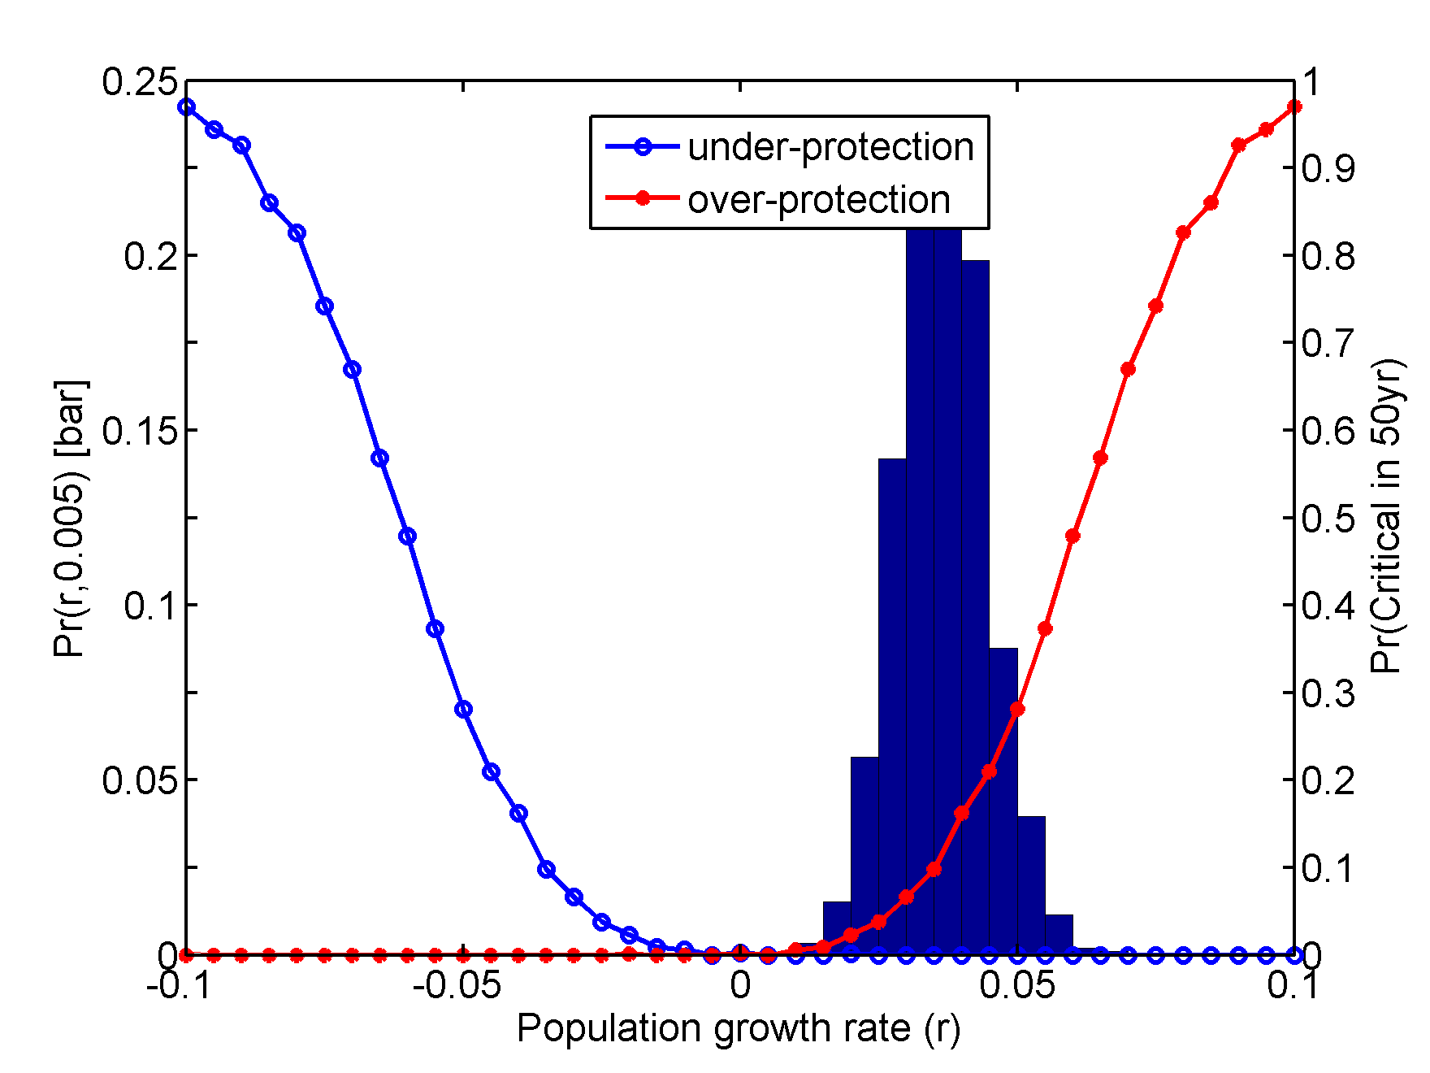
Tradeoffs
Relative weighting of objectives
Relative value of the response to STAKEHOLDERS and DECISION MAKERS
Value = reward * uncertainty * weight
  Reward – response
  Uncertainty – confidence
  Weight - value of the response

Slide 37
Decision model
Objective
“What’s important”
Tradeoffs
Monitor for success
Management Alternatives
Means
“How we get there”

Slide 38
Decision model
Tradeoffs
Objective
“What’s important”
Monitoring for success
Management Alternatives
Means
“How we get there”

Slide 39
Adaptive management
Objective
“What’s important”
Means
“How we get there”
Time

Slide 40
Forms of AM
Sequential decisions implemented uniformly over the system
  A single population
Multiple populations
  Treatment of multiple populations as pseudoreplicates
  Treatments differ between units according to an experiment design
Active or passive?
  Active – decisions motivated by reducing uncertainty
  Passive – decision motivated by meeting objectives

Slide 41
Double loop
Define Problem
Identify alternatives
Predict consequences
Articulate objectives
Reconsider the setup
Is the problem right?
Are the objectives appropriate?
Are additional objectives necessary?
Are additional alternatives available?
Were the decision criteria appropriate?
Decide
Monitor
Adjust
Implement

Slide 42
Impediments and failures
Natural-resources researchers and managers lack training.
Institutions are not amenable to adaptive management
Distrust of and resistance to management agencies
Misapplication to situations where AM is infeasible

Slide 43
Conclusions
Some interpret SDM & AM to be one in the same
  AM may be a special case of SDM
Both
  Useful for decisions at multiple scales
    Local scales
    Landscape scales
    Continental scales
  Embrace and seek to reduce uncertainty
  Encourage and even require involvement by stakeholders, decision-makers, managers, and researchers
  Require an approach to research and management that requires additional training

Slide 44
Is it that easy?
Technically:
  Useful for decomposing problems of “wicked” complexity (Gunderson 2011)
  Not appropriate for every problem
  (Gregory et al 2006)
Politically and socially
  Challenges are HUGE!!

Slide 45
Structured decision-making (SDM)
What is it?
“A formal application of common sense for situations too complex for the informal use of common sense.”
R.L. Keeney

