Slide 1
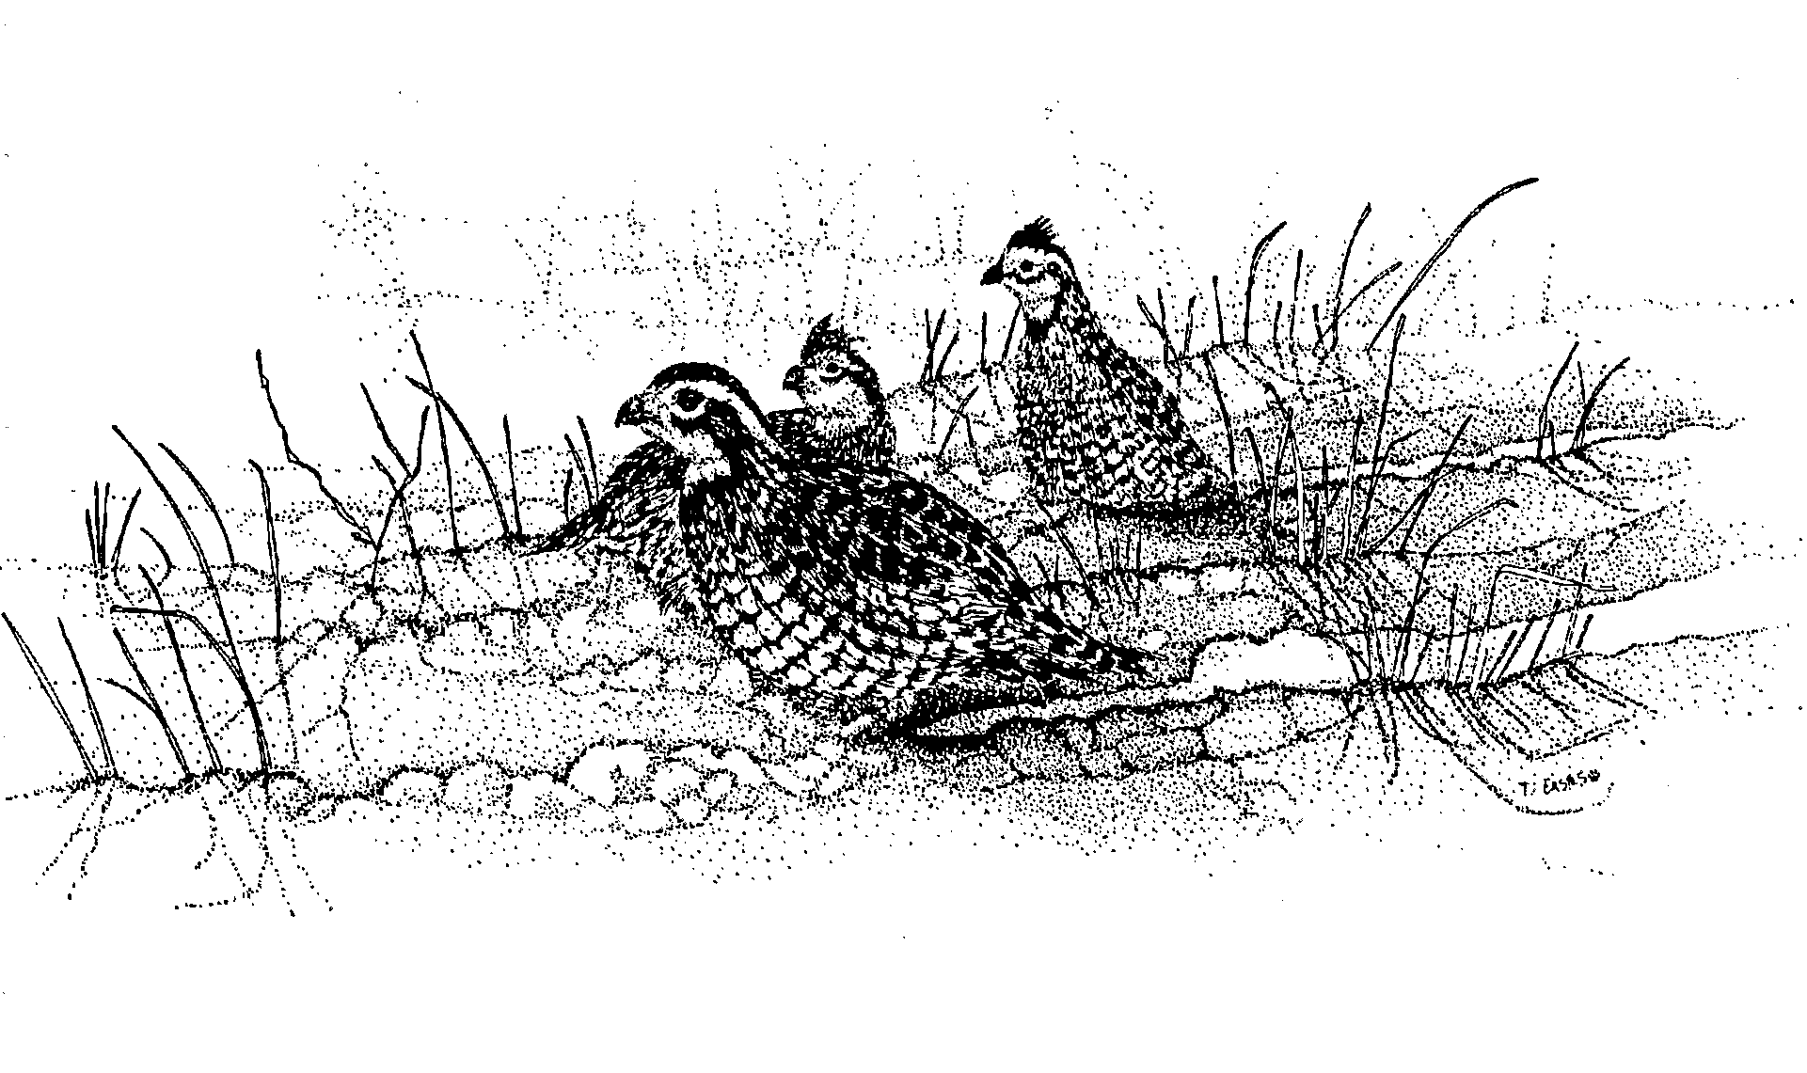
Annual Variation in Northern Bobwhite Survival and Cause-specific Mortality in Relation to Ground Cover and Phenology of Raptor Migration
R. Douglas Holt, L. Wes Burger, Jr., Bruce D. Leopold
Mississippi State University
K. David Godwin
Mississippi Department of Wildlife, Fisheries, and Parks

Slide 2
Introduction
2-year Over-winter ecology study (1 September-28 February 2000-2002)
Black Prairie Wildlife Management Area in the Blackland Prairie physiographic region of northeast Mississippi

Slide 3
Introduction
Bird capture in September and November each year
Birds fitted with 5-6 g necklace style transmitter
Birds relocated ≥ 5 days/week
Survival estimated using Kaplan- Meier method modified for staggered entry

Slide 4
Survival Estimates
2000-2001 (n = 173) 0.027 (SE = 0.0087)
2001-2002 (n = 71) 0.362 (SE = 0.0765)

Slide 5
Cause-specific Mortality
 | Avian | Mammalian | Unknown | Other
2000-2001 | 49.6% (SE = 0.040) | 37.1% (SE = 0.039) | 8.6% (SE = 0.023) | 1.3% (SE = 0.009)
2001-2002 | 28.0% (SE = 0.071) | 22.9% (SE = 0.067) | 12.7% (SE = 0.053) | 0

Slide 6
Raptor Migration Phenology
Christmas Bird Count (CBC) data downloaded from the National Audubon Society (conducted between 14 December and 5 January each year)
Downloaded data for the years 1985-2001
Downloaded data for a 14 state region
Downloaded data for 181 locations
Ranging from 120 in 1985 to 177 in 1998
176 in 2000
173 in 2001
Data downloaded for 4 species of migratory raptors
Sharp-shinned hawks
Cooper’s hawks
Northern harriers
Red-tailed hawks

Slide 7
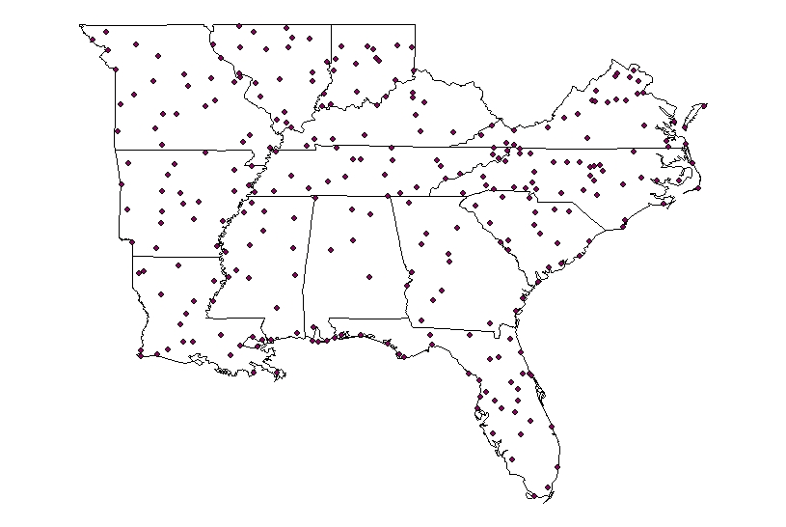
Raptor Migration Phenology

Slide 8
Raptor Migration Phenology
Kriging
Interpolation procedure that uses a set of points with z values to generate an estimated surface that incorporates spatial structure
Universal kriging allows for trends in the spatial data
Kriged surfaces developed with a cell size of 0.1² decimal degrees (~ 10424 ha)

Slide 9
Raptor Migration Phenology

Slide 10
Raptor Migration Phenology

Slide 11
Raptor Migration Phenology

Slide 12
Raptor Migration Phenology

Slide 13
Raptor Migration Phenology

Slide 14
Raptor Migration Phenology

Slide 15
Raptor Migration Phenology

Slide 16
Raptor Migration Phenology

Slide 17
Raptor Migration Phenology

Slide 18
Raptor Migration Phenology

Slide 19
Raptor Migration Phenology

Slide 20
Raptor Migration Phenology

Slide 21
Raptor Migration Phenology

Slide 22
Raptor Migration Phenology

Slide 23
Raptor Migration Phenology

Slide 24
Raptor Migration Phenology

Slide 25
Raptor Migration Phenology
Year-specific spatial patterns of relative raptor abundance

Slide 26
Raptor Migration Phenology
Mean relative abundance of Cooper’s hawks

Slide 27
Raptor Migration Phenology
Mean relative abundance of northern harriers

Slide 28
Raptor Migration Phenology
Mean relative abundance of red-tailed hawks

Slide 29
Raptor Migration Phenology
Mean relative abundance of sharp-shinned hawks

Slide 30
Growing Season Precipitation and Over-winter Temperature
Long-term weather data for Mississippi Division 6
Data from Jan. 1895 – May 2002
Data collected for mean monthly precipitation, Modified Palmer Drought Severity Index, and mean monthly temperature

Slide 31
Growing Season Precipitation and Over Winter Temperature
Growing Season Precipitation

Slide 32
Growing Season Precipitation and Over Winter Temperature
Modified Palmer Drought Severity Index
(PMDI)
Calculated using precipitation, temperature, Thornwaite’s evapotranspiration index, runoff, soil recharge, and average regional weather conditions
Values range from > 4 (extreme moisture) to < -4 (extreme dryness)
Normal values range from 1.5 to -1.5

Slide 33
Growing Season Precipitation and Over Winter Temperature
Growing Season PMDI Values

Slide 34
Growing Season Precipitation and Over Winter Temperature
Over Winter Temperature

Slide 35
Growing Season Vegetation Structure
Vegetative data collected at nest and brood locations during nesting seasons of 2000 and 2001
Used to index vegetation conditions going into winter season
% grass canopy
% forb canopy
Visual obstruction index
Compared using General Linear Models Procedure in SAS
Vegetation characteristics as dependent variables
Year and type (brood and nest) as fixed effects
Grass structure was sparser at brood sites (F_{1,245} = 6.00, P = 0.015) in 2000 (13.09%) vs. 2001 (42.39%)

Slide 36
Conclusions
2000-2001 vs. 2001-2002
Increased mortality
Most attributed to avian predation
Colder winter temperatures coupled with decreased growing season precipitation
Sparser vegetative ground cover
Higher relative abundance of wintering migratory raptors

Slide 37
Problems
Low sample size
1 site
2 years
Confounding effects of vegetative cover and relative raptor abundance
this study “bad” growing season, high relative abundance of raptors
“good“ growing season, low relative abundance of raptors
What happens when we have “good” growing season with high relative abundance of raptors or “bad” growing season low relative abundance of raptors?

Slide 38
Problems
No independent local raptor surveys to validate migration phenology
Additional data is needed to validate estimates of raptor migration and to answer questions with respect to habitat vs. predation as driving factors of over-winter northern bobwhite survival.

Slide 39
Acknowledgements
Mississippi Department of Wildlife, Fisheries, and Parks
BPWMA Staff
Ricky Flint
Robert Miller
Technicians, Volunteers, and Other Graduate Students

Slide 40
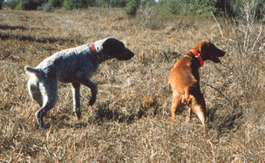
Questions ?

