Slide 1
Temporal Variability in Survival of Non-Breeding Northern Bobwhites in Ohio
-----------------------------------------------------------------------------------------------
Adam Janke
Robert Gates
-----------------------------------------------------------------------------------------------
School of Environment and Natural Resources
Terrestrial Wildlife Ecology Laboratory
Ohio State University

Slide 2
Introduction
Survival important vital rate in declining bobwhite populations (Sandercock et al. 2008)
Seasonal variation important determinant of population growth rates (Folk et al. 2007, Sandercock et al. 2008)
Non-breeding season survival is important vital rate in northern populations
Guthery 2000, Folk et al. 2007, Sandercock et al. 2008, Gates et al. This Session

Slide 3
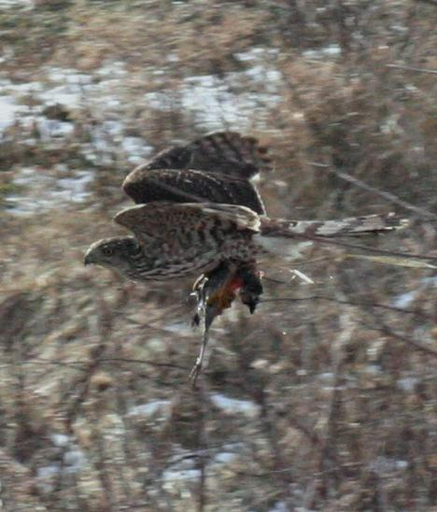
Introduction
Intra-seasonal variation may additionally be important (Moynahan et al. 2006 – GRSG)
Target limiting periods
Investigated non-breeding season (October – March) survival on private lands in Ohio – 2008-2011
Notes:
Variance estimates sensitive to sampling effort and dependency (Burnham et al. 1987, Schmutz et al. 1995, Gould and Nichols 1998)

Slide 4
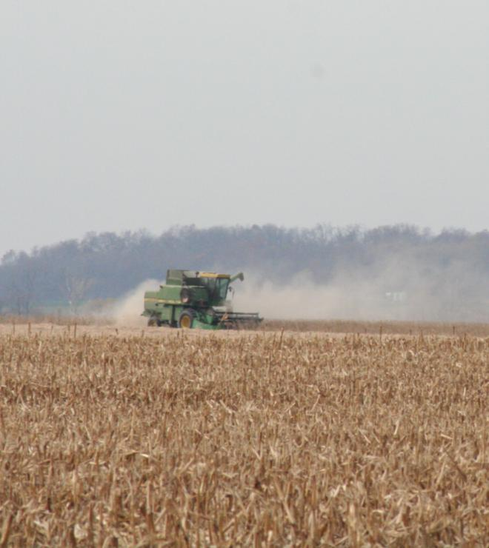
Study Area
Private land in core of bobwhite range in Ohio

Slide 5
Study Area
Private land in core of bobwhite range in Ohio
Habitat composition representative of land-use in region

Slide 6
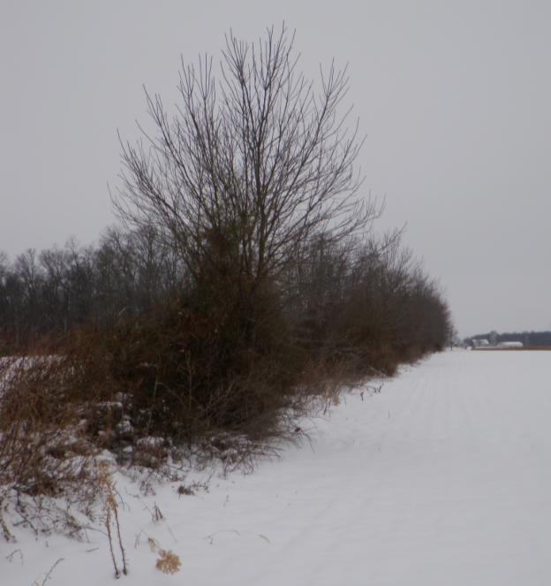
Study Area
Private land in core of bobwhite range in Ohio
Habitat composition representative of land-use in region
Primarily used woody cover along fencerows and ditches

Slide 7
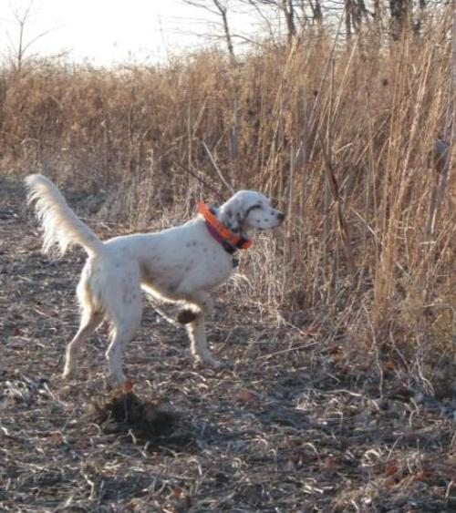
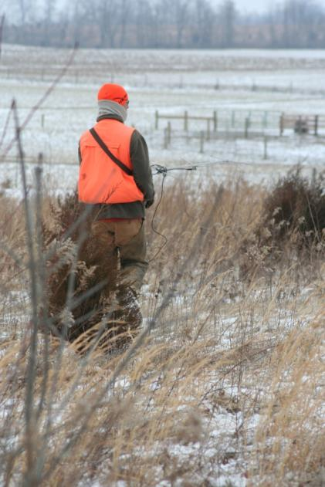
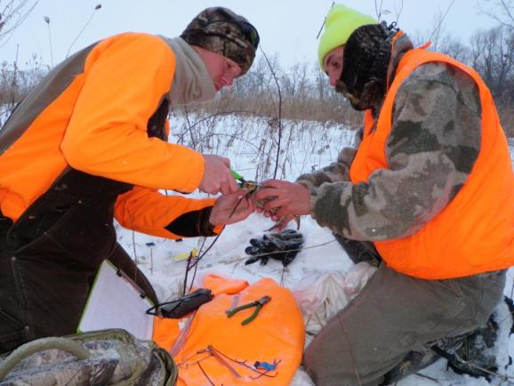
Methods
Located coveys
Captured and radiomarked 2-5 individuals/ covey
Located individuals daily to record habitat use and cause-specific mortality

Slide 8
Survival analysis
Known-fates model in Program MARK
Daily intervals for 1 October – 31 March
2008-09 Season 10 December – 31 March, extrapolated to entire interval following Sandercock et al. 2008
7 day exclusion period (Guthery and Lusk 2004, Holt et al. 2009)
Temporal models (n = 17)
constant, weekly, bi-weekly, monthly
Additive effects and interactions with year
e.g. Week, Week + Year, Week + Year + Week x Year
Selected most parsimonious model with AICc
Data bootstrapping procedure to improve variance estimate with ĉ (Bishop et al. 2008)
Resampled based on covey affiliation (Williams et al. 2003)
Cumulative incidence function (CIF) for harvest mortality (Heisey and Patterson 2006)

Slide 9
Results
Low survival in each non-breeding season (Oct. – Mar)
311 individuals from 73 coveys
(08-09 n=55, 09-10 n=130, 10-11 n=126)

Slide 10
Mortality causes
Harvest CIF = 0.068 (0.012, 0.123)

Slide 11
Results
Heterogeneous temporal models within and among years
Slight dependency among covey members
ĉ = 1.54
Model |  | AIC_{c} |  | ΔAIC_{c} |  | w_{i} |  | K
S(Week)Year+Week*Year |  | 1585.479 |  | 0.000 |  | 0.935 |  | 52
S(BiWeek) Year+BiWeek*Year |  | 1590.822 |  | 5.343 |  | 0.065 |  | 26
S(Month) Year+Month*Year |  | 1617.168 |  | 31.689 |  | 0.000 |  | 12

Slide 12
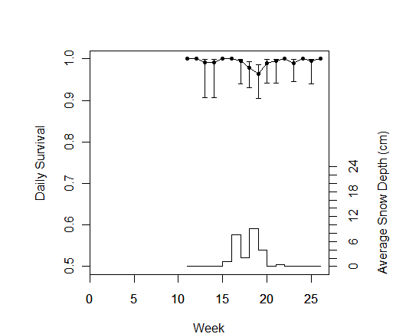
2008-09
S*=0.294
*extrapolated to 182 d. interval

Slide 13
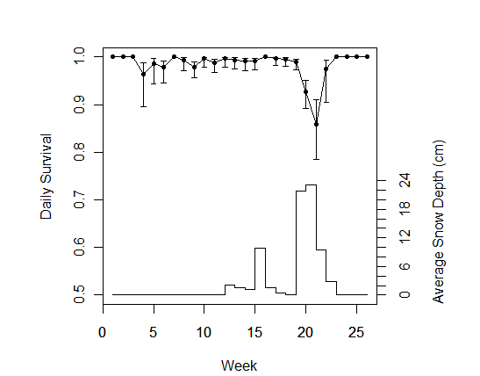
2009-10
S=0.055 (0.026, 0.113)

Slide 14
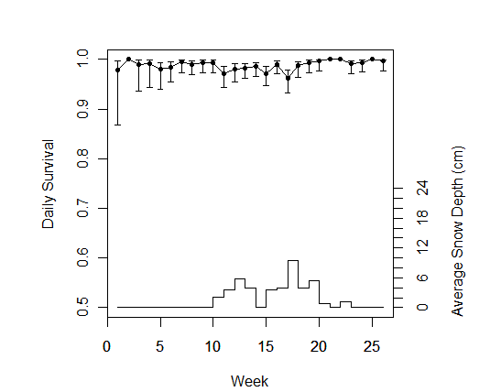
2010-11
S=0.121 (0.069, 0.203)

Slide 15
2008-09

Slide 16
2009-10

Slide 17
2010-11

Slide 18
Discussion
Variable survival among years consistent with previous long-term studies

Slide 19
Discussion
Highly variable survival among years consistent with previous long-term studies
Survival influenced primarily by predation
Harvest not highly influential
Covey-level Allee Effects
Survival during periods of snow cover most variable
Predation, rather than freezing or starvation (e.g. Leopold 1937, Trautman et al. 1939)

Slide 20
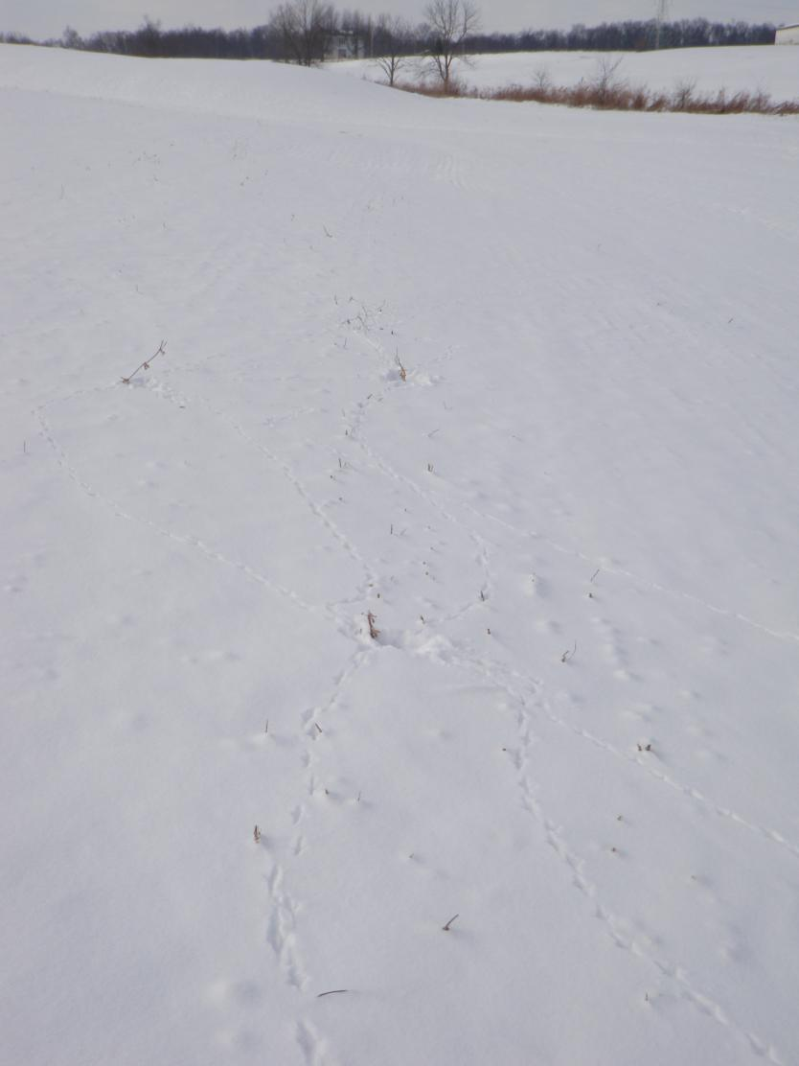
Cover
Food

Slide 21
Management Implications
Improve survival (decrease predation) during periods with snow accumulation to improve non-breeding season survival, population growth rates
Providing suitable woody cover close to food resources may reduce vulnerability to avian predators

Slide 22
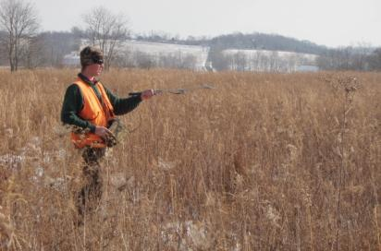
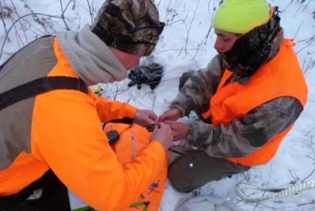
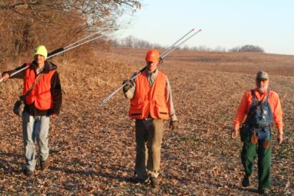
Acknowledgements
Landowners
Division of Wildlife
Dennis Hull
Heidi Devine
Barb Graves
George Fee
Mark Wiley
Mauri Liberait
Dr. Amanda Rodewald
Dr. Stan Gehrt
Bret Graves
Jay Jordan
Bryce Adams
Chris Grimm
Matt Crowell
Les Murray
Nan Radabaugh
Mark Peugeot
Laura Jenkins

Slide 23
Questions
Adam Janke
adam.janke@sdstate.edu

Slide 25
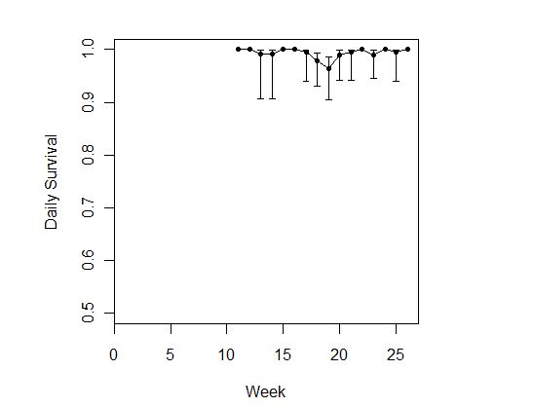
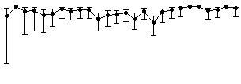
2009-10
2010-11
2008-09

