Slide 1
Impacts of Bermuda Grass on Northern Bobwhite Chick Mobility and Heat Exposure
James A. Martin¹, Jason Burkhart², Reggie Thackston³, and John P. Carroll²
¹Mississippi State University
²University of Georgia
³Georgia Department of Natural Resources

Slide 2
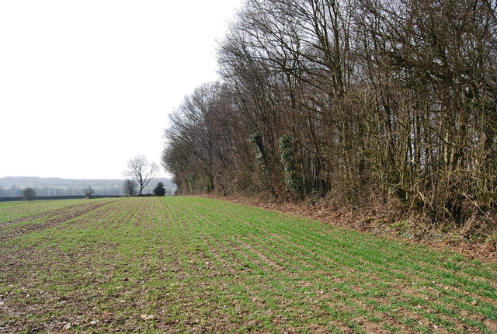
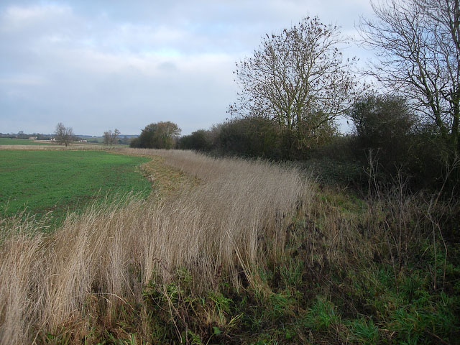
Field Borders

Slide 3
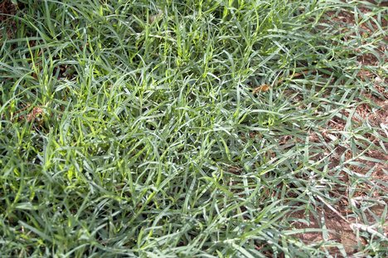
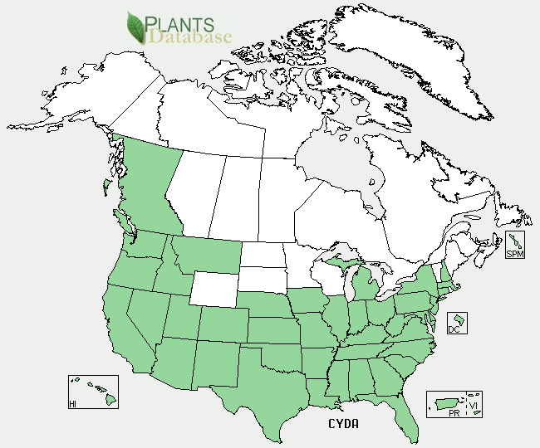
Bermuda Grass

Slide 4
Objectives
Measure the effect of Bermuda grass density on northern bobwhite chick movements
Compare ambient temperatures in areas dominated by Bermuda grass and NOBO friendly forbs
Determine lethality curves for NOBO

Slide 5
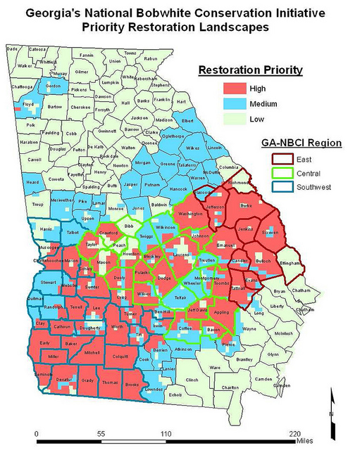
Study Area
Upper coastal plain of GA, USA
Hot summers
Dominated by agriculture
Bermuda grass prevalent

Slide 6
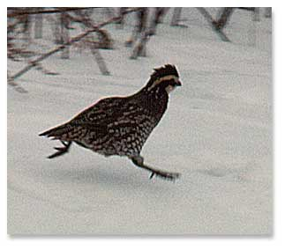
Experimental Design
Randomized complete block design
  Treatments: “Low” Bermuda grass density (0-20%); “High” (>20 %); and a control of 0% Bermuda grass
  “Trials” considered blocks (n=8)

Slide 7
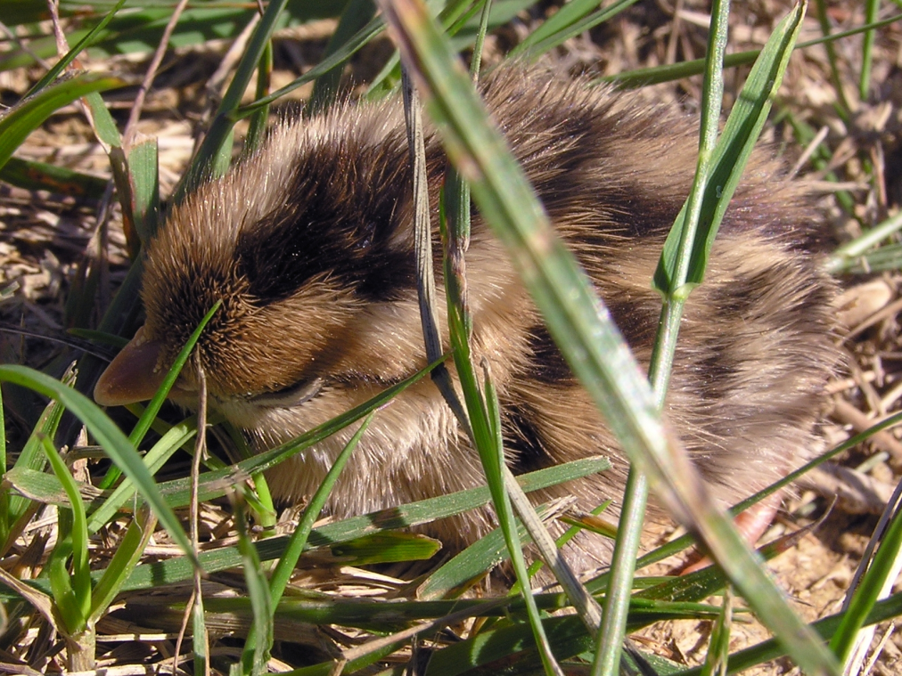
Experimental Design
Purchased 1-day old chicks
Set-up a 2 m “race track” for chicks to complete
Chicks put in groups of 8 chicks
Randomly chose groups
Groups not chosen provided stimuli for chicks in trial

Slide 8
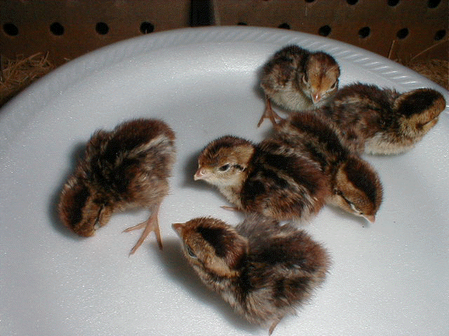
Experimental Design/Analysis
Trials conducted during morning and evening
Chicks were used at 5 and 10 days old
ANOVA used for analysis (alpha 0.05)

Slide 9
Temperature Comparison
Paired design of forb dominated and Bermuda grass dominated plots within field borders
HOBO® temperature data loggers placed in each plot (n=3); probes was placed at “chick level”
Only daytime readings used in analysis
t-test used to compare

Slide 10

Time-to-Death
where
t = time in seconds;
m = body mass in g;
s = specific heat (J/g/C); and
G = rate of heat gain (W/C)
Guthery (2000)

Slide 11
Results: Time-to-Complete
 |  | Bermudagrass Density
Chick Age | Low (0%) | Medium (>0%-20%) | High (>20%)
5 Days | 0.77 (0.095) | 1.17 (0.094) | 1.22 (0.093)
10 Days | 0.61 (0.052) | 0.67 (0.056) | 0.56 (0.059)

Slide 12
Temperature by Treatment

Slide 13
Temperature Threshold (40° C)
Table 2. Temperature summary for bermudagrass and forb patches in Laurens County, Georgia during August 7 – September 6, 2001.
¹ The threshold was set at 40 C, based on Guthery (2000). However, for chicks this temperature may be less.
 | Bermuda |  | Forb
Variable | Mean | SD | Mean | SD | Proportion Different
Mean Temperature (C) | 34.51 | 2.71 | 31.58 | 2.31 | 0.08
Mean Max Temperature (C) | 44.20 | 2.82 | 40.06 | 3.48 | 0.09
% Days > Threshold¹ | 0.87 | - | 0.67 | - | 0.23
% Time >Threshold | 0.32 | 0.18 | 0.11 | 0.12 | 0.67

Slide 14
Time-to-Death

Slide 15
Discussion
Bermuda grass density affected movement, but only at 5 days old
Lack of effect at 10 days not surprising biologically
Literature scant on thermodynamics of bobwhite chicks (Guthery et al. for adults)

Slide 16
Discussion
We made assumptions that heat affects chicks similar to adults (perhaps our results are conservative)
If there are not similar, do adult bobwhites select habitats for their optimal thermal environment or that of the chicks?

Slide 17
Conclusions
Bermuda grass likely fragments landscape for NOBO because of thermal environment and increased risk from slowed movements
Removal of Bermuda grass is warranted, but good luck!

Slide 18
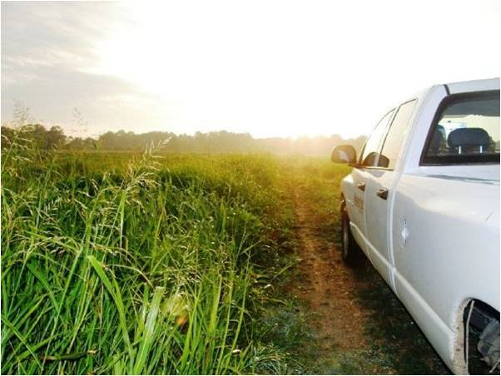
Questions?

