Slide 1
Climate Change and Northern Bobwhites: The State of Our Knowledge, Possible Outcomes, and the Risk of Ignorance
James A. Martin
Mississippi State University

Slide 2
Premise
No perturbation has received as much public and scientific attention
Climate change is a paradigm that includes ecological, climatic, and social processes
Not trying to make you all into “believers”

Slide 3
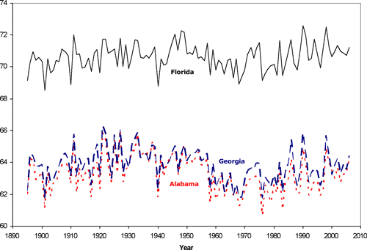
What is occurring?

Slide 4
Weather & Bobwhites
“As July temperature increased over the long-term mean, the number of bobwhites counted increased...but the relationship decelerated at high July temperatures...” -Lusk et al. 2001

Slide 5
Weather and Bobwhites
“High precipitation (mean annual precipitation = 90 cm) and mild temperature (mean max. Jul to Aug temp = 35.0° C) scenarios produced the greatest increases in bobwhite density, resulting in densities >5–6 bobwhite/ha...” -Rader et al. 2011

Slide 6
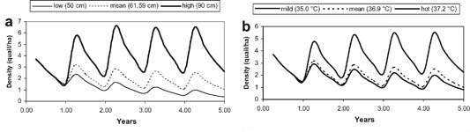
Rader et al. 2011
The Journal of Wildlife Management Volume 75, Issue 1, pages 61-70, 31 JAN 2011 DOI: 10.1002/jwmg.4 http://onlinelibrary.wiley.com/doi/10.1002/jwmg.4/full#fig4
Notes:
Results of deterministic model sensitivity analysis. a: Bobwhite density response over 5 yr to 3 levels of annual precipitation. b: 3 levels of mean maximum July to August temperature. c: 3 levels of nest‐clump availability. d: 3 levels of nest predation.
© This slide is made available for non-commercial use only. Please note that permission may be required for re-use of images in which the copyright is owned by a third party.

Slide 7
Weather & Bobwhites
“Hatchability fluctuated among years, and variation in hatchability was partly explained by variability in summer temperature and precipitations.”—Rolland et al. 2010

Slide 8
Latitude as a Climate Surrogate

Slide 9
Climate Change & Bobwhites
No doubt NOBO respond to short-term weather patterns
No doubt NOBO have an optimal climate (a niche)
However, a great deal of uncertainty how bobwhites would respond (or currently responding) to climate change

Slide 10
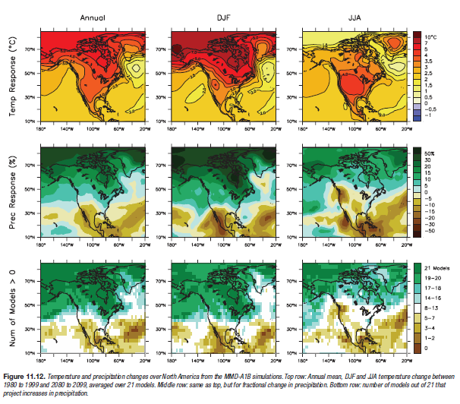
Why the uncertainty?

Slide 11
Effects to other birds? Blackburnian Warbler

Slide 12
“Climate change altered community richness the most when species had narrow niches, ....With high interspecific dispersal variance, the best dispersers tracked climate change, out-competed slower dispersers and caused their extinction.” Urban et al. 2012

Slide 13
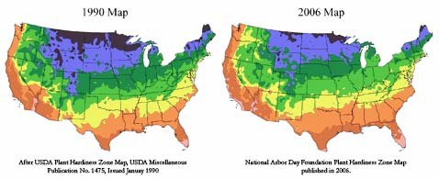
Plant Shifts?

Slide 14
What if?
Bermuda grass outcompeted Fescue in Kentucky
Fire ant distribution included Kansas
West Texas had more frequent droughts
It rained more in south Florida

Slide 15
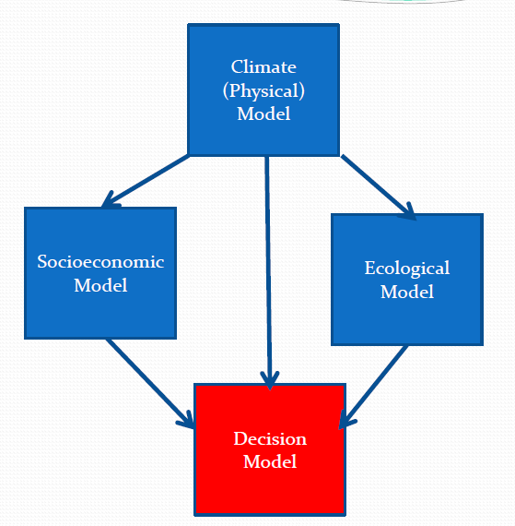
What do we do?

Slide 16
Use of SDM and ARM

Slide 17
What if we do nothing?

Slide 18
Questions?

