Slide 1
Exclosure: an experimental technique for protection of northern bobwhite nest
Joseph H. Treadway, Jr.,
C. Brad Dabbert,
Robert B. Mitchell,
Byron R. Buckley
Notes:
Nest success is one of many possible limiting factor for bobwhite quail throughout its range. Bobwhite are boom or bust birds (which this year in Texas was a bust year) and in those bad years every egg counts. So this study evaluates the potential of nest predator exclosures to increase nest success

Slide 2
Background
Bobwhite nest success 28-46%
Average 45% in south Texas
Previous nest success 38%
Research of predator removal is contradictory
Beasom (1974), Lehmann (1984) success to slightly successful
Guthery and Beasom (1977), Frost (2000)found no increase or ambiguous results
Notes:
Bobwhite nest success can average roughly 30 – 45%, and in south Texas average about 45%. A previous nest success on the study site was documented at 38%. A method used for potentially increasing nest success has been predator removal. There have been several peer reviewed studies conducted on the removal of nest predators to protect ground nesting birds but they have produced a wide range of results from out right success to no increase. So this technique leaves a lot to chance (meaning that it is assumed that more predators will not move in to replace those removed). But…….

Slide 3
Exclosure
Exclosures have been used successfully for various ground nesting species to allow nests to progress past the nesting stage
Ducks (Anas spp.) (Cowardin et al. 1998)
72%
Piping plovers (Charadrius melodus) (Melvin et al. 1992)
17% →90%
Sea turtles (Caretta caretta) (Ratnaswamy et al. 1997)
92.4% nest success
Notes:
Exclosure are a little more predictable. They have been used successfully in several different ground nesting spp. from ducks which documented a 72 increase in nest success to piping plovers which increase nest success from 17 to 90% and even sea turtles have benefited from predator exclosures.

Slide 4
Objectives
Evaluate nest exclosures as a research tool to eliminate vertebrate predation on bobwhite nests
Hen/brood ability to move through exclosure or abandonment
Notes:
The objectives of the study was to examine the effectiveness of the exclosure on bobwhite nests and to evaluate if hen and chicks movement were impeded.

Slide 5
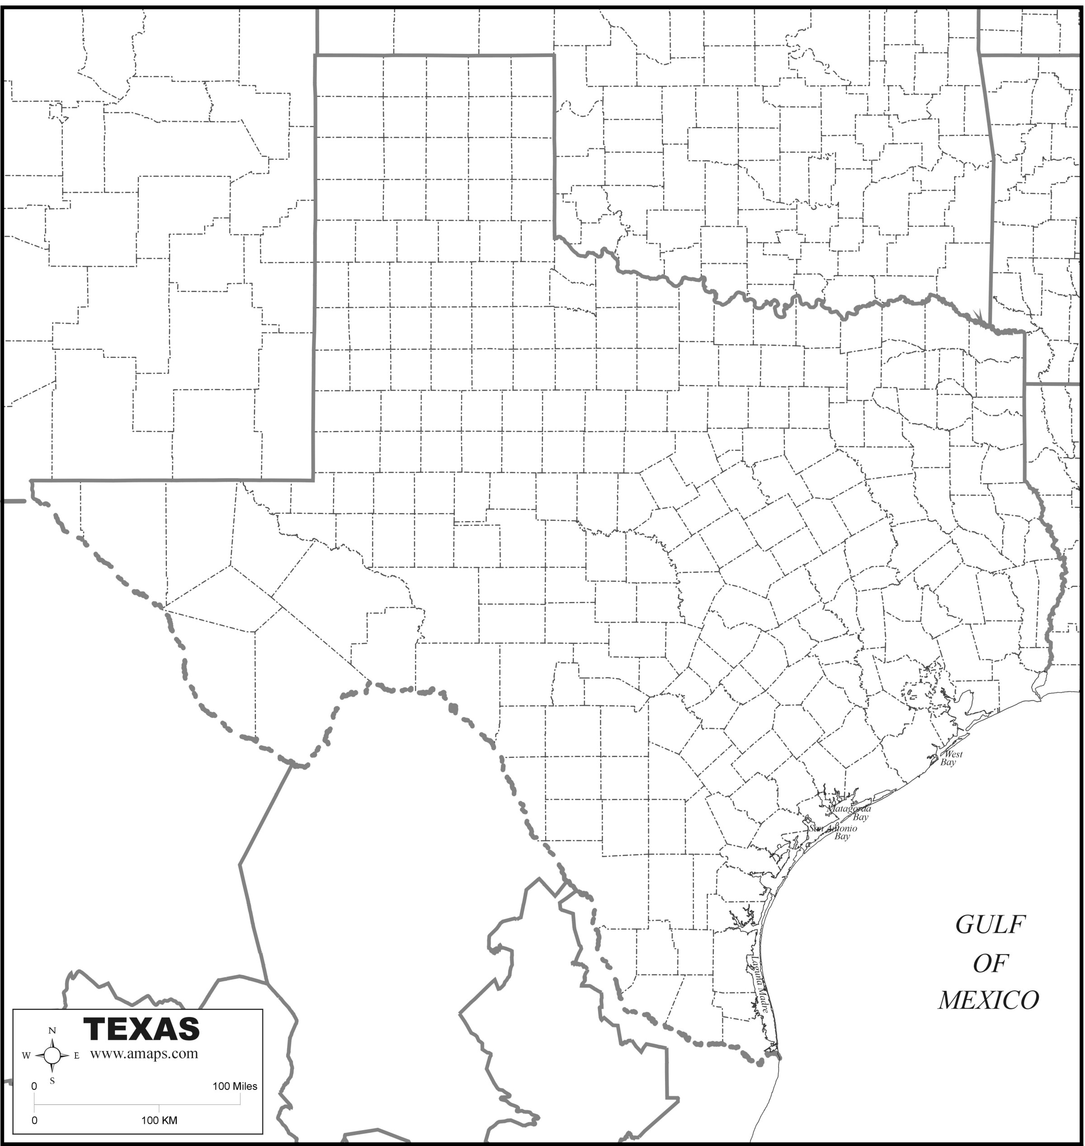
Study Area
Refugio County, TX
10,040 ha
Working ranch:
Cattle, Oil, and Agricultural
Coastal Prairie
Grasses, oak (Quercus spp.), mesquite (Prosopis spp.), huisache (Acacia spp.)
Photo by David Rosen
Notes:
The study site was located in southeast texas. It was on a 10000 ha working ranch with coastal prairie which the dominent veg was grassland with oaks and mesquite spread about.

Slide 6
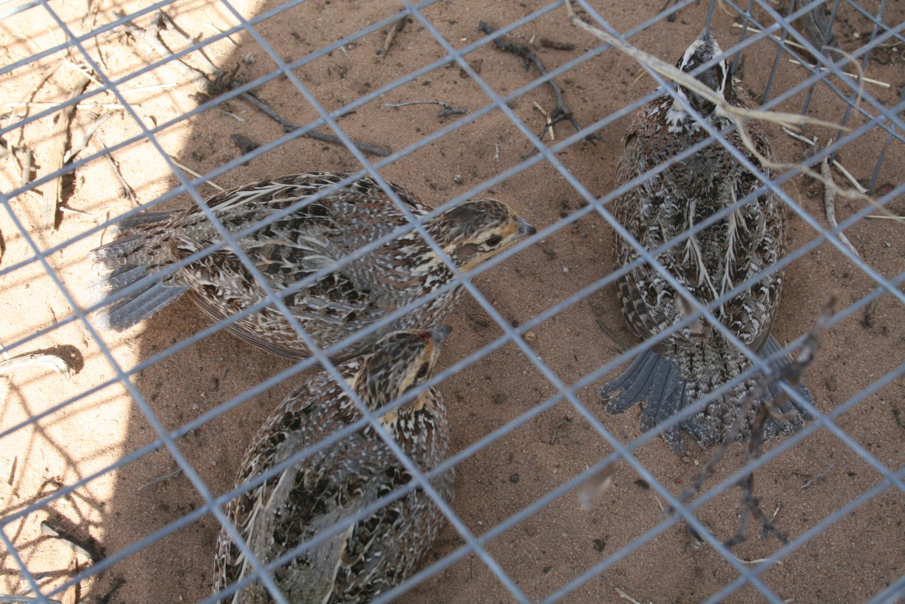
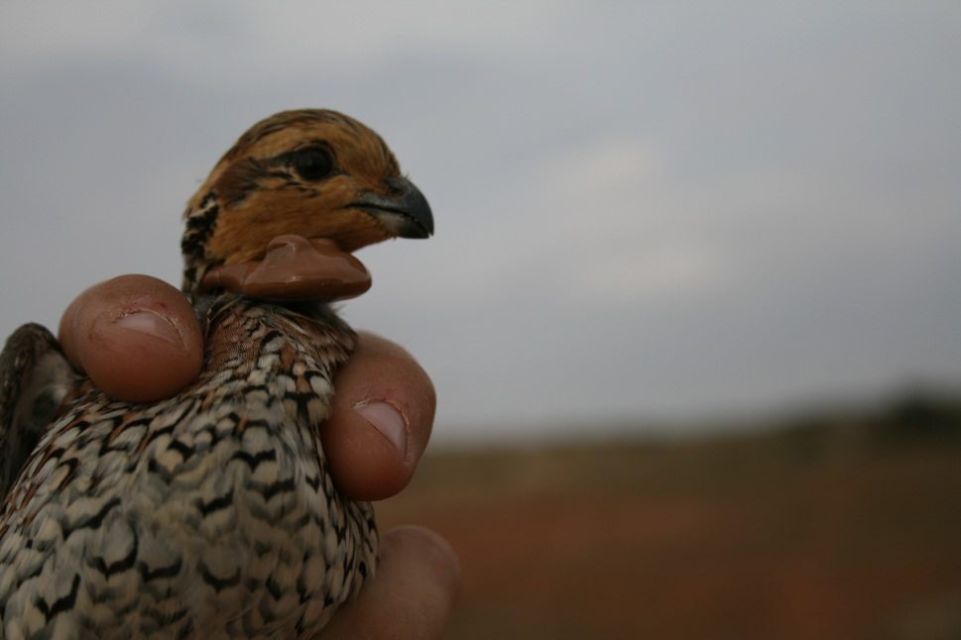
Methods
Walk-in-funnel traps
6g necklace radio transmitter
Homing to monitor
2-3 days (early nest cycle)
Daily (last nest cycle)
Hens nested at random
Notes:
The hens were captured with a walk in funnel trap and fitted with a 6g necklace radio transmitter. They birds were followed until they began to nest and after nest inittiation hens were monitored 2-3day in the early stages of nesting but then increase to daily when they neared the 24 day mark. Hens were allowed to nest at random on the study site.

Slide 7
Methods (continued)
Randomly assigned a treatment
Exclosure
Control
Notes:
Once a nest was discovered it was randomly assigned a treatment either exclosure or control. The exclosure is about 1.2m squared and almost half a meter high .It has two small doors to allow the hen to come and go and is held down with two pieces of rebar.

Slide 8
Methods (continued)
Exclosure
Attempted to install while hen was away
Welded wire
1.22m x1.22m x0.4m
5cm x 10cm openings
Staked with rebar
←1.22m→
Stake
.4m
1.22m
Nest

Slide 9
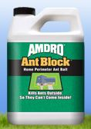
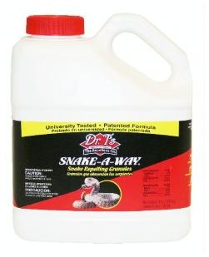
Methods (continued)
Amdro®
Red imported fire ants
Spread 1.7kg/ha 60 square meter
Snake-a-way®
Prevent snakes
85kg 10-12 cm band around nest
Chemicals were used to increase chances of nest success
Notes:
Once the exclosure was in place chemicals were placed to prevent depredation by red imported fire ants and reptiles. Amdro was spread over 60 square meters around the nest while snake a way was spread in a band just around the nest area.

Slide 10
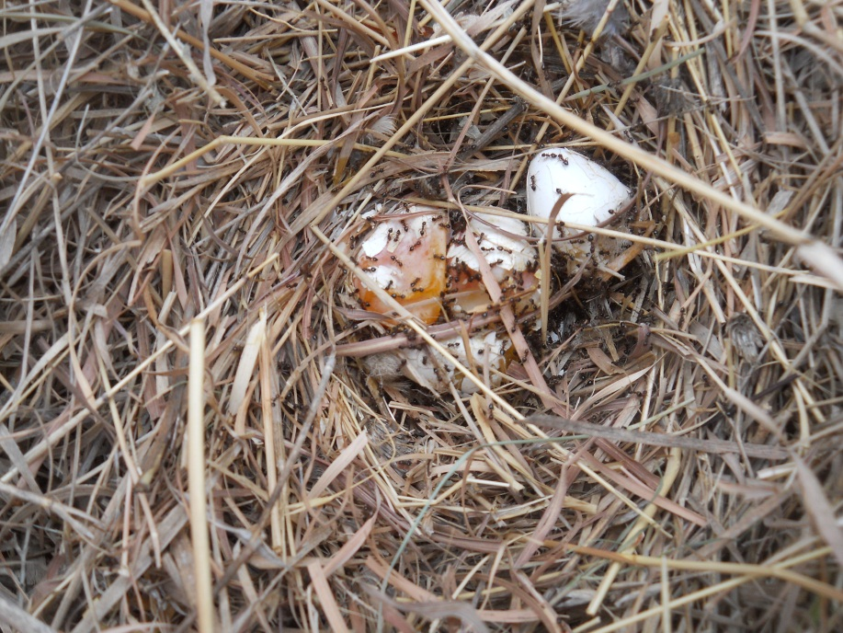
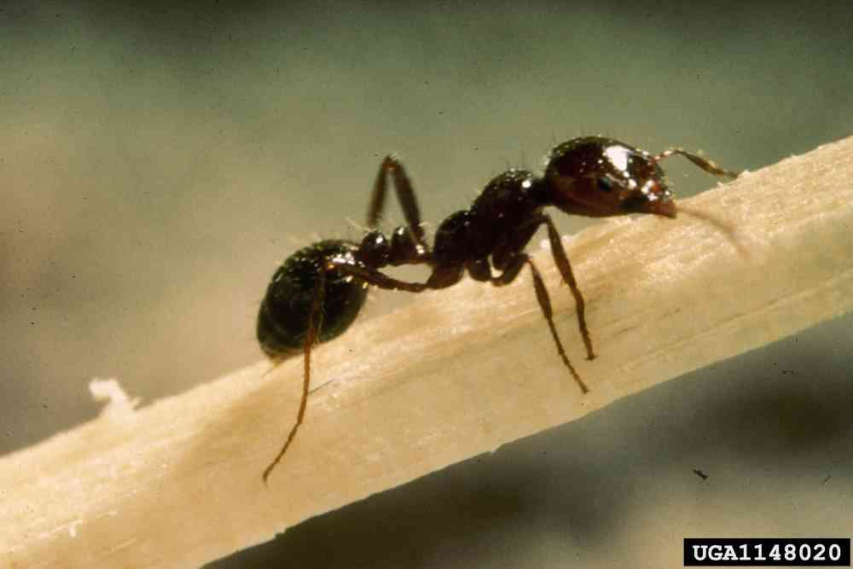
Methods (continued)
Nests were labeled as:
Successful = 1 egg hatched
Nest predators
Imported fire ant or other
Photo by Alicia Andes
http://www.desertmuseum.org/invaders/invaders_fireant.php

Slide 11
Results
Hens did not abandon due to exclosure
4 exclosures were installed with hens on nest
Hens that flushed returned to incubate
One control nest was depredated by red imported fire ants
One exclosure nest was destroyed in each year (N=2)
Unknown predator but signs point to:
Long-tailed weasels (Mustela frenata),
Hispid cotton rats (Sigmodon hispidus),
Eastern spotted skunks (Spilogale putorius)

Slide 12
Results (continued)
2000
75% exclosure (n=4)
25% control (n=12)
2001
100% exclosure (n=4)
67% control (n=6)

Slide 13
Results (continued)
2000
75% exclosure (n=4)
25% control (n=12)
2001
100% exclosure (n=4)
67% control (n=6)
Pooled data (P=.011)
88% (n=8)
39% (n=18)

Slide 14
Discussion
Individual nest predators were difficult to accurately determine except for Red Imported Fire Ants
Sample size did not allow for extensive evaluation of all aspects of the study
Provide successful, non-lethal form of nest protection from typical vertebrate nest predators for research purposes
Notes:
1-This study was conducted to determine the effects of exclosures on vertebrate predators not to id what the predators were.
2-Due to the small sample size different aspects of the study were difficult to evaluate meaning chemical deterrent for reptiles
3-It was determined that hens did not abandon nest even when the exclosure was placed over them while they were on the nest, even when a hen flushed from the nest prior to the exclosure being place they returned to incubate
4-And brood movenment was not impeded.

Slide 15
Discussion (continued)
Hen movement was unimpeded
Brood dispersal with hen was not affected
Potential future research:
Investigate chemical deterrent
Different habitat throughout the bobwhites range
Motion capture cameras to identify individual predators of exclosure nests
Notes:
This study was to provide a non lethal method of protecting bobwhite nests from typical vertebrate predators and this method has the potential to aid in future nesting studies.

Slide 16
Acknowledgements
Texas Red Imported Fire Ant Initiative
J.F. Welder Heirs
Technicians and graduate students
Texas Tech University
Natural Resources Management

Slide 17
Questions

