Slide 1
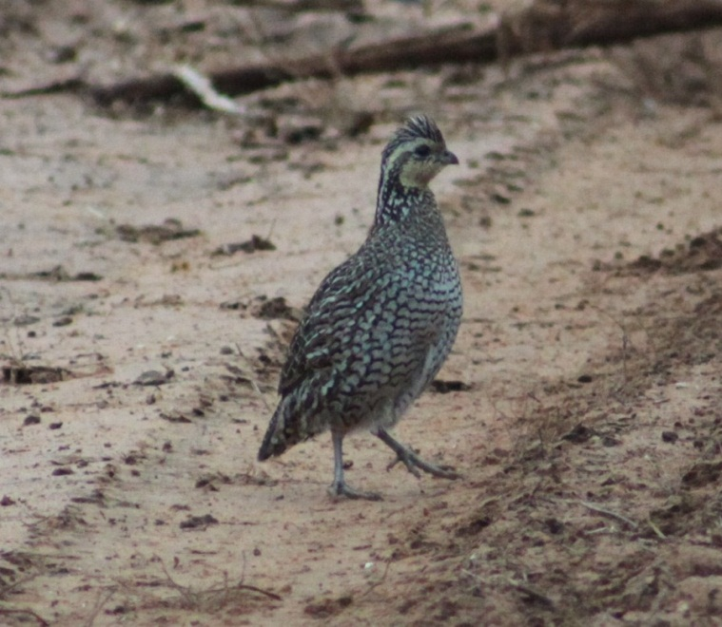
Three-year study on the parasitic eyeworm in northern bobwhites from the Rolling Plains of Texas
Stacie M. Villarreal
Caesar Kleberg Wildlife Research Institute, Texas A&M University-Kingsville

Slide 2
Co-authors
Alan M. Fedynich¹
Leonard A. Brennan¹
Dale Rollins²
¹Caesar Kleberg Wildlife Research Institute, Texas A&M University-Kingsville, Kingsville, TX
²Texas AgriLIFE Research, Rolling Plains Quail Research Ranch, San Angelo, TX

Slide 3
Overview
Introduction of project
Background information on parasites
Objective of project
Study area
Methods
Results
Discussion
Conclusion

Slide 4
Introduction
Quail are enjoyed for hunting and other
non-hunting recreation
Bring in revenue for small towns (Brennan 2007)
Bobwhites have been declining for several years
Some helminths can have negative impacts on bobwhites (Peterson 2007)
Little information on parasites in Rolling Plains or effects on bobwhites (Jackson 1969)

Slide 5
Background
Little is known about potential negative effects of eyeworms
Cause vision problems
Cause distractions & make quail less attentive to surroundings
Jackson (1969) observed bobwhites exhibiting peculiar behavior when dogs attempted to flush them (i.e., running)
3 different species of eyeworms found in North America
Oxyspirura mansoni, domestic birds
Oxyspirura pusillae, wild birds
Oxyspirura petrowi, wild birds

Slide 6
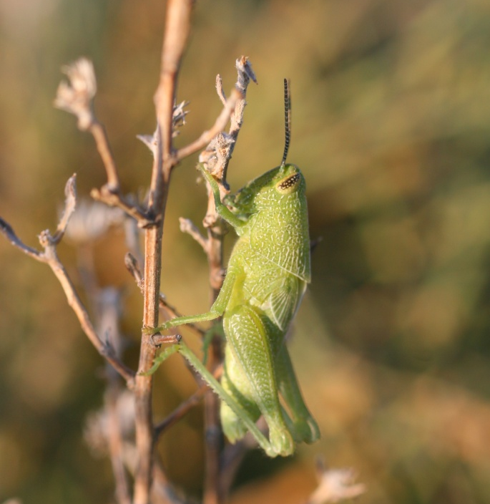
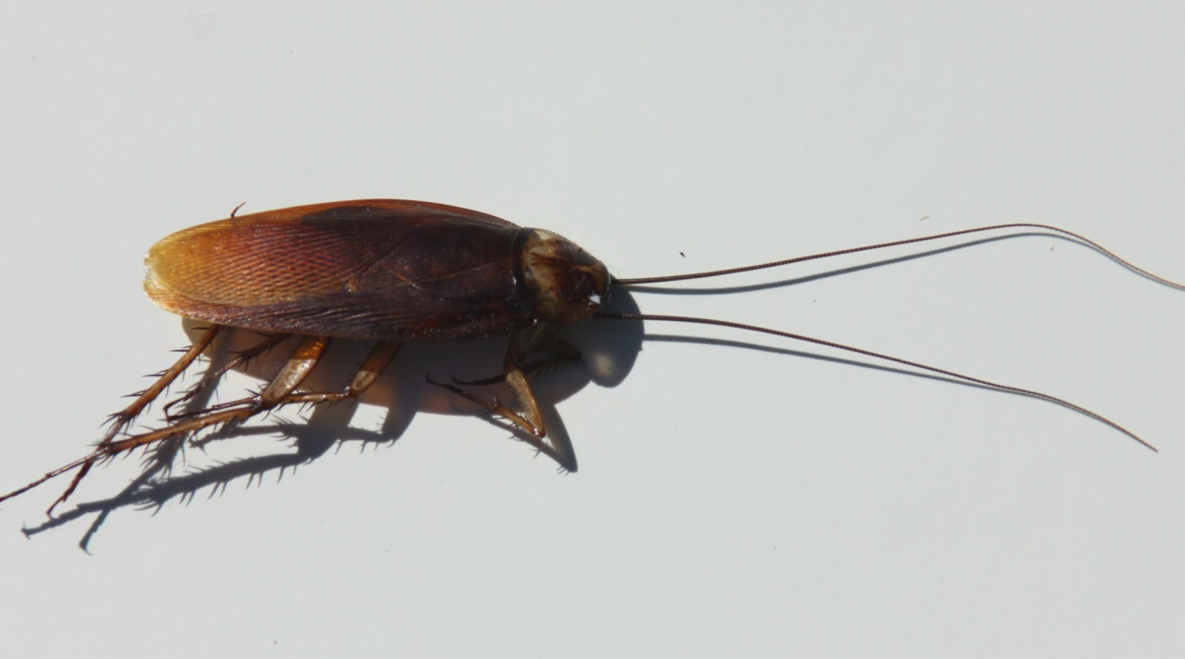
Background
Found:
Ruffed grouse, greater prairie chicken, sharp-tailed grouse, and ring-necked pheasant
Scaled and Montezuma quail in Texas (Pence 1975, Dancak et al 1982, Landgrebe et al. 2007)
Intermediate host
Cockroaches (Fielding 1926) and/or grasshoppers (Cram et al 1931)

Slide 7
Background-Life Cycle

Slide 8
Objectives
Assess the prevalence, intensity, and abundance of Oxyspirura petrowi in northern bobwhites from the Rolling Plains of Texas
Determine whether infections vary by
age (juvenile, adult)
sex (male, female)
Hunting season (2007-2008, 2009-2010, 2010-2011)

Slide 9
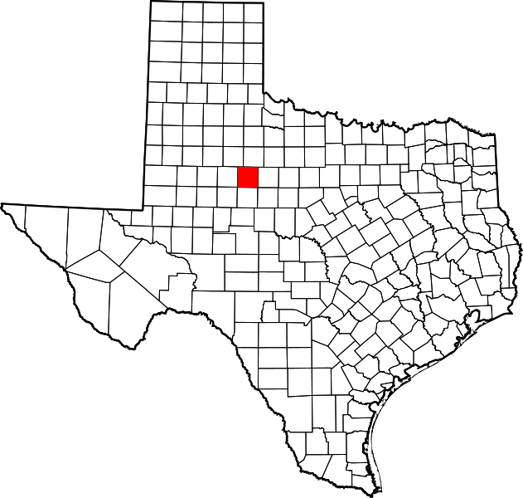
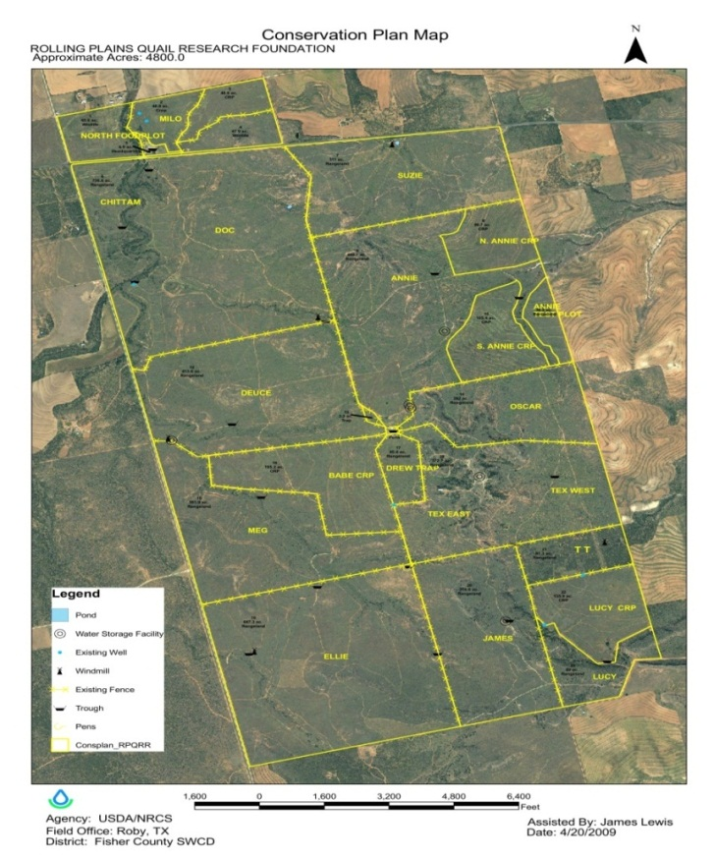
Study Area
Location
Rolling Plains Ecoregion
Fisher County, Texas
Roby, Texas
Rolling Plains Quail Research
Ranch
Melton Ranch

Slide 10
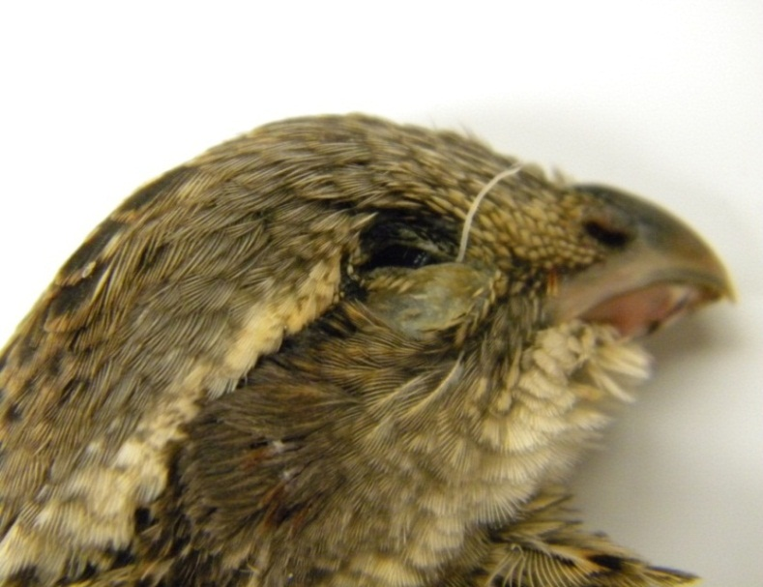
Methods
Hunter donated
Quail sex and age identified in field
Carcasses were frozen until necropsy
Head removed
Eyes examined, nictitating membrane, and around the eye cavity
Fixed in glacial acetic acid
Stored in 70% ethanol and 8% glycerin

Slide 11
Methods
2007-2008 (n = 33)
9 adult males, 11 adult females, 5 juvenile males, and 8 juvenile females
2009-2010 (n = 86)
28 adult males, 18 adult females, 17 juvenile males, and 23 juvenile females
2010-2011 (n = 54)
17 adult males, 4 adult females, 18 juvenile males, and 15 juvenile females

Slide 12
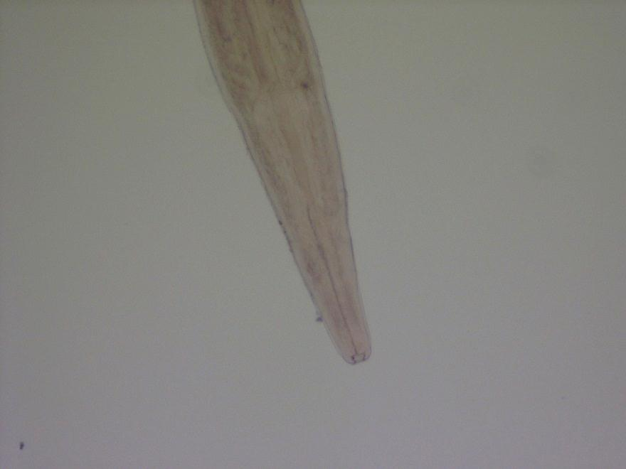
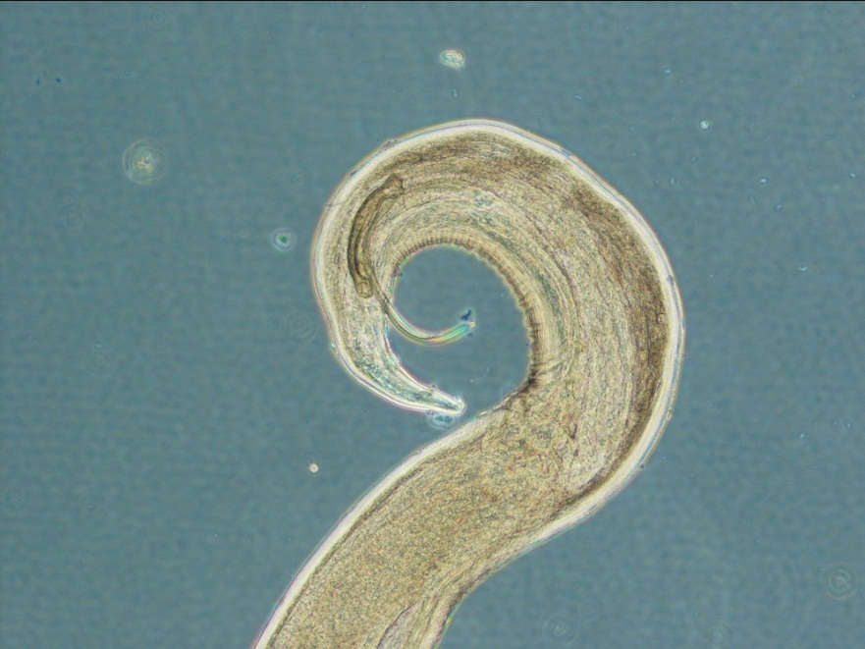
Results
57% Prevalence
Intensity
Median: 4 Range: 1-40
Mean: 6 Total: 596
Abundance
Median: 1 Mean: 3.4
Range: 0-40

Slide 13
Results
Prevalence, Intensity, and Abundance of Oxyspirura petrowi by northern bobwhite age and sex from the Rolling Plains of Texas
 | Host Age |  | Host Sex
 | Adult | Juvenile | Male | Female
Number of Host | 85 | 88 | 94 | 79
Prevalence No. Infected (%) | 57 (67%) | 42 (48%) | 53 (56%) | 46 (58%)
Intensity ̅x ± SD | 6.9 ± 7.3 | 4.8 ± 4.7 | 5.8 ± 5.2 | 6.3 ± 7.6
Abundance ̅x ± SD | 4.6 ± 6.8 | 2.3 ± 4.0 | 3.3 ± 4.8 | 3.7 ± 6.6

Slide 14
Results
Prevalence, Intensity, and Abundance of Oxyspirura petrowi in northern bobwhites by collection year from the Rolling Plains of Texas
 | 2007-2008 | 2009-2010 | 2010-2011
Number of Host | 33 | 86 | 54
Prevalence No. Infected (%) | 19 (58%) | 54 (63%) | 26 (48%)
Intensity ̅x ± SD | 8.3 ± 10.1 | 5.0 ± 4.2 | 6.5 ± 6.6
Abundance ̅x ± SD | 4.8 ± 8.6 | 3.1 ± 4.1 | 3.1 ± 5.6

Slide 16
P-values from Chi–square comparisons for prevalence values of Oxyspirura petrowi from northern bobwhites in the Rolling Plains of Texas
Age | Sex | Year
0.0158 ↑A | 0.8070 | 0.2337
A = adult, ↑ = higher

Slide 17
P-values from ANOVA comparisons for ranked values of Oxyspirura petrowi from northern bobwhites in the Rolling Plains of Texas
 | Model | Age | Sex | Year
Intensity | 0.3485 | 0.0849 | 0.8044 | 0.5795
Abundance | 0.0291 | 0.0050 | 0.5483 | 0.5131

Slide 18
Discussion
Highest recorded number (40) of eyeworms in a host individual
Average 6 eyeworms per infected bird
Average 3.4 eyeworms per all birds
McClure (1949) found 2 eyeworms in ring-necked pheasants in February

Slide 19
Discussion
Prevalence & mean abundance were higher in adults
Prevalence & mean abundance were not significantly different for host sex or hunting season
Exposure probabilities to infected intermediate host are similar between sex

Slide 20
Conclusion
Provides new information about the distribution patterns of eyeworms
Host sex does not appear to be a major factor in helminth prevalence, abundance, and intensity
Host age was an important factor in influencing prevalence and abundance
Future studies are needed to determine if eyeworms have a negative impact

Slide 21
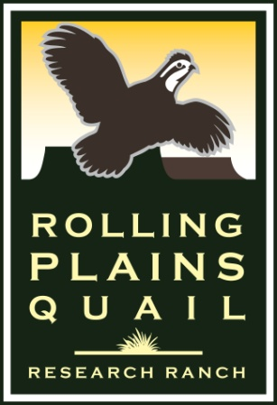
Thank you to the following people who helped…
Rolling Plains Quail Research Ranch
Paul Melton
Lloyd LaCoste
Barrett Koennecke
Becki Perkins
Britani Lolley
Cady Mercer
Photos by: Nicholas Villarreal

Slide 22
Literature Cited
Brennan, L. A. 2007. Preface. Pages xi–xii in L. A. Brennan, editor. Texas quails: Ecology and management, Texas A&M University Press, College Station, TX.
Cram, E. B., M. F. Jones, and E. A. Allen. 1931. Internal parasites and parasitic diseases of the bobwhite. Pages 229–313 in H. L. Stoddard, editor. The bobwhite quail its habits, preservation, and increase. Charles Scribner’s Sons, New York.
Dancak, K., D. B. Pence, F. A. Stormer, and S. L. Beasom. 1982. Helminths of the scaled quail, Callipepla squamata, from northwest Texas. Proceedings of the Helminthological Society of Washington 49: 144–146.
Fielding, J. W. 1926. Additional observations on the development of the eye worm of poultry. Australian Journal of Experimental Biology and Medical Science 5: 1–8.
Jackson, A. S. 1969. Quail management book for west Texas Rolling Plains. Texas Parks and Wildlife Department, Austin, Texas, Bulletin No. 48.
McClure, H. E. 1949. The eyeworm, Oxyspirura petrowi, in Nebraska pheasants. Journal of Wildlife Management 13: 304–308.
Pence, D. B. 1975. Eyeworms (Nematoda: Thelaziidae) from west Texas quail. Proceedings of the Helminthological Society of Washington 42: 181–183.
Peterson, M. J. 2007. Diseases and parasites of Texas quails. Pages 89–114 in L. A. Brennan, editor. Texas quails: Ecology and management. Texas A&M University Press, College Station, Texas.
Rollins, D. 2007. Quails on the Rolling Plains. Pages 117–141 in L. A. Brennan, editor. Texas quails: Ecology and management. Texas A&M University Press, College Station, Texas.

Slide 23
Questions?

