Slide 1
Invertebrate Abundance at Northern Bobwhite Quail Brood Locations
Thomas L. Warren, Sean R. Yancey, C. Brad Dabbert
Department of Natural Resources Management, Texas Tech University

Slide 2
Introduction
Northern bobwhite (Colinus virginianus) populations have experienced a steady decline throughout Texas
Texas Parks and Wildlife Roadside Counts reveal steep declines in bobwhite in the Cross Timbers ecoregion
Rolling Plains ecoregion populations, while more stable, have only exhibited one population peak in thirteen years

Slide 3
Introduction
Little information exists pertaining to bobwhite chick demographics even though this metric has a major influence on chick survival (Sandercock et. al 2008)
Bobwhite chicks rely on invertebrates for an important source of protein for growth and development (Stoddard 1931, Nestler et. al 1942, Hurst 1972)
We hypothesized brooding northern bobwhite hens would select feeding sites with greatest invertebrate diversity and abundance

Slide 4
Study Area
Experiment conducted in eastern Texas Panhandle in Gray County, Texas
Sampling conducted on private grazing lands managed for livestock and wildlife
Traditionally maintained strong bobwhite quail populations

Slide 5
Study Area
Area falls within the Rolling Plains ecoregion
Climate characterized as semi-arid (20.13 inches avg. annual precipitation)
Majority of precipitation (84%) coincides with breeding season

Slide 6
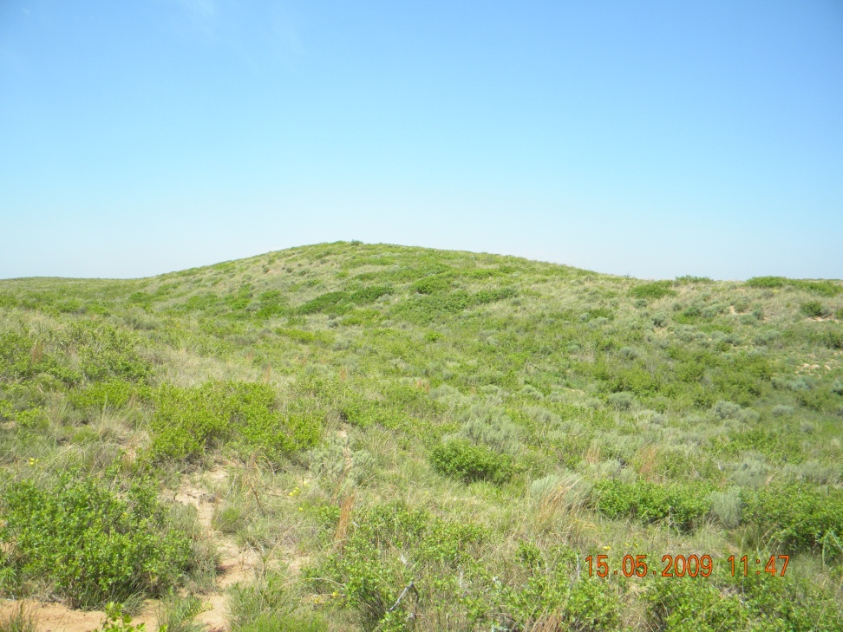
Study Area
Soils characterized as rolling hills and dunes comprised of sandy surface and subsoil
Vegetation consists of shrub-grassland

Slide 7
Methods
Bobwhite hens trapped from February-April
Hens fitted with 6 gram necklace-style radio transmitter (American Wildlife Enterprises)
Monitored ≥ 3 weekly throughout breeding season

Slide 8
Methods
Invertebrate samples collected at observed brood and paired random location
10-meter transects swept 25 times with 38 cm diameter sweep net
Samples sorted and counted by Order

Slide 9
Analysis
Shapiro-Wilks test indicated non-normal distribution of error (P > 0.05)
Wilcoxon signed rank test conducted to compare between years, brood, and random sites
Analysis executed using IBM SPSS

Slide 10
Results
Samples collected from 6 and 8 radio tagged females with broods in 2008 and 2009
Samples pooled over both years due to small sample size (n = 34)
Coleoptera, Hemiptera, and Orthoptera selected from 14 collected Orders due to high frequency of occurrence (λ = 0.55)

Slide 11
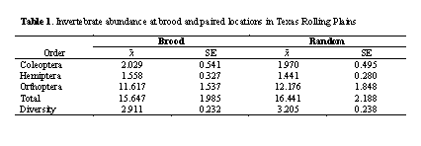
We found total abundance did not differ between sites (P = 0.925), nor did abundance of Coleoptera (P = 0.990), Hemiptera (P = 0.888), and Orthoptera (P = 0.911)
Similarly, invertebrate Order diversity did not differ between sites (P = 0.469)

Slide 12
Discussion
Abundance of Coleoptera, Hemiptera, and Orthoptera ranked highest among all Orders collected
These are an important component in gallinaceous chick diets
However, bobwhite hens in our study did not select brood sites based upon invertebrate abundance or diversity

Slide 13
Discussion
Randel et. al (2007) reported similar results from wild turkeys in Texas.
In contrast, black grouse, capercaillie, and ruffed grouse hens appear to select sites with higher invertebrate abundance (Baines et. al 1996, Haulton et. al 2003, Wegge et. al 2005)

Slide 14
Discussion
Important note – Palmer (2001) reported lack of correspondence of arthropod abundance between standard sampling techniques and human-imprinted chicks.
Race (1960) suggested sweep-net techniques sample inaccessible vertical strata
However studies suggesting hens select sites based upon abundance used sweep net techniques similar to ours (Baines et. al 1996, Haulton et. al 2003, Wegge et. al 2005)

Slide 15
Management Implications
Although we discovered no detectable differences, it should not discount the importance of invertebrates to quail chicks.
Brood rearing hens in other gallinaceous species have been found to select sites of higher invertebrate abundance and diversity.
We suggest management practices to increase abundance and diversity would be beneficial to bobwhite chicks.

Slide 16
Acknowledgements
Texas Tech University, Natural Resources Conservation Service and Texas Parks and Wildlife for funding and assistance
Landowners Bill Gething and Jeff Haley
Field technician Chadd Malone

Slide 17
Literature Cited
Baines, D.Nest, I. A. Wilson, and G. Beeley. 1996. Timing of breeding black grouse Tetrao tetrix and capercaillie Tetrao urogallus and distribution of insect food for the chicks. Ibis 138:181-187
Haulton, G. S., D. F. Stauffer, and R.L. Kirkpatrick. 2003. Ruffed grouse (Bonasa umbellus) brood microhabitat selection in the Southern Appalachians. American Midland Naturalist 150: 95-103
Hurst, George A. 1972. Insects and bobwhite quail brood habitat management. National Bobwhite Quail Symposium 1: 65-82
Nestler, R. B., W. W. Bailey, and H. E. McClure. 1942. Protein requirements of bobwhite quail chicks for survival, growth, and efficiency of feed utilization. Journal of Wildlife Management 69(3): 185-193
Palmer, W. E., M. W. Lane II, and P. T. Bromley. 2001. Human imprinted chicks and indexing arthropod foods in habitat patches. Journal of Wildlife Management 65: 861-870
Race, S. R. 1960. A comparison of two sampling techniques for lygus bugs and stink bugs on cotton. Journal of Economic Entomology 53: 689-690.
Randel, C. J., R. B. Aguirre, M. J. Peterson, and N. J. Silvy. 2007. Invertebrate abundance at Rio Grande wild turkey brood locations. Journal of Wildlife Management 71: 2417-2420
Stoddard, H. L. 1931. The bobwhite quail: its habits, preservations and increase. Third Edition. Charles Scribner’s Sons, New York, USA
Wegge, P., T. Olstad, H. Gegersen, O. Hjeljord, and A. Sivkov. 2005. Capercaillie broods in pristine boreal forest in northwestern Russia: the importance of insects and cover in habitat selection. Canadian Journal of Zoology 83: 1547-1555

