Slide 1
Efficacy of Targeted Mist Netting to Capture Northern Bobwhites During the Non-Breeding Season in Ohio
Mark J. Wiley
Adam K. Janke
Robert J. Gates

Slide 2
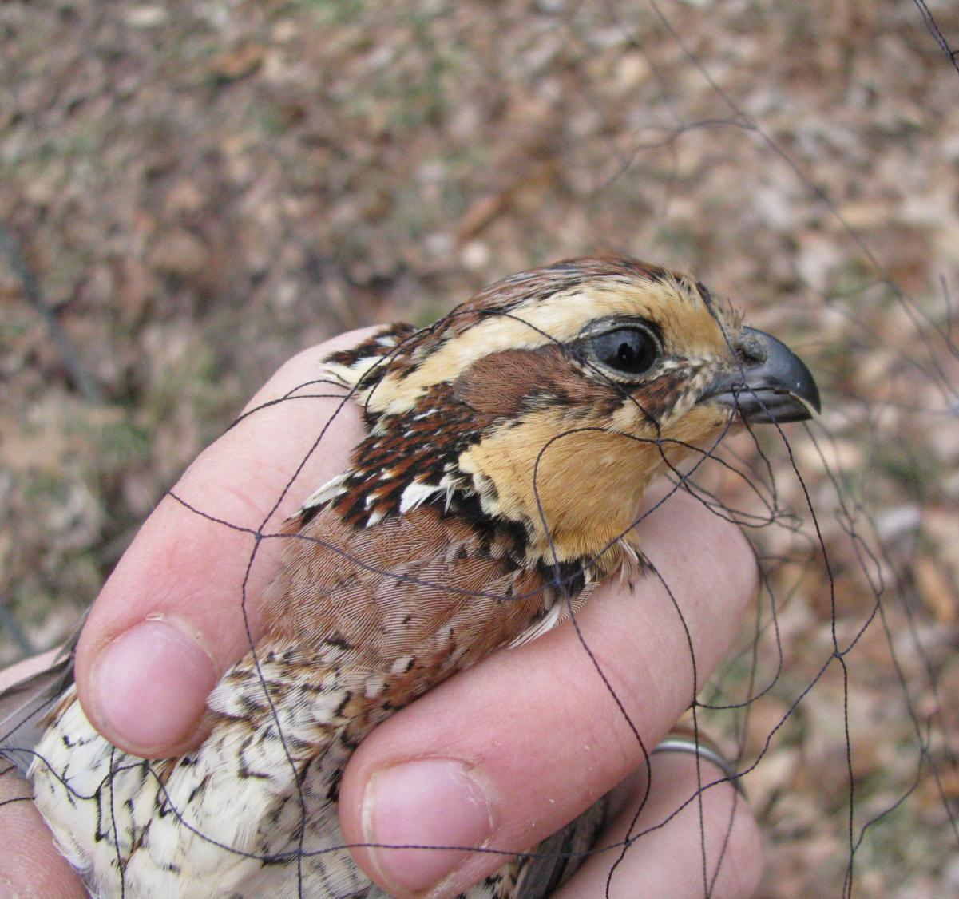
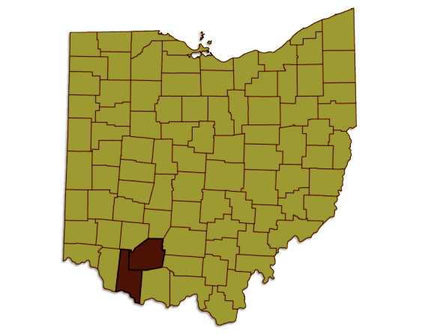
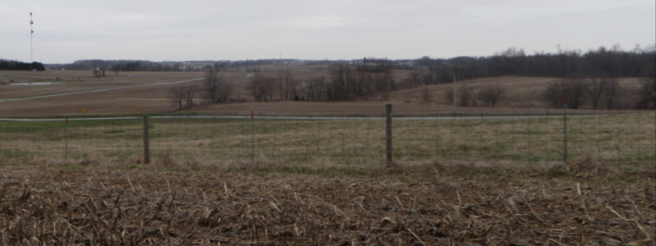
Ohio Bobwhite Research
Study Area
Southwestern Ohio
4 private land sites
>50 landowners
Habitat Composition
55% Row crops
Corn, soybeans, and wheat
19% Early successional
Grasslands, old fields, fencerows, and ditches
13% Forest
Woodlots
Notes:
Show that areas are like. Fencerows and agriculture, on the ground photos

Slide 3
Common Capture Techniques
Baited Funnel Traps (Stoddard 1931)
Effective (Truitt and Dailey 2000)
Effectiveness varies with environmental conditions
Not always suitable on private land
Increased presence can irritate landowners
Trap checks likely to disrupt hunters
Inefficient when targeting individuals
Radiomarked
Pointing dogs
Incidental contact
Nightlighting (Labisky 1968)
Effective (Truitt and Dailey 2000)
Potentially alarming
landowners, neighbors, law enforcement

Slide 4
Alternative Capture Techniques
Targeted Mist Netting
Gallinaceous species
Pointing dogs (Skinner 1998)
Radiotelemetry (Schladweiler and Mussehl 1969)
Researchers driving birds (Silvy and Robel 1968, Campbell 1972, Browers and Conelly 1986)

Slide 5
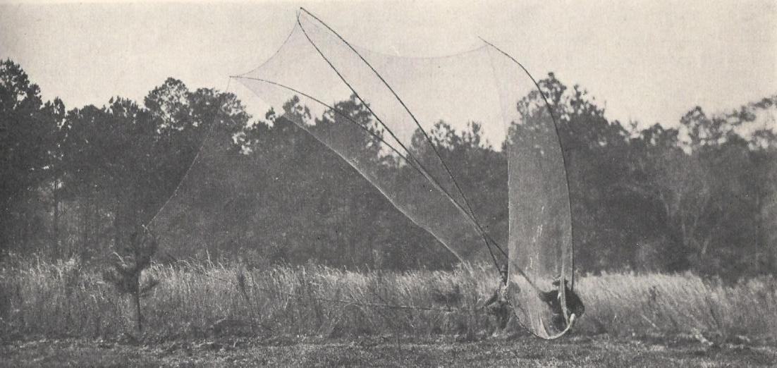
Alternative Capture Techniques
Targeted Netting for Bobwhites
“Clapnets” (Stoddard 1931: 441)

Slide 6
Alternative Capture Techniques
Mist Netting Bobwhites
Breeding season with audio lure (Cink 1975, Lohr et al. 2011)
Nonbreeding season?

Slide 7
Introduction
Evaluate the efficacy of targeted mist netting
Compare targeted mist netting with baited funnel trapping…
Body mass
Age ratio
Sex ratio
Post-capture survival

Slide 8
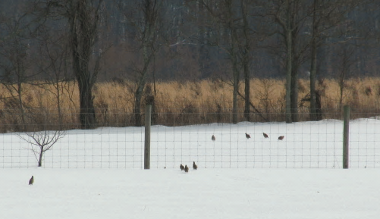
Methods
Netting and trapping used concurrently
1 October-28 February 2009-2011
Maintain ≥ 1 radio in each known covey
Implementation of capture technique
Non-random
Opportunistic

Slide 9
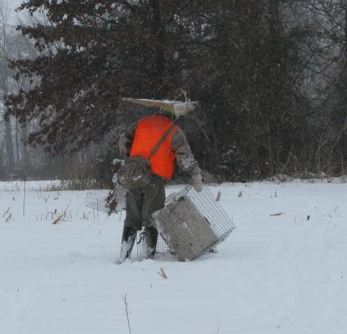
Methods
Traps
30x40x45cm
Burlap buffer
Trapping
Concealed within cover in areas with evidence of activity
Pre-baited, Baited
Cracked corn
Checked twice daily
After sunrise
Sunset

Slide 10
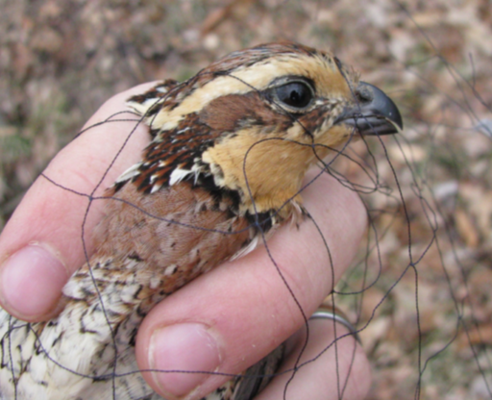
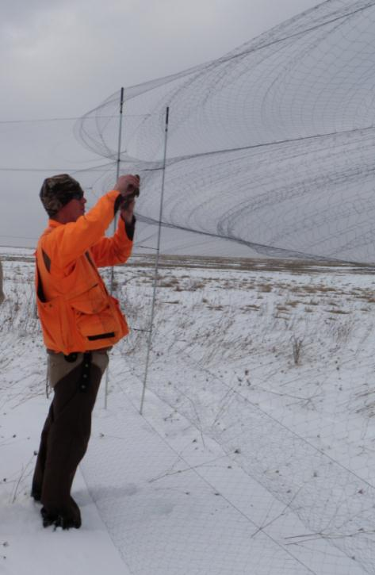
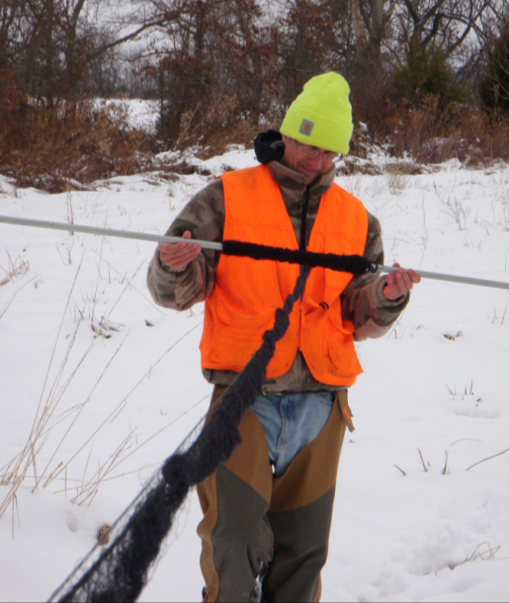
Methods
Mist Nets
2.6x12m, four-shelf nets
61mm mesh
Suspended between 3.05m conduit poles
Furled and rolled on poles

Slide 11
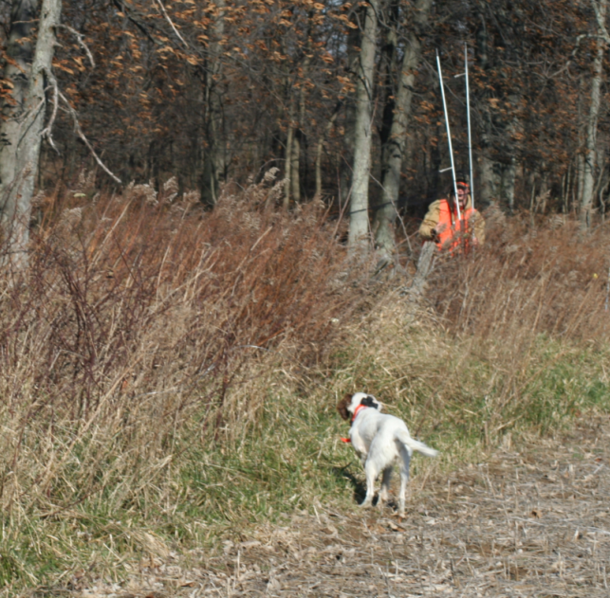
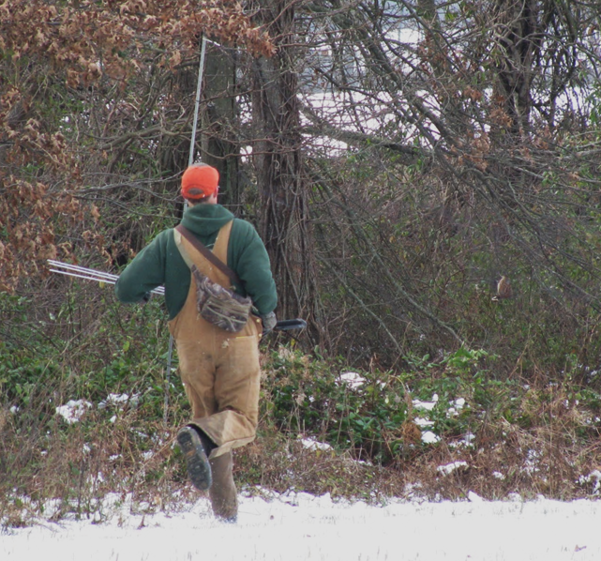
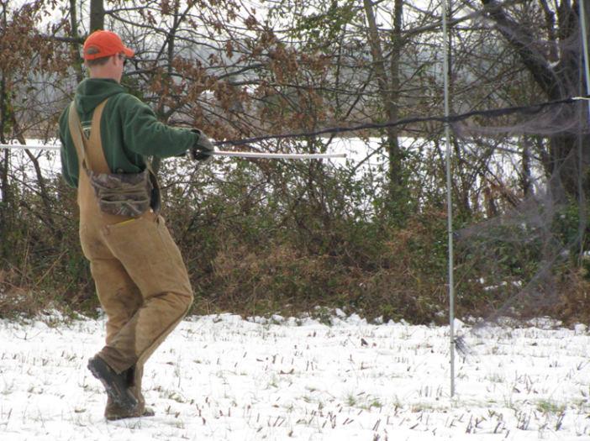
Methods
Mist Netting
Locate bobwhite
Radiotelemetry
Pointing dogs
Incidental contact
Erect nets near bobwhite
Intersect predicted flush direction
Flush toward nets

Slide 12
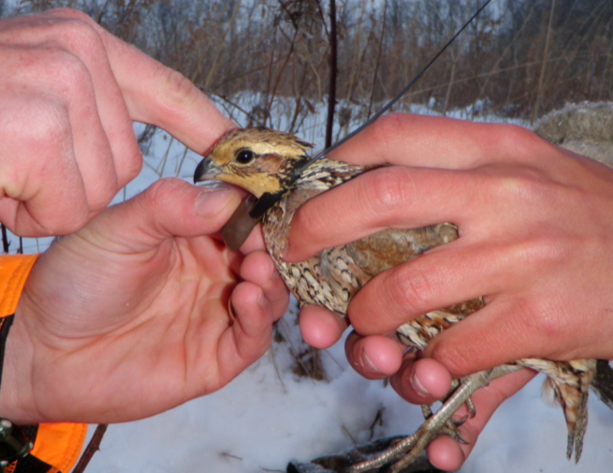
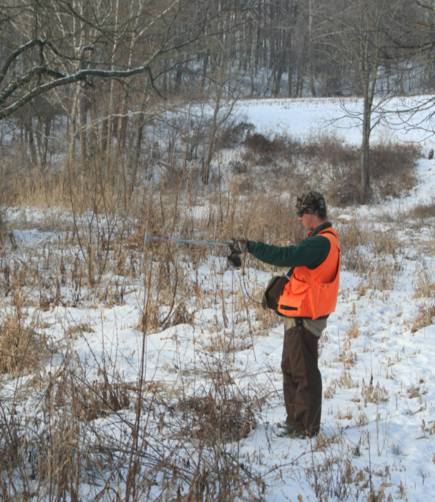
Methods
Capture/handling
Age and sex (Rosene 1969)
Body mass
Leg band
Radiotransmitters
6.6g pendant
Mortality-sensing
Radiotracking
≥ 6 times/week

Slide 13
Comparisons
Age and sex capture ratios
Chi Square test
Body mass
t-test
Survival
Nest Survival Model in Program MARK
21 day post-capture interval
Models with days-since-capture (3, 7, 14, 21), capture technique covariates, and their interaction (Holt et al. 2009)
AICc

Slide 14
Results
 | 2009-10 | 2010-11 | Total
Trapping captures | 137 | 120 | 257
Netting captures | 105 | 148 | 253
Trapping (2010-2011)
484 trap-days
.306 birds /trap-day
Netting (2009-2011)
201 targeted netting attempts
≥ 1 bobwhite flushed after nets deployed
141 successful
≥1 bobwhite captured

Slide 15
Results
 |  | Targeted netting | Funnel traps
Sex | Male | 132 | 136
 | Female | 104 | 106
 | Unknown | 21 | 11
Age | Adult | 59 | 52
 | Juvenile | 191 | 200
 | Unknown | 7 | 1
No difference in sex ratio of captures
(χ² = 0.001, df = 1, P = 0.973)
No difference in age ratio of captures
(χ² = 0.480, df = 1, P = 0.4884)

Slide 16
Body Mass
Netting Mean – 185.6 g
95% CI = 183.5, 187.6 g
Funnel Trapping Mean - 191.4 g
95% CI = 188.7, 194.1 g
Mean body mass of netted captures was less than trap captures
P = 0.009

Slide 17
Survival Results
Model | ΔAIC_{c} | w_{i}
7 DSC | 0.000 | 0.275
14 DSC | 0.807 | 0.183
21 DSC | 1.873 | 0.108
Technique+ 7 DSC | 1.989 | 0.102
Technique + 14 DSC | 2.796 | 0.068
3 DSC | 2.826 | 0.067
Technique + 21 DSC | 3.860 | 0.040
Technique+ 7 DSC + Technique x 7 DSC | 3.992 | 0.037
Null | 4.407 | 0.030
Short-term acute effect of capture
No difference among techniques
β_{net} = 0.002
(-0.214, 0.219)
odds ratio = 1.002 (0.807, 1.244)
n = 259 (netting n = 156, trapping n = 103)

Slide 18
Summary
Targeted mist netting is an effective and versatile alternative to traditional capture techniques
Short term effect of capture, handling, radiomarking
No difference in post-capture survival between techniques

Slide 19
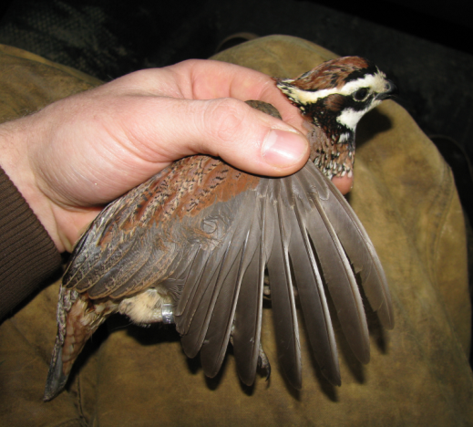
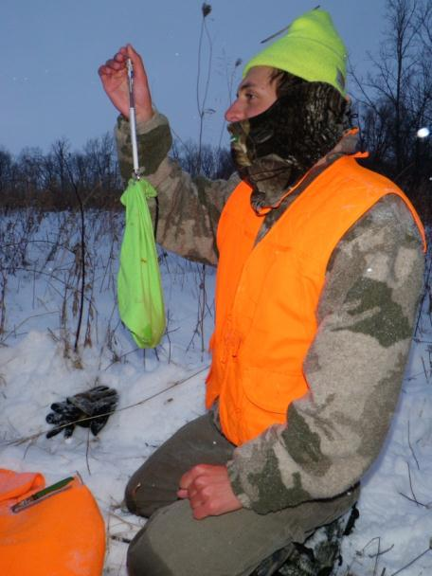
Summary
Capture rates of age and sex classes were similar
Netting may provide more accurate estimates of body mass
“Crop full”, “Crop FULL”, “Crop bulging”

Slide 20
Netting is well suited for use…
On private land
Reduces investigator presence
Avoid recreational users (e.g. hunters)
Radiotelemetry studies
Capture specific individuals
Quickly capture individuals multiple unmarked coveys
With other techniques to optimize capture
Breeding season
Calling males
Radiomarked pairs
Incidental contact
Fledged young
May merit additional research

Slide 21
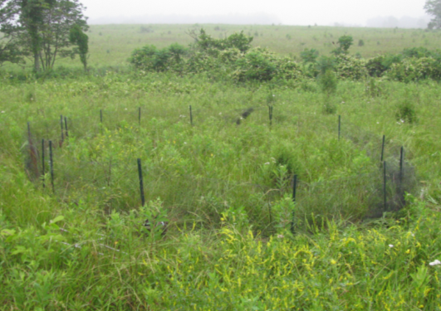
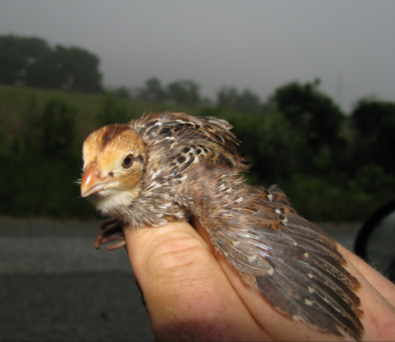
Research and Management Implications
Corral (Smith et al. 2003)
Roosted, brooding adult
Effective
Requires that chicks can not fly
1-12 days post-hatch
Targeted Netting
Flying chicks
≥ 12 days post-hatch
Smaller chicks capable of passing through nets
Experiment with smaller mesh

Slide 22
Acknowledgements
Field Assistants
Mauri Liberati
Jay Jordan
Bryce Adams
Bret Graves
Nan Radabaugh
Mark Peugeot
Laura Jenkins
George Fee
Chris Grimm
Matt Crowell
Funding
Ohio Department of Natural Resources, Division of Wildlife
Federal Aid
≥ 50 Cooperating Landowners
Fallsville Wildlife Area
Indian Creek Wildlife Area

Slide 23
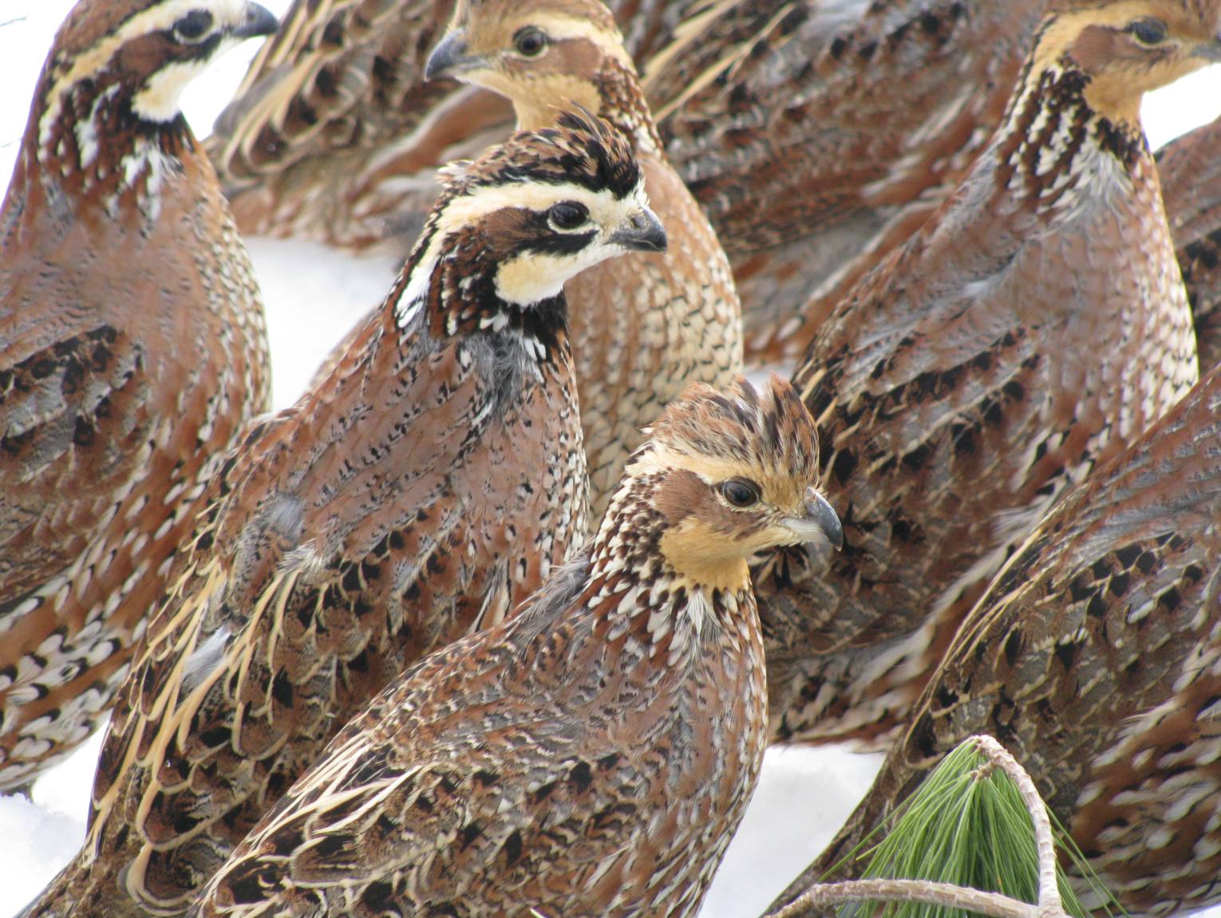
Questions

