Slide 1
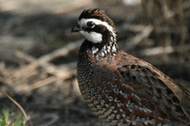
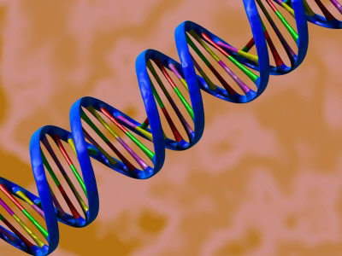
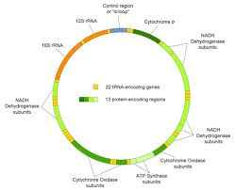
Phylogeography of the Bobwhites
Damon Williford,
Randy W. DeYoung, Leonard A. Brennan, Fidel Hernández
Caesar Kleberg Wildlife Research Institute
Texas A&M University-Kingsville
Kingsville, Texas 78363
Rodney L. Honeycutt
Natural Science Division
Pepperdine University
California 90263

Slide 2
The Bobwhites (Colinus): Savanna-specialists
Yucatán Bobwhite (Colinus nigrogularis)
Northern Bobwhite (Colinus virginianus)
Photo by David Blank
Photo by Ryan Shaw
Spot-bellied Bobwhite (Colinus leucopogon)
Crested Bobwhite (Colinus cristatus)
Photo by Elidier Vargas
Photo by Karla Perez Leon

Slide 3
Subspecies Distributions
Spot-bellied Bobwhite
6 subspecies
Spot-bellied Bobwhite
Crested Bobwhite
14 subspecies
Northern Bobwhite
19 Subspecies
Yucatán Bobwhite
4 subspecies

Slide 4
Geographic Variation in Bobwhites

Slide 5
Unanswered Questions
How many bobwhite species are there?
How are those species related to one another?
How distinct are the subspecies within each bobwhite species?
Biogeographic and evolutionary history?

Slide 6
Phylogenetics and Phylogeography
Phylogenetics: evolutionary relationships among groups.
Phylogeography
Geographic distribution of genetic genealogies.
Infer causes of observed patterns.
Mitochondrial DNA (mtDNA)
Great initial genetic marker.
Maternal inheritance
No recombination

Slide 7
Phylogeographic Patterns

Slide 8
Objectives
Examine the interspecific relationships among the bobwhite species using mtDNA.
Examine phylogeography of each species.
Determine how much genetic variation is accounted for by subspecies taxonomy.
Use findings to infer historical causes of phylogenetic and phylogeographic patterns.

Slide 9
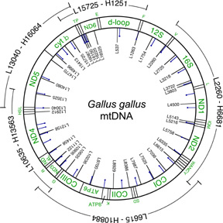
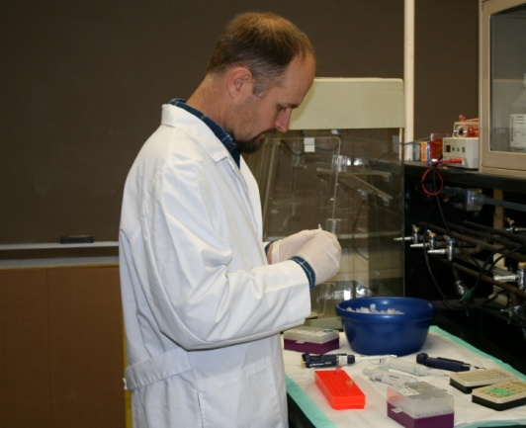
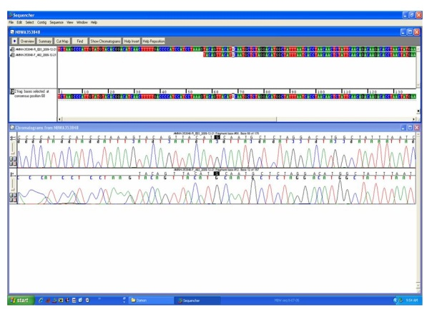
Methods: Laboratory
Tissue sample
DNA Extraction
PCR
We amplified a 350-bp segment of ND2 and 220-bp D-loop of the mitochondrial genome.
Sequencing
Editing
Notes:
9

Slide 10
Methods: Analysis
Interspecific relationships (ND2 and D-loop)
Maximum likelihood phylogenetic tree.
Sequence divergences among bobwhite species.
Intraspecific phylogeography (D-loop only)
Minimum spanning networks of haplotypes
Distribution of pairwise nucleotide differences
Unimodal = demographic expansion.
Multimodal = population differentiation.
Analysis of molecular variance (AMOVA)
Quantifies the amount of genetic variation due different hierarchical levels.
How much genetic variation accounted for by subspecies.

Slide 11
Bobwhite Phylogeny based on ND2 and D-loop
Sequence Divergences (p distance)
 | Crested | Spot-bellied | Yucatán
Crested
Spot-bellied | 0.022
Yucatán | 0.098 | 0.094
Northern | 0.091 | 0.083 | 0.027

Slide 12
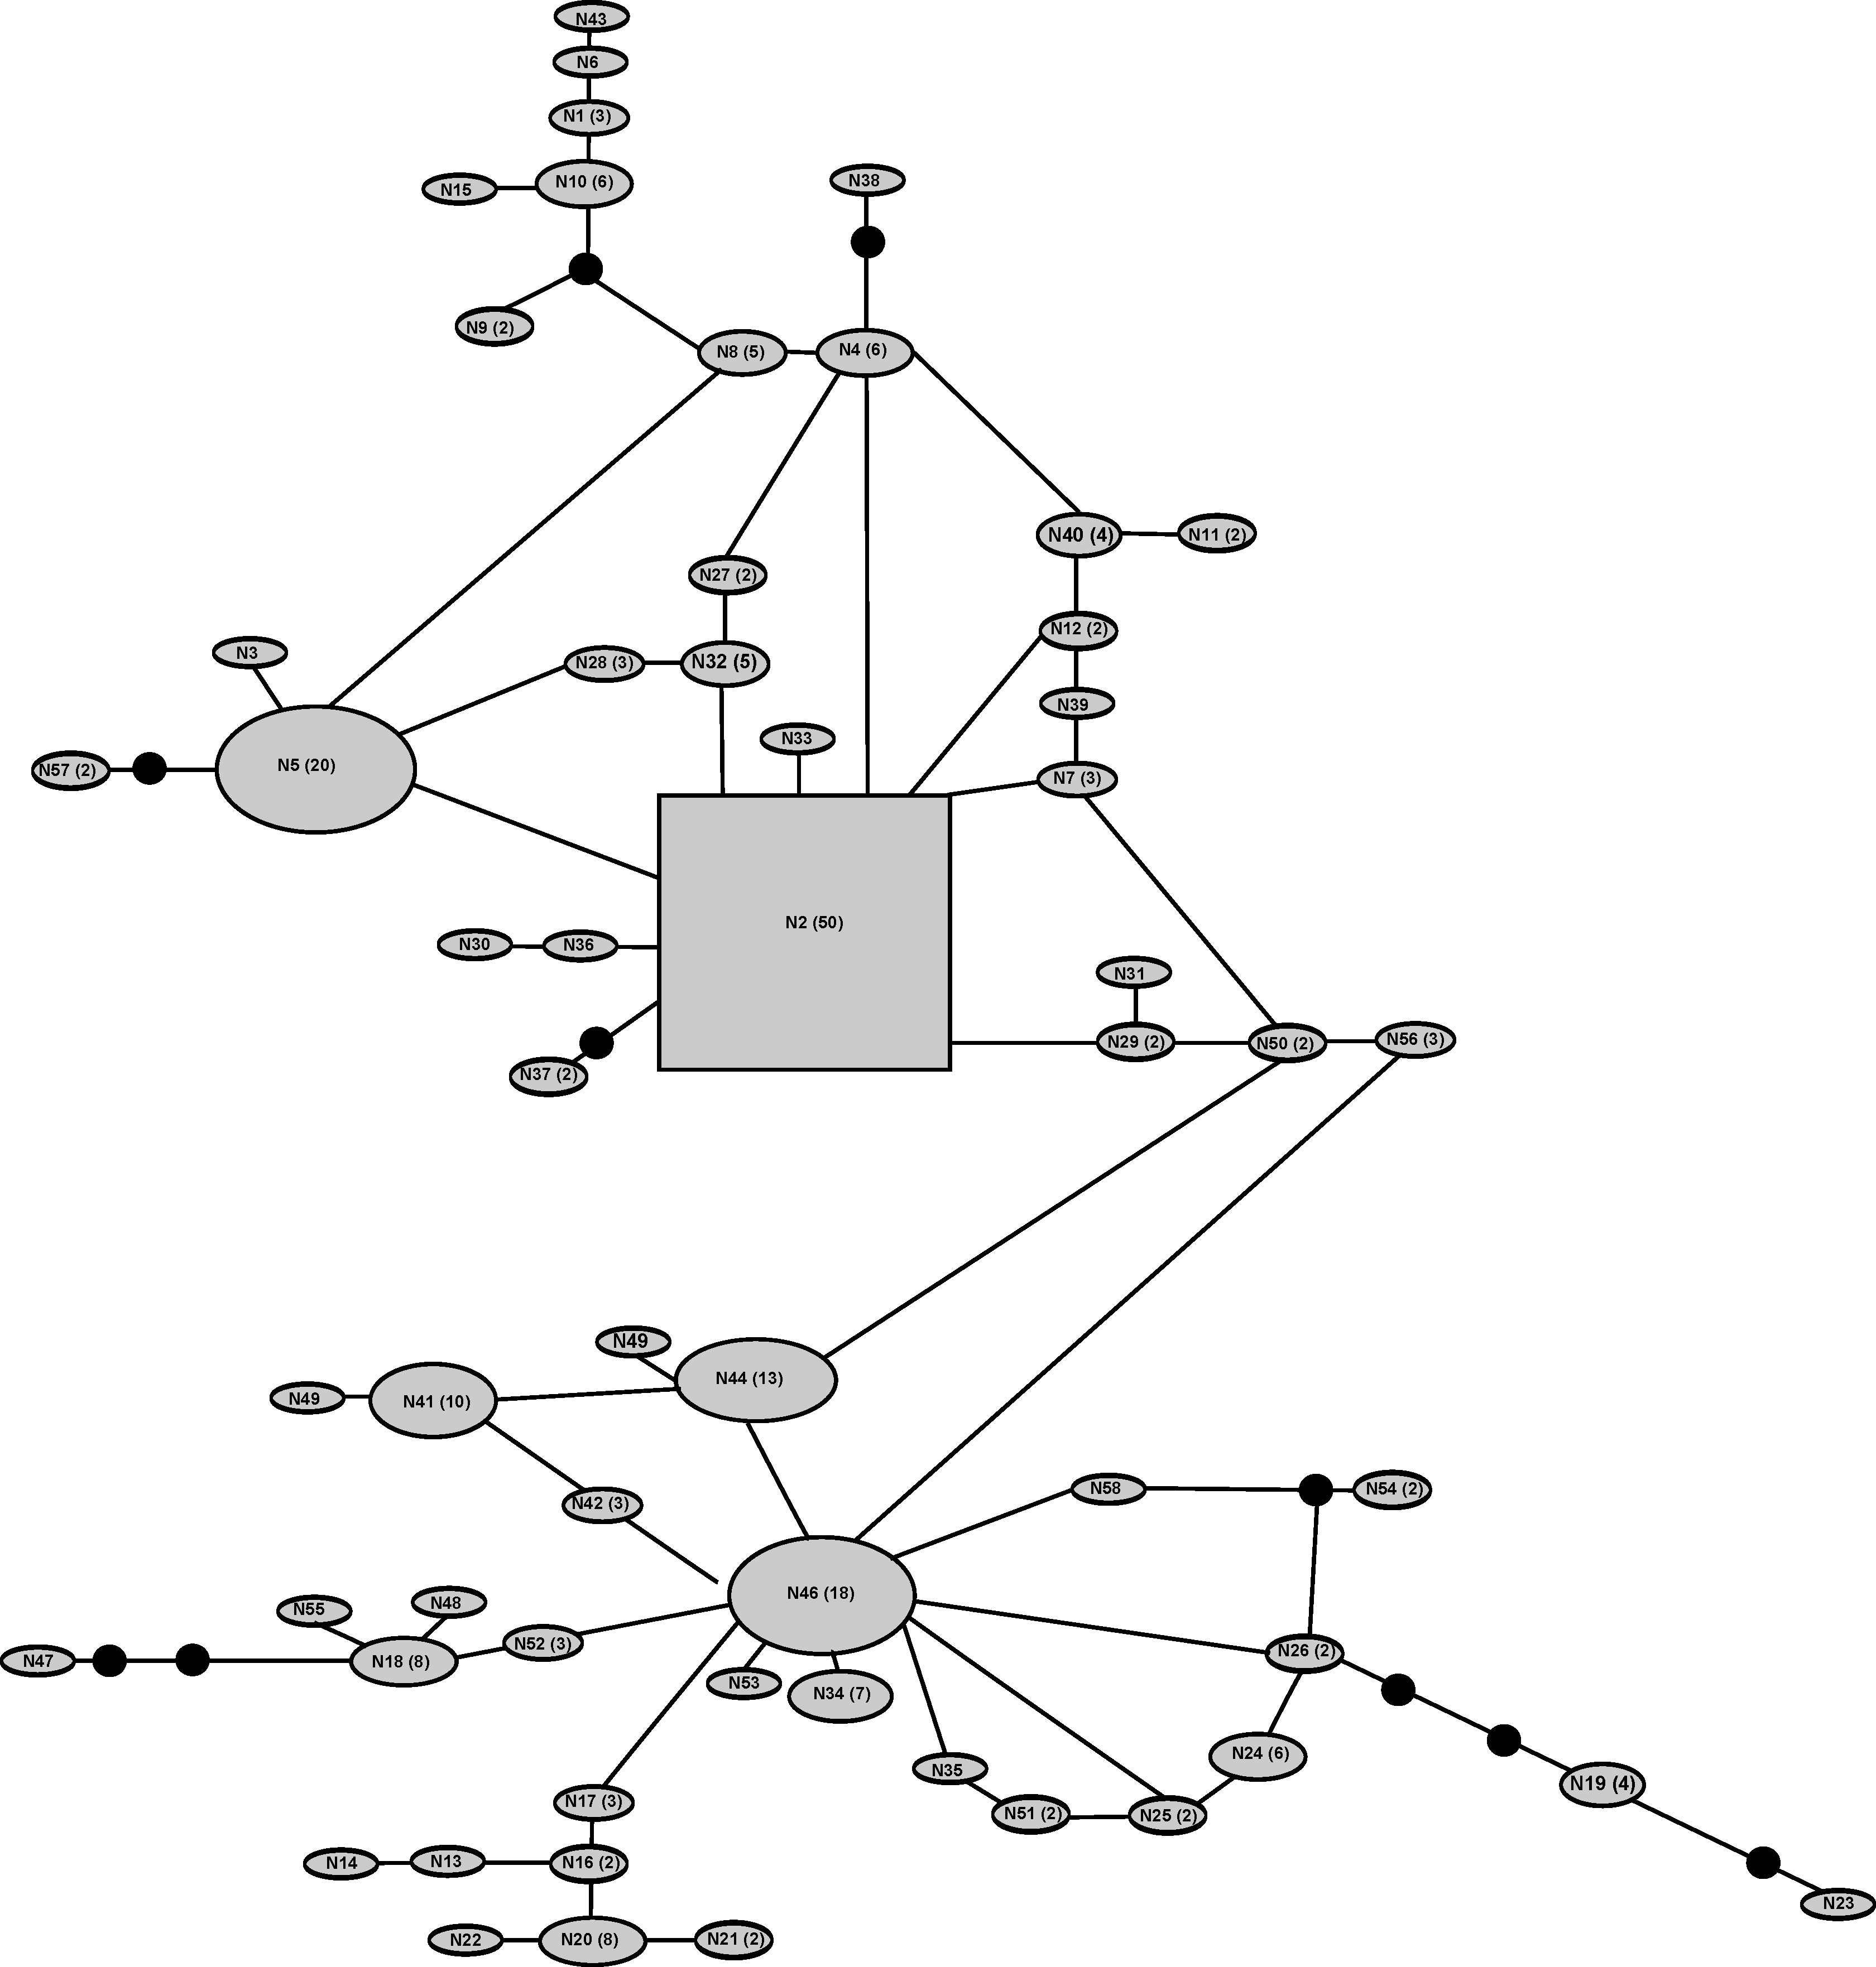
Northern Bobwhite
58 haplotypes.
50% of haplotypes shared by ≥ 2 subspecies.
Expansion

Slide 13
Yucatán Bobwhite
Differentiation
7 haplotypes.
2 geographically and genetically distinct groups.

Slide 14
Crested and Spot-bellied Bobwhites
Differentiation
5 spot-bellied bobwhite haplotypes shared among subspecies.
20 crested Bobwhite subspecies not shared among subspecies.

Slide 15
AMOVA Results

Slide 16
Conclusions
Species relationships
Colinus may not be a natural group.
Yucatán and northern bobwhites are distinct species.
Species status of crested and spot-bellied bobwhites unclear.
1 polytypic species?
4 closely related species?
Phylogeography
Northern bobwhite
Repeated patterns of isolation and expansion.
Climate driven changes in availability of suitable habitat.
Yucatán and crested/spot-bellied bobwhites
Allopatric fragmentation
Climate-driven expansion and fragmentation of savanna and geological events.

Slide 17
Future Research
Future work
Additional samples from all species
Additional genes
Morphometric and colorimetric analysis

Slide 18
Acknowledgments
A special thanks to the institutions that allowed us the use of their specimens:
American Museum of Natural History
Bell Museum of Natural History
Natural History Museum of Los Angeles County
Dallas Museum of Nature & Science
Museum of Texas Tech University
Welder Wildlife Foundation
Yale Peabody Museum
Field Museum of Natural History
Lab assistance and sample collection: A. Zamorano, J. Summers, K. Corman, and A. Floyd.
This project was funded by the Elliot B. and Adelle Bottom Fellowship in Quail Research.

