Slide 1
Tom Dailey, Ron Reitz, Heather Scroggins, Tom Treiman and Nigel Hoilett
Quail VII, January 2012
Rowing Against the Tide: The Challenge of Getting Landowners to Manage Habitat for Their Favorite Wildlife Species, Bobwhites
A Summary of 3 Studies of Missouri Landowner Attitudes

Slide 2






Acknowledgements
USDA NRCS/MSU Bobwhite Restoration Project
Missouri State Council - Quail Unlimited
USDA Missouri FSA and NRCS
NE Missouri RC&D
University of Missouri: College of Agriculture Food and Natural Resources, Forage Research and Extension Center, Adair and Gentry County Extension Centers and Greenley Research Center
Missouri Department of Conservation
Notes:
We would like to acknowledge………….

Slide 3
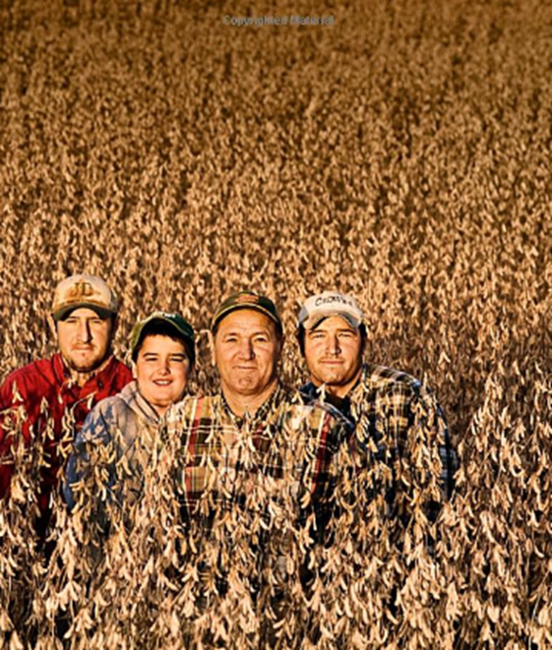
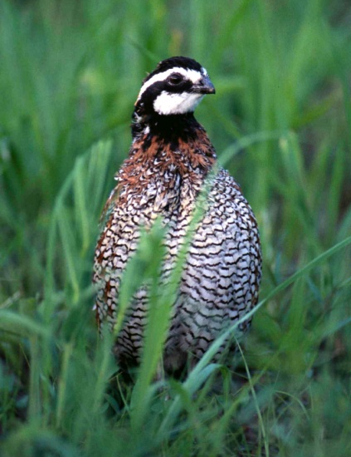
Road Map
MO quail problem & restoration efforts
3 Studies of landowner attitudes
Affinity for quail, but not quail management
Some solutions

Slide 4
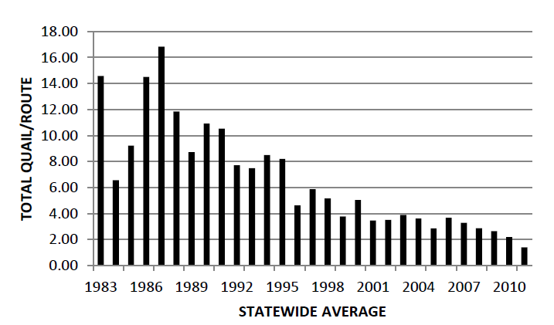
Impact of Unmotivated Landowners
MO Statewide Quail Population Trend

Slide 5
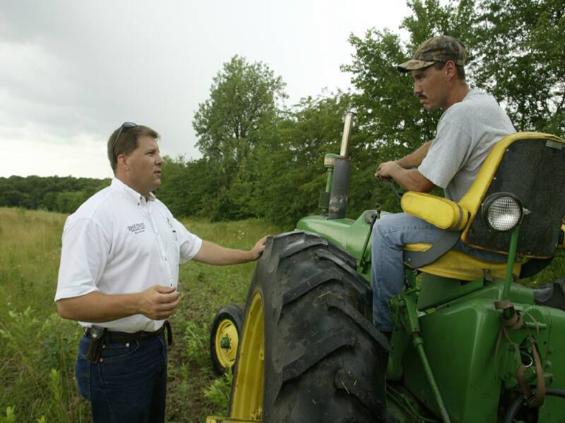
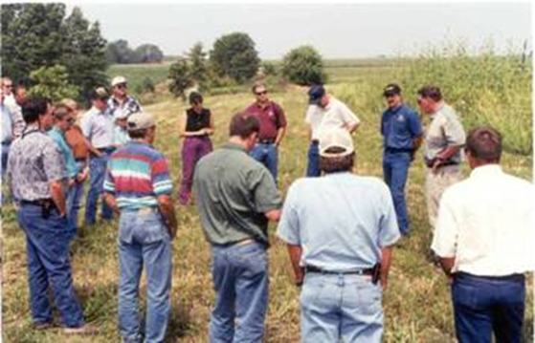
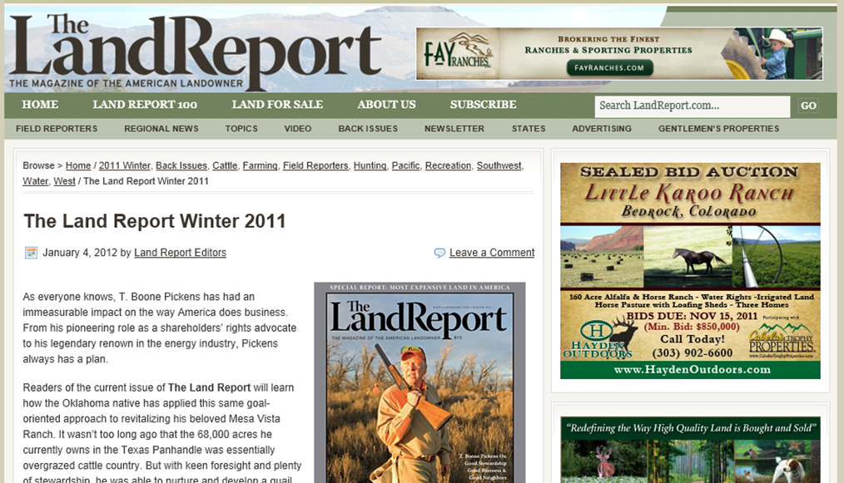

“Working Lands”
Income from land important
Discretionary $ limiting

Slide 6
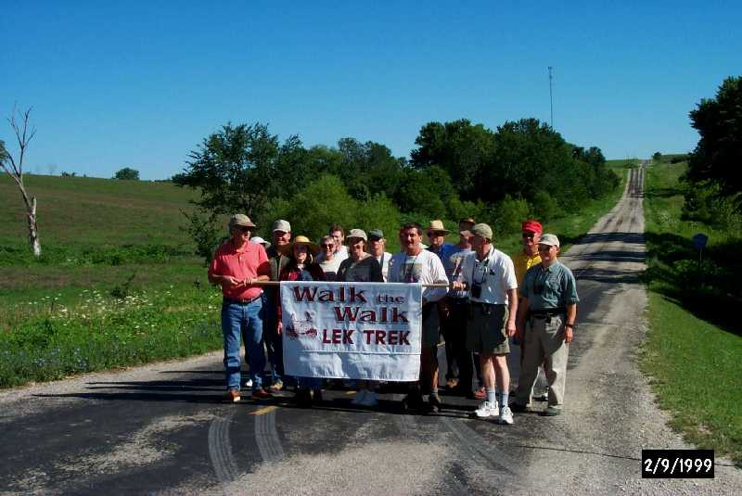
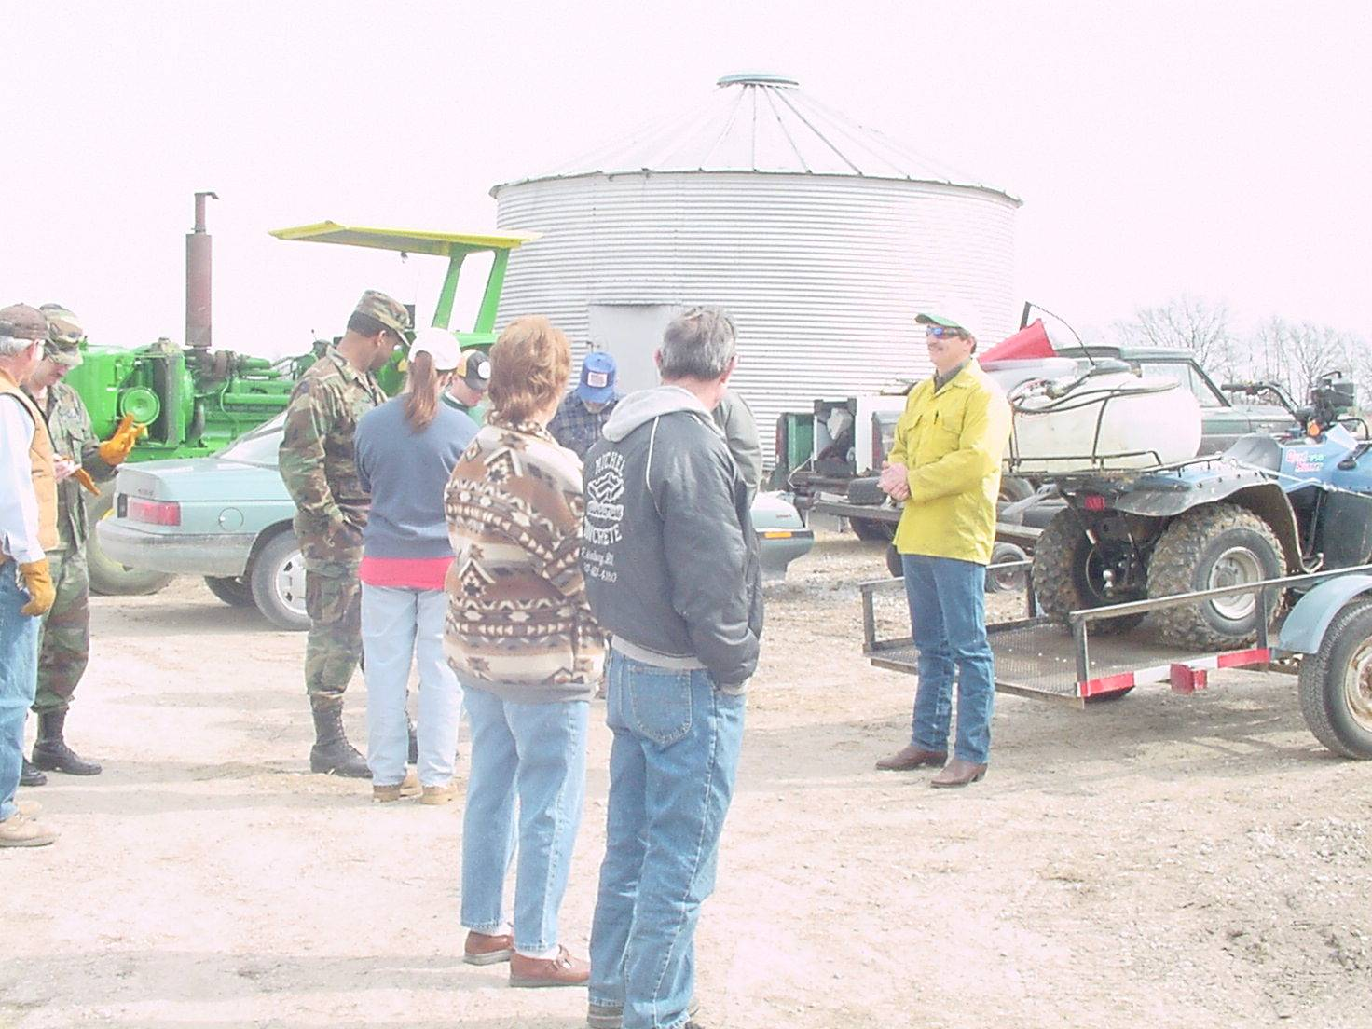
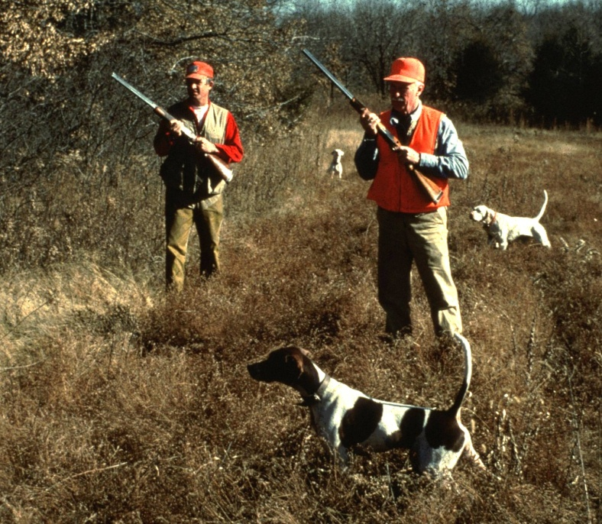
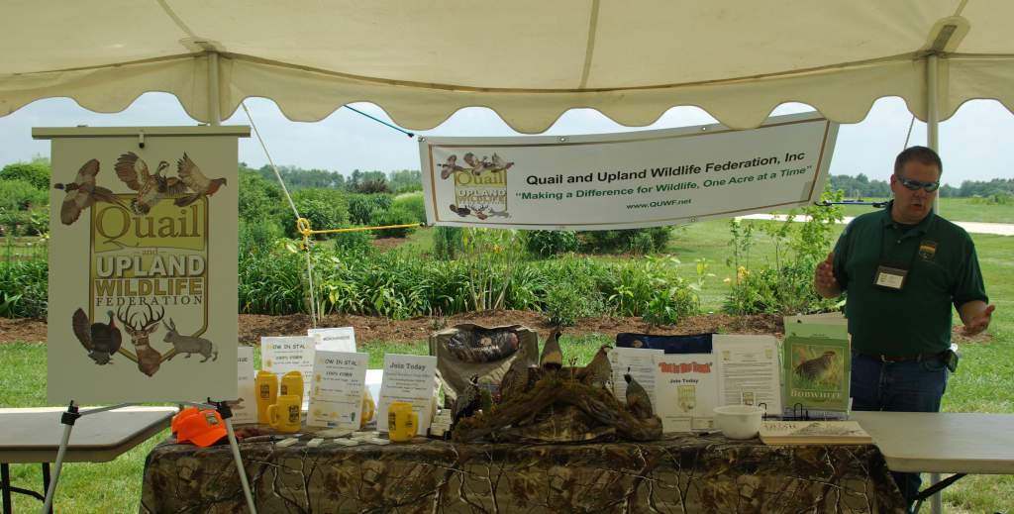
Our View of Private Landowners

Slide 7
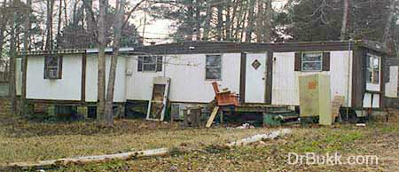

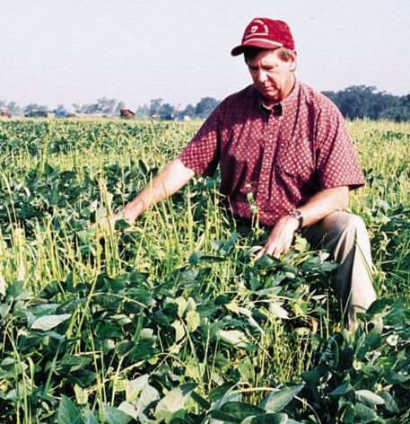
Reality
You want me to do what for quail??
Notes:
People do not have discretionary income or time to spend on habitat.
Their values might not place high priority on wildlife, and the habitats they need.

Slide 8
‘CULTURE EATS STRATEGY EVERY TIME.’
Elson Floyd, Univ. Missouri President
Notes:
The reality is that top-down conservation programs will not result in much done on the ground unless local rural culture is thoroughly understoond. MU’s former President made this comment after a failed attempt, a few years into his leadership, to consolidate satelitte campuses.

Slide 9
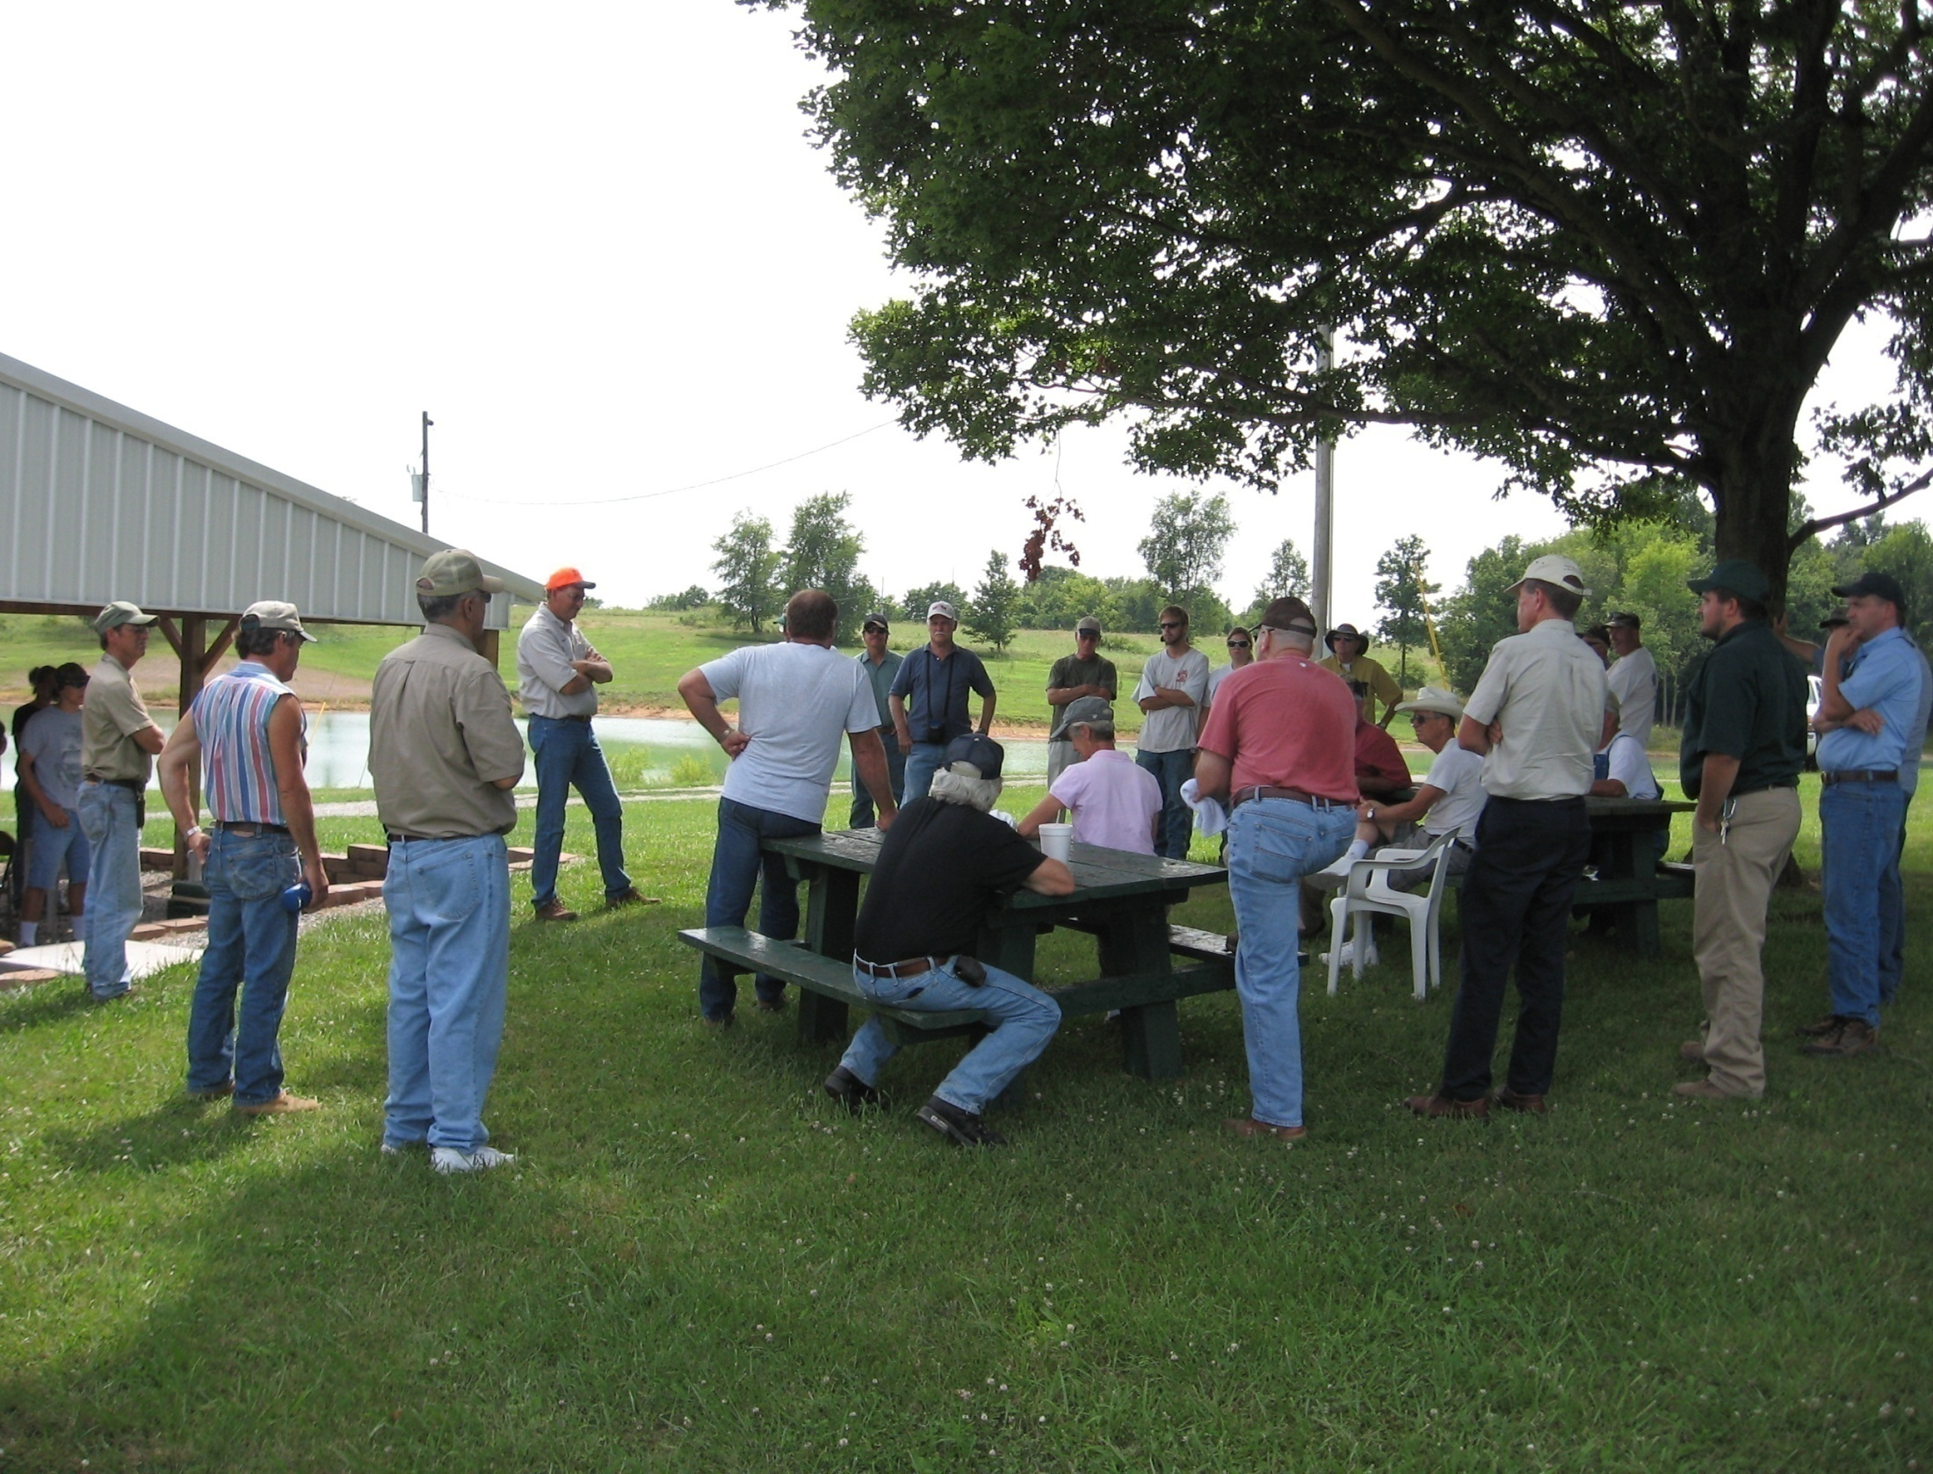
“Human values shape our efforts.”
Concept 10: Human values are diverse and dynamic and significantly shape conservation efforts.
Conservation biology is part of a multifaceted and interdisciplinary social-ecological system…
Solutions to conservation problems require integrated and holistic management, and are multidisciplinary, taking into account social, political, and economic contexts…
Lindenmayer & Hunter. 2010. Some Guiding Concepts for Conservation Biology. Conservation Biology.
Notes:
Conservation biology is part of a multifaceted and interdisciplinary social-ecological system. In any social-ecological system, the social factors are usually the most forceful and manipulable. This means solutions to conservation problems require integrated and holistic management, and are multidisciplinary, taking into account social, political, and economic contexts. Moreover, just as populations and ecosystems are dynamic, so are societies and economies. For example, in many places, human perspectives of large charismatic animals such as whales and wolves have shifted dramatically over a few decades from a focus on exploitation or eradication to protection.

Slide 10
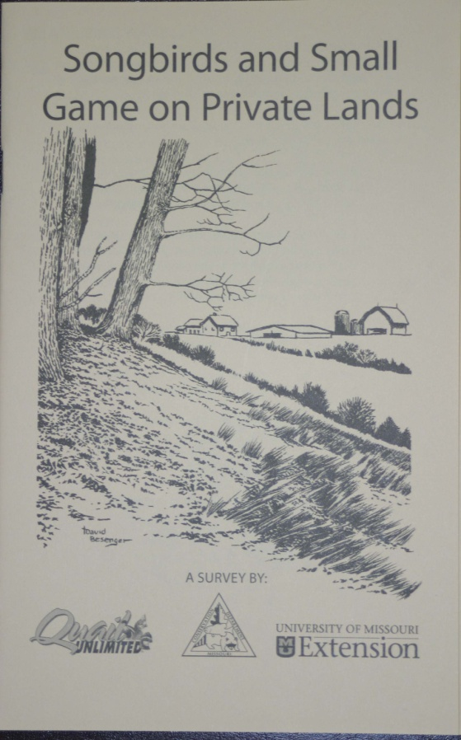
The Surveys
1,955 responses in CRP landowner/quail study--North
735 responses in all-landowner/quail study—NE/NW
367 responses in landowner/p chicken study--SW
Response rate >40% in each survey
How important or unimportant is it to you to have the following on your land?
% Choosing Somewhat Important or Very Important
Notes:
In addition to the responses to the QHD questionnaire, I will also show related questions from the northeast Missouri CRP landowner survey. This was conducted in 2004 as part of the openlands initiative. All crp contract holders were surveyed in Adair, Knox, Macon, Monroe, Ralls, Randolph, Schuyler, and Scotland counties. We aimed to sample all CRP contract holders on record in 2004, which amounted to 3,283 landowners being surveyed.
Missouri Landowners and Grassland Wildlife Management report was generated via paper and pencil survey. The study sample was drawn from a list of people who owned land in or near surviving Prairie-Chicken habitats in the state of Missouri. Through the U. S. Mail these subjects received a Wave 1 survey packet containing a cover letter, uniquely identified survey, and a business reply envelope. Wave 1 participants also received a $2 bill as an incentive to fill out and return the survey. This initial mailing was sent out March 1, 2007. 367 landowners from the original sample responded to this survey, creating an overall survey response rate of 44%.
Total responses: 3,057

Slide 11

Two studies of north MO landowners:
CRP contract holders
All landowners
Notes:
In addition to the responses to the QHD questionnaire, I will also show related questions from the northeast Missouri CRP landowner survey. This was conducted in 2004 as part of the openlands initiative. All crp contract holders were surveyed in Adair, Knox, Macon, Monroe, Ralls, Randolph, Schuyler, and Scotland counties.
We aimed to sample all CRP contract holders on record in 2004, which resulted in 3,283 landowners being surveyed.

Slide 12
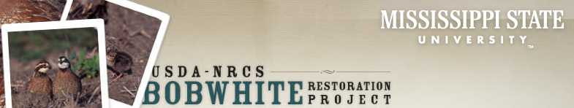
Use of human dimensions information as a tool for selecting large-scale quail restoration areas in Missouri http://www.cfr.msstate.edu/nbci/index.asp

Slide 13
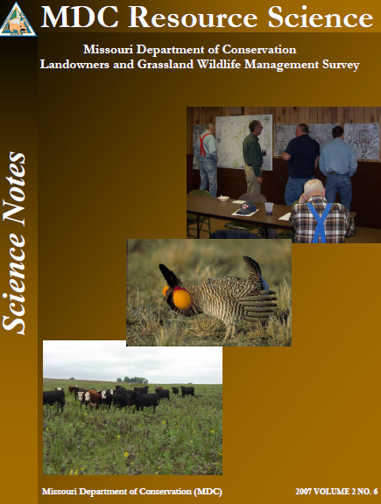
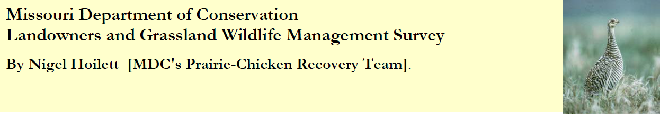
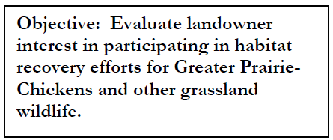
Notes:
As part of a habitat conservation initiative in west-central MO, researchers engaged landowners in focus groups and also gathered information through attitude surveys.
Much to the chagrin of p chicken enthusiasts, landowners did not share their love for the species.

Slide 14
What do landowners think about restoring habitat to benefit wildlife?
How important is it to have quail & other species on their land?
Are landowners willing to use wildlife-friendly practices?
What affects their willingness to use wildlife-friendly practices?
Are they willing to be part of a co-op?
What do they want in a co-op?
What are the reasons for not being in a co-op?
Notes:
One of the objectives of the survey was to determine what landowners in these areas think about restoring wildlife habitat.
Some of the questionnaire items designed to address this issue were:
-How important is it to have quail & other species on their land?
-Are landowners willing to use wildlife-friendly practices?
-What affects their willingness to use wildlife-friendly practices?
-Are they willing to be part of a co-op?
-What do they want in a co-op?
-What are the reasons for not being in a co-op?

Slide 15

Northern Missouri All-Landowners
% IMPORTANCE

Slide 16
Northeast Missouri CRP Landowners
% IMPORTANCE

Slide 17
West-Central Missouri P Chicken Landowners
Grassland Birds
% IMPORTANCE
Notes:
This survey was patterned after the 2 in north Missouri, so the chart is similar. Once again quail were most important to landowners, and grassland birds were close behind. This was much better than in northern MO, perhaps because there is more native grassland in west

Slide 18
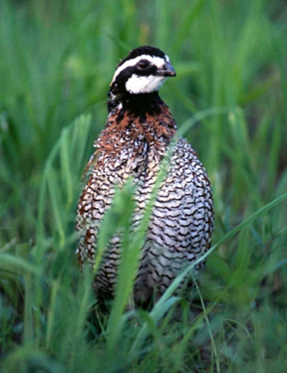

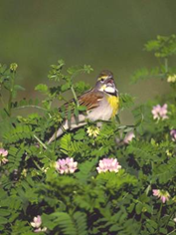
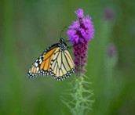

Slide 19
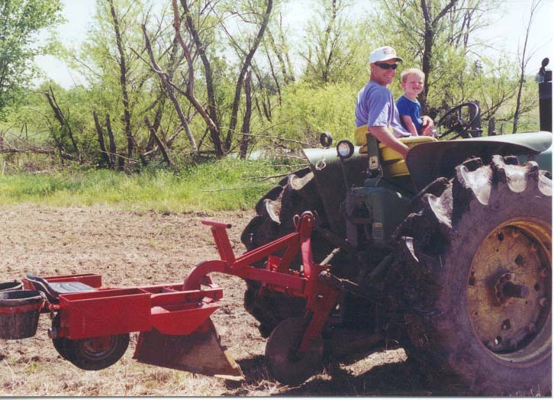
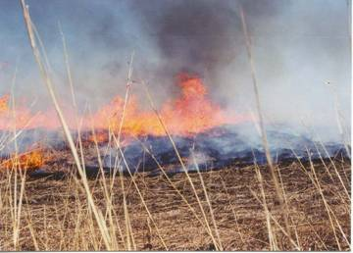
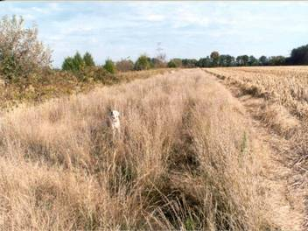
Are you willing to use quail-friendly practices?

Slide 20
The practices listed below are known to benefit quail. How likely or unlikely is it that you would use each of these practices on you land to benefit quail?
Percent “Somewhat Likely” or “Very Likely” to Implement Practice
Percent
Notes:
We provided a number of practices that the landowner could check. Here’s what landowners were willing to do. While 80% liked having bobwhites on their property, fewer respondents said they might be likely to integrate management practices into their operation to benefit the species. Although there was a marked decline in interest, a substantial number of landowners are willing to use important quail-friendly practices.
The listed practices are aimed a remedying many of the habitat problems quail face. For north Missouri, an area dominated by cropland, there are several practices that address major habitat deficiencies . A major limitation on quail abundance is distribution of quality woody cover. A remedy for this, “plant native shrubs around fields,” got a positive response from 50% of landowners. Another key practice, designed to provide nesting, brood-rearing and roosting cover around crop fields, are borders of grass and forbs, e.g., USDA CP33. Forty percent of landowners were willing to use the practice “replace some cropland with grass border.” A general practice, “reduce use of herbicides,” was popular with 44% of landowners, but a more specific practice, “allow weeds next to Roudup-ready crops,” was popular with only 29%. Forty percent were willing to leave standing rows of grain, a practice recently cost-shared by MDC.
The 2nd most popular practice were grain food plots. Although grain food plots are not now recommended as a stand-alone practice, MDC advocated for this practice for decades (and still gives away free seed), so it’s not surprising it is popular. Food plots also attract game species, making them easier to hunt.
Another major limitation for quail are thick, monoculture stands of grass, e.g., old CRP fields. Thirty to 43% were willing to disk, burn or herbicide grasslands to improve plant diversity.
Tall fescue is the most serious obstacle to quail recover, yet only 30% of landowners were willing to use herbicide to kill fescue. This is surprising because cattle operators are now well aware that fescue presents many problems for cattle production because of the endophyte in fescue. Of course fescue is everywhere, not just in pastures, so a reluctance to kill fescue could be because of many reasons.
MDC and other agencies have made a concerted effort for 3 decades to increase native warm-season grasses and forbs—36-42% of landowners are willing to do this.
Livestock production is second only to crops in use of land in north MO. Because quail need woody thickets, ungrazed woody cover is critical—41% are willing to fence woody cover.
Forest thinning was the least popular (24% positive).
A question about quail-friendly practices is very important for at least 2 reasons. First, it describes the kind of management activity that needs to be done to benefit quail. Second, it allows biologists to identify landowners who might be willing to do the habitat work, but are not necessarily willing to join a cooperative. We will talk about this later in the coop question.

Slide 21
Would you be interested in joining a quail co-op?
Full-time farmers
Part-time farmers
Non-farming farmland owners
Non-farming non-farmland owners
Notes:
Again, we know the interest in quail exists, yet there is little desire to commit to a co-op by the landowners.
Your full-time, production landowners were least interested, but were really not that far behind the other landowner types.

Slide 22
Are landowners interested in quail?
Are landowners willing to use quail-friendly practices?
What affects their management decisions?
Are they willing to be part of a co-op?
What do they want in a co-op?
What are the reasons for not being in a co-op?
Notes:
What about the landowners that told us “No”? What were some of the reasons they identified for not wanting to participate?

Slide 23
16. If you answered no or maybe to question #12, please tell us why you might not want to consider joining a quail co-op. How important or unimportant was each of the following in making your decision?
Percent Responding “Somewhat Important” and “Very Important”
Percent
Notes:
About 65% of those not interested in a coop cited that they did not want to attract hunters. Those that said ‘maybe’ were more concerned about this than those that said no (72% vs. 63% respectively). Interestingly, it is not that these landowners are not willing to let people on their land, because, overall, about 66% of these landowners in another survey question, let their neighbors hunt and fish on their land. Again, it appears they don’t want strangers knocking on their door requesting to hunt.
The next most important reasons were that they did not want to be involved in contracts, did not want to dedicate the time, and did not want to deal with the requirements of government programs. Other issues such as access to labor and equipment, and high cost also influenced their decision to the question. A good thing is that a lack of interest in quail or the belief that habitat does not help quail were not often cited by respondents, meaning that landowners have some interest in quail and believe habitat is important. We need to look at these issues more in focus groups we will be conducting.

Slide 24
Some Attitude Highlights
Although bobwhites are popular, getting landowners to do restoration & management of habitat is very challenging:
Landowners do not necessarily like:
  the habitats (e. g., brush, weeds, unmowed grass, wildflowers and native grass), or
  the recommended management (e. g., prescribed fire)
  to create habitat that attracts outside hunters
Some landowners don’t have the expertise, equipment, money, or time
Many dislike contracts, ‘red tape’ and complicated programs

Slide 25
Road Map
MO quail problem & restoration efforts
3 Studies of landowner attitudes
Affinity for quail, but not quail management
Some solutions
Notes:
The

Slide 26
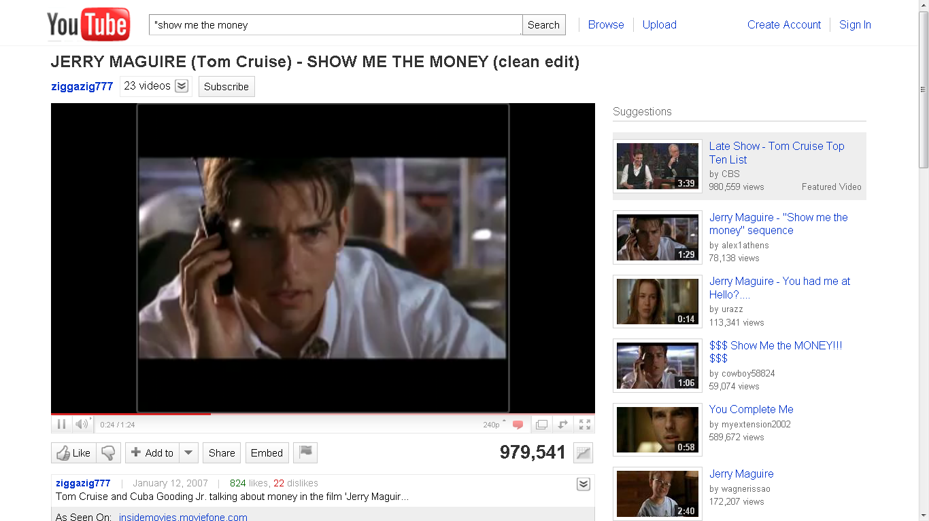
SHOW ME THE MONEY!
Notes:
The most obvious solution for motivating landowners is to provide compensation for the actual habitat management and for loss of income. This has worked very effectively.

Slide 27
SHOW ME THE MONEY
GA Bobwhite Quail Initiative
MO Scott County QFA
Notes:
In two of our major ‘success’ stories, places where big chunks of working land produced a large increase in quail abundance, compensation was a key motivator.
In GA BQI, initial habitat incentive programs were effective, but the percentage of the landowners/landscape participating was deemed insufficient to reach quail population goals. This was remedied by substantially increasing incentives for landowners.
In MO Scott County, funding through the Farm Bill, Conservation Security Program at the time, and close partnerships among MDC, USDA and Soil and Water Conservation District, resulted in what has become one of the most well-compensated habitat restoration programs.
The problem with both approaches is this level of funding was not sustainable, with neither of these programs continuing as originally designed.
So, money is only part of the solution. Sustainable initiatives require a high level of non-monetary motivation by landowners.

Slide 28
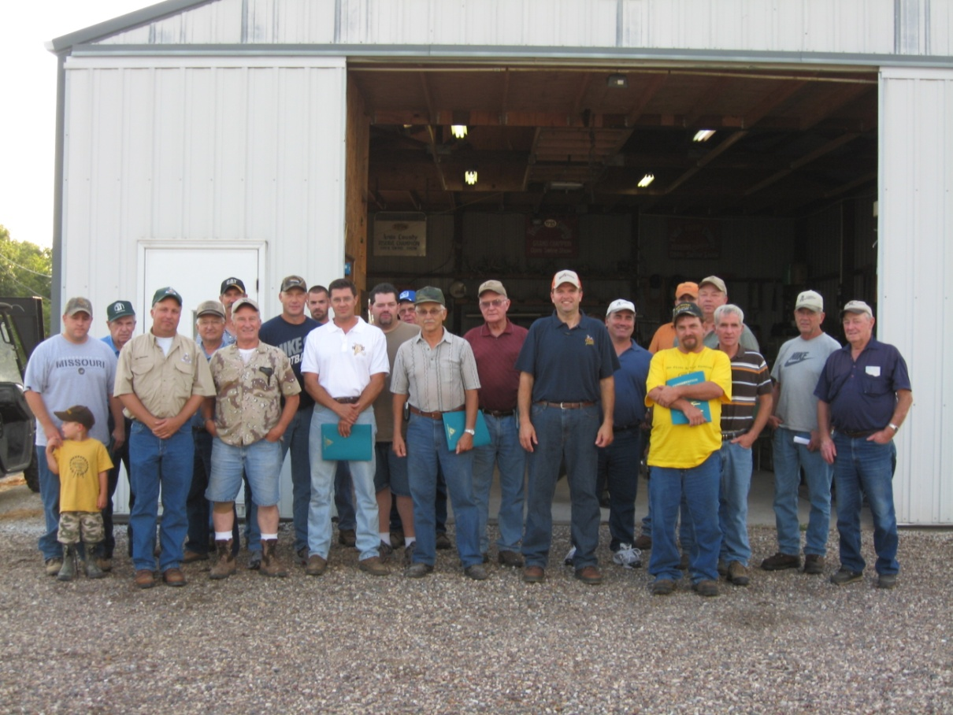
KNOX COUNTY QUAIL FOCUS AREA
A Landowner Cooperative
John Pinkowski
Private Land Conservationist
Missouri Department of Conservation

Slide 29
QFA
My supervisor said something profound when we were discussing this whole Quail Focus Area Concept.
He said “We are getting pretty good at knowing how to produce the proper habitat for a given management species. What we need to learn more about now is how to get that habitat on the ground on a large enough scale to make a difference.”
My presentation will focus on how a small group of landowners teamed with the department to try to accomplish that landscape level of management for quail.

Slide 30
KEYS TO SUCCESS
J. Pinkowski
Landowner leadership within a simple organizational structure
  - Stakeholders in leadership
Detailed planning
Focus on education
  - Landowners are the salespeople
Building a group identity
Measurable results
Notes:
Now we can get into some of the details that have made the landowners in this area successful.

Slide 31
CONCLUSION
J. Pinkowski
Quail focus areas can be an effective tool for increasing or maintaining bird numbers
To be successful, landowners must take ownership of the organization
It takes the right mix of landowners to make a Quail Focus Area work
It is all about establishing relationships

Slide 32
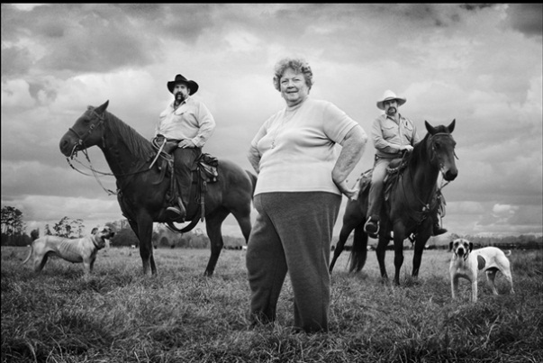
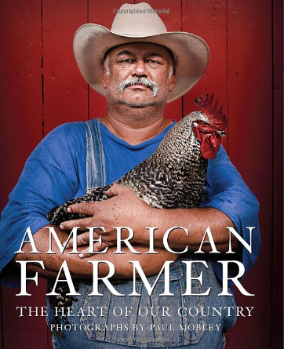
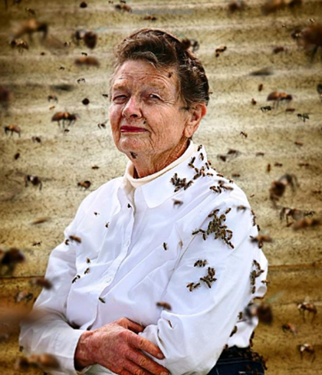
Working Lands
UNDERSTANDING AND WORKING WITHIN RURAL CULTURE
IS THE KEY TO SUSTAINABLE WILDLIFE CONSERVATION
Notes:
In conclusion ….. UNDERSTANDING AND WORKING WITHIN RURAL CULTURE IS THE KEY TO SUSTAINABLE WILDLIFE CONSERVATION
Thus, we are challenged as researchers to focus more attention on social science.

